Slide 1
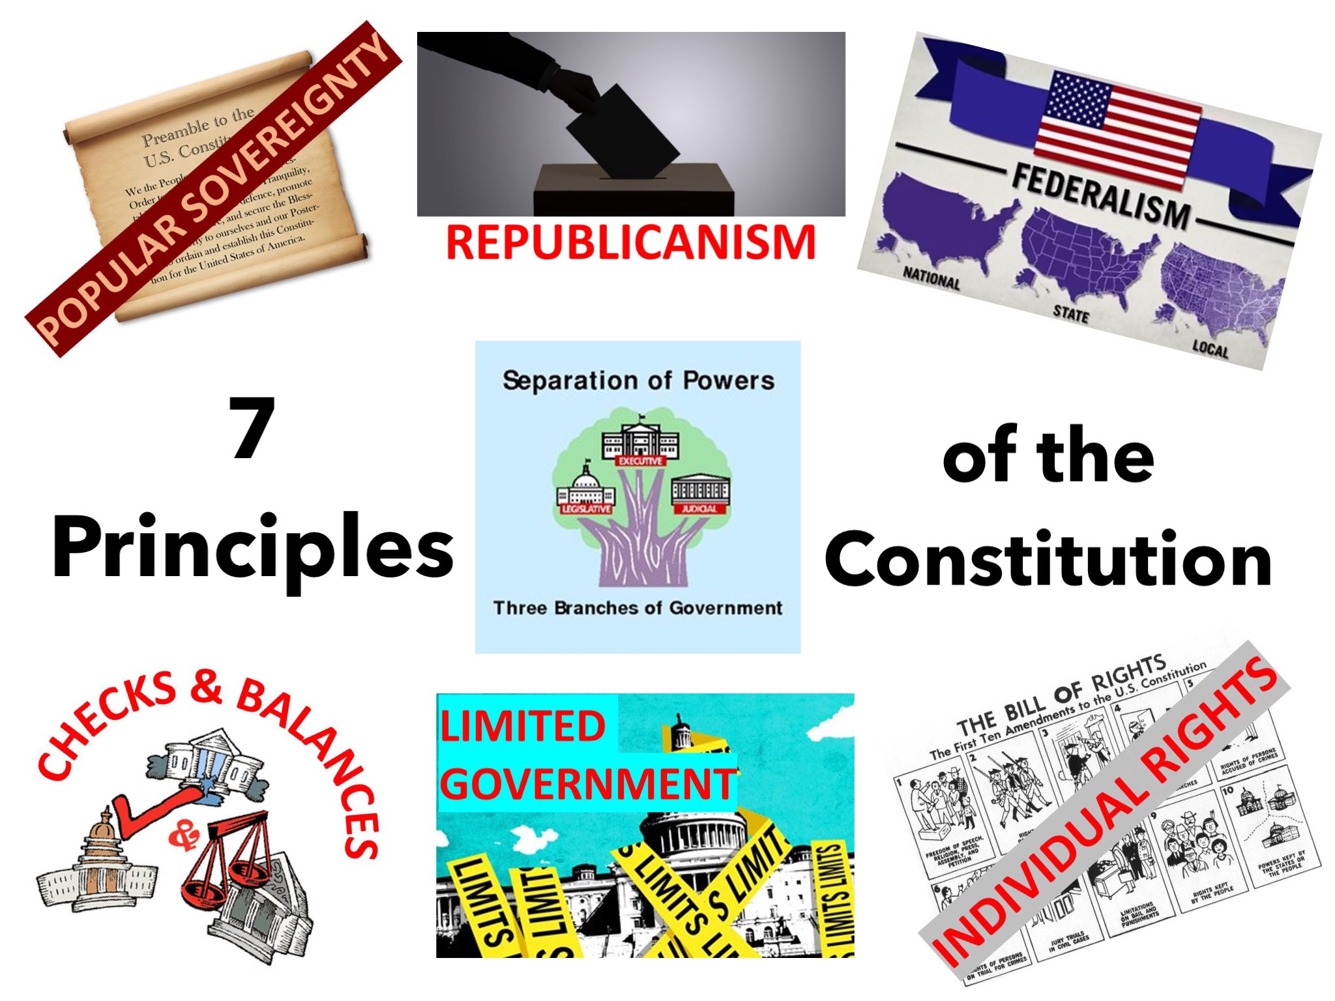
Principles, Federalism & Amendments Review
Use your notes for ALL of the exercises!!
Division of State & Federal Powers: p.97; Art. I Section 8 p.R47; Ch. 23 Section 3 p.648
Checks and Balances: p.66; Constitution p.R43
Parts of the Constitution: Constitution p.R43
Amendments: p.R57
Amendment Process: p.77
Informal Amendments: pp.79-81
Matching: Glossary

