Slide 1
Modern Democracy

Slide 2

What should 21st century democracy look like in the United States?
Big Question:

Slide 3


Who has the power?
Democracy
Dictatorship

Slide 4
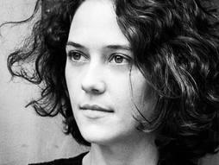
Background on Pia Mancini
  Pia Mancini and her colleagues want to upgrade democracy in Argentina and beyond.
  They want to bring citizens inside the legislative process, and run candidates who will listen to what they say through their open-source mobile platform, DemocracyOS.

Slide 5
DIRECTIONS:
Complete the pre-watching questions so you can familiarize yourself with the content of the film.
Listen to Manchini speak; then using the quotes from her lectures, REACT to them!
        DOWN based on what you heard. Even if you don’t have a lot of political background knowledge, write SOMETHING
        Be an ACTIVE participant.
Be prepared to share your answers with THE CLASS.
NOTE: The film will be paused to allow you think time.

Slide 6
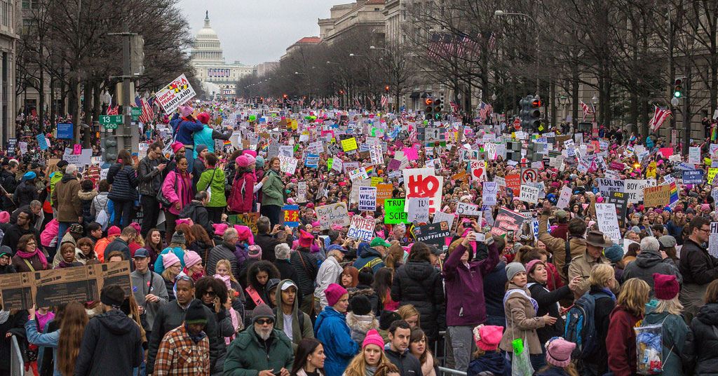
Citizenship in action…
Homework: chapter 2, components #3, 4, 5

Slide 7
POST VIEWING DISCUSSION
EXPECTATIONS-- Everyone participates!
One person (red) serves as the secretary to write down the “general” ideas of the group
One person (blue) will be the public announcers and share the group’s ideas with the class
One person (green) serves as the task manager; keeping the group focused on the activity.
All the others (yellow) are ACTIVE participants (this round)

