Slide 1
Finished Early?
Begin defining the Outcome 1 Essential Terms in your notebook (this will save you homework later)
Hint: to help yourself study divide the page in ½ so you can fold it over and quiz yourself

Slide 2
Remember…
All forms of government have +’s & -’s
They differ in terms of:
  What level of government has more power?
  How much control and how many people have control?
  How much is power distributed between groups?
Some governments work better in different situations

Slide 3

Communism
the collective ownership of property and organization of labor for the common advantage of all members. A system of government in which the state plans...

Slide 4

Socialism
means of producing and distributing goods is owned collectively or by a centralized government that often plans and controls the economy

Slide 5
Homework
Research your assigned system of government:
  Who has power?
  How are laws made?
  How much personal freedom is there?
  What do citizens expect from the government?
  What are the positive and negative aspects of this government?
  Monarchy, Representative Democracy, Fascism, Socialism, Communism

Slide 6
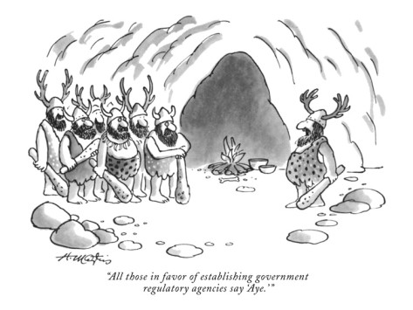
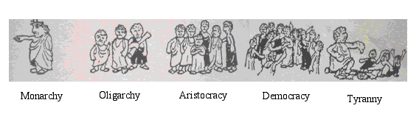

Slide 7
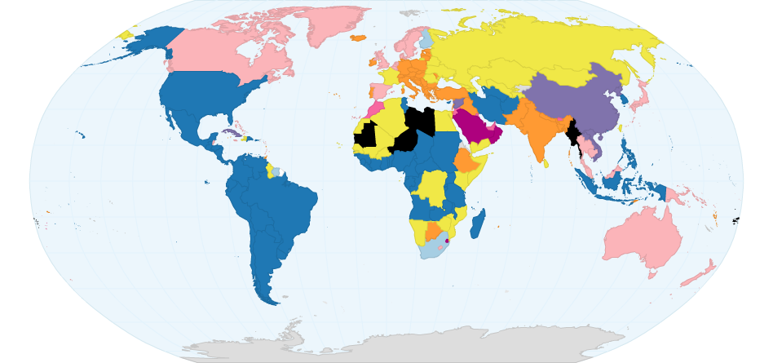
Develop a key for four colors and explain your reasoning.

Slide 8
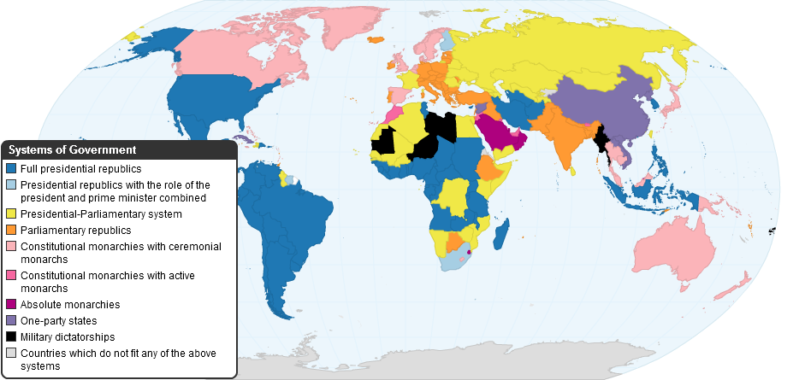
Systems of Government

Slide 9
Puzzle Time
With your group, assemble the puzzle so the questions are correctly answered for each form of “government.”
Form/? | Who has the power? | How much personal freedom is there? | What do the people expect from the government? | How are laws made? | Strengths & Weaknesses
Monarchy
Representative Democracy
Socialism
Communism
Fascism

Slide 10
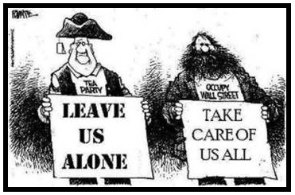
Finished Early?
Use pages 9-11 in your textbook to complete #5 on p.11 on your bellwork sheet.

Slide 11
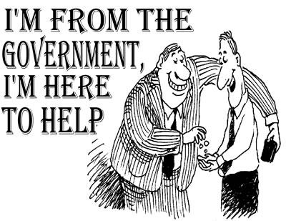
Forms of Government

Slide 12
Government
the institution through which the state maintains social order, provides public services and enforces binding agreements on citizens

Slide 13
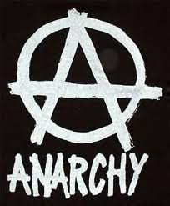
Anarchy!
Absence of any form of political authority.
Political disorder and confusion.

Slide 14
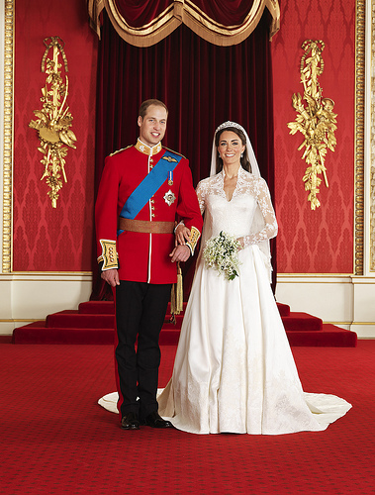
Monarchy
Government by a monarch hereditary ruler
Constitutional Monarchy = …

Slide 15
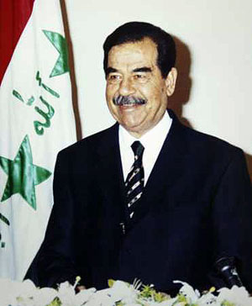
Autocracy
Government by a single person having unlimited power; despotism

Slide 16
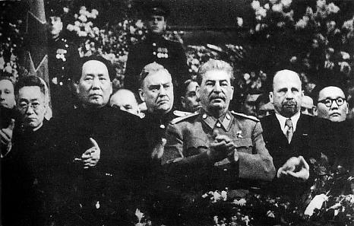
Totalitarian
the state recognizes no limits to its authority and strives to regulate every aspect of public and private life wherever feasible, without any respect for human rights

Slide 17
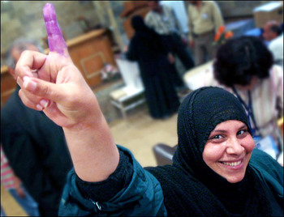
Democracy
Government by the people, exercised either directly or through elected representatives.

Slide 18
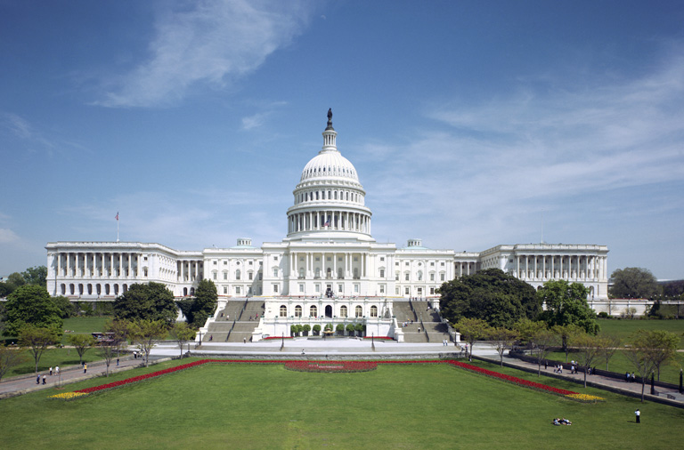
Republic
Government in which the people exercise power through their elected representatives

Slide 19
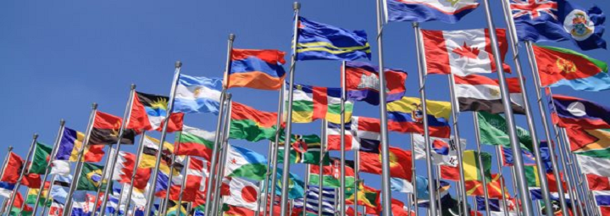
Remember…
All forms of government have +’s & -’s
They differ in terms of:
  What level of government has more power?
  How much control and how many people have control?
  How much is power distributed between groups?

Slide 20
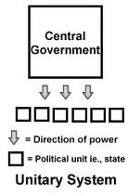
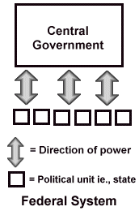
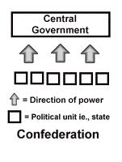
Where is the Power Located?

Slide 21
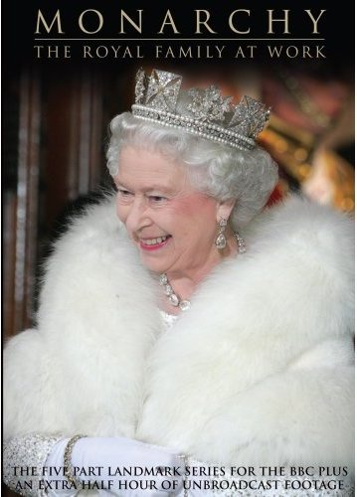
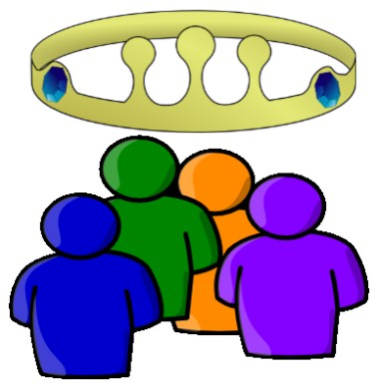
Who has the power?
Democracy
Dictatorship

Slide 22
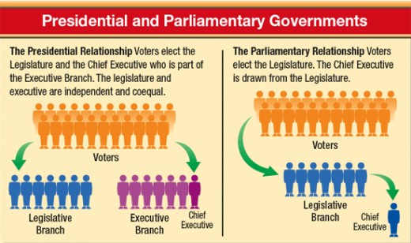
Legislative v. Executive
Ex: Is the President separate from Congress?

Slide 23
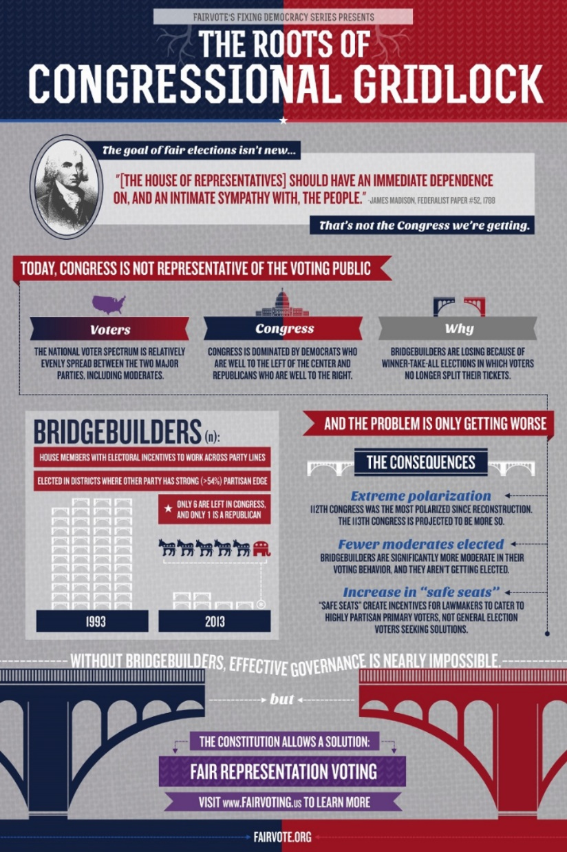
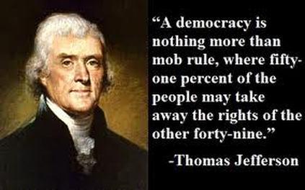
Remember…
Some governments work better in different situations:

