Slide 1
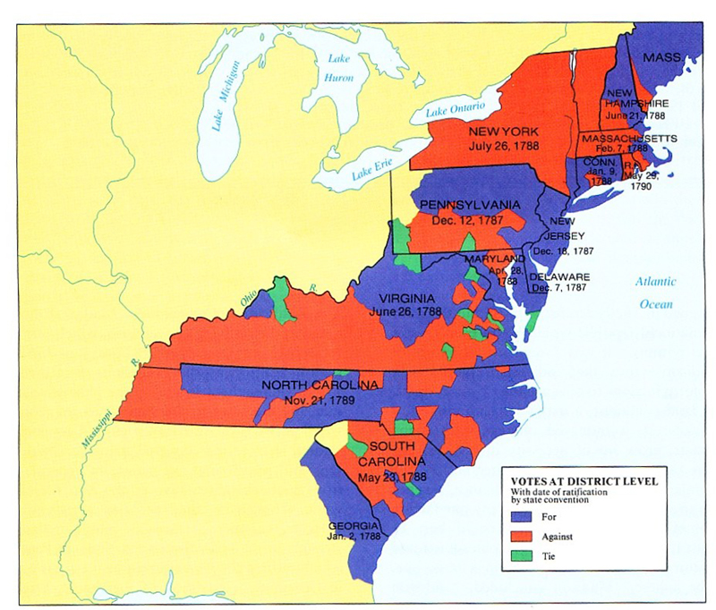
Bellwork 1/24: p.49 & 57 “caption questions”

Slide 2
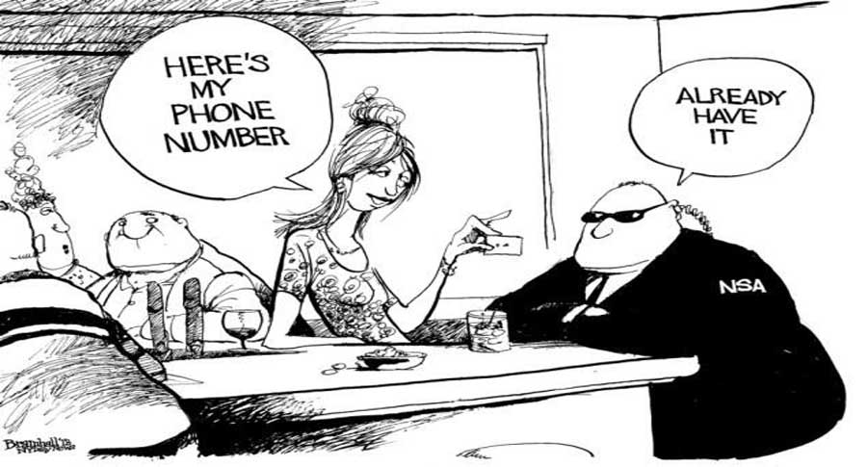

Slide 3
 | Document A: Anti-Federalist Melancton Smith | Document B: Federalist Alexander Hamilton
Is this person happy with how the new Constitution deals with representation?
What kind of government would this person like to see?
Find a Quote to support your claim.
Based on this document, what sort of people in society would support this point of view?

Slide 4
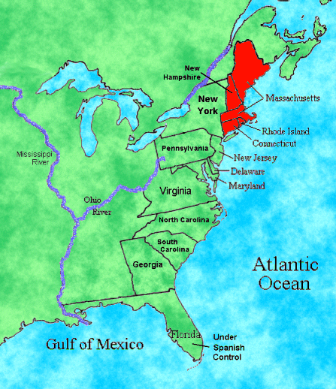
The Connecticut (Great)
Compromise
Legislative Branch
Bicameral
House of Reps
Based on Population
Senate
Equal Rep

Slide 5
Federalist &
Anti-federalist
“Thus I consent, Sir, to this Constitution because I expect no better, and because I am not sure that it is not the best.
“The powers delegated by the proposed Constitution to the federal government are few and defined. Those which are to remain in the State governments are numerous and infinite.”

Slide 6
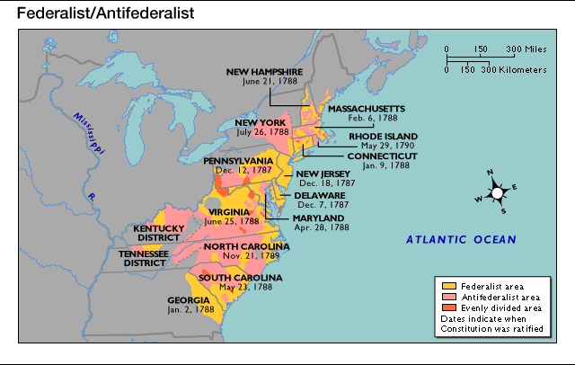
Ratification (Article VII)
9/13 states had to ratify for the Constitution to go into effect

Slide 7
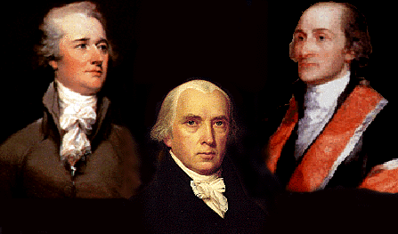
Federalists
In favor of the Constitution
Generally wealthy, business interests, urban & coastal areas
Madison, Hamilton, Jay (Washington?)
Strong central government was necessary to prevent chaos – for the Constitution

Slide 8
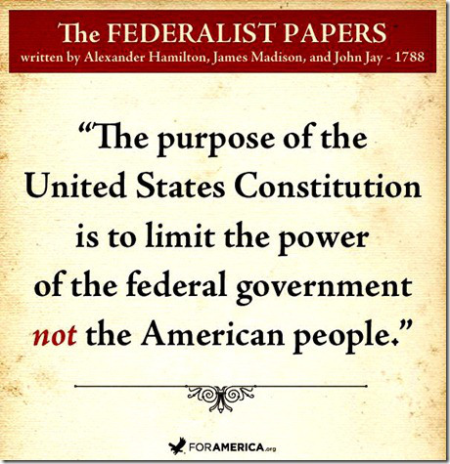
The Federalist Papers
Collection of essays in support of ratifying the Constitution
* a primary source look at the political philosophy of the founders

Slide 9
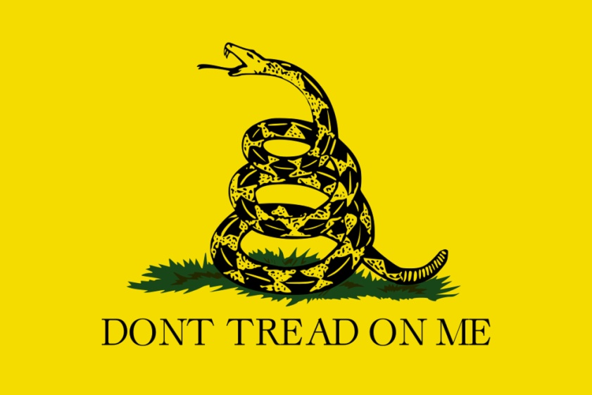
Antifederalists
Against the Constitution
Generally middle to lower class, farmers, rural areas
Jefferson, Paine, Henry
Feared strong central government & supported States’ power

Slide 10
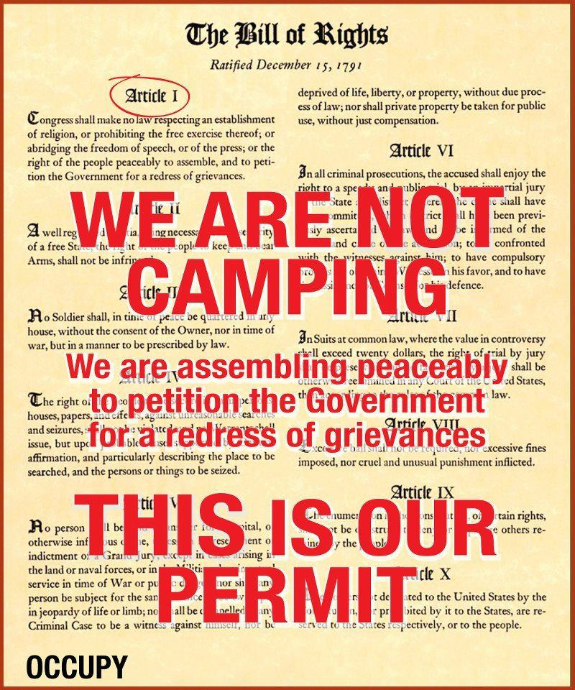
The Bill of Rights
Added to the Constitution in 1791
Amendments 1-10
Protects citizens from abuse of power by the central (national/federal) government
(Now the States too)

Slide 11
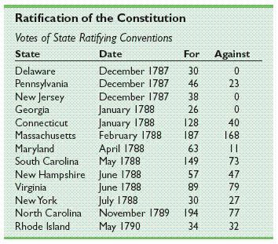

Slide 12
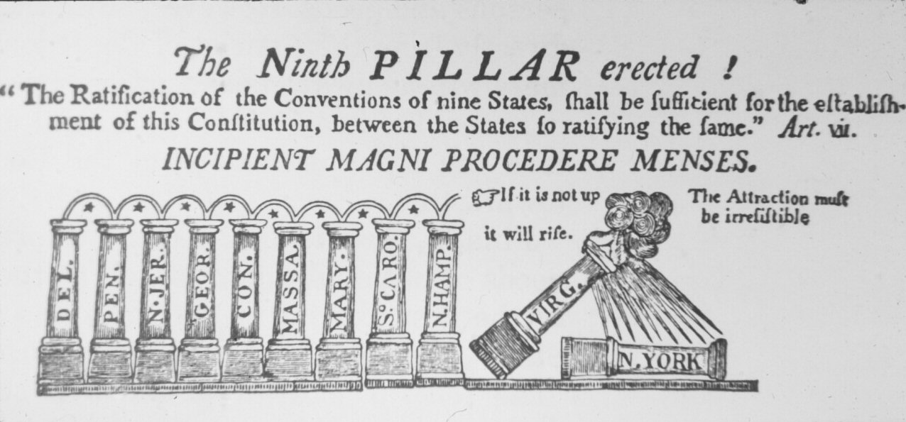

Slide 13
