Slide 1
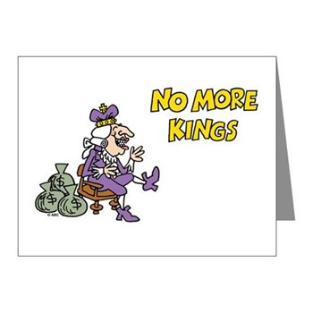
Notes:
To start off, play this video which reviews the “standard version” of why America declares independence. Remind students that we talked yesterday about how the colonies and England viewed began to view government differently during the colonial period.

Slide 2


Slide 3
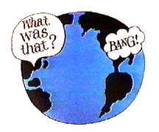
Steps to Unity
1. First Continental Congress (1774)
Wrote a letter to the King
Imposed boycott
on GB - all the
colonies starting
to work together
Notes:
But, we didn’t declare independence right away…there were steps to independence…

Slide 4
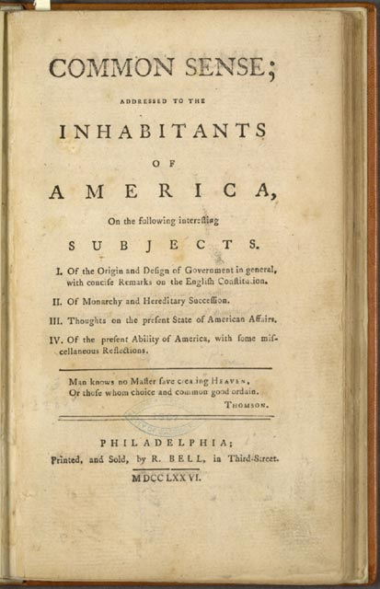
2. Common Sense (1775)
Colonial Propaganda by Thomas Paine
Convinced many that independence was necessary
"But where says some is the King of America? I'll tell you Friend, he reigns above, and doth not make havoc of mankind like the Royal Brute of Britain...let it be brought forth placed on the divine law, the word of God; let a crown be placed thereon, by which the world may know, that so far as we approve of monarchy, that in America THE LAW IS KING.”

Slide 5
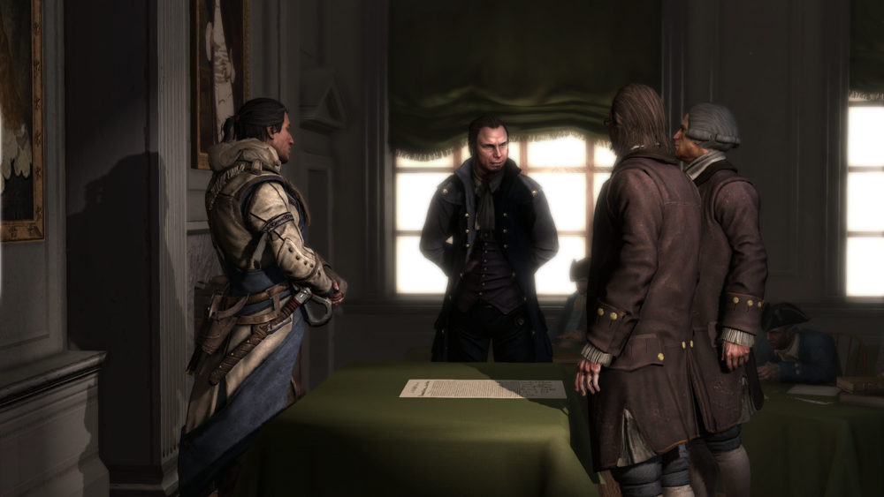
3. Second Continental Congress (1776)
Purpose was to write another letter to the King!
  But…they declared independence
  No true constitutional authority, but served as the acting government
Notes:
Delegates from all 13 colonies
John Hancock – President
George Washington - Commander of Continental Army

Slide 6

The Declaration of Independence
( go to page R38)
Written by Thomas Jefferson
July 4, 1776
Key Ideas:
Borrowed from John Locke
Natural rights – life, liberty, property
Social Contract - people give up power to the government in exchange for safety & security
consent of the governed – we agree to give power to the government
Notes:
Some Key facts to remember about the Declaration…..

Slide 7
Main Parts of the Declaration
Part 1 – Preamble
  Introduction, why we are writing this
Part 2 – Declaration of Rights
  Statement of purpose and basic human rights
Part 3 – List of Grievances
  Complaints about George III
Part 4 – Formal Declaration
  Statement of separation from Great Britain

Slide 8
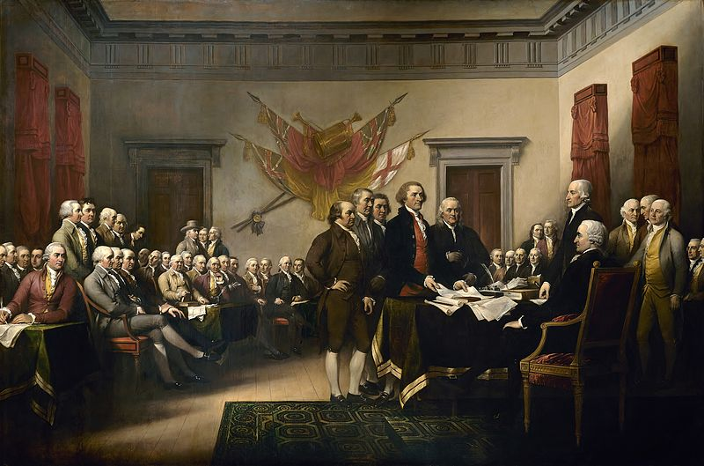
As you watch…pay attention for:
Who were they writing for/to?
Why include so many grievances?
Notes:
Who were they writing for/to?
Colonists – convince some/all that independence was necessary & they should fight for it
King – declare independence, you no longer rule us
English citizens – we have been abused by the King/Parliament so we have to do this
The “world” – convince other countries (France, etc.) that our cause is just and they should help us
Why so many grievances?
* Have to convince others that we are not just unhappy with taxes….we have lots of reasons why King George abused us and why we should be independent

Slide 9


Slide 10
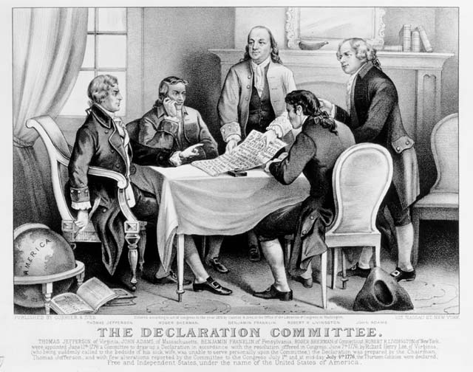
Declaration of Independence
Translation/Matching
With a partner, match the quotations from the Declaration with the appropriate translations…write them on your sheet.
Turn this in before you go!!!

Slide 11
