Slide 1
 | Articles of Confederation | Constitution
Levying taxes | Congress could request states to pay taxes | Congress has right to levy taxes on individuals
Federal courts | No system of federal courts | Court system created to deal with issues between citizens, states
Regulation of trade | No provision to regulate interstate trade | Congress has right to regulate trade between states
Executive | No executive with power. President of U.S. merely presided over Congress | Executive branch headed by President who chooses Cabinet and has checks on power of judiciary and legislature
Amending document | 13/13 needed to amend Articles | 2/3 of both houses of Congress plus 3/4 of state legislatures or national convention
Representation of states | Each state received 1 vote regardless of size | Upper house (Senate) with 2 votes; lower house (House of Representatives) based on population
Raising an army | Congress could not draft troops, dependent on states to contribute forces | Congress can raise an army to deal with military situations
Interstate commerce | No control of trade between states | Interstate commerce controlled by Congress
Disputes between states | Complicated system of arbitration | Federal court system to handle disputes
Sovereignty | Sovereignty resides in states | Constitution the supreme law of the land
Passing laws | 9/13 needed to approve legislation | 50%+1 of both houses plus signature of President

Slide 2
What problems do you think delegates had when writing a new constitution? How did Franklin feel about it? Explain.
“I confess that there are several parts of this Constitution which I do not at present approve, but I am not sure I shall never approve them. For having lived long. I have experienced many instances of being obliged by better information or fuller consideration, to change opinions even on important subjects, which I once thought right, but found to be otherwise.”
- Benjamin Franklin, 1787

Slide 3
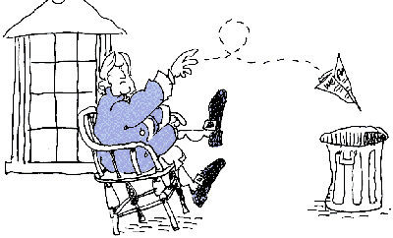
Bundle of Compromises (p.54)

Slide 4
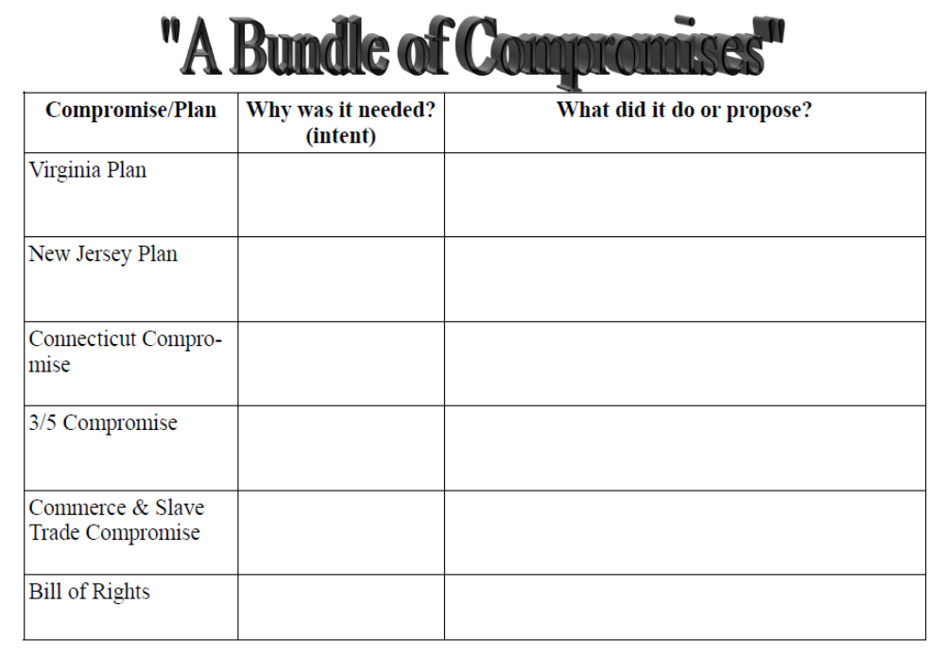

Slide 5

Finished Early?
Continue working on identifying Outcome A Terms!

Slide 6
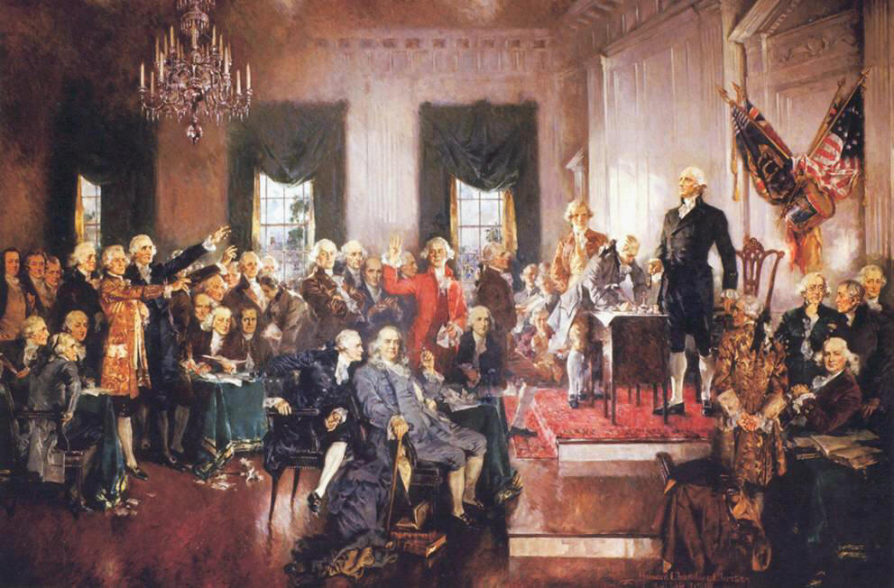
Constitutional Convention
Key Plans, Ideas & Ratification

Slide 7
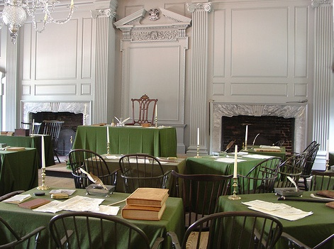
Independence Hall,
Philadelphia
George Washington – President
James Madison – Secretary
“Father of the Constitution”
Rhode Island
wasn’t even there!!

Slide 8
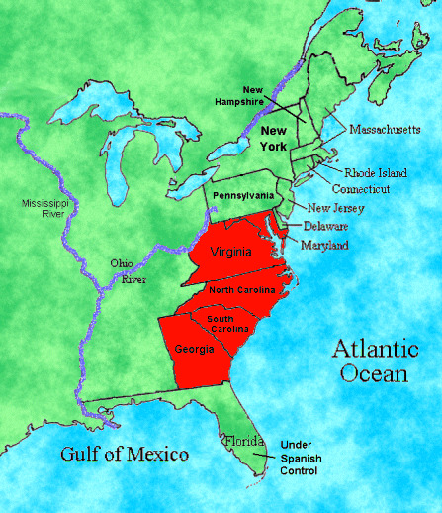
The Virginia Plan
Basis for the final Constitution
Supported by Largely Populated States
Supported by Nationalists like James Madison

Slide 9
The Virginia Plan
Bicameral Legislature
Lower house chosen by the people
Upper house chosen by the lower
Bar state laws found “unconstitutional”

Slide 10
The Virginia Plan
Strong Executive
Chosen by Legislature
Judiciary (Court System)
Appointed by Legislature

Slide 11
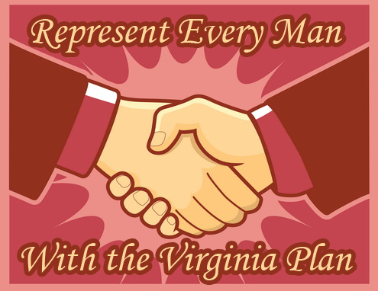
The Virginia Plan
Stronger national government
favored the bigger states
representation based on population & taxes paid

Slide 12
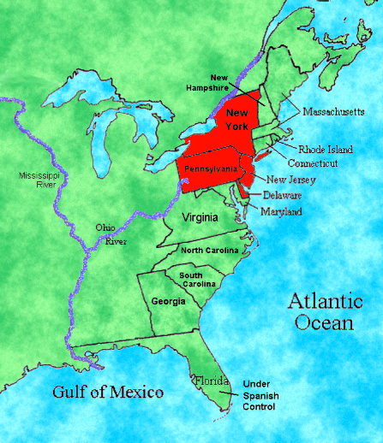
The New Jersey Plan
Revision of the Articles
Supported by Small States (Population)
Largely Rejected

Slide 13
The New Jersey Plan
Unicameral Legislature
One Vote Per State
Ability to Tax & Regulate Trade

Slide 14
The New Jersey Plan
Weak Executive
Elected by Congress
National Judiciary
Chosen by the Executive

Slide 15
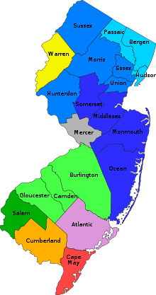
The New Jersey Plan
Limit national government
favored the smaller states
equal representation regardless of size or population

Slide 16
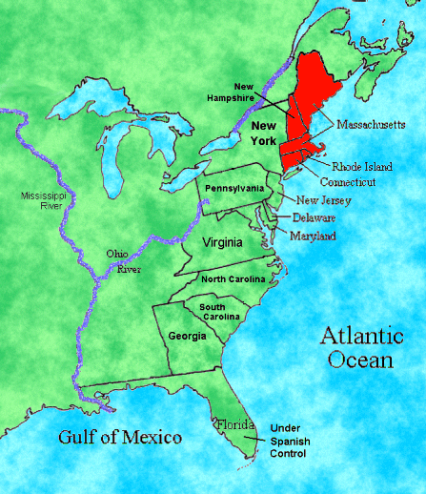
The Connecticut (Great)
Compromise
Legislative Branch
Bicameral
House of Reps
Based on Population
Senate
Equal Rep

Slide 17
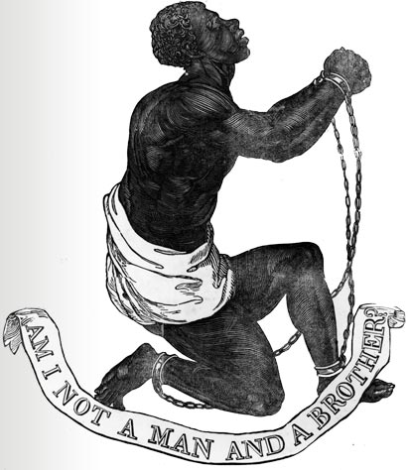
3/5 Compromise
South had less population
Counted slaves as 3/5 of a person for representation & TAXES

Slide 18
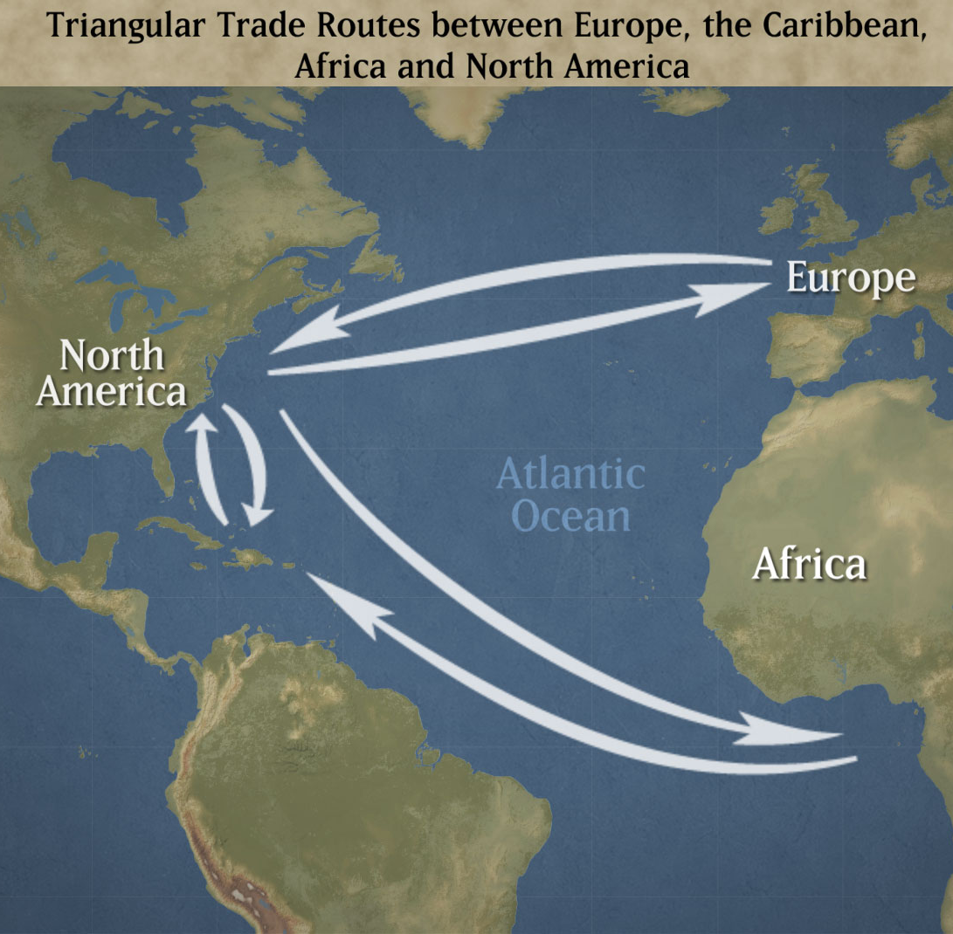
Commerce & Slave Trade
South needed to protect its’ economy
Congress can not tax exports
Congress could not act on the slave trade for 20 years

Slide 19
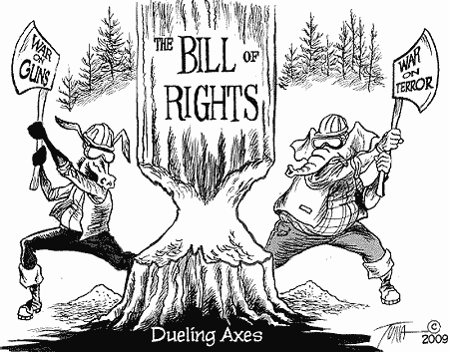
Bill of Rights
Gained Support of (some) Antifederalists
Added to Constitution in 1791
First 10 Amendments; protect individual liberties

Slide 20
According to this quotation, what issue concerned the delegates the most? What is Dickinson’s position?
“Let our government be like that of the solar system. Let the general government be like the sun and the states the planets, repelled yet attracted, and the whole moving regularly and harmoniously in several orbits.”
- John Dickinson, 1787

