Slide 1
Bellwork 1/11
Name one family tradition which you plan to keep when you have a family or are older. Explain why.

Slide 2


Slide 3
Quote Matching Exercise
Match the English quotes on the left to the Amendments contained in the Bill of Rights (p.R57).
  Use both the actual words of the Constitution (on the “brown” part of the page) and the translations (on the white part of the page)
Write down the Amendment which corresponds to each English quote and a quotation from that Amendment.
An Amendment may be used more than once or not at all.

Slide 4
English Ideas
What we got from the Brits
(and others…)

Slide 5
Different Influences:
Magna Carta
Petition of Right
English Bill of Rights
Enlightenment Philosophers
Colonial Charters

Slide 6
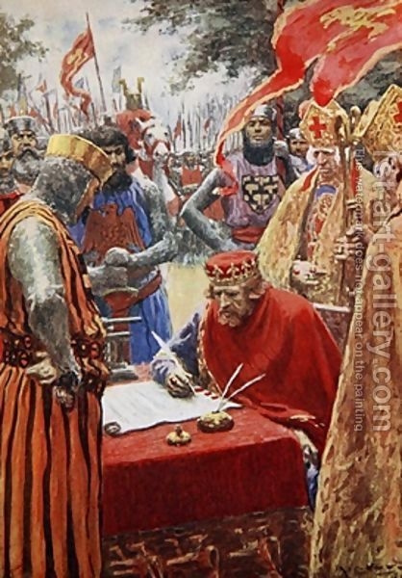
The Magna Carta
First Limits on the Power of the King
Granted rights to “freemen”

Slide 7
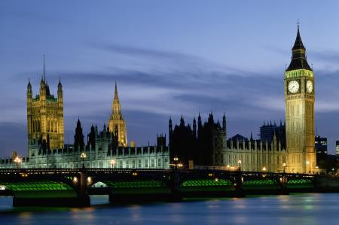
Petition of Right
No Taxation Without Consent of Parliament

Slide 8
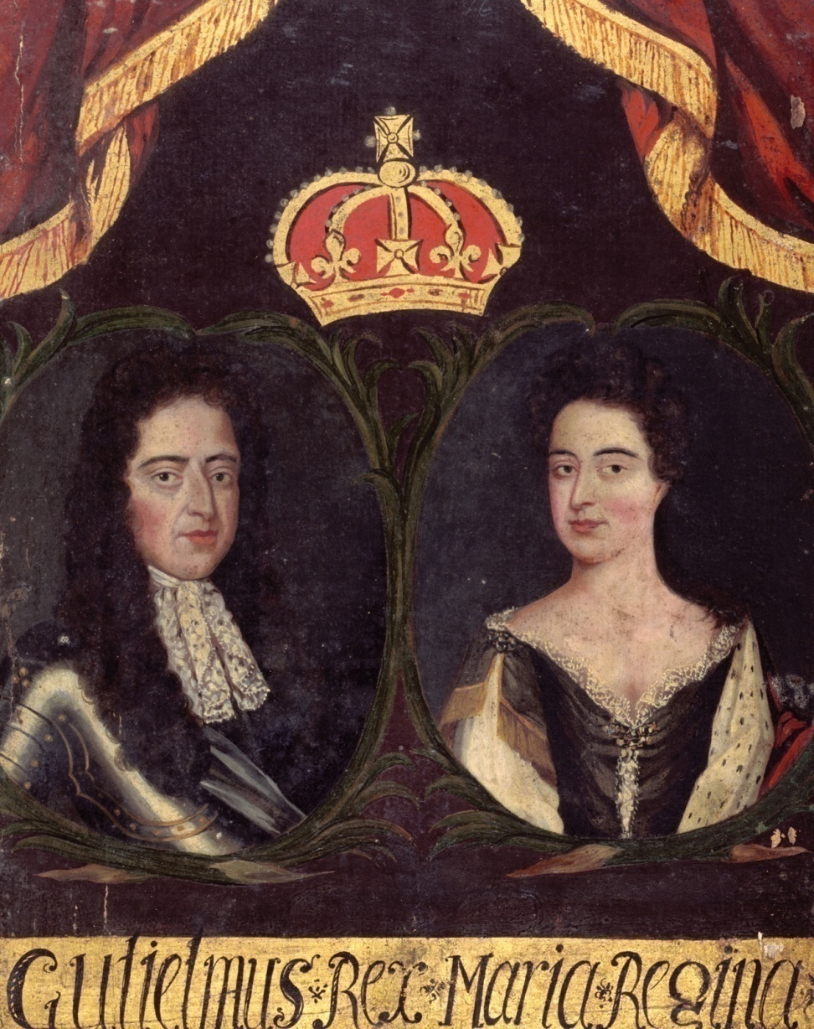
English Bill of Rights
William & Mary
Glorious Revolution

Slide 9
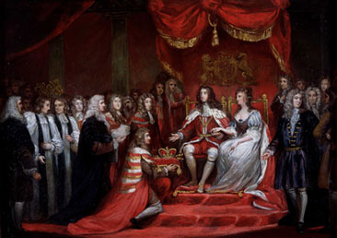
English Bill of Rights (cont.)
Applied to Colonists & Englishmen
Kings rule with consent of the people’s elected representatives
Colonists believe they have these rights…

Slide 10
Enlightenment Philosophers
Voltaire
  Freedom of Speech
Montesquieu
  Separation of Powers
Locke
  Life, Liberty, Property
  Social Contract

Slide 11
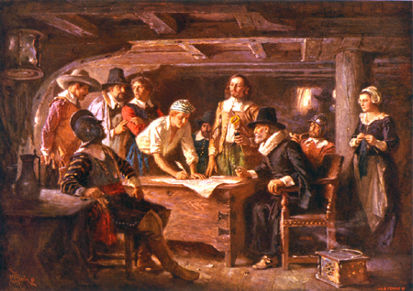
Colonial Charters
Mayflower Compact (MA)
House of Burgesses (VA)

Slide 12

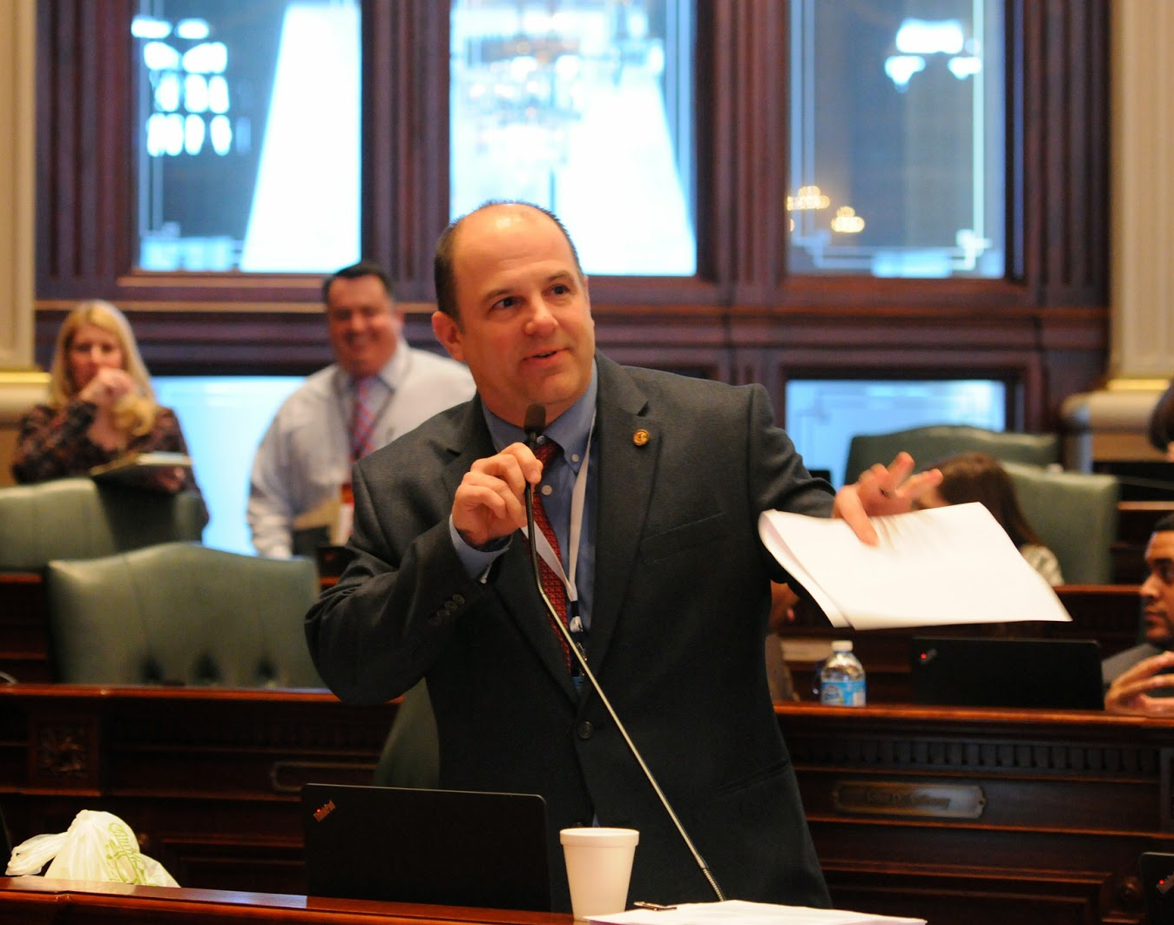
Representative Government a system of government in which people elect delegates to make laws and conduct government (republic)

Slide 13

Limited Government a system of government in which the power of government is limited, not absolute

Slide 14
We kept these ideas….
Representative Government
  House of Burgesses
  Mayflower Compact
  Stamp Act
Limited Government
  Magna Carta
  English Bill of Rights
  Enlightenment Philosophers
  Petition of Right
And built them into the Bill of Rights, Constitution & traditions

Slide 15


Slide 16
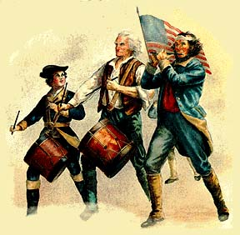
When we think these are violated…

