Slide 1
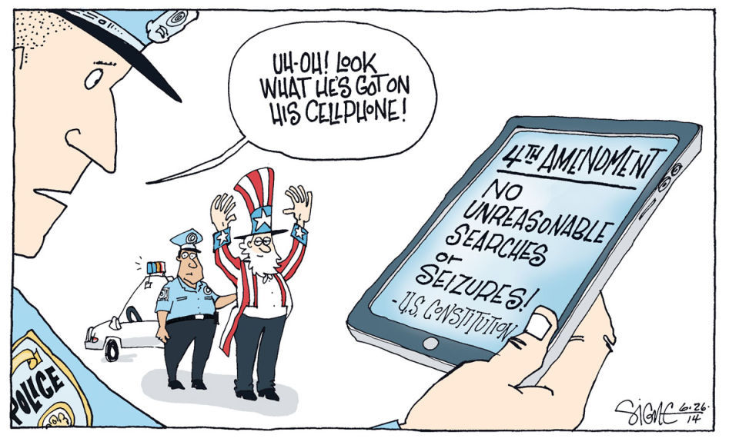
Bellwork 9/19:
Interpreting the Fourth Amendment

Slide 2
Amendment IV no “unreasonable” search and seizure
Due Process
  The process the police use to enforce the law has to be fair
Warrant
  Issued by a judge, gives government the right to search and/or seize something
  Exceptions (there are lots): plain view, inevitable discovery, lawful arrest…
Probable Cause
  Standard which must be met for a warrant…it is likely that a crime has and/or is being committed
Exclusionary Rule
  Illegally gained evidence cannot be used against the accused in court

Slide 3
J.W. v. DeSoto County School District (2008)
After receiving a text message from his father, 12-year-old Richard Wade, an African-American Southaven Middle School honor student, opened his phone to read the message during football class, a violation of school rules. Rather than simply confiscating the phone and turning it in to the school office as required by policy, several school officials searched through the private and personal pictures Richard had stored on the phone. The phone was subsequently turned over to police, who claimed that the pictures constituted "gang-related activity" and "indecent pictures" – Richard was suspended for three days and was ultimately expelled.
Was this an illegal search? Were the student’s rights violated?
* Create a 2-3 sentence argument using the Fourth Amendment!

Slide 4

J.W. v. DeSoto County School District (2008)
“The court found that the search of the student’s cell phone was not unlawful because the student had brought it to school and used it against school rules. These acts diminished the student’s expectations of privacy. Here, the court said, the Mississippi school’s actions were “limited” to only looking at the student’s photos and was not “fishing” through the students personal life.”

Slide 5
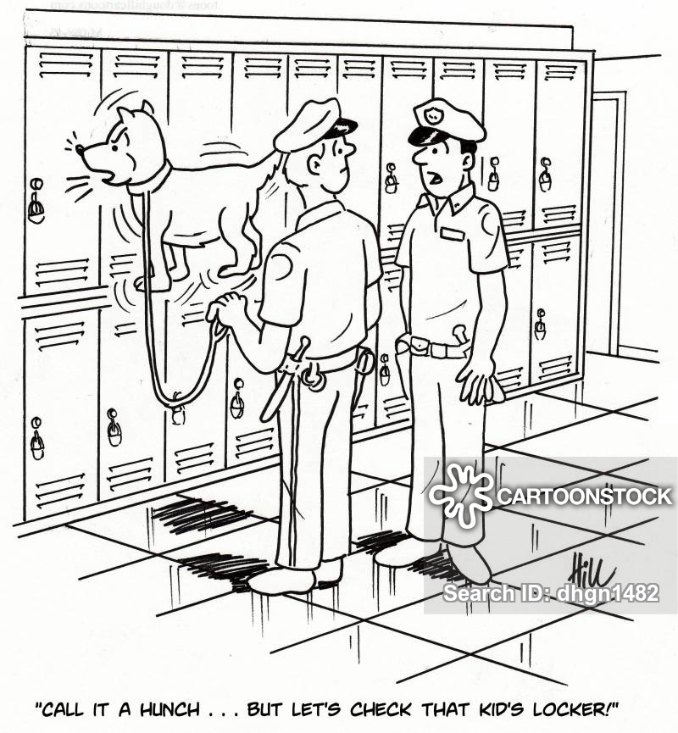

Slide 6
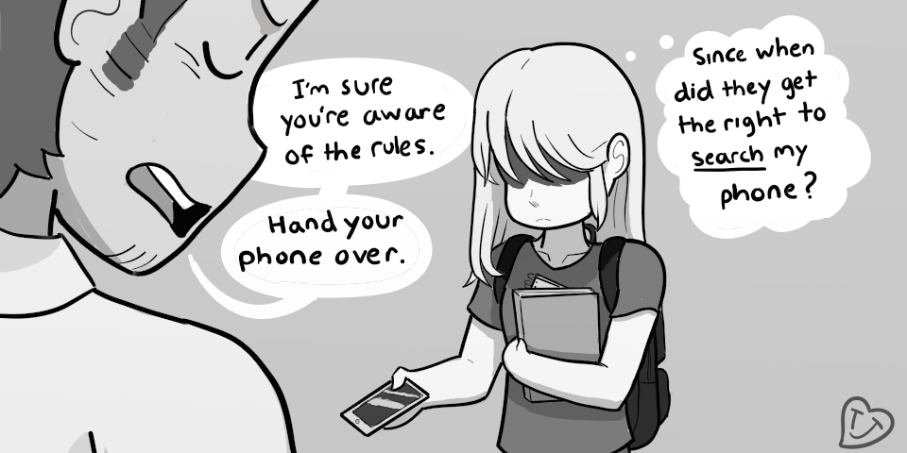
“Adding to the Constitution…”
With a partner, interpret the phrases/words contained in the Fourth Amendment.
Decide the example cases based on your interpretation. Be prepared to share and defend your answers.

Slide 7
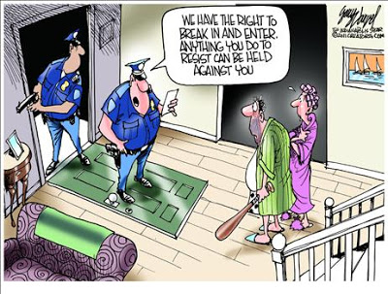
Other court cases/ precedents… with a partner, decide the three cases, using your interpretations of the 4th Amendment… ensure you explain your decisions.

Slide 8
Amendment IV
“The right of the people to be secure in their persons, houses, papers, and effects, against unreasonable searches and seizures, shall not be violated, and no warrants shall issue, but upon probable cause, supported by oath or affirmation, and particularly describing the place to be searched, and the persons or things to be seized.”

Slide 9
Is this a legal search?
The Police enter a Joliet apartment building with a warrant to search apartment 3I for cocaine. They accidentally enter apartment 3J and find child pornography.

Slide 10
Amendment V
“…nor shall any person be subject for the same offence to be twice put in jeopardy of life or limb; nor shall be compelled in any criminal case to be a witness against himself, nor be deprived of life, liberty, or property, without due process of law...”

Slide 11
Was this confession legally obtained?
Robert Berkemer was driving 40 mph in a 25 mph zone when he saw the flashing lights of a patrol car behind him. He dutifully pulled over to the side of the road. The officer approached him, and requested that he step outside of the vehicle. Robert stepped out of the car, and the officer asked him whether or not he was aware of how fast he was going. In response to the officer’s questioning, Robert admitted that he had been speeding. At his traffic hearing, Robert argued that because he was detained and interrogated without receiving his Miranda warnings, his confession should not be admitted.

Slide 12
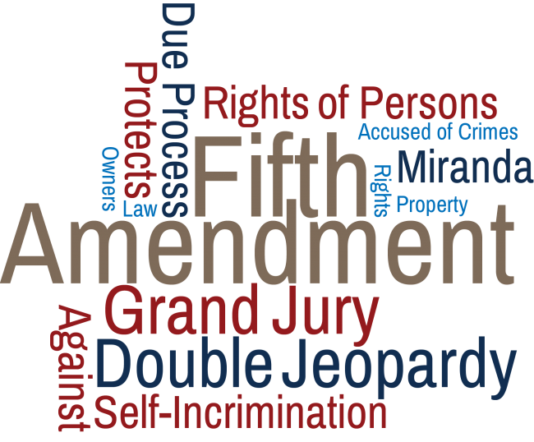
Self Incrimination
“pleading the 5th” or your “right to remain silent”
You do not have to testify against yourself in court (or to the police)
It is the government’s job to prove you guilty, not yours to prove yourself innocent

Slide 13
Amendment I
“Congress shall make no law respecting an establishment of religion, or prohibiting the free exercise thereof; or abridging the freedom of speech, or of the press; or the right of the people peaceably to assemble, and to petition the government for a redress of grievances.”

Slide 14
Is this a violation of the First Amendment?
In a rural New Mexico town, a student voluntarily leads the crowd in prayer before Friday night football games…the practice is stopped because it violates “separation of church and state.”

Slide 15
Is this speech protected by the 1st Amendment?
During the NATO Summit in Chicago a young member of Occupy Chicago makes a speech at an authorized assembly. He tells crowd members that the police surrounding them are the enemy and pawns of the capitalist government . He tells the crowd the pigs should be beaten for their crimes against the people.

Slide 16
First Amendment Freedoms
Speech
Press
Religion
Assembly
Petition
Remember….no rights are ABSOLUTE!!

Slide 17


