Slide 1
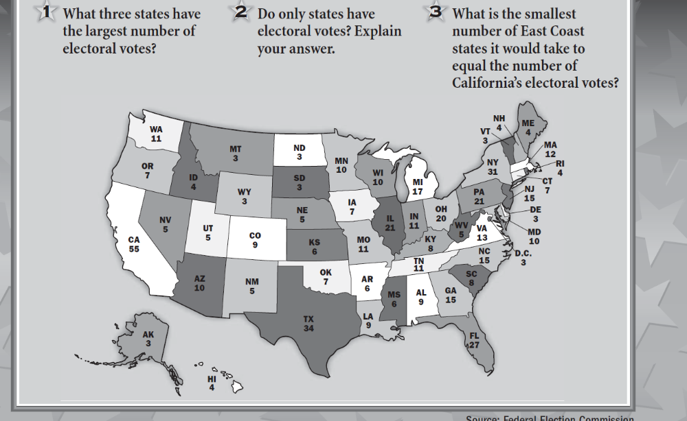

Slide 2
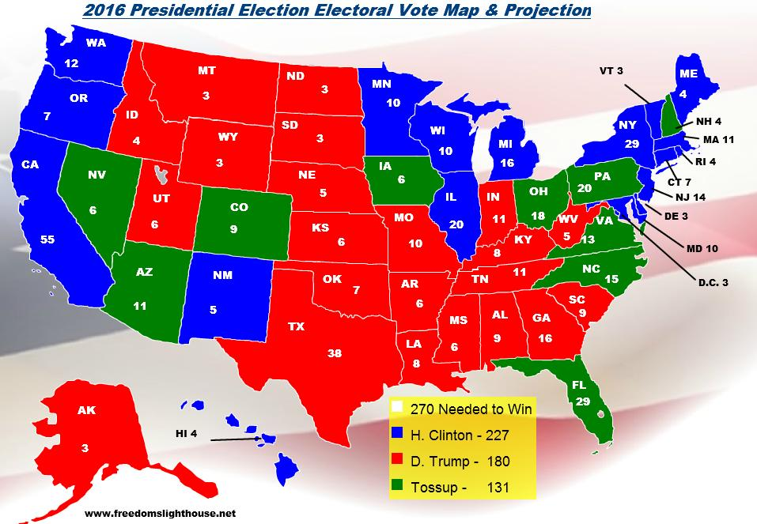
The Electoral College

Slide 3
Do the voters matter?
Yes!
You are voting for ELECTORS State legislatures choose them.
* 51 small elections add up to one big one

Slide 4
Specifics
270 of 538 votes required to win
# Electors = # Senators + # Representatives
No winner- House of Reps. & Senate decide
Electors are selected by state legislatures
MOST states give votes on a winner take all basis

Slide 5
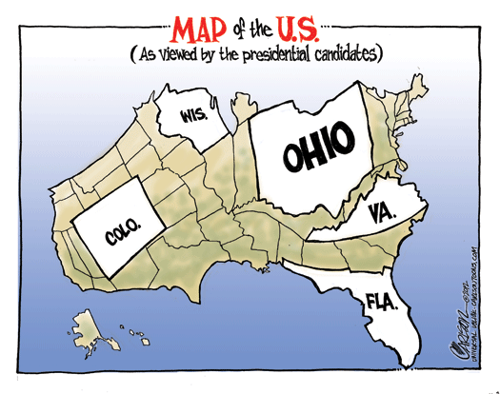
Fictitious Election
Color in the states by alternating (or another method) with your partner.
  KEEP A RUNNING TOTAL AS YOU GO!
When you are finished, determine who won your election.
* Answer questions 3, 4 and 5 using your noggin & textbook (if needed)

Slide 6
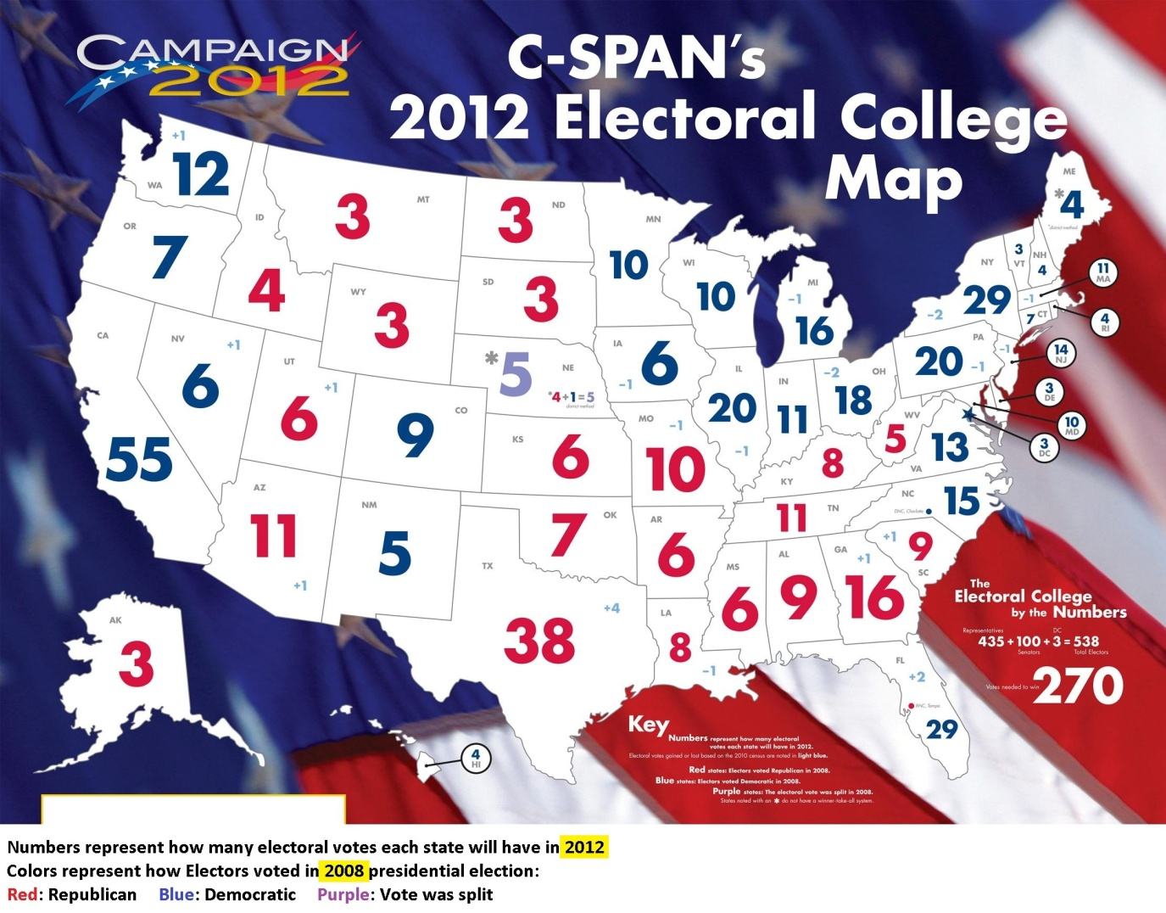

Slide 7
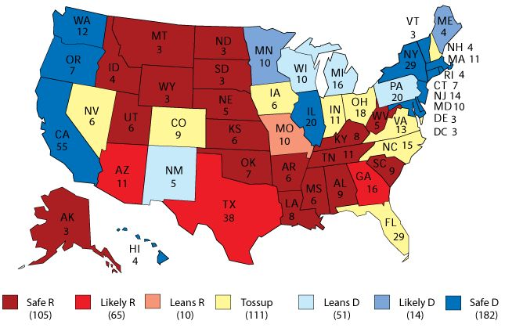
Which states would you concentrate on?

Slide 8
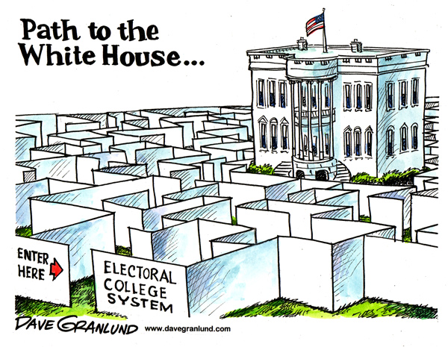
How do you win?
A majority of the electoral vote is needed to win – 270
  (There are 538 votes – DC gets 3!)
Each state gives their votes on a winner take all basis
  (Except ME & NB)
If there is no winner, the House of Representatives decides

Slide 9
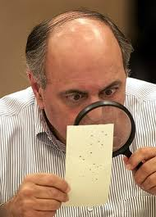
Problems
“Big 11”
Over-representation & under-representation
Non-Popular vote winner
“non-standard” votes

Slide 10

Large States are Extremely Powerful
Focus on smaller states in the primaries (earlier primary)
Focus on big states and swing states in the general election

Slide 11
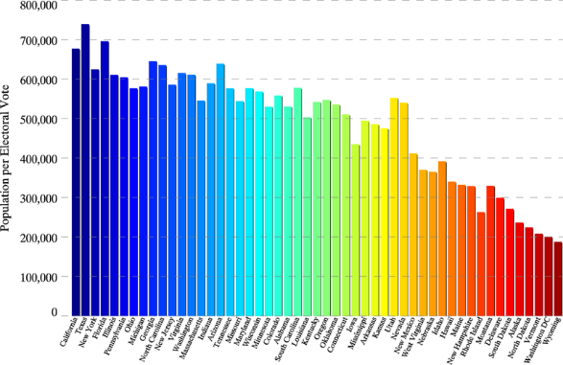
Over-representation & Under-representation

Slide 12
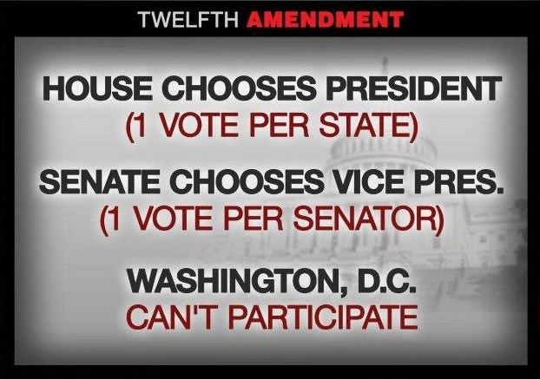
Why not get rid of it?
“safety valve”
Amendment Process

Slide 13
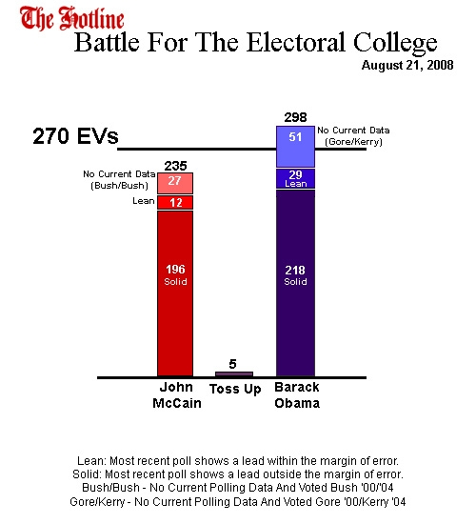
Solutions
Abolish
  Direct Popular Election
Divide electoral votes
  Proportionally?
  By district?

Slide 14
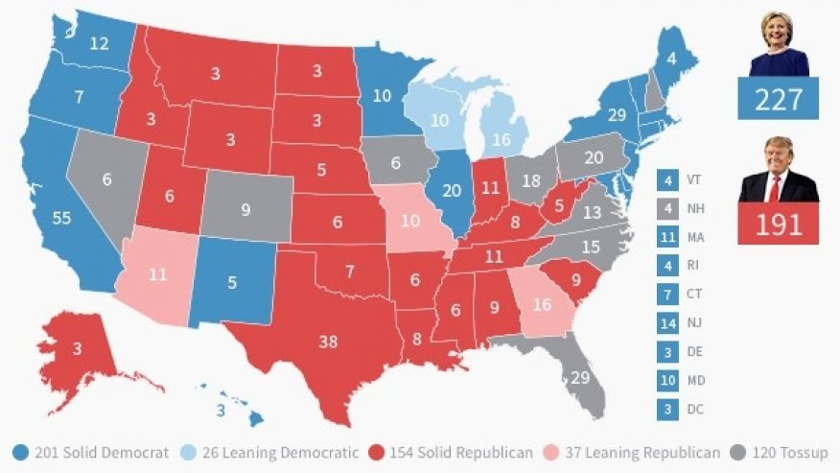

Slide 15
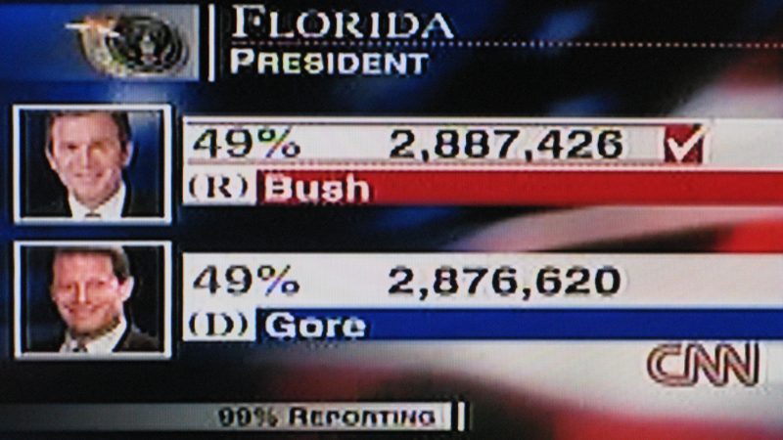
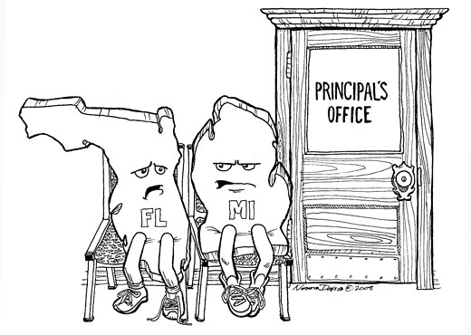
Why was 2000 so close?

Slide 16
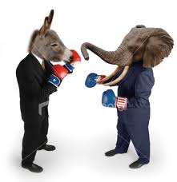
Why not get rid of it?
Most Americans want direct popular elections
However, it would require a Constitutional Amendment which would not pass
  Why?

Slide 17
