Slide 1
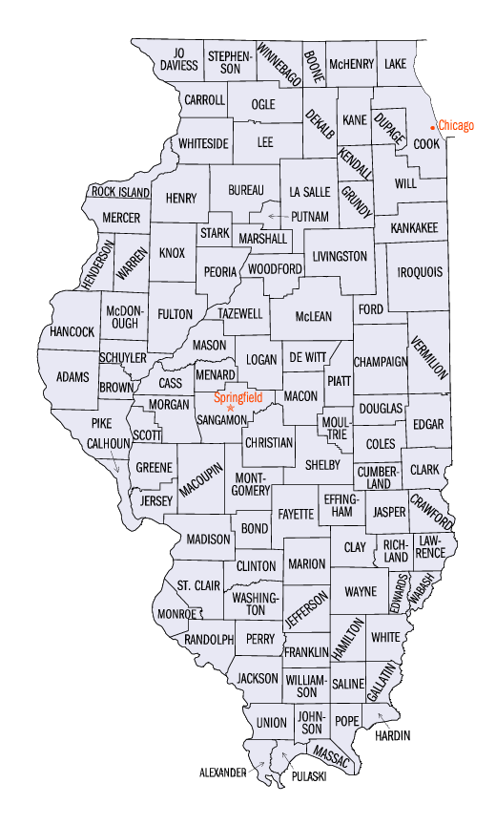


Notes:
Go through the instructions on the .pdf (you will need to have them change the number of districts we currently have, I couldn’t find or update my .pdf). There are an even number of cubs/Sox counties but they should try (following the rules) to divide the counties into groups in order to create an advantage for their team.
For instance, since it’s even it should be 9 majority Sox districts and 9 majority Cubs districts, but they want to group counties together to create an advantage for their team. The best possible I believe is 13-5 but see if they can do better.
The may make mistakes but the important thing for them to realize is that if you are creative, you can create advantages. Discuss who had the most lopsided division and why/how it turned out that way, what techniques did they use? How were they creative with their lines?

Slide 2
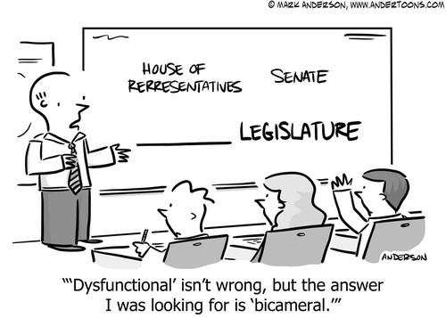
Bellwork 10/4: Analyzing Primary Sources p.155

Slide 3
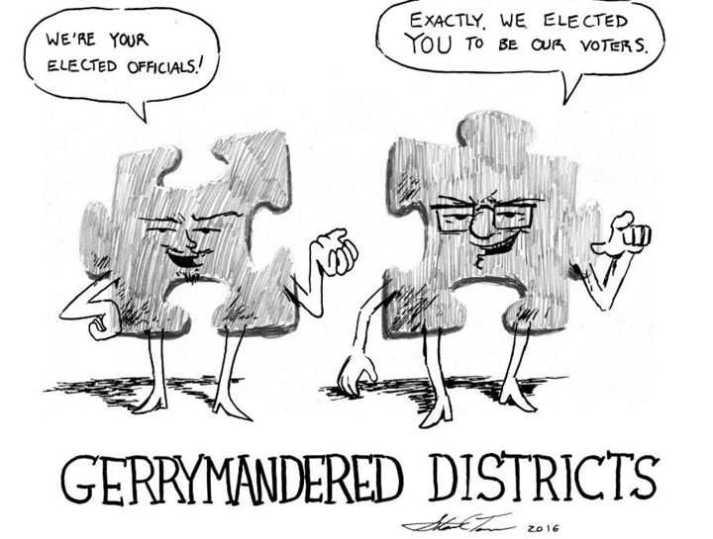
Gerrymandering: funny word, serious controversy
Notes:
Gerrymandering is controversial because it “allows” elected officials to pick their voters, not the other way around….most Americans have no idea how this game is played.

Slide 4
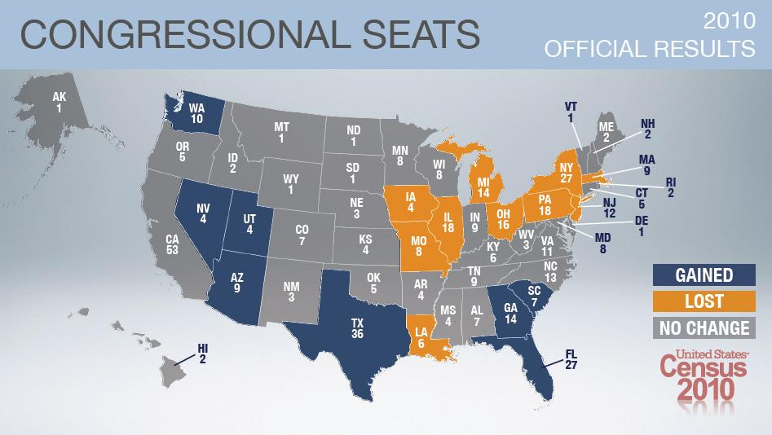
How Many Does Each State Get??
at least one per state (Illinois – 18)
Reapportionment
  census is conducted every 10 years
  Census Bureau reapportions (redistributes) seats
  State legislatures then redistrict (redraw the boundaries) of the district in their state
Notes:
Since the House is based on population, when population changes, the number of reps per state needs to change.
? Which areas of the country are growing relative to the rest of the country? Any consequences of this?

Slide 5
The Rules
Districts must be:
  Compact
  Contiguous
  Not drawn to limit or take away the voting power of citizens
Notes:
When redistricting there are only three rules….

Slide 6

Gerrymandering…
Notes:
Explanation of how it works…..

Slide 7
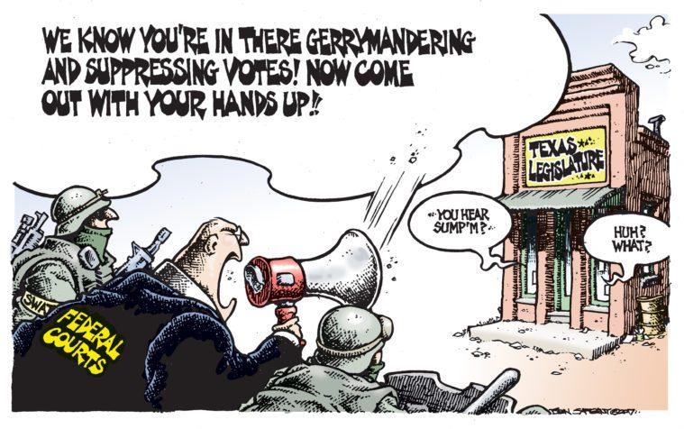
Lets see how well state legislatures play this game…

Slide 8
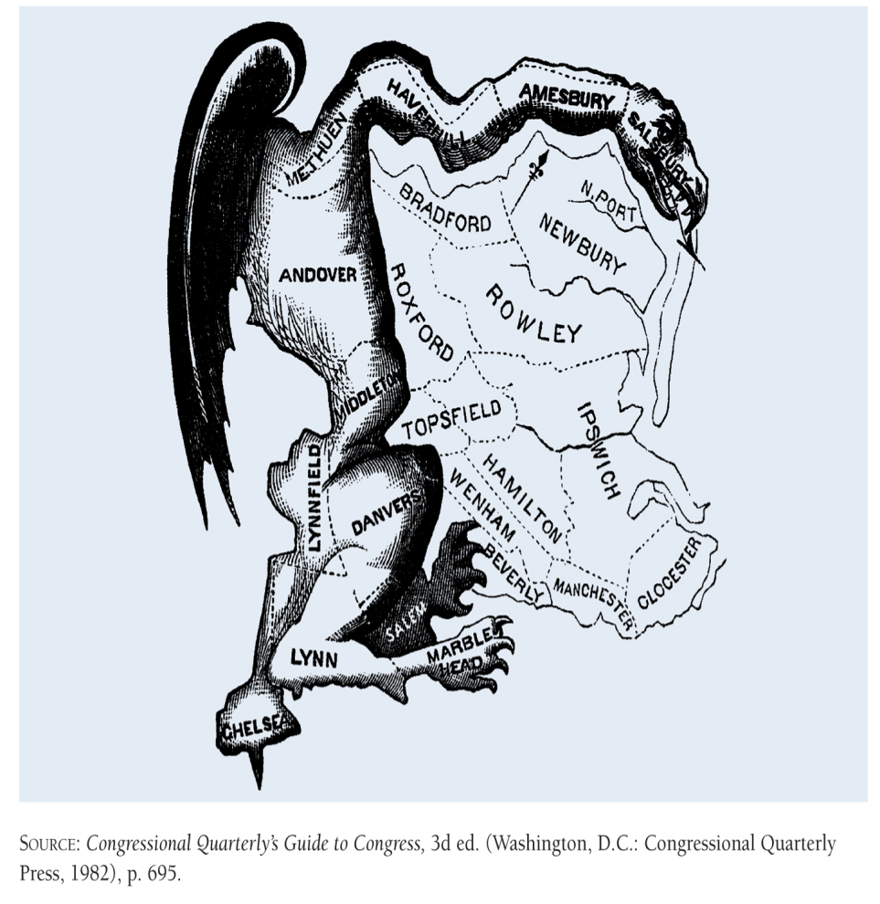
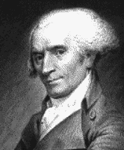
The Original Gerrymander
Notes:
I think the video covers this……

Slide 9
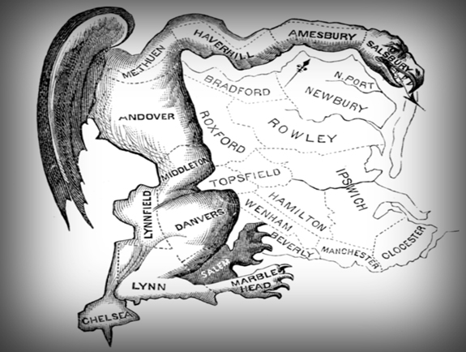
Gerrymandering
drawing district lines to the benefit or detriment of a particular group
  Wesberry v. Sanders said:
Illegal IF it violates “one person, one vote”
  “Packing & Cracking”
Notes:
So one district can’t be a lot bigger or a lot smaller than another but…that doesn’t mean that they can’t be creative…..to create advantages for their party or a minority group.
It’s the courts that decide what’s legal or not….

Slide 10
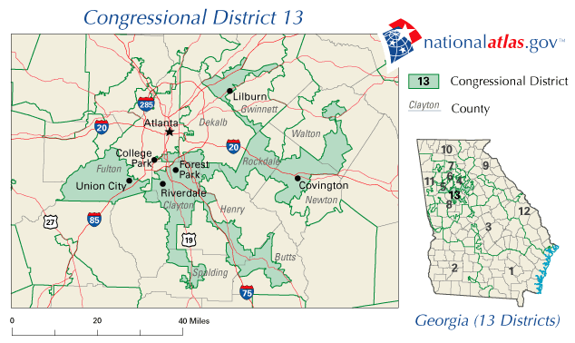
The 13th Congressional District (Amoeba) of Georgia
Notes:
Who might this create an advantage for? Republicans – drawn to connect the suburbs (more conservative) around a democratic city

Slide 11
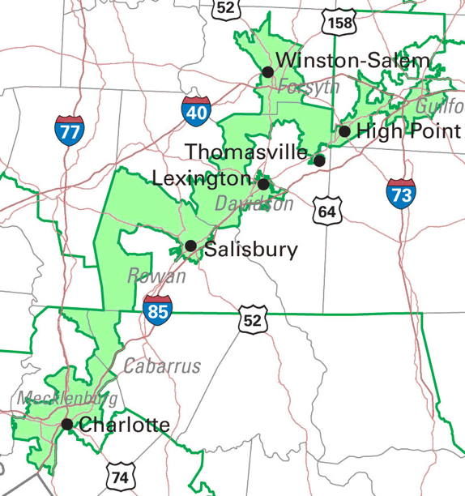
12th Congressional (I-85) District – North Carolina
Notes:
The 12th Congressional District in North Carolina, as put in place for the 1992 election, is perhaps America's best known congressional district. (The original Massachusetts "gerrymander" in 1812 may be more famous, but it was a legislative district.) North Carolina's 12th was a kind of in vitro offspring of an unromantic union: Father was the 1980s/1990s judicial and administrative decisions under the Voting Rights Act, and Mother was the partisan and personal politics that have traditionally been at redistricting's core. The laboratory that made this birth possible was the computer technology that became available for the 1990s redistricting cycle. The progeny won no Beautiful Baby contests. A Wall Street Journal editorial described the 12th as "political pornography." Known as the "I-85 district," the12th stretched 160 miles across the central Piedmont region of the State, for part of its length no wider than the freeway right-of-way.
The 12th Congressional District triggered redistricting law's major innovation of the 1990s, the "Shaw Doctrine."
Shaw Doctrine
On the basis of these opinions, the currently applicable standards appear to be:
It is permissible to be aware of race in the districting process and to consider issues of race.
Race, however, may not be the predominant factor in the redistricting process to the subordination of traditional districting principles.
Districts are not necessarily unconstitutional because they have odd shapes; however, a bizarre shape may be evidence that strongly suggests that race was the predominant factor driving the districting decision.
If race was the predominant consideration in the districting decision, the districts are subject to strict scrutiny analysis and the governmental body must demonstrate that they are a narrowly tailored means of addressing a compelling governmental interest.
Compliance with Section 2 of the Voting Rights Act is a compelling governmental interest.
The Court has been willing to assume that compliance with Section 5 of the Voting Rights Act is a compelling governmental interest, but it has never been required to decide the issue.
Districts drawn to comply with Sections 2 or 5 must be narrowly tailored. That means, among other things, that they use race no more than is necessary.
Compliance with Section 5 does not mean doing whatever the Department of Justice requires in order for it to preclear a districting plan. Essentially, the Supreme Court found that DOJ had required jurisdictions to do more than the law permitted. In those instances, a governmental body could not rely on the necessity of complying with DOJ's Section 5 preclearance requirements as a justification for a race-based decision.

Slide 12
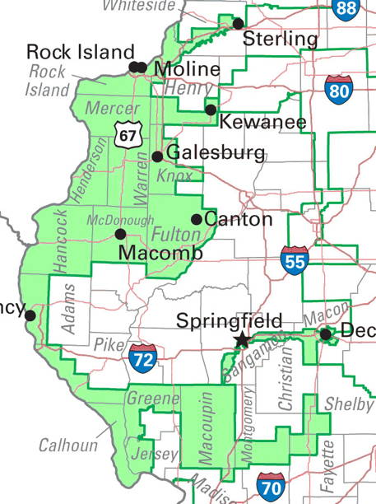
Illinois’ (old) 17th District
(rabbit riding a scooter)
Notes:
Who’s advantage? Democrats in mid-size cities linked together in relatively rural & conservative western Illinois.

Slide 13
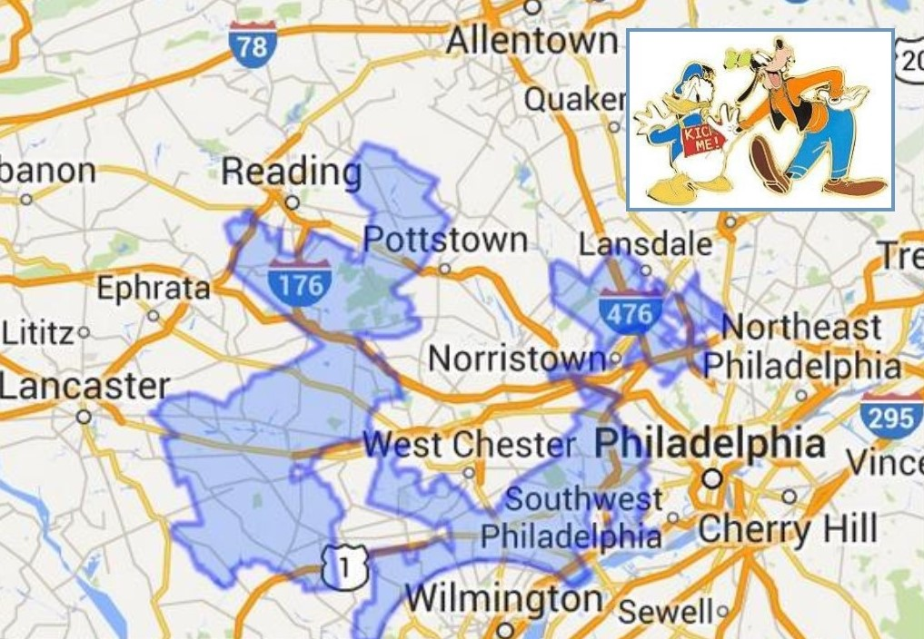
Goofy Kicking Donald Duck – Pennsylvania 7th
Notes:
Drawn to give GOP an advantage around Philadelphia, it was struck down by the courts

Slide 14
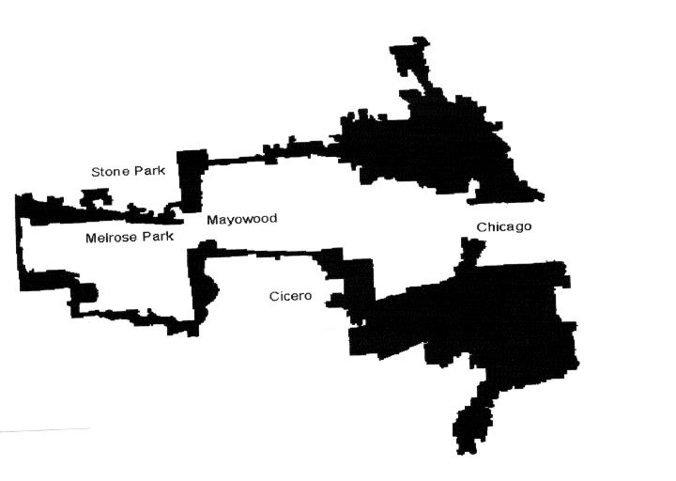
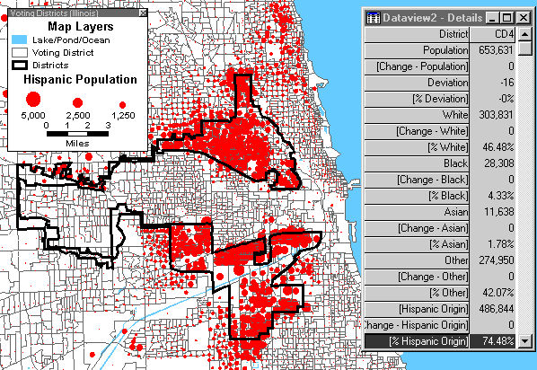

4th Congressional (Earmuff) District - Illinois
Rep. Chuy Garcia
Notes:
District Demographics
· 49% white; 6% black; 3% Asian; 64% Hispanic
· Hispanic district, surrounding a black district (the 7th)
After Shaw was decided in 1995, the federal district court approved plan fell under scrutiny again. Specifically, the 4th congressional district, a majority Hispanic district, was challenged as an unconstitutional racial gerrymander. The court decided that although the district was indeed a racial gerrymander, it served the compelling interest of the state of Illinois in redressing past vote dilution of Hispanic voters.

Slide 15
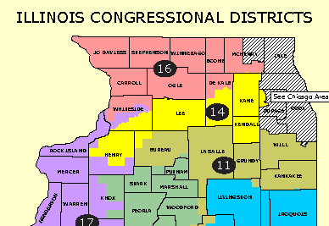
2002-2012
Notes:
We live in the 14th district, this is what it looked like when the GOP drew the lines….notice rural areas all joined together.
The GOP got to draw the lines in 2002 because they won a tie breaker which always happens in the state legislature…to break the tie they draw a name out of a hat (literally), a GOP legislator was chosen so they voted for the GOP preferred map.

Slide 16
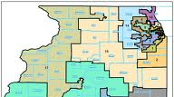
2012-2022
Notes:
When the DEMS won the tie breaker in 2012, the changed the 14th district to link together more urban areas like aurora, elgin, parts of Rockford and still some more GOP areas.

Slide 17


Which meant…..
vs
Randy Hultgren (R)
14th Congressional District
Joe Walsh (R)
8th Congressional District
Notes:
This also meant that two GOP congressmen now lived in the same district and had to run against each other, which knocked out one GOP representative. and set the stage for:

Slide 18

Our Democratic Representative – 14th District – IL
Lauren Underwood
Notes:
The combination of gerrymandering and the wave of democratic votes (against President Trump?) leads to a Democratic Representative from an historically GOP district.

