Slide 1

Bureaucracy
officials & employees who administrate, run, and work for the government
* recall, the President is the administrator of the entire federal government
Notes:
On Friday we did a massive web of the federal bureaucracy…I don’t know how far we got….as a class you are going to review the work the did on Friday (they should still have these or they may have turned them in) and review/answer the key questions about the bureaucracy on the other side of the web they completed.
* Main point they need to get: the bureaucracy is vast which leads to some degree of independence BUT the president is ultimately in charge of the bureaucracy as well as Congress can oversee the bureaucracy and the courts can review their actions for constitutionality

Slide 2
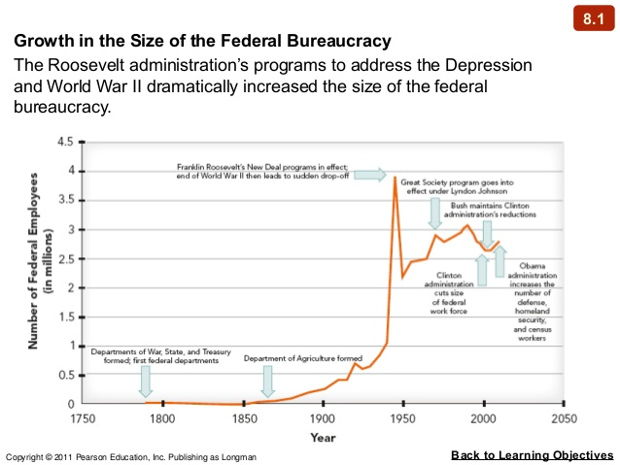

Slide 3
Major Parts:
President & Vice President
Cabinet
Executive Office of the President
Independent Agencies
Regulatory Commissions
Notes:
Reviewing the major parts on their chart…..

Slide 4
With partners (groups of 3):
1. The five types of agencies in the Executive Branch are shown for you: President and Vice President, Executive Office of the President, Cabinet, Regulatory Agencies and Independent Agencies.
* give a short definition for each part
2. For each part of the executive branch (listed above) make links showing the following:
A. President and Vice President
B. 15 Cabinet Departments (p.275-279)
* give a short description of their responsibilities
C. 5 Agencies under the EOP (p.234-239)
* use each of the four red headings in Chapter 8 Section 4 and 1
“other”
* describe what they are / what they do
D. 2 Independent Agencies (p.279-280)
* describe what they are / what they do
E. 2 Regulatory Commissions (p.280-281) - use p.282 to find examples
* describe what they are / what they do
Notes:
Did this on Friday (Mr. Land should be able to tell you how far they got), he’s a coteacher first hour.

Slide 5
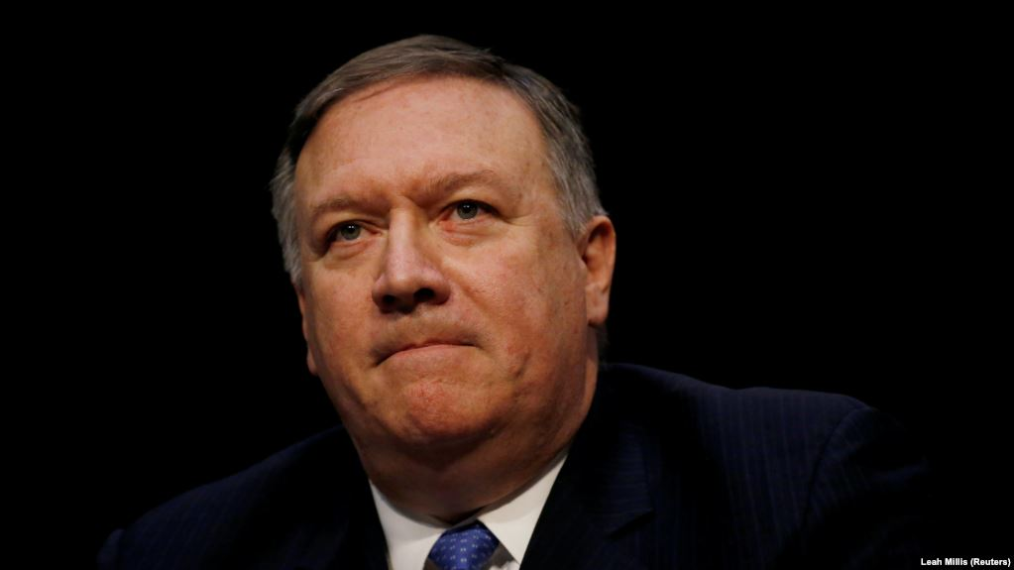
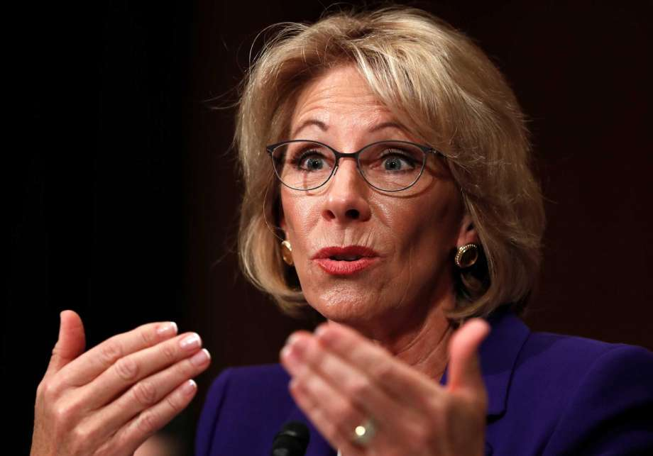
The Cabinet advisors to the President, administrators of their departments
Secretary of State
Mike Pompeo
Secretary of Education
Betsy DeVos
Notes:
Again, checking their information…..

Slide 6
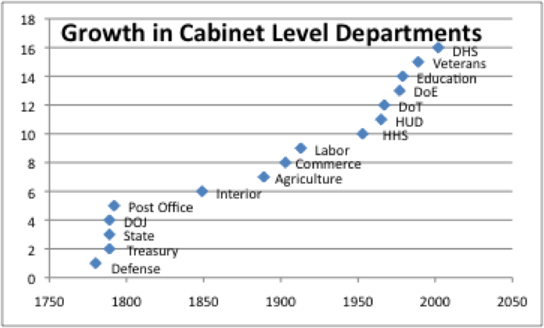
Notes:
Number of cabinet departments grow as we expect the federal government to do more…..explodes after the depression..

Slide 7
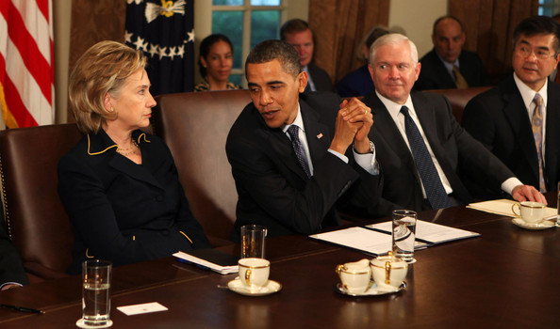
T.E.A.C.H. H.E.A.D.L.I.G.H.T.S.
Every letter stands for a cabinet department
Notes:
Just a way to amaze your friends and neighbors with all the cabinet departments…
* Use A for Veterans Affairs and G for Attorney General/Department of Justice

Slide 8
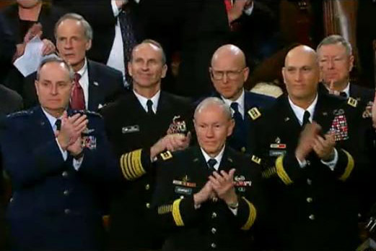
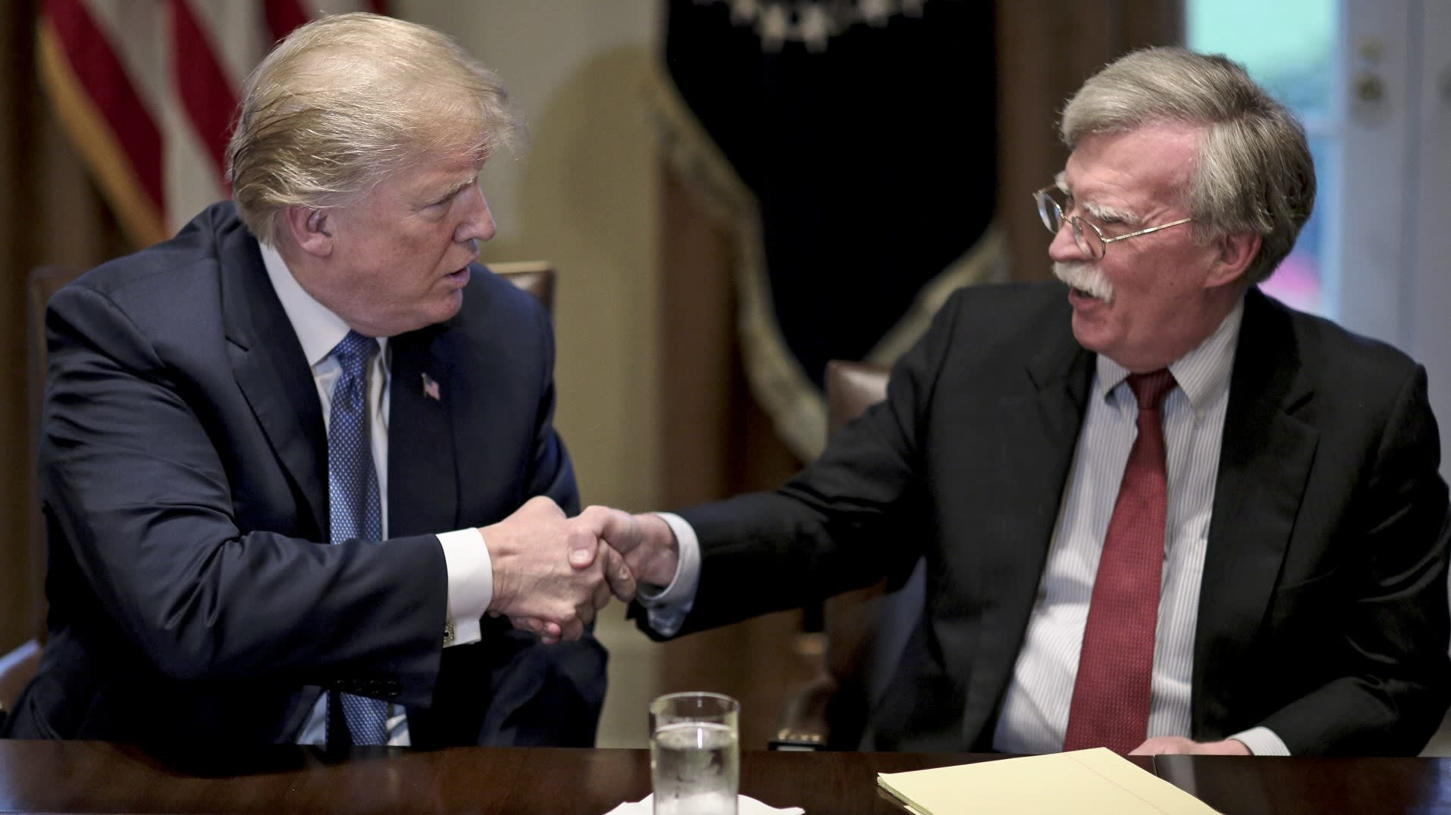
Executive Office of the President (EOP)
- direct advisors to the President & help him make decisions/do his job
(no other power, so they don’t have to be confirmed by the Senate)
National Security Council
National Security Advisor
John Bolton
Joint Chiefs of Staff
(Military Heads)

Slide 9

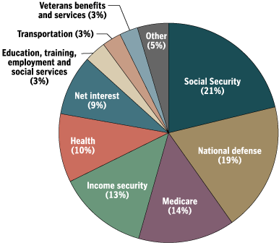
Executive Office of the Pres.
Office of Management & Budget

Slide 10
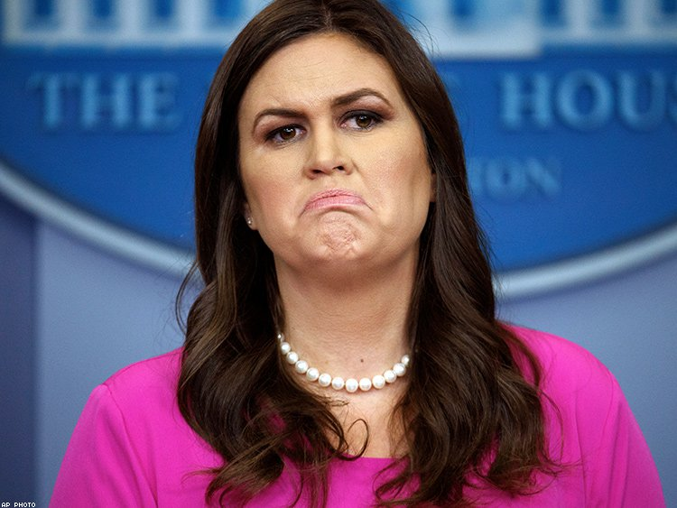
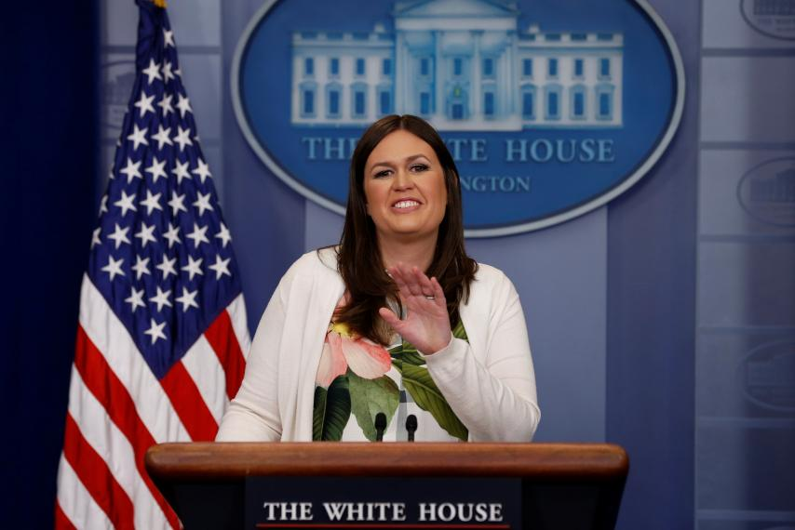
Executive Office of the Pres.
Press Secretary
Trump Press Secretary
Sarah Huckabee Sanders
Notes:
Robert Gibbs

Slide 11
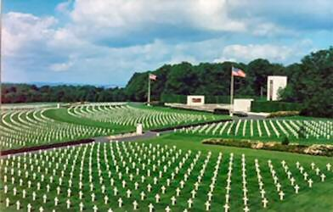
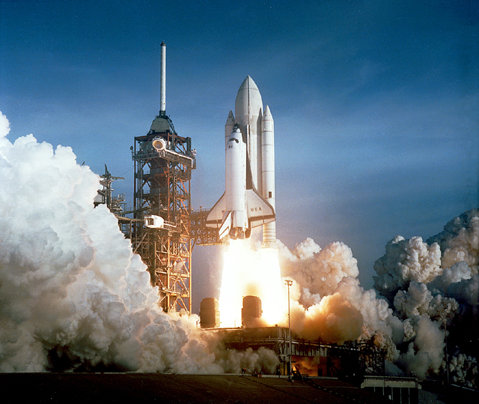

Independent Agencies
- special status outside of cabinet departments; don’t really fit in other departments because of specialty
NASA
American Battle Monuments Commission

Slide 12
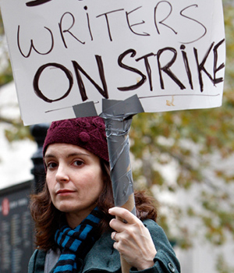
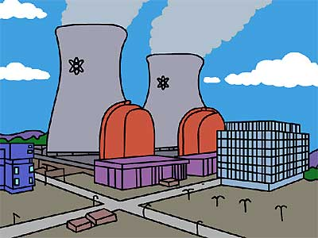

Regulatory Commissions
- independent so they don’t make biased decisions for or against someone/something (i.e. Congress or the President)
Nuclear Regulatory Commission
National Labor Relations Board

Slide 13
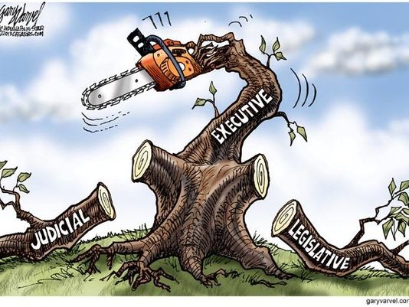

Slide 14
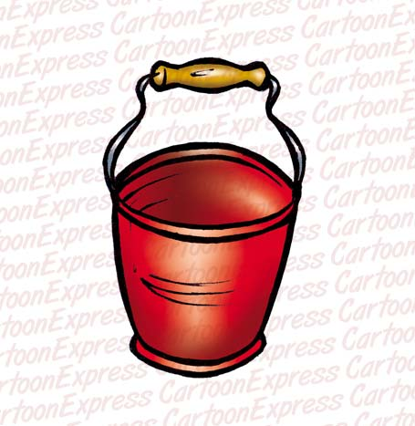
“ The Vice Presidency isn’t worth a warm bucket of ****.”
- Vice President John Nance Garner

Slide 15
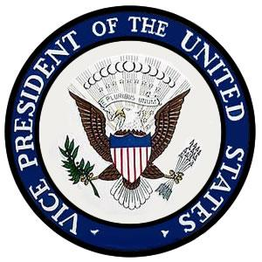
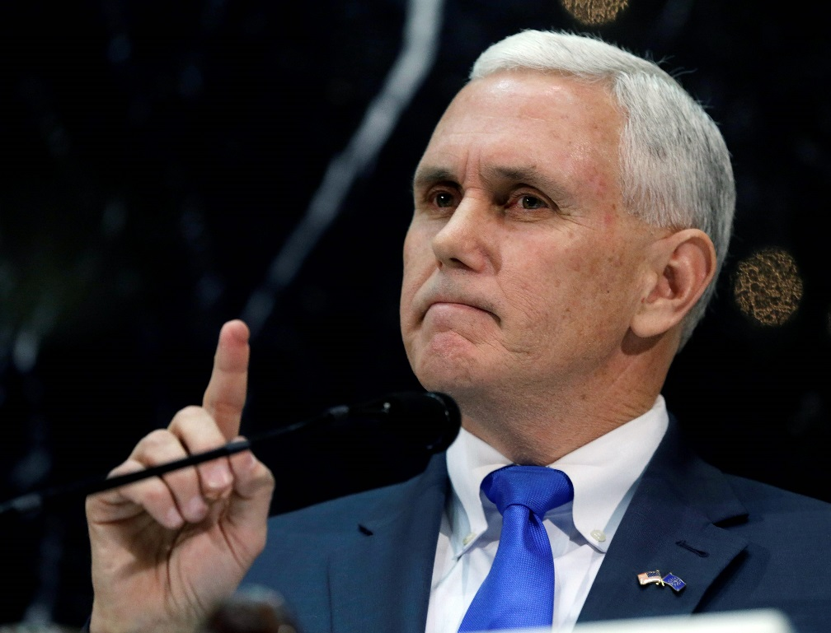
The Vice President
Official Duties
  Presidential disability
  President of Senate
    Breaks ties
  Take Over
Others:
  (delegated
  tasks)
  (balance the
  ticket)

