Slide 1
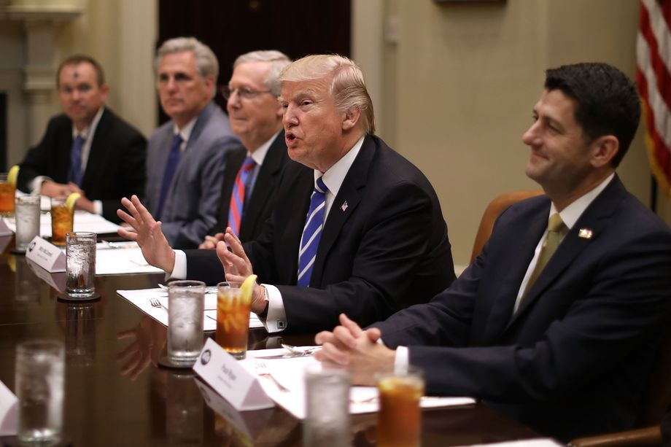
Bellwork 3/7: Caption ?’s p.183, 185, 186
Republicans Unveil Plan to Repeal and Replace Obamacare:
The American Healthcare Act

Slide 2
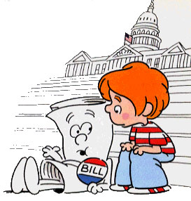
How a Bill Becomes a Law

Slide 3


Slide 4

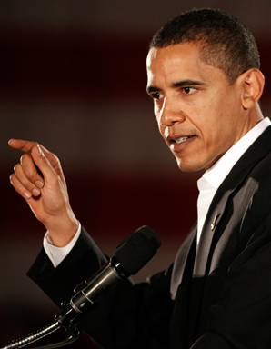
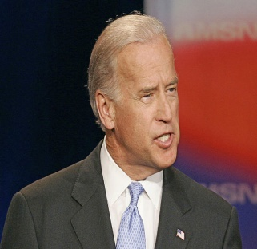

Step One: Introduction
Idea: Anyone!
Introduction: Congressional members only!
Placed in the “hopper” Senator introduces bill
House
Senate

Slide 5
Step Two: Committee Action
House
Senate
Sent to respective STANDING committees and/or subcommittees
Bill dies
OR
sent to committee hearing
where further info is gathered

Slide 6
Step Three: Markup Session
House
Senate
Changes made if necessary
Riders/Amendments added
Majority to agree on changes

Slide 7
Step Four: Reporting a Bill
House
Senate
Kill the Bill!!
OR
Report the Bill to the Floor

Slide 8
Step Five: Floor Action
House
Senate
Debate the Bill
Filibuster & Cloture

Slide 9
Step Six: Floor Action-Voting on Bills
House
Senate
Quorum (majority) needed to Vote

Slide 10
Step Seven: Final Passage
House
Senate
Both house MUST agree to identical Bill
Conference Committees

Slide 11
Step Eight: Presidential Action
Pocket Veto?
President
Nothing: After 10 days becomes law.
Veto the Bill
Sign the Bill
Congressional Override: 2/3 in both Houses

