Slide 1
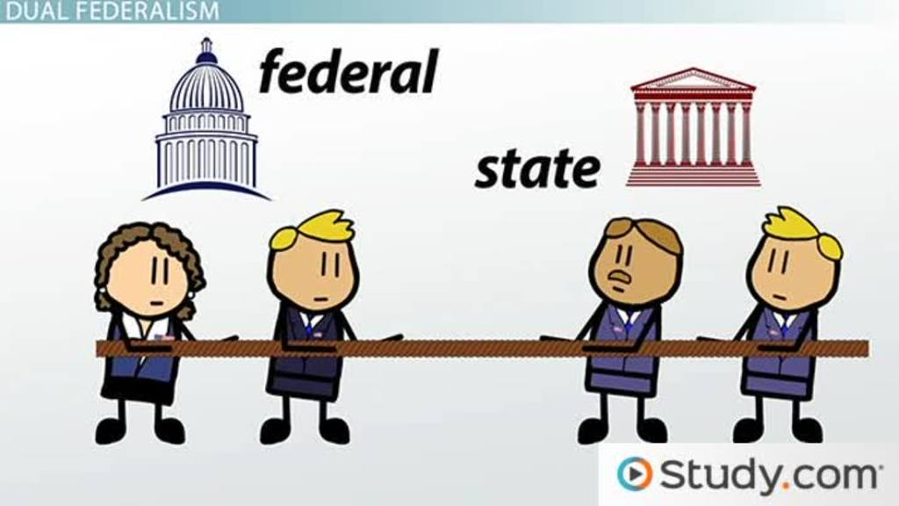
Bellwork:
Caption Question p. 97
Interpreting Political Cartoons p.119

Slide 2
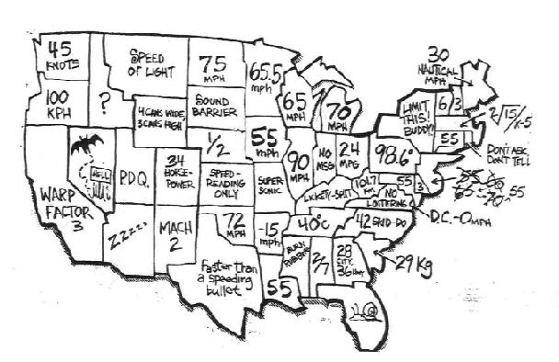

Slide 3
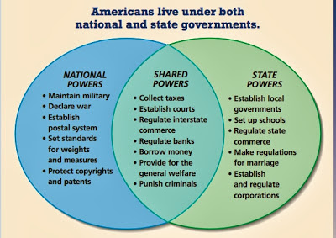

Slide 4
Federalism
Division of National & State Government

Slide 5
National Government
Constitutional Powers
Expressed
Implied
Inherent
Collectively known as
“Delegated Powers”

Slide 6
National Government
Expressed Powers
AKA: “Enumerated Powers”
Directly stated in the Constitution
Examples:
Coin $
Raise an Army & Navy

Slide 7
National Government
Implied Powers
Powers the Nat’l Gov’t requires to carry out the Expressed Powers
Example:
Military Draft is implied by the power to raise an army
Basis: “Necessary & Proper Clause” (Elastic Clause)

Slide 8
National Government
Inherent Powers
Certain powers may be exercised because it is a government.
Examples:
Establishing Foreign Relationships
Immigration Control

Slide 9
State Government
Reserved Powers
Powers “not delegated to the U.S. by the Constitution…”
Example:
Regulation of public school systems

Slide 10
Rights Guaranteed to the States
Republican Government
Protection
Territorial Integrity

Slide 11
State & National Powers
Concurrent Powers
Powers both Nat’l & State Gov. can exercise.
Example:
Tax
Establish Courts

Slide 12
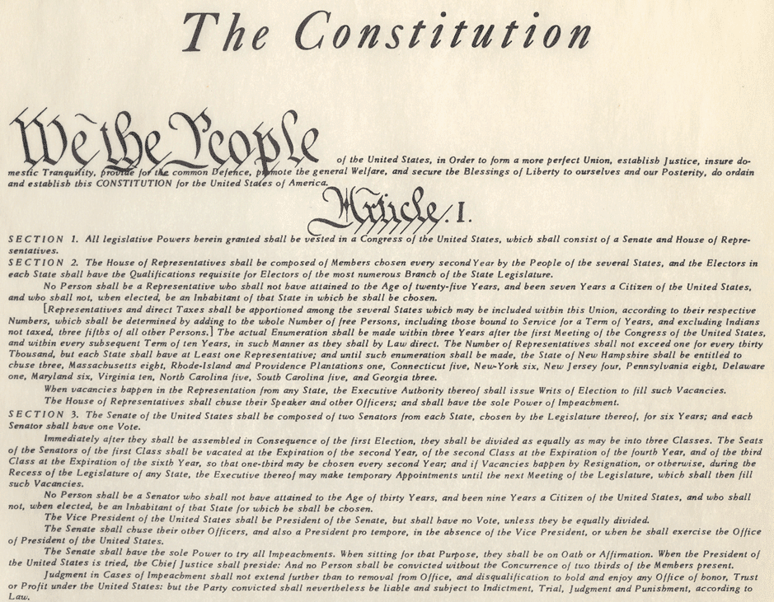
Conflict between National & State Government
In matters where laws conflict the Supremacy Clause takes effect.

Slide 13
Denied Powers
Powers denied at all levels
Denied Nat’l Power
Tax Exports
Denied State Power
Coin Money
Denied to Nat’l & State
Prohibit Religions

Slide 14
Partners:
Sort the cards/classify into four categories:
  Federal (Delegated) powers
  Concurrent Powers
  State (Reserved) Powers
  Denied to both levels (rights of the people)
Sort the Federal (Delegated & Concurrent Powers) into:
  Expressed/Enumerated (Article I, Section VIII)
  Implied

Slide 15
Classification of Powers:
Use the Constitution, p.97, Ch. 23, Section 3
Delegated | Concurrent | Reserved
Rights of the People/Denied
Expressed
Implied
I DON’T KNOW!!

Slide 16
