Slide 1
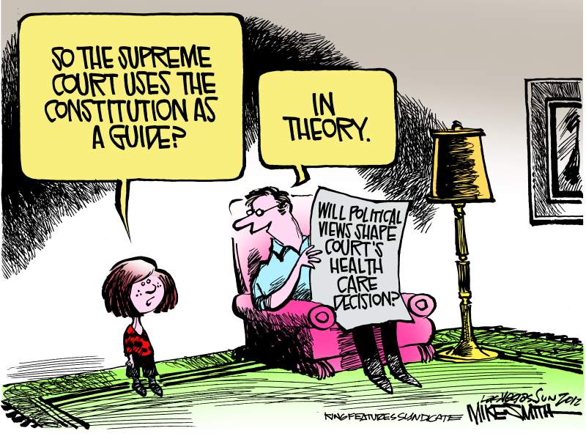
Bellwork 3/19: I.P.C. page 351
Notes:
Students should answer the bellwork question in their notebooks….please review answers or do it as a class

Slide 2
Judicial Philosophies
* More than just liberal or conservative
* Judges are not technically Republican or Democratic but….their philosophies do generally align with the parties/ideologies
Notes:
Ensure students are taking down notes…we talked about appointment yesterday…today we are going to talk about a judges beliefs about the law and the constitution.

Slide 3
What are they thinking…?
Activism
Restraint
VS.
take an active role
Using the judiciary’s power to:
check the power of the government
Defend individual rights and protect those less powerful
Usually liberal
passive role – not elected representatives
Leave policy decisions to the executive or legislative branches
Usually conservative

Slide 4
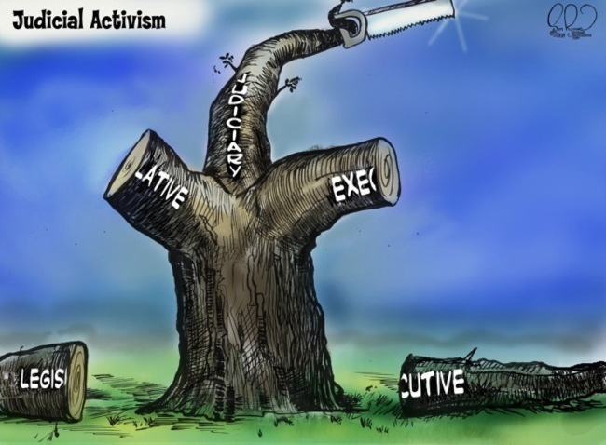
Notes:
Review main point…when judges are activist they are becoming too powerful and cutting off the other branches of government

Slide 5
What are they thinking…?
Broad Construction
VS.
Strict Construction
interpret the context and purpose of the law
usually liberal
“living Constitution”
“letter of the law”
usually conservative
“originalism”

Slide 6
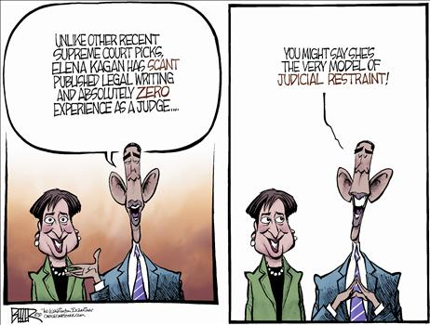
Notes:
Obama’s nominee was criticized as not having enough experience.

Slide 7
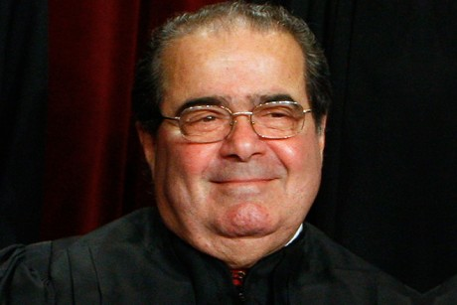
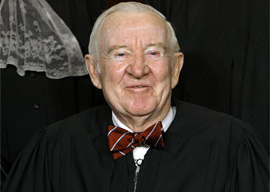
Meet The Justices…
Bachelor Number 1
Bachelor Number 2
* Remember…all judges have philosophies and can interpret federal law or the Constitution….district, appellate, or supreme court (even state judges for that matter)
Notes:
Play both videos….ask students to write down two key statements and/or rulings (see the next slide) and use them to determine what philosophy they hold….review and have them explain.

Slide 8
Meet The Justices…
Bachelor Number 1
Bachelor Number 2
Key Statements or rulings:
Judicial Philosophy?
Key Statements or rulings:
Judicial Philosophy?
* Remember…all judges have philosophies and can interpret federal law or the Constitution….district, appellate, or supreme court (even state judges for that matter)

Slide 9
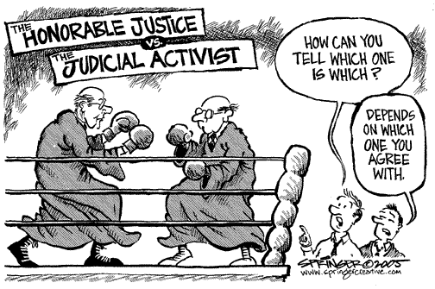
Notes:
Have a student explain the main point. If I agree with a justice, then they are honorable….if I disagree then they are practicing judicial activism and doing too much.

