Slide 1
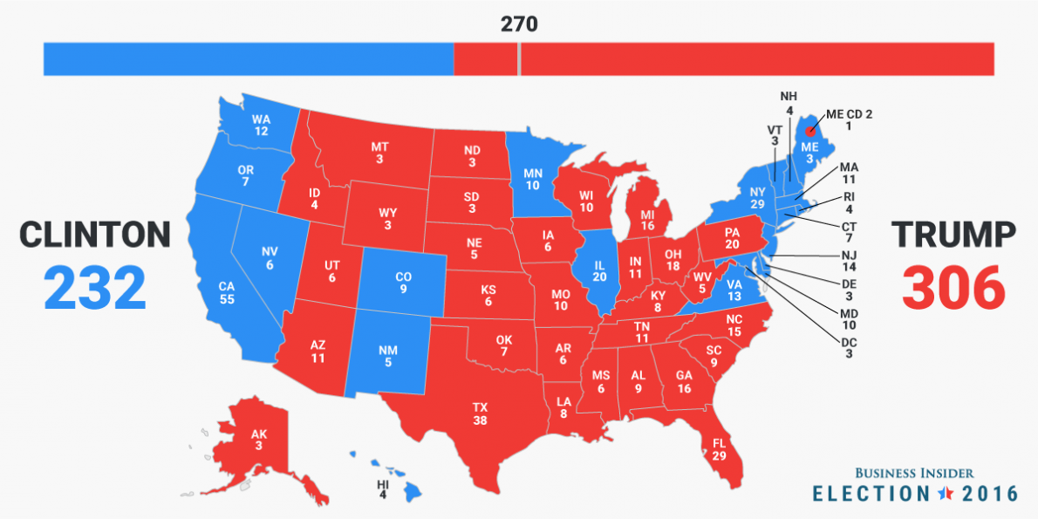
The Electoral College

Slide 2
Is the E.C. “Un-Democratic?”
There are legitimate arguments both FOR and AGAINST the Electoral College… only you can decide what you think about it
FOR: “Balance”
Against: “Popular Sovereignty” in US Constitution

Slide 3
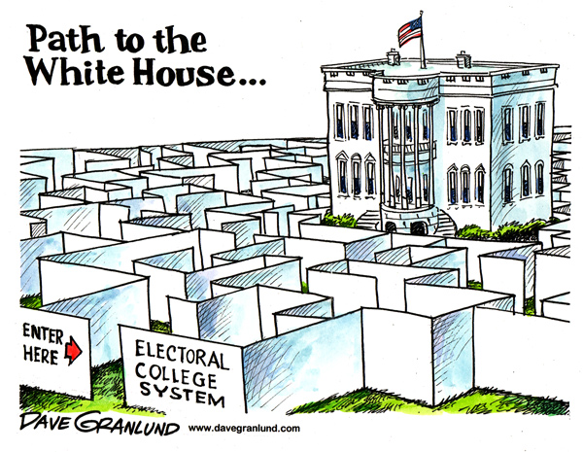

Slide 4
Do the voters matter?
Yes!
You are voting for ELECTORS State legislatures choose them.
* 51 small elections add up to one big one
Notes:
If Hillary Clinton can win the popular vote by 2 million votes….and DJT still wins…do the voters matter?
* Don’t write this down….

Slide 5
E.C. Specifics
270 of 538 votes required to win
# Electors = # Senators + # Representatives
No winner- House of Reps = President & Senate = Vice President
Electors are selected by state legislatures
MOST states give votes on a winner take all basis
Notes:
Things we need to remember about how the Electoral College works…..

Slide 6
Fictitious Election (partners)
With a partner or two, create a fictitious election map…you can switch off coloring in states or just color in sections…MAKE IT UP and see what happens
  Keep track of the number of electoral votes you have as you go so you don’t have to go back
Use the election you created to answer the questions on your worksheet
Use p.223-224 to help with #5 and #6
Notes:
Grab markers from the office so kids can color things in…a blank map should be in the file cabinet, folder is titled “Voters, Parties & Elections.”
Discuss their results, why no one wins in three party elections…which we never have…
Double side the map with the questions…

Slide 7
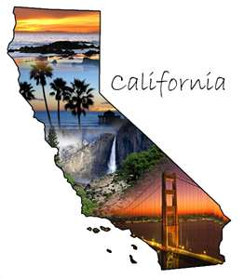
Large States are Extremely Powerful
Focus on smaller states in the primaries (earlier primary)
Focus on big states and swing states in the general election
Notes:
What was your strategy to win?...which states matter most?

Slide 8
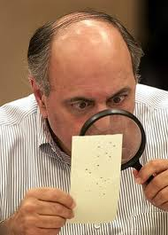
Problems
“Big 11”
Over-representation & under-representation
Non-Popular vote winner
“non-standard” votes
Notes:
Big 11 – only need eleven states to win 270 votes….ask students which ones they are
Over & Under Representation…some states get more electoral votes than they should, some get less (explanation on next slide)
Non-Popular Vote Winner – DJT wins the electoral college but not the popular vote
Non-Standard Votes – an elector (recall Ben Leatherberry from the video) can vote for whomever they want….they almost never do and when they have it hasn’t mattered but what if?!

Slide 9
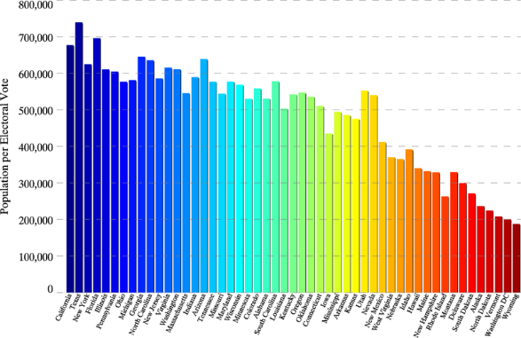
Over-representation & Under-representation
Notes:
Texas – 1 elector for @725,000 people – underrepresented
Wyoming – 1 elector for @190,000 people - overrepresented

Slide 10
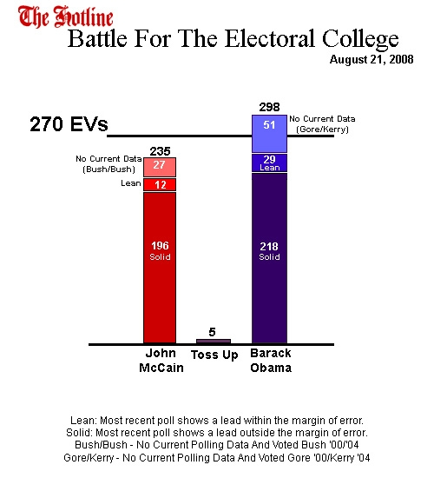
Solutions
Abolish
  Direct Popular Election
Divide electoral votes
  Proportionally?
  By district?
Notes:
What solutions did they find?
Abolish – the most popular but least likely to happen because you would need an Amendment which is hard to do
Divide electoral votes – states can do this, they just don’t because giving them “winner take all” makes them more valuable….some states already do; Nebraska and Maine divide them by districts

Slide 11
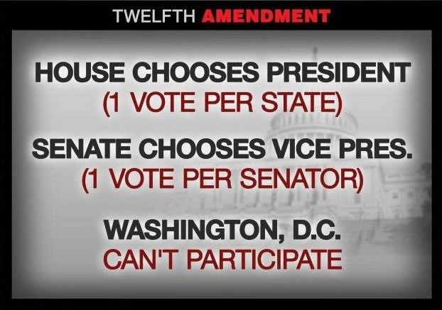
Why not get rid of it?
“safety valve”
Amendment Process

Slide 12

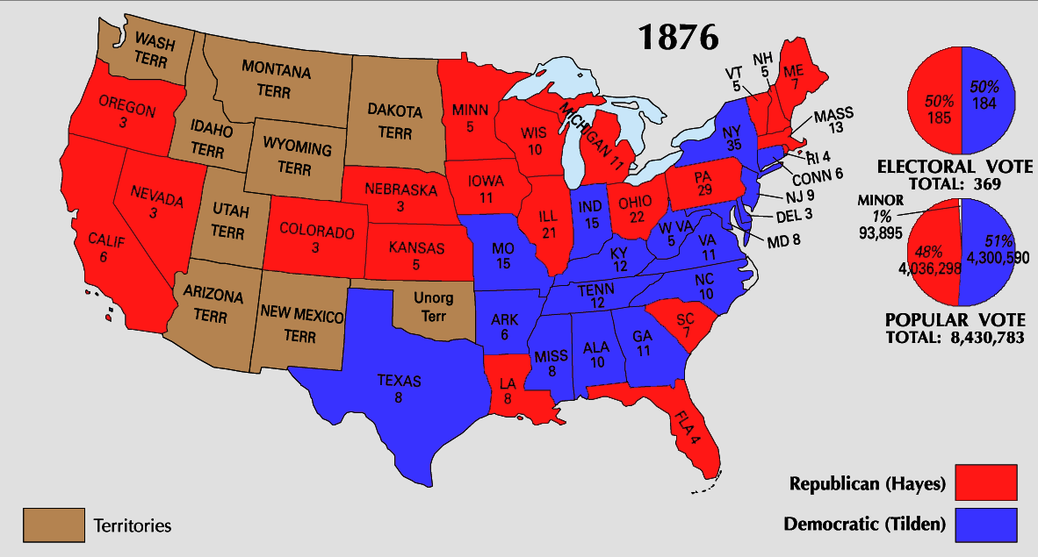
The Electoral College
Notes:
Wrap up…the electoral college was a way to ensure states felt protected from the power of the national government….it is usually not an issue and has only been a problem four times…it is a problem when the country is most divided like TODAY…the civil war…1824…otherwise we don’t worry about it.

Slide 13
The Founders on Who Should Vote
Initially in the days of the early Republic, the only people who could vote were white, male, property owners.
Even after the 15th Amendment extended suffrage to African American men (1869), they still had trouble voting due to Jim Crow Laws

Slide 14
Women’s Suffrage
The 19th Amendment extended voting rights to women in 1920

Slide 15
Other Amendments
12th Amendment offers the broadest protection of voting rights
26th Amendment: Can vote at 18

