Slide 1
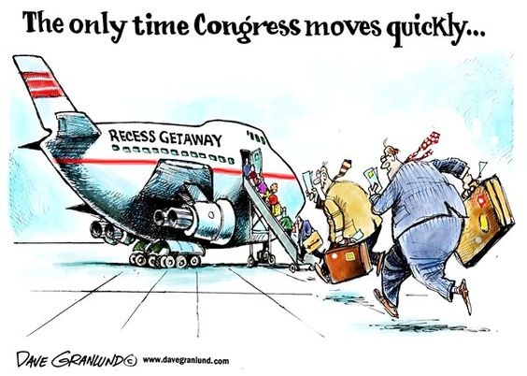
BELLWORK 10/1:Congressional Committees

Slide 2
Congressional Committees
Use Chapter 5, Section in your text to:
  The three main purposes of committees
  Identify the five different types of committees
Then using the “bills” on the back, decide which committee each would go to based on the subject of the bill and the committee name
* Simply write your guess under the bill

Slide 3


Types of Committees
Standing Committees - permanent panel with full legislative functions and oversight responsibilities
Subcommittees – formed to tackle very specific tasks within the jurisdiction of the full committees
Select or Special Committees - groups appointed for a limited purpose and limited duration
Joint Committees - includes members of both chambers to conduct studies or perform housekeeping tasks
Conference Committee - includes members of House & Senate to work out differences between similar bills
Notes:
Committees are like groupwork, congress breaks down it’s work into committees but there are lots of different types….
Leave room between each so you can write down an example of each type of committee

Slide 4
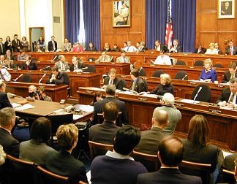
Standing Committees

Slide 5
House Standing Committees
Agriculture
Appropriations
Armed Services
Budget
Education & Workforce
Energy & Commerce
Financial Services
Government Reform
House Admin.
International Relations
Judiciary
Resources
Rules
Science
Small Business
Standards of Official Conduct
Transportation & Infrastructure
Veterans Affairs
Ways & Means
Notes:
Yellow are particularly important:
Appropriations – budgets amounts of money to different parts of the government (Trump is trying to change this with his “national emergency)
Rules – sets the rules for what can be done with a bill on the floor (have influence over EVERY bill)
Ways and Means – deal with taxes and tax rates

Slide 6
Senate Standing Committees
Agriculture, Nutrition, & Forestry
Appropriations
Armed Services
Banking, Housing, & Urban Affairs
Budget
Commerce, Science, Transportation
Energy & Natural Resources
Environment and Public Works
Finance
Foreign Relations
Governmental Affairs
Health, Education, Labor & Pensions
Judiciary
Rules and Administration
Small Business and Entrepreneurship
Veterans Affairs
Notes:
Armed Services – represent and/or work with 40% of annual budget
Judiciary – confirms (or not) new judges to the courts

Slide 7
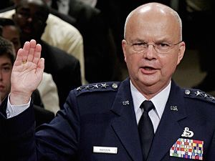
Special, Select Committees
House Select Committee on Energy Independence & Global Warming
Senate Select Committee on Ethics
House & Senate Select Committees on Intelligence
Gen. Michael Hayden is sworn in during a full committee hearing of the Senate Select Intelligence Committee on his nomination to be director of the Central Intelligence Agency.

Slide 8
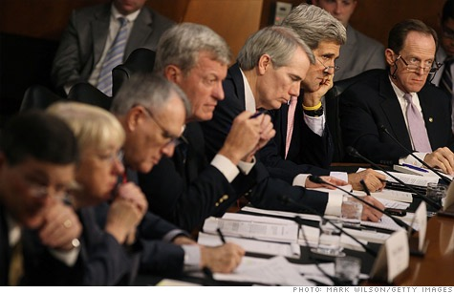
Joint Committees
Joint Economic Committee
Joint Committee on Printing
Joint Select Committee on Deficit Reduction (aka – Supercommittee)
“Super-committee Members”

Slide 9
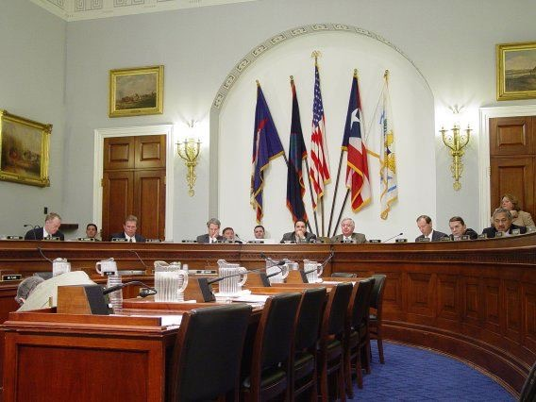
Legislative (Law) Committees:
Function and Purpose
* “groupwork” – allows them to break up the work that needs to be done

Slide 10
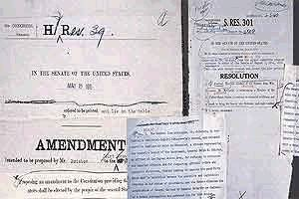
Legislative Committees:
Function & Purpose
1. Consider bills (a.k.a. “mark-up” bills)
A bill with a member’s mark-up notes
Notes:
Just like a rough draft of a paper, the committee wants to make sure the bill is good and doesn’t need any changes

Slide 11
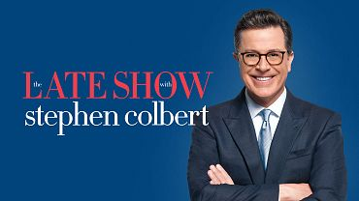
Colbert Testifies
In 2016 Stephen Colbert (Late Night Show Host) was asked to testify to the agriculture committee about an immigrant labor bill.
Do you think celebrities should testify before Congress?
Should Stephen Colbert be punished for “making a mockery” of a Congressional hearing?
Do you think that immigrant laborers deserve and/or need protection from the government? Why or why not?
Notes:
Just and example of how a committee of this type works with some video thrown in….
You can discuss these questions or require them as an exit slip after viewing the videos.

Slide 12
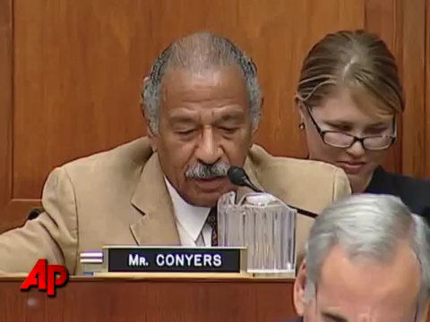
PreTestimony

Slide 13
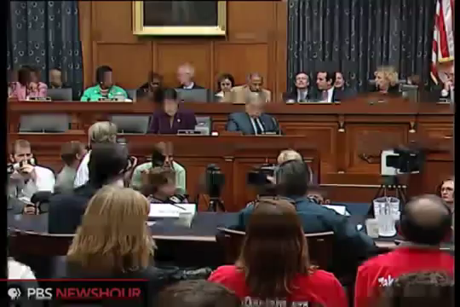
Colbert Testifies

Slide 14
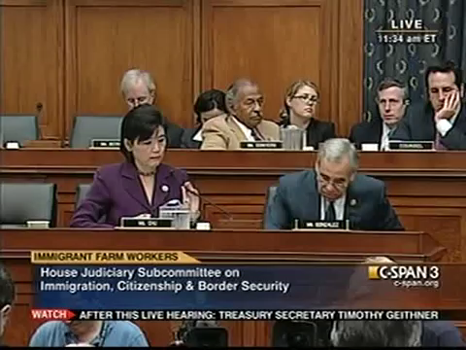
Colbert out of character

Slide 15
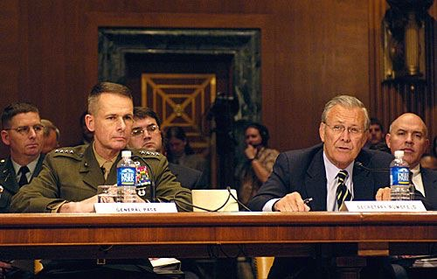
Legislative Committees:
Function & Purpose
2. Maintain oversight of executive agencies
Secretary Donald Rumsfeld testifies before a Senate Appropriations Committee hearing re: the Department of Defense Budget (May, 2006)
Notes:
Oversight means watching over departments of the government to ensure they are doing their job….another example is the TSA and how Congress may tell the TSA what to do if the public is unhappy

Slide 16
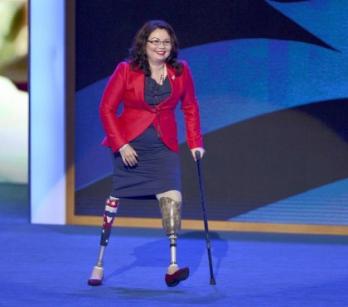
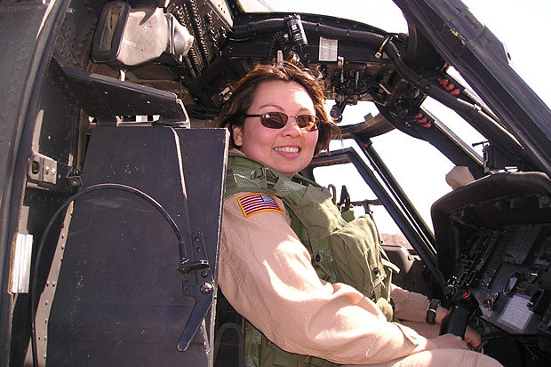
Rep. Duckworth goes after Department of Veterans Affairs abuse of benefits
Notes:
Investigating abuse of veterans benefits, Duckworth gives this guy the business over his abuse of disability benefits….obviously she is a real disabled veteran

Slide 17

Rep. Duckworth goes after abuse of benefits in the Department of Veterans Affairs

Slide 18
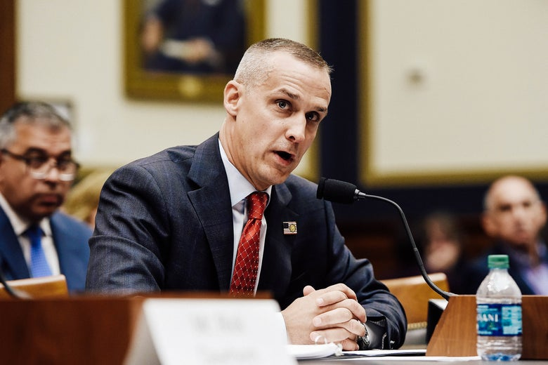
Legislative Committees:
Function & Purpose
3. Conduct investigations & hearings
Notes:
Hyperlinks on title and on picture from Cohen’s testimony before the House investigations committee looking into Russian interference in the 2016 election.

Slide 19

Steroids in Baseball
Notes:
Just another famous example….

Slide 20


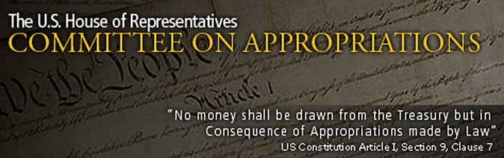
Which committee would you rather be on?
Notes:
Agriculture – because you might have lots of people in your state/district concerned about that
Appropriations because they handle the money
Takeaway: all committees are important for different reasons.

Slide 21
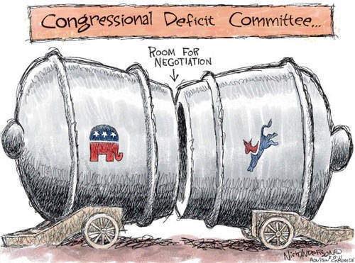

Slide 22
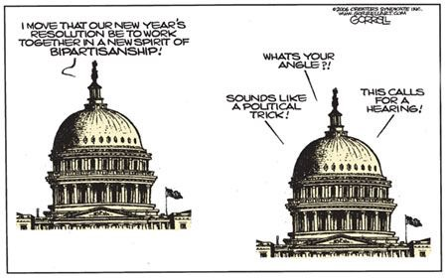

Slide 23
Congressional Committees
Use the textbook (p.141-145) to describe the major functions of committees, the different types and give examples.
Ensure each partner has the information!
Read the bills on the separate page & use the handout to:
  Determine what the subject of the bill is
  Predict which committee it would go to
  Also, use p.143 for help

