Slide 1
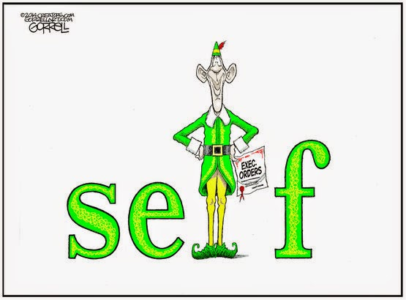
BW 3/13:Caption ?’s pp.246, 255
Notes:
Very similar to yesterday but bellwork built in because this lesson is shorter/quicker. Students should take notes on guided notes sheet. Then make groups and have them apply together.

Slide 2
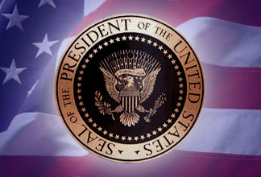
The Presidency on Trial
Attempting(?) to limit Presidential power

Slide 3
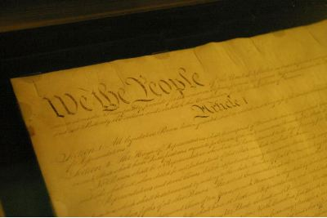
Formal Checks on
Presidential Power

Slide 4
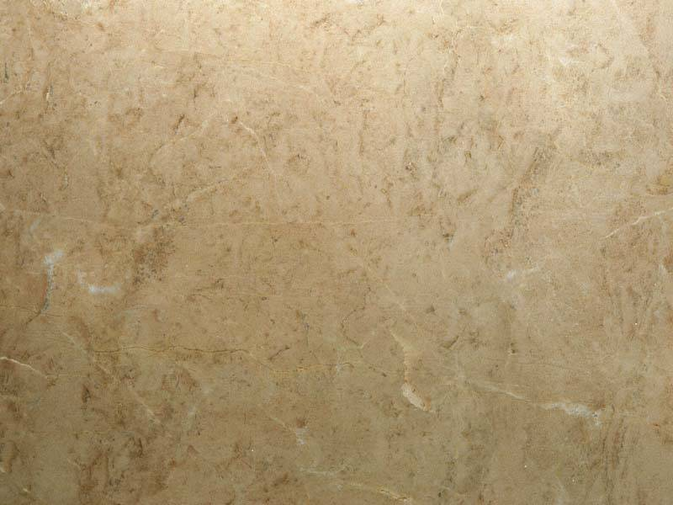
Congressional Checks on the President
(Article I)
Make laws
  ex: War Powers Resolution
Override presidential vetoes
Power to declare war
Power of the purse (taxes and funding)
Regulation of armed forces

Slide 5
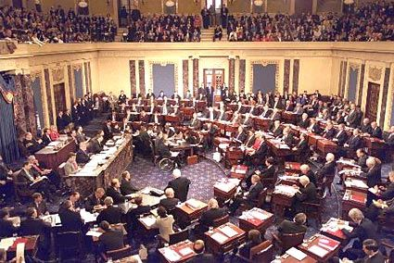
Congressional Checks (cont.)
Impeachment Power (House)
Impeachment Trial (Senate)
President Clinton’s impeachment trial, January, 1999

Slide 6
Limits on Presidential Power (Article II)
President elected indirectly by the people
Election by House if no majority of electoral vote
must deliver State of the Union address
Senate approves treaties and ambassadors

Slide 7
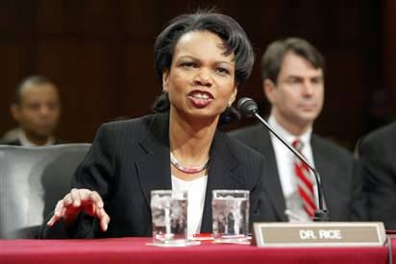
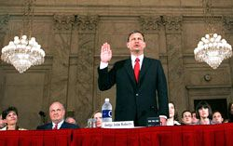
Limits on Presidential Power (Article II)
Senate approves cabinet/department nominations
“Advice and consent” of federal judge appointments (Senate)
Secretary of State Condoleezza Rice testifies at her Senate Foreign Relations Committee confirmation hearing, January, 2005.
Nominee for Chief Justice, John Roberts is sworn in at his Senate Judiciary committee confirmation hearing, September, 2005.

Slide 8
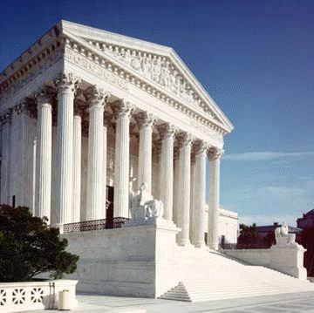
Judicial Checks on the President
Judicial review (Marbury v. Madison)
Chief Justice presides over presidential impeachment trial (Article I)
Life Terms

Slide 9
Constitutional Amendments
12th – Choosing president & vice-president on separate ballots
20th – Lame Duck
22nd – Presidential term limits
(2 terms; 10 years total)
25th – Presidential disability and succession

Slide 10
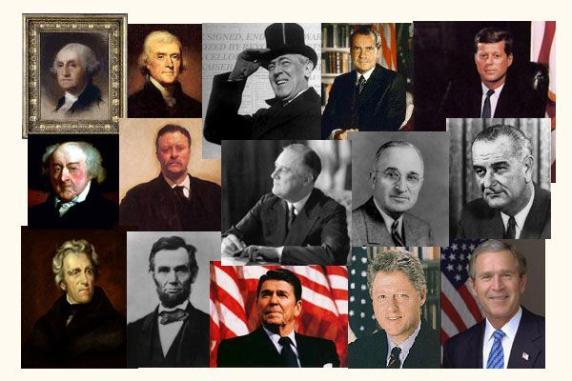
Limits on Presidential Power: Informal Checks

Slide 11
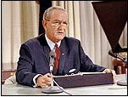
Public Opinion
ultimate check is the ballot box
polls, approval ratings, etc.
more powerful in first term
(Also a powerful tool of the Presidency, a.k.a. “bully pulpit”)`

Slide 12


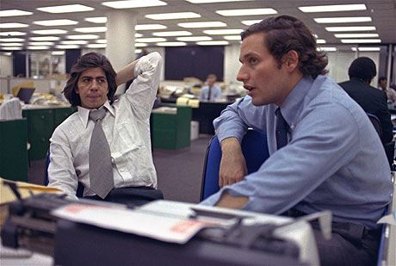
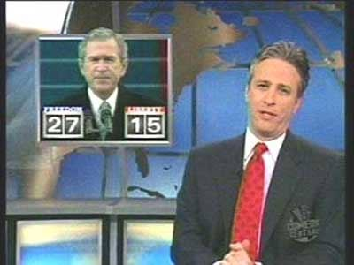

The Media
Influences public opinion by:
  agenda setting
  commentary & opinion leaders
  “watchdog”

Slide 13
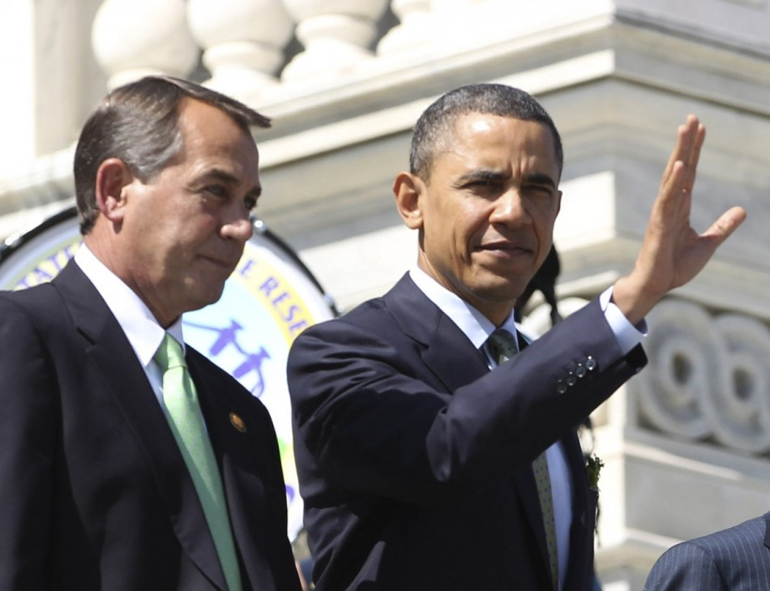
Partisan Politics
Opposition party may:
  Scrutinize
  Criticize
  Oppose
decisions & policies

Slide 14
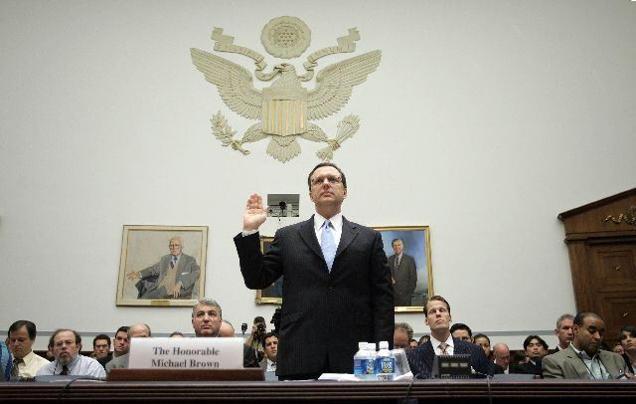
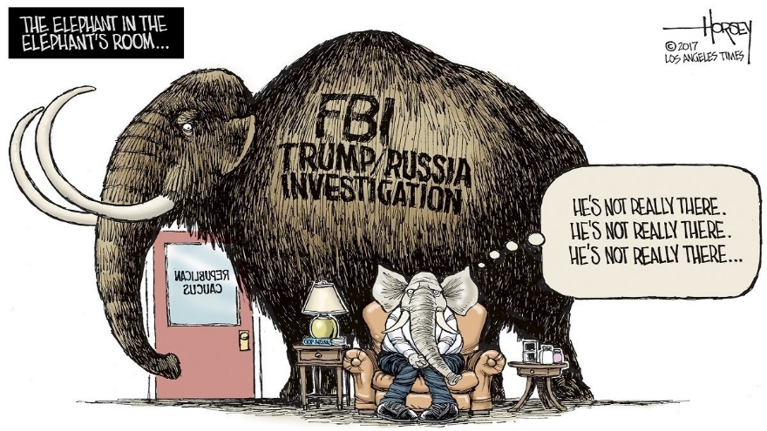

Congressional Investigations
Public investigations supporting congressional oversight

Slide 15
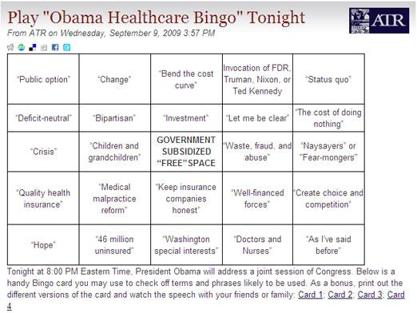
Interest Groups & NGO’s
*monitor the president’s policies
Endorse or oppose candidates
Contribute to campaigns
  Support or $$

Slide 16
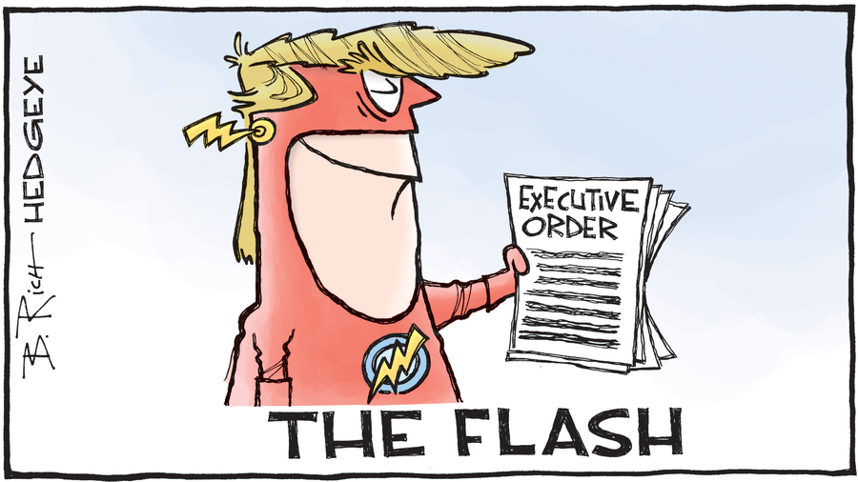
Scenario Time
Identify & explain the formal & informal powers at work in each scenario.
There may not be formal and informal checks for all scenarios.

Slide 17
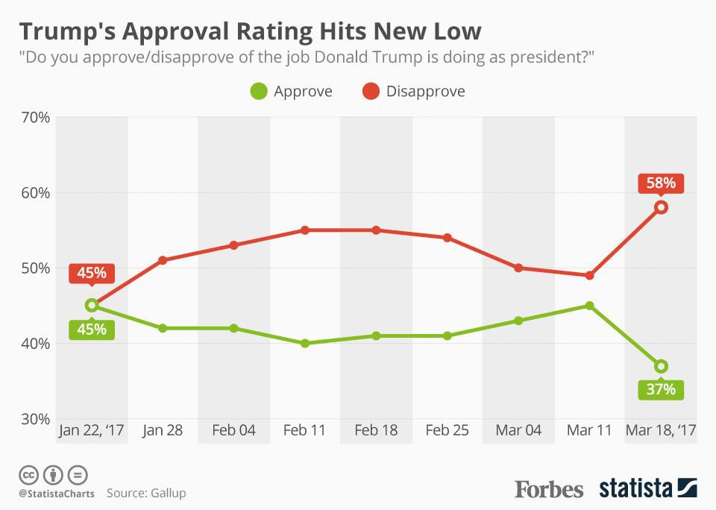
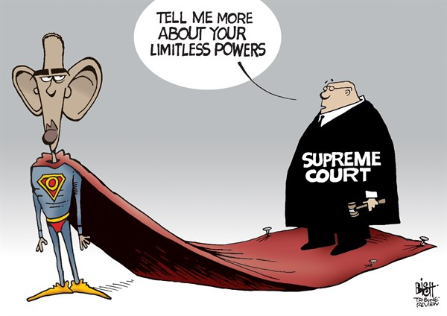
Put it together…
Which are more powerful, the presidency’s powers or the checks on the President’s powers?

Slide 18
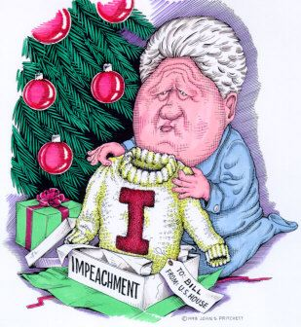
Title: "Bill Clinton's Christmas present from the U.S. House."
Artist: John Pritchett
Date: unknown
Source: http://www.pritchettcartoons.com/gift.htm

Slide 19
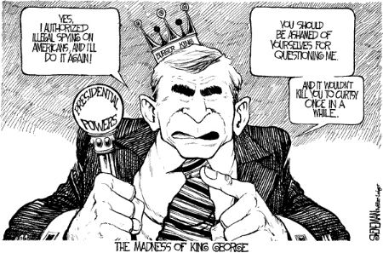
Title: “The Madness of King George"
Artist: Drew Sheneman, The Newark Star Ledger Date: December, 2005
Source: http://www.cagle.com/news/DomesticSpying/1.asp

Slide 20
