Slide 1
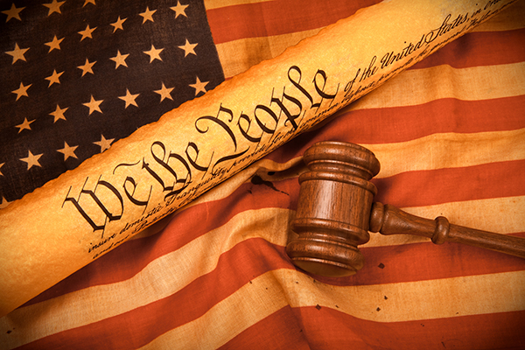
Bellwork 2/14: Read p.82 & 83
* identify two facts you find interesting, disturbing, silly or weird

Slide 2
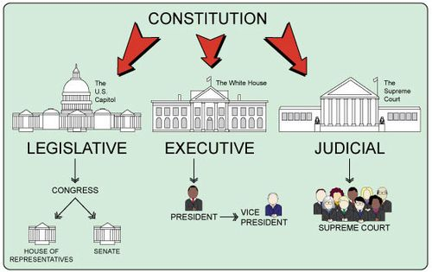
3 Branches Venn Diagram
Within your group, assign each person a branch of government
  Legislative (Congress)
  Executive (President)
  Judicial (Courts)
Each partner should complete their assigned portion then share with others
Compare what your branches do to fill in the areas that overlap

Slide 3
Executive Branch
In the overlapping areas, list at least two ways in which power of the two branches “overlap.”
Use your notes pp. 69-75
and the chapter for each branch.
Basic Duties:
3 Specific Duties:
Groups/Organizations:
Legislative Branch
Judicial Branch
Basic Duties:
Basic Duties:
3 Specific Duties:
3 Specific Duties:
Groups/Organizations:
Groups/Organizations:

Slide 4
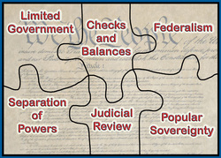
When you finish….Principles Practice use p.65 or your notes for definitions

Slide 5


