Slide 1

Hail to the Chief
The Power of the
American Presidency
Explain how presidents have justified their use of formal and informal powers
Explain how the president can implement a policy agenda

Slide 2
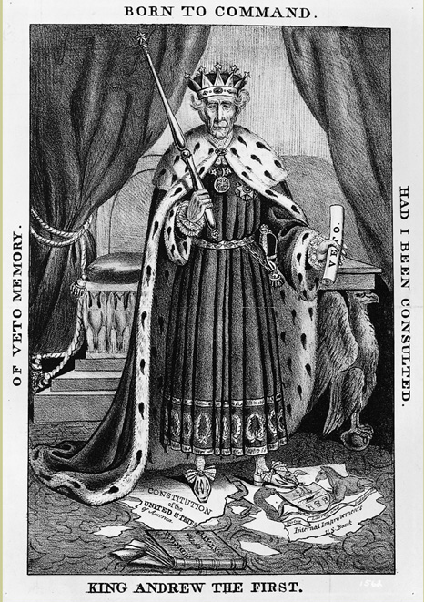
An Imperial
(Kinglike)
president?
Over time, many have worried the presidency has been too powerful…what examples of too much power are in this cartoon?

Slide 3
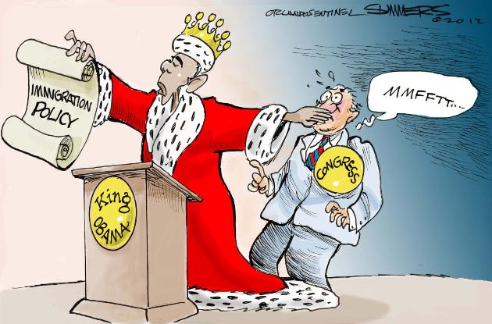
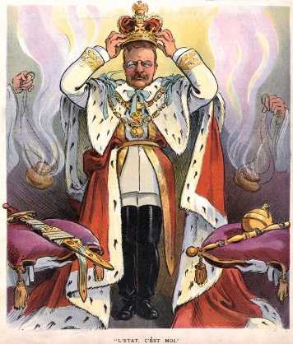
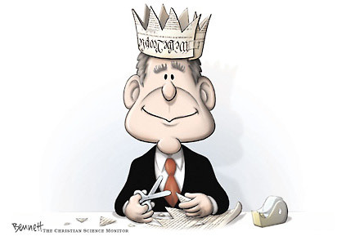
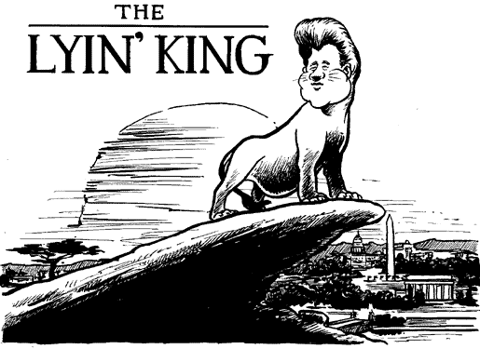
We still debate & discuss this today.
Notes:
Lots of presidents have been accused of using their powers in a kinglike manner….think Trump and “national emergency”

Slide 4
Demographic Characteristics of U.S. Presidents
100% male
98% Caucasian
98% Protestant
81% of British ancestry
78% college educated
71% politicians
64% lawyers
>52% from the top 3% wealth and social class
0.5% born into poverty
71% elected from large states
Notes:
Anything surprising?

Slide 5
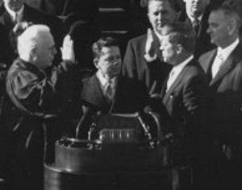
Constitutional Qualifications
Must be at least 35 years old
Must have lived in the United States for 14 years
Must be a natural born citizen
Notes:
Students should just follow along and take notes on the guided notes page(s) as you go through these. Some are a review/expansion of the roles of the President.

Slide 6
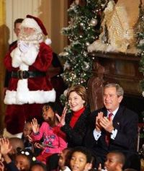
Presidential Benefits
$400,000 tax-free salary
$50,000/year expense account
$100,000/year travel expenses
The White House
Secret Service protection
Camp David country estate
Air Force One personal airplane
Staff of 400-500
Christmas at the White House, 2004

Slide 7
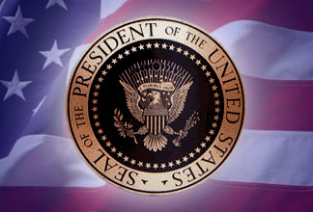
Formal Powers of the President
Constitutional or enumerated powers of the presidency
Found primarily in Article II of the Constitution

Slide 8
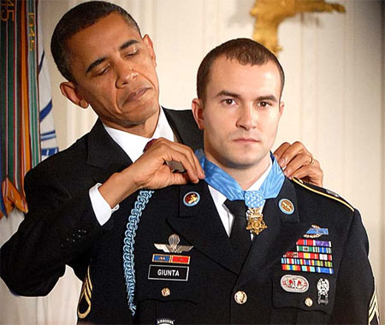
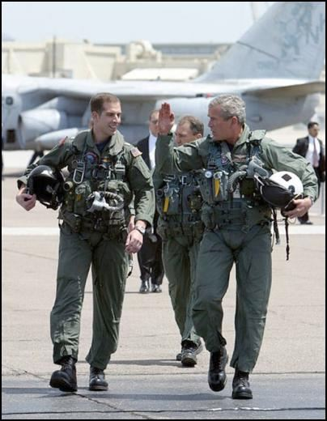
Formal Powers:
Commander-in-Chief
Commander in Chief of the Army, Navy, AF, Marines, CG
Commander in Chief of the state militias (now the National Guard)
Commission all officers

Slide 9
Formal Powers:
Chief Executive
“Faithfully execute” the laws
“Require the opinion of heads of executive departments” – consult the cabinet
Grant pardons for federal offenses
  except impeachment
Nominate judges of the Supreme Court and Cabinet
  with consent of the Senate
Fill vacancies that may happen during recess of the Senate

Slide 10
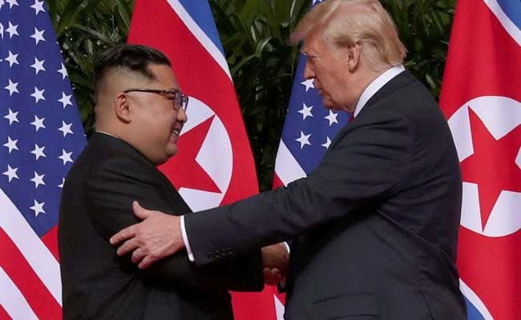
Formal Powers:
Chief Diplomat
  Appoint ambassadors
  Make treaties
    (subject to Senate confirmation)
  Receive ambassadors

Slide 11
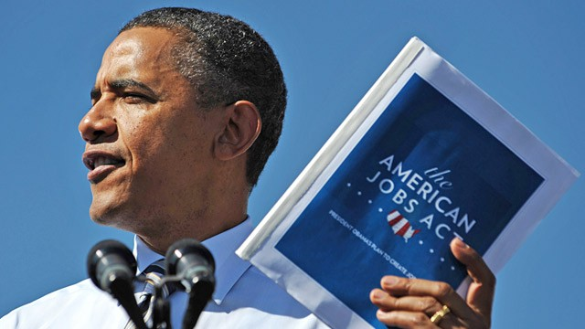
Formal Powers:
Chief Legislator
Give State of the Union address to Congress
Recommend “measures” to the Congress
Upon “extraordinary occasions” convene special sessions of Congress

Slide 12
Formal Powers:
Chief Legislator (cont.)
Presidential Veto
  must veto within 10 days or it becomes law
  Pocket Veto - President does not sign within 10 days & Congress adjourns
  Congress can override with 2/3 majority from both Houses
Veto Politics
  Congressional override is difficult (only 4%)
  Threat of veto can cause Congress to make changes in legislation

Slide 13
Informal Powers
Those powers not explicitly written in the Constitution
Similar to “necessary and proper” powers of Congress
In the modern era (since 1933), the President’s informal powers may be significantly more powerful than his formal powers
Notes:
Other side of the notes….

Slide 14
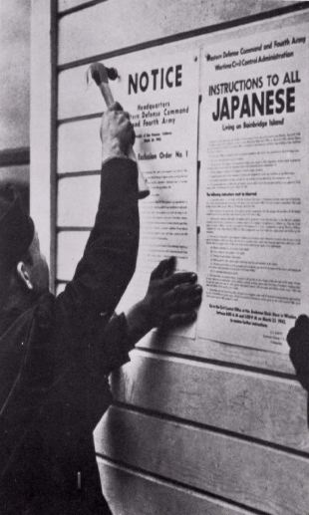
Executive Orders
Orders issued by the President that carry the force of law
Clinton’s “Don’t ask don’t tell” gays in the military policy
FDR’s internment of Japanese Americans
President Trump’s Immigration Ban
Notice for Japanese “relocation,” 1942

Slide 15


Slide 16
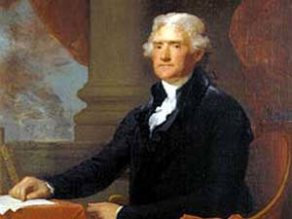
Executive Agreements
International agreements, made by a president that has the force of a treaty; does NOT need Senate approval
  (technically) only in effect for that President’s term
Jefferson’s purchase of Louisiana in 1803
Trump – undoes NAFTA , becomes USMCFTA
usually trade agreements between
US and other nations

Slide 17
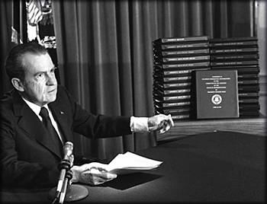
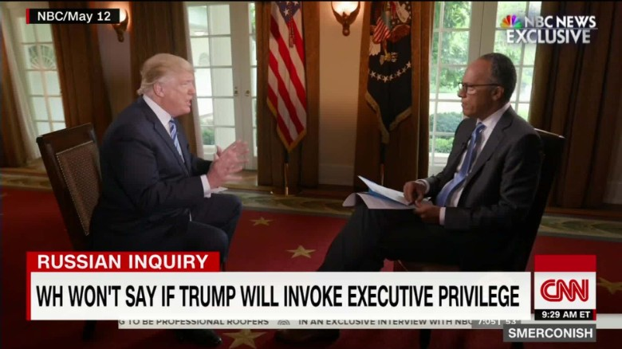
Executive Privilege
The President may keep info. related to national security secret
  including from the Courts and Congress
United States v. Nixon (1973) – presidents do NOT have unqualified executive privilege (Nixon Watergate tapes)
Trump – Mueller investigation?

Slide 18
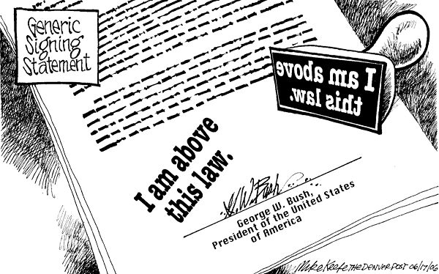
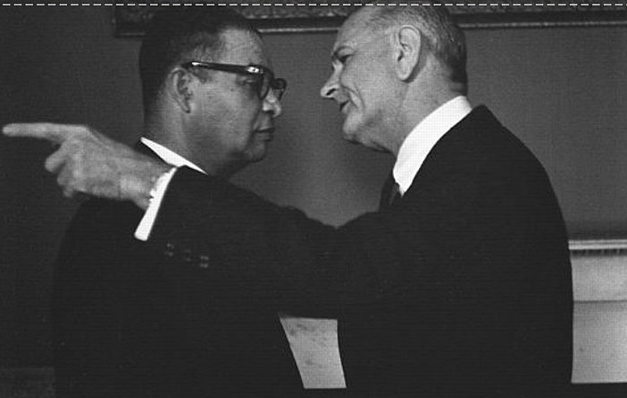
Other Informal Powers
Bargaining & persuasion
Signing Statements
  Informs Congress & the public of the president’s interpretation of laws he signs

Slide 19
Groupwork
With your group, review the scenarios. Identify the formal and informal powers involved, then EXPLAIN whether or not the President acted constitutionally.
When you are finished answer the last three questions on your notes sheet.

Slide 20
Why are informal powers more important than formal powers, particularly to modern presidents?
Identify several advantages and disadvantages of the use of the president’s informal powers.
Has the use and perhaps abuse of the informal powers created an “Imperial Presidency?”

Slide 21
Presidential Quotations

Slide 22
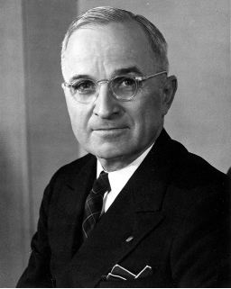
President Harry S. Truman
"I sit here all day trying to persuade people to do the things they ought to have the sense to do without my persuading them. That's all the powers of the President amount to."
Truman, 33rd President, 1945-53

Slide 23
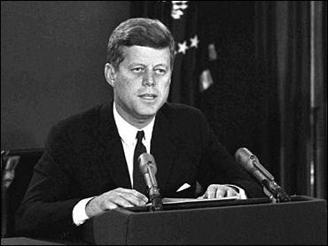
President John F. Kennedy
“No easy problem ever comes to the President of the United States. If they are easy to solve, somebody else has solved them.”
President Kennedy’s nationally televised address during the Cuban Missile Crisis, October, 1962

Slide 24
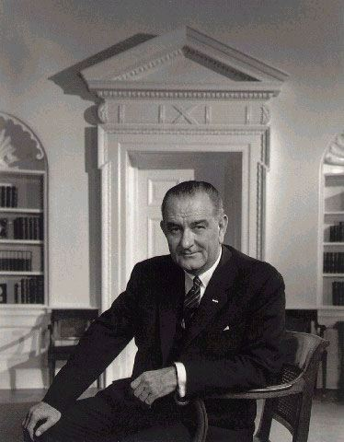
President Lyndon B. Johnson
“The presidency has made every man who occupied it, no matter how small, bigger than he was; and no matter how big, not big enough for its demands.”
President Johnson,
36th President, 1963-69

Slide 25
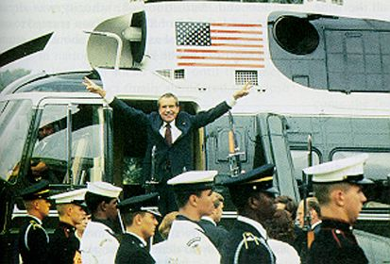
President Richard M. Nixon
"Under the doctrine of the separation of powers, the manner in which the president personally exercises his assigned executive powers is not subject to questioning by another branch of government."
In the aftermath of the Watergate scandal, President Nixon departs the White House after his resignation, Aug., 1974

Slide 26
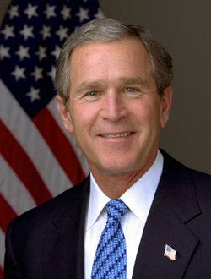
President George W. Bush
“To those of you who received honors, awards, and distinctions, I say 'Well done.' And to the C students, I say 'You, too, can be president of the United States.'”
President George W. Bush, speaking at Yale University's 300th commencement ceremony
President Bush, 43rd President, 2001-present

