Slide 1
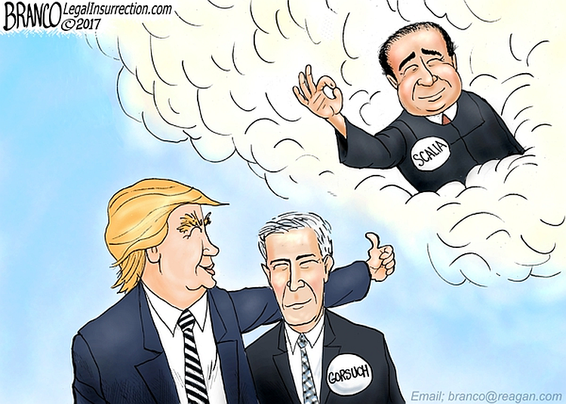
In 2016, many Republican voters said they supported Donald Trump for a single reason: the Supreme Court. Indeed, exit polls showed that nearly 3 out of 4 voters said Supreme Court appointments were an important factor in their vote. In addition, more than 1 in 5 (most of those Republicans) said it was the most important factor.
Notes:
Do judicial appointments matter…you bet they do…

Slide 2
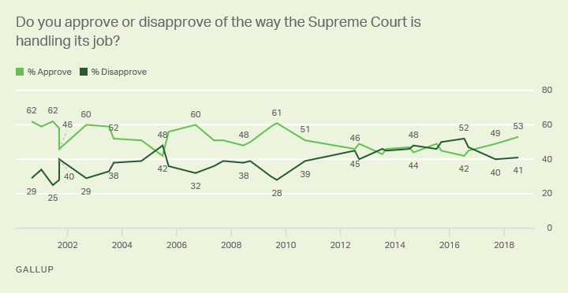

Slide 3
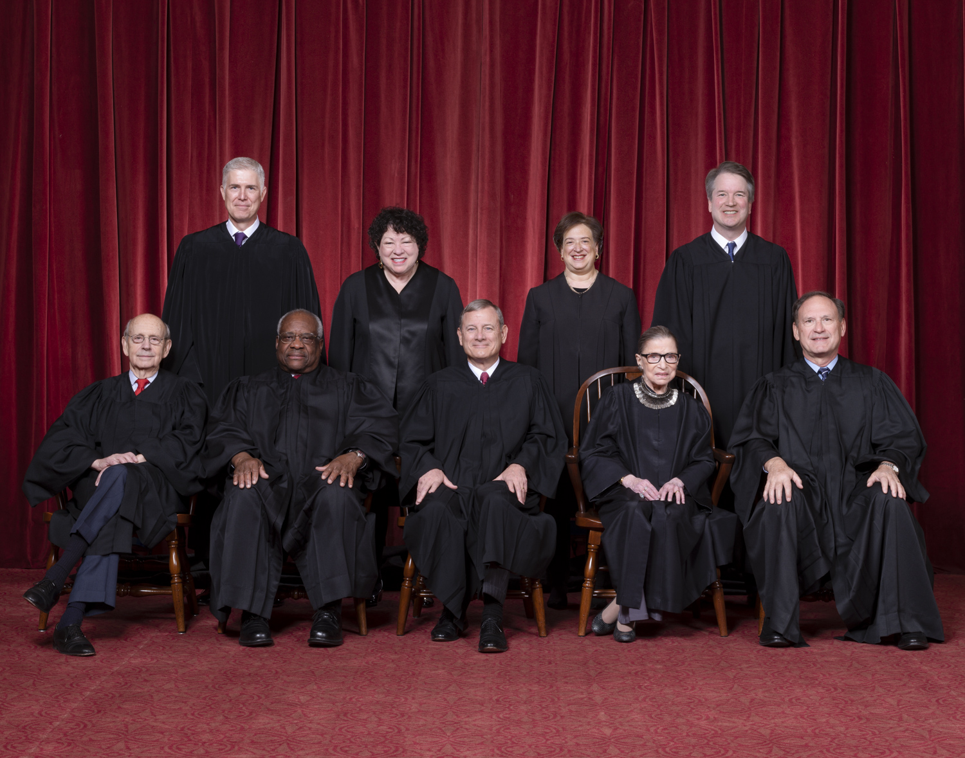
Notes:
Current court

Slide 4
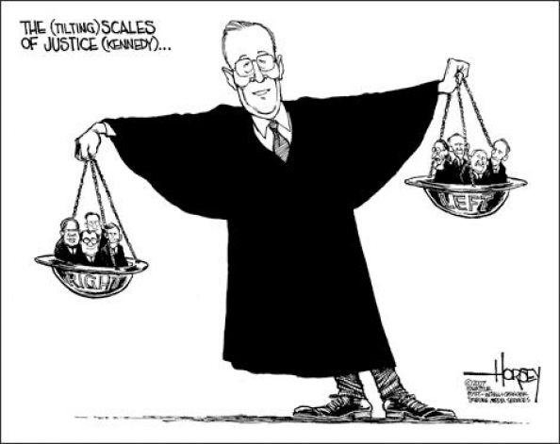
Notes:
Controversy was so great because Anthony Kennedy was the swing vote

Slide 5
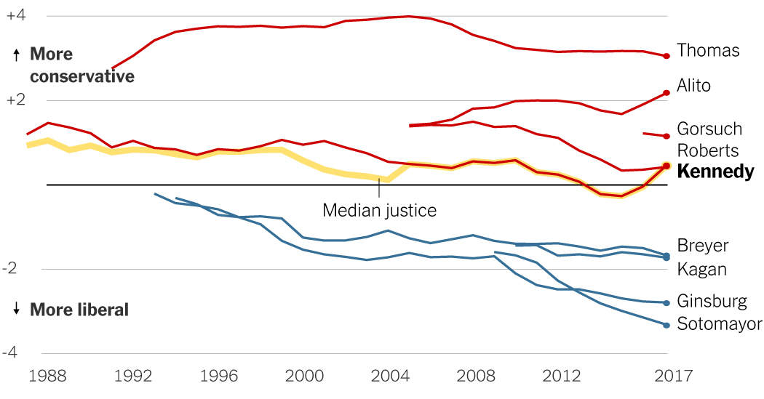
Notes:
He was right in the middle, now it appears Justice Kennedy will be

Slide 6
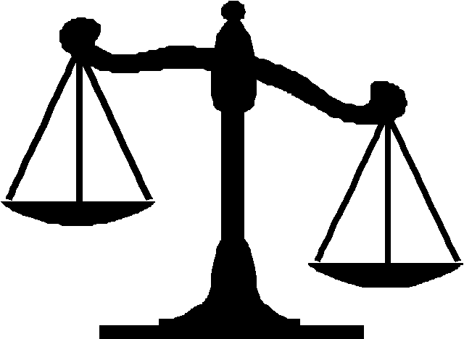
Judicial Appointment
With a partner, complete the “Choosing a Supreme Court Nominee” exercise. Use the words of the Constitution on the back to guide you…
* this is all the Constitution says about judges and their qualifications (no there isn’t much)
Notes:
Should take about 20-25 minutes here…eventually you usually have to guide them that there are only two constitutional qualifications…appointment by the pres and approval by the senate (and good behavior)

Slide 7
Considerations
First Term?
Race, Ethnicity, Gender, Religion, Age
Majority Party in Senate
  “political capital”
Ideological (party) Profile
  balance?
Notes:
Have some of them share their paragraphs and what ideas they came up with why?

Slide 8
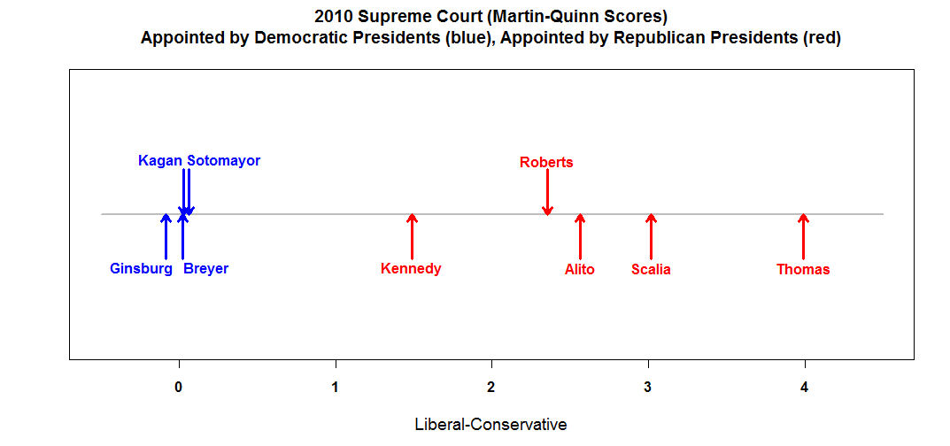
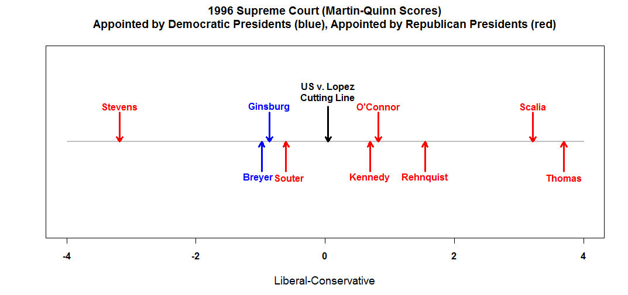
Notes:
On overall scales justices seem more conservative or liberal but on individual cases they may change…see U.S. v. Lopez

Slide 9
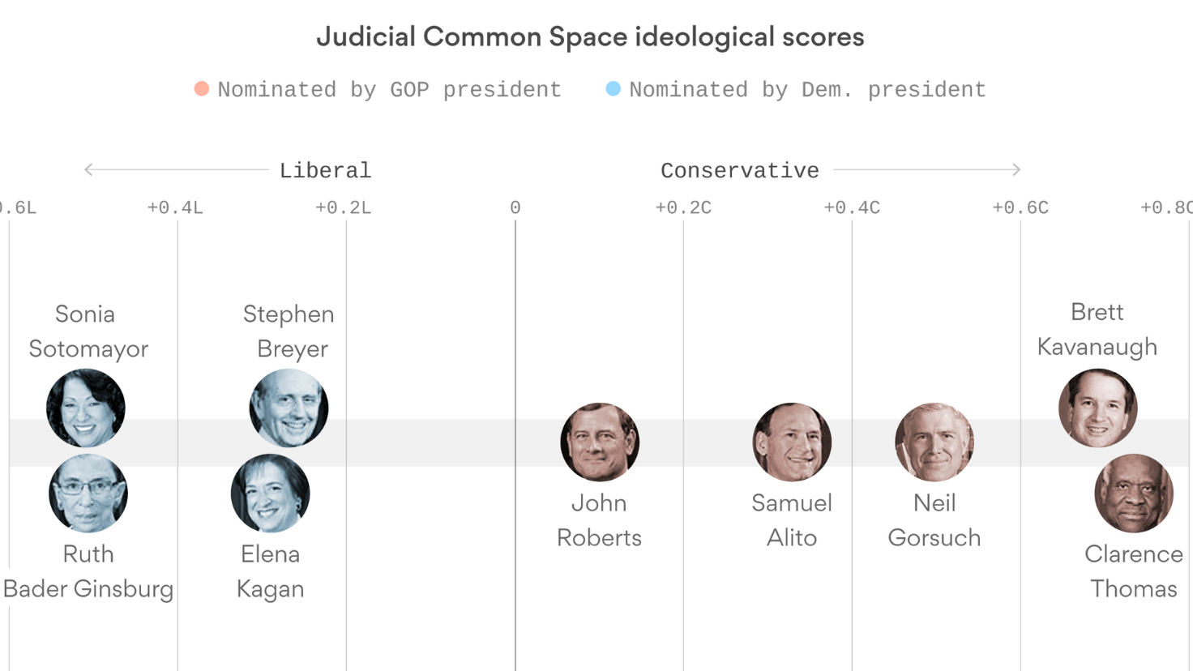
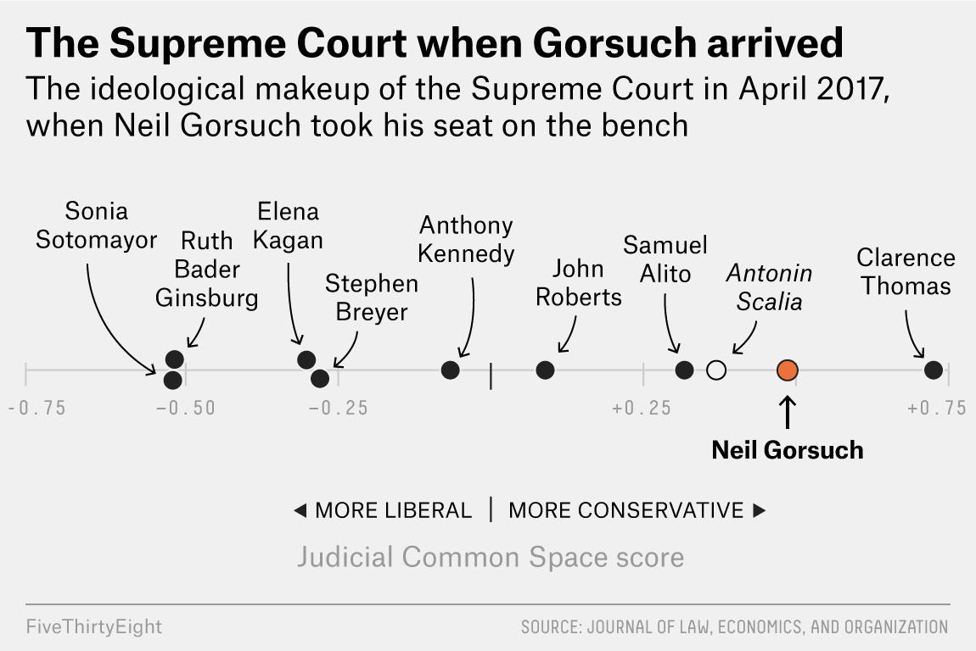
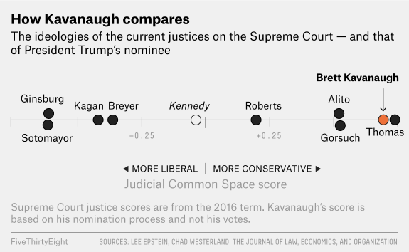

Slide 10
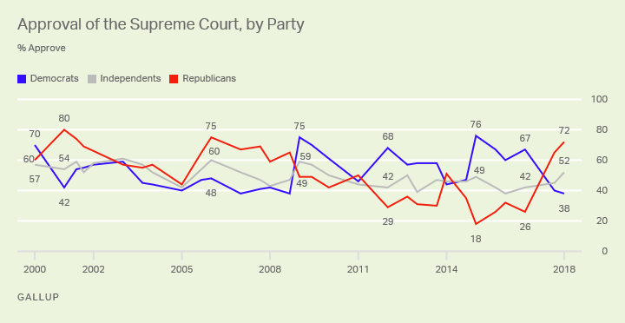
Notes:
Notice public opinion largely follows court decisions (democrats spike after Obergefell v. Hodges – gay marriage)

Slide 11
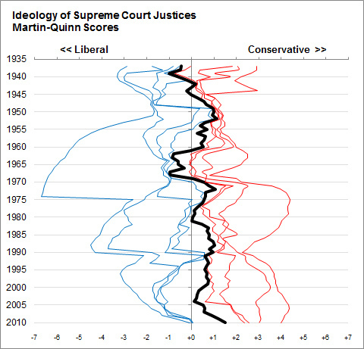
Notes:
We have never strayed too far from the middle

Slide 12
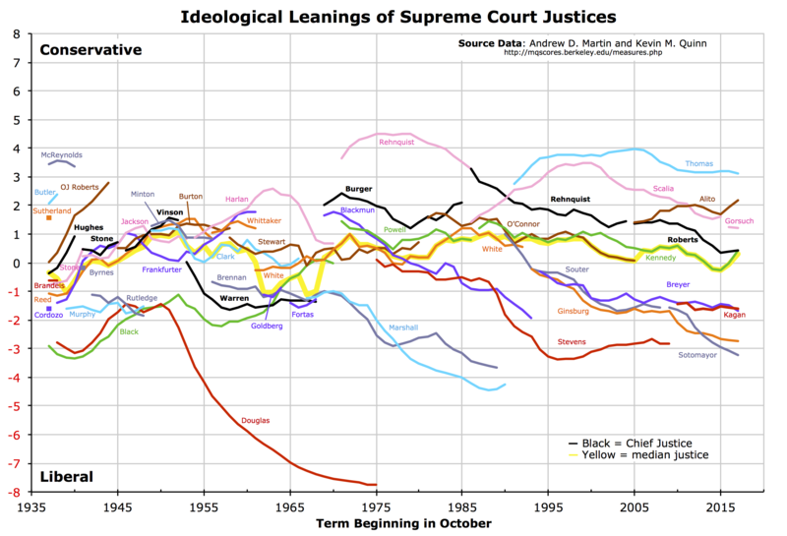

Slide 13
Considerations (cont.)
Support of constituent groups
Professional Qualifications
  Experience
Presidential “Legacy”
Notes:
Other considerations they may not have thought about

Slide 14
Appointment
President appoints judges for ALL federal court vacancies
Senate must confirm all nominations by majority vote (Advice and consent)
Federal judges serve for life (unless they resign)
Notes:
Big things to remember, hint, hint

Slide 15
Appointment
https://abcnews.go.com/Archives/video/robert-bork-nominated-supreme-court-10180043 - Bork - Why does his nomination fail?
Thomas – Why does his nomination succeed?
Notes:
Two videos to use if there is extra time –
Bork – too conservative and fears of abortion
Thomas – draw a parallel with Kavanaugh

Slide 16
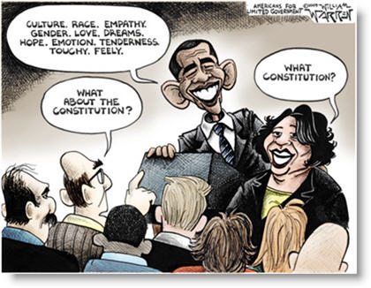

Slide 17
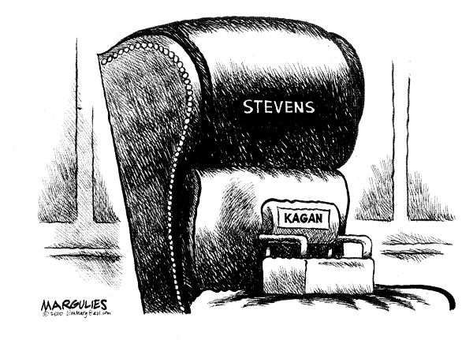

Slide 18
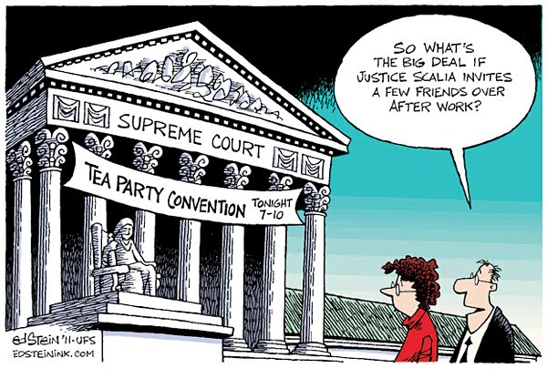

Slide 19
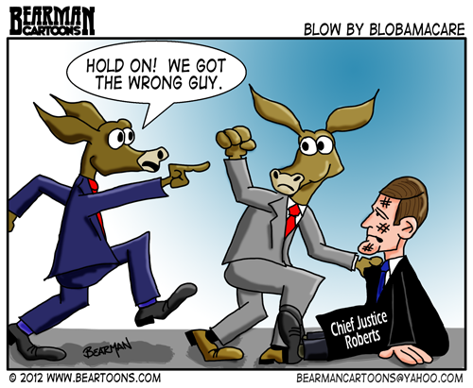

Slide 20
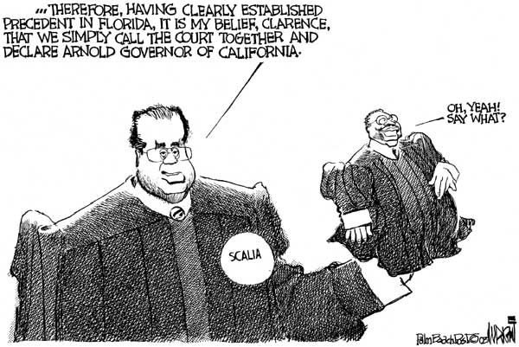

Slide 21
