Slide 1
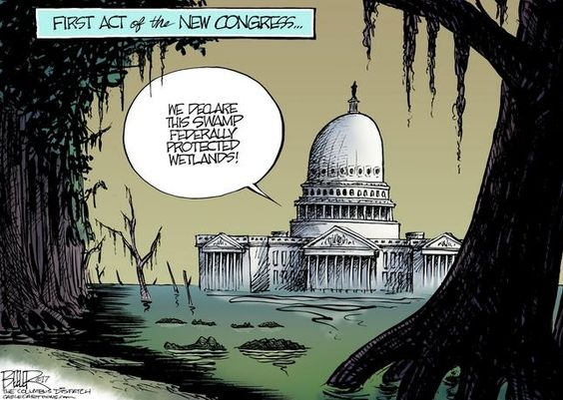
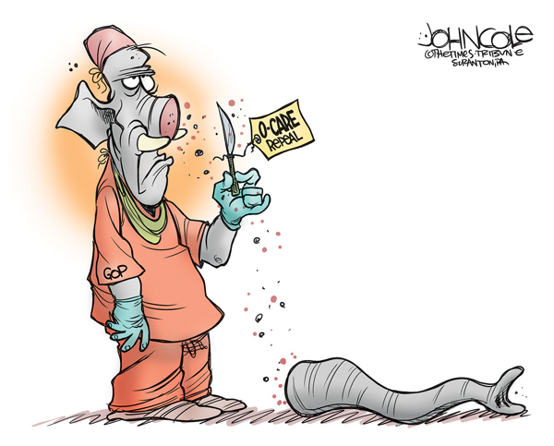
Bellwork 9/26 – Caption ?’s p.127, 129

Slide 2
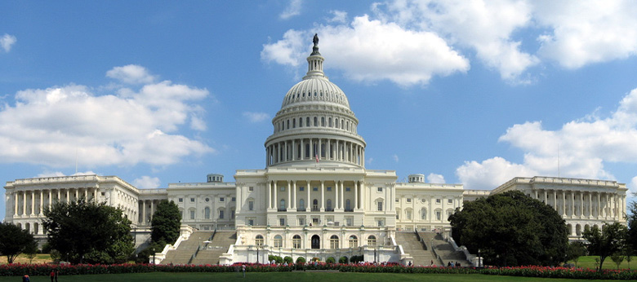
Congress
The Legislative Branch
“…to make the laws and interpret the people’s will.”

Slide 3
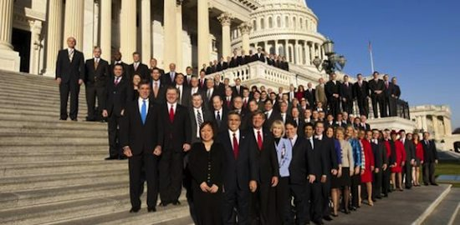
Who are these people???

Slide 4
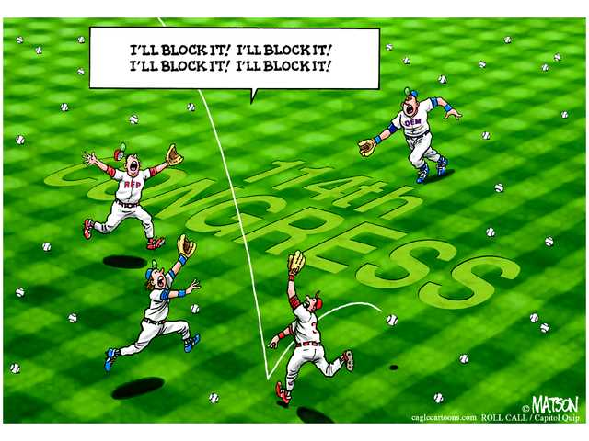
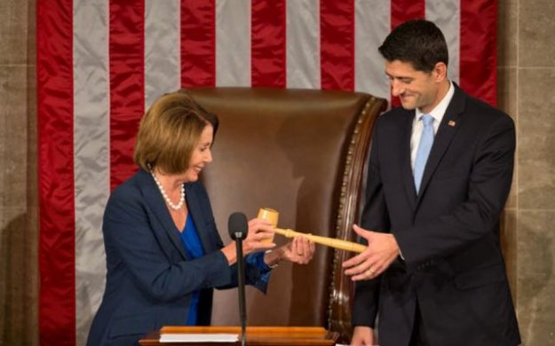
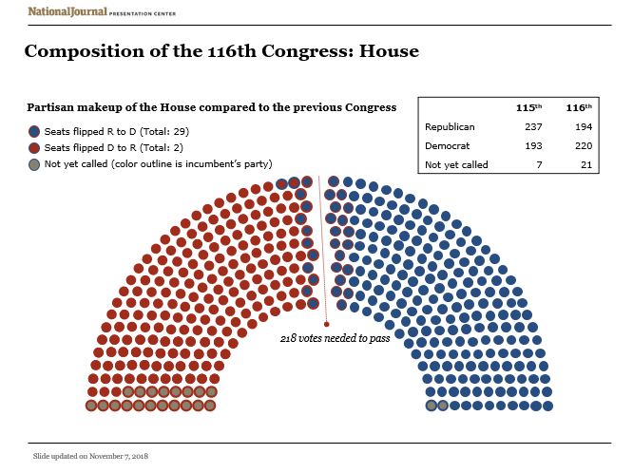
The 116th Congress

Slide 5
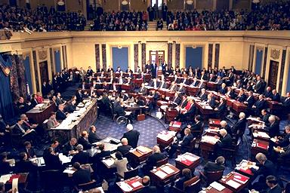
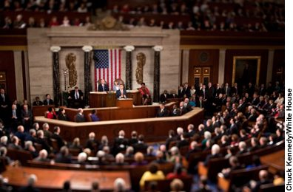
Senate & House of Representatives
“Upper House”
“Lower House”
Why?

Slide 6
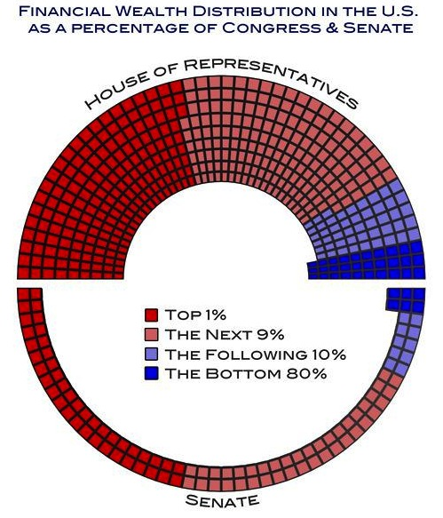
Some Specifics…
Bicameral
Term
Session

Slide 7
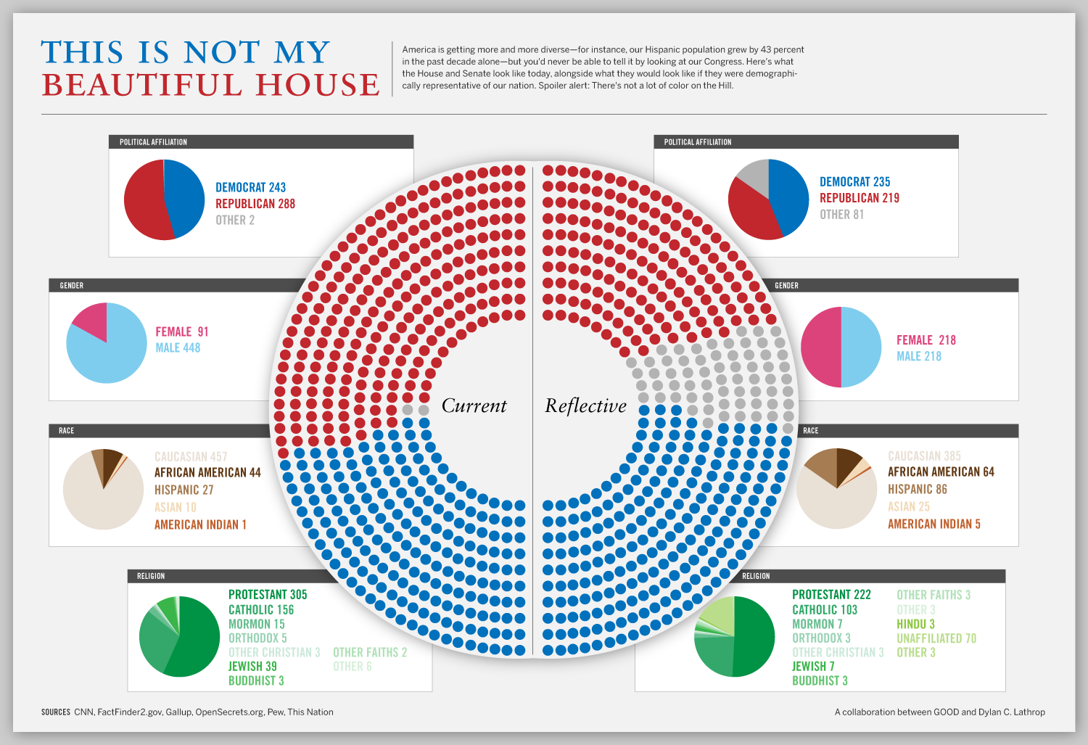
Does Congress Look Like Us?

Slide 8
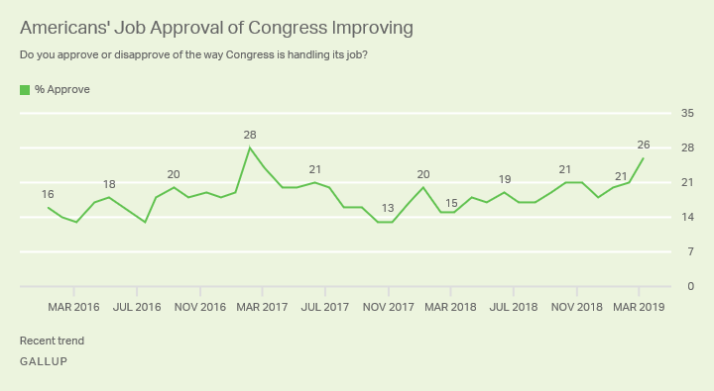
Are they doing a “good job?”

Slide 9
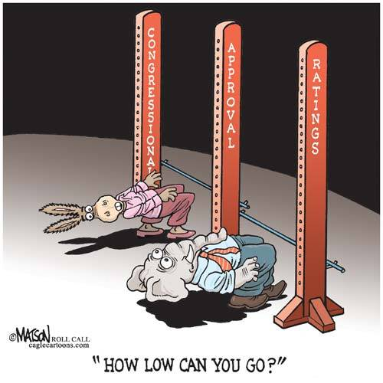
Do We Trust Them?
95% Reelection Rate
Incumbents (the person that currently holds the office) holds a distinct advantage in elections
Why?

Slide 10
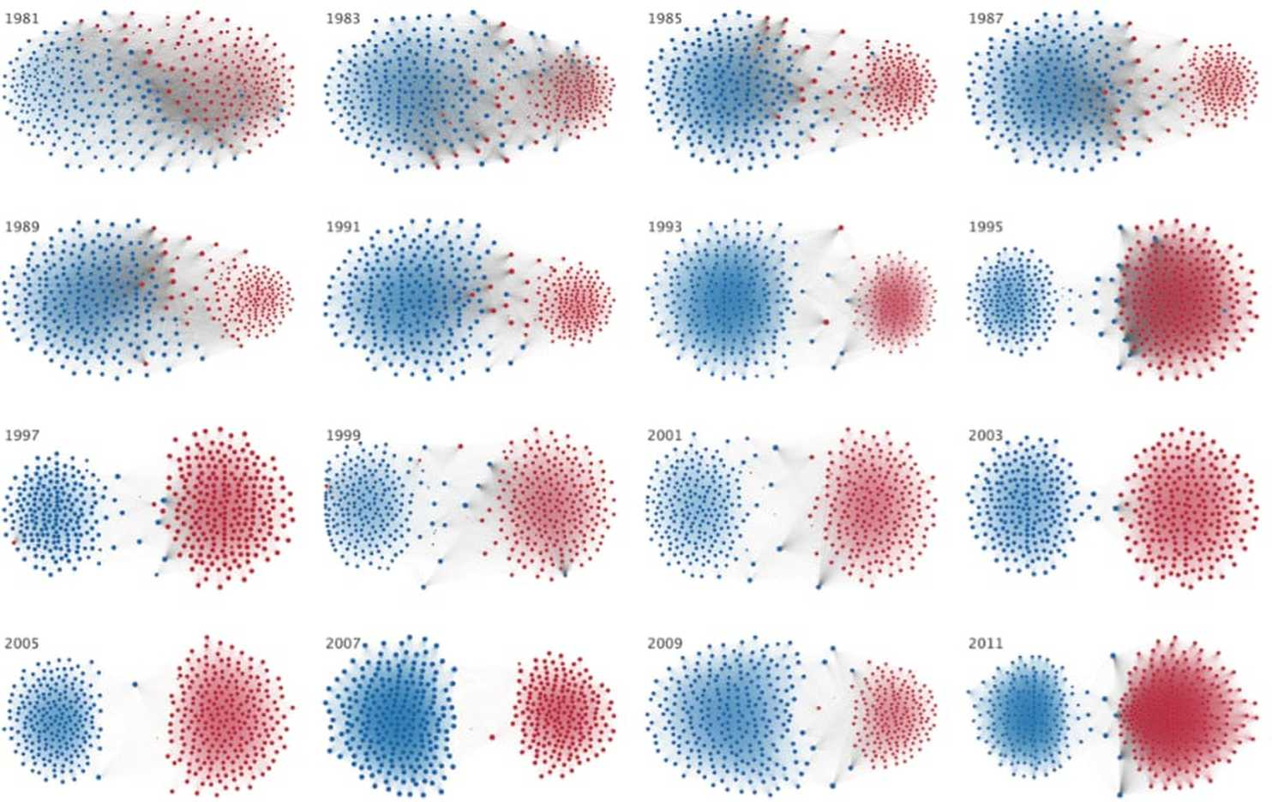
Polarization in Congress

Slide 11
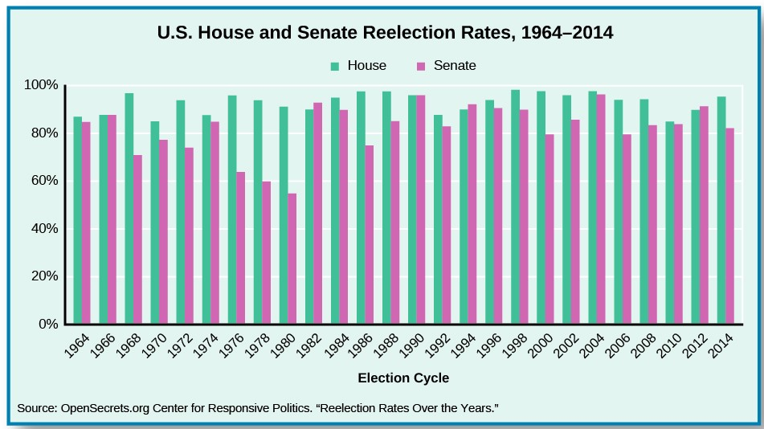
Bellwork 9/27
Read p.129 “Reelection to Congress”
* List advantages incumbents have that result in their frequent reelection.

Slide 12
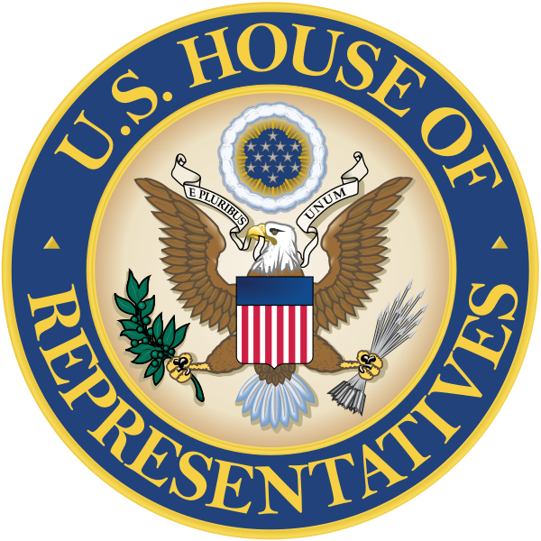
The House of Representatives

Slide 13
Key Numbers
Qualifications:
25 years old
7 years a citizen
resident of the state they represent
Other numbers:
2 year term (unlimited)
435 total representatives

Slide 14
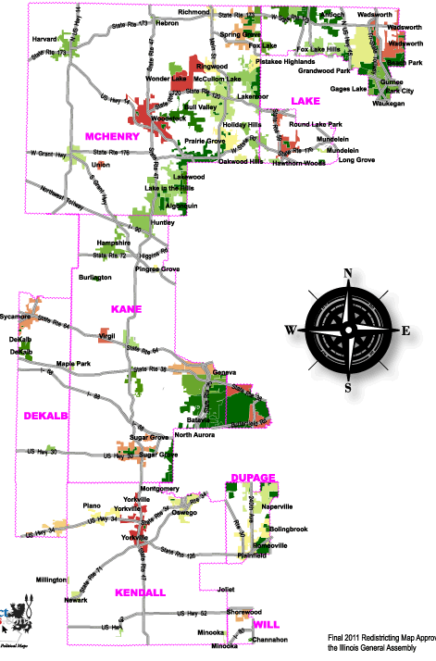

14th District Representative
Lauren Underwood – (D)

Slide 15
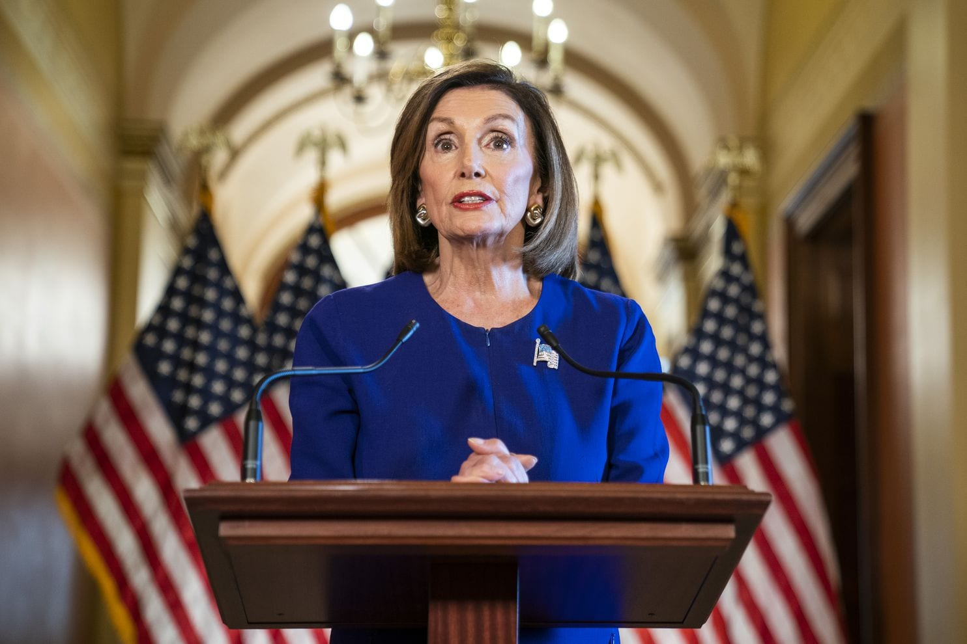
Speaker of the House
Nancy Pelosi- D, CA

Slide 16
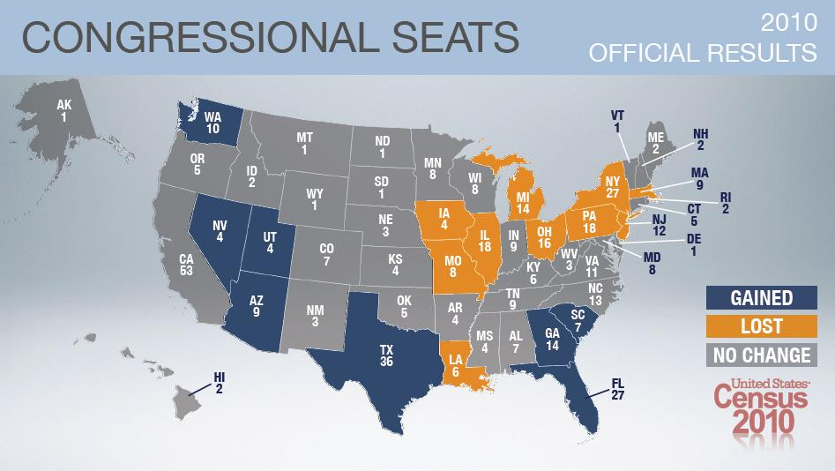
How Many Does Each State Get??
at least one per state (Illinois – 18)
Reapportionment
  census is conducted every 10 years
  Census Bureau reapportions (redistributes) seats
  State legislatures then redistrict (redraw the boundaries) of the district in their state

Slide 17
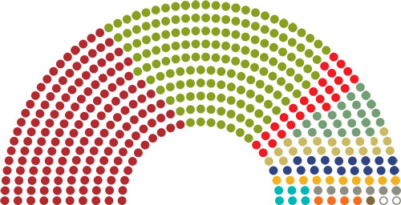
Other House Specifics
All revenue (tax) bills must start here
Impeachment process begins here
Stricter debate rules
House Members by contributing sector:
Dark red –business
Green – finance/real estate
Red – Health
Grey – Agribusiness
Tan – Lawyers/Lobbyists
Gray - Defense

Slide 18

The Senate
Interpreting Political Cartoons p.155

Slide 19
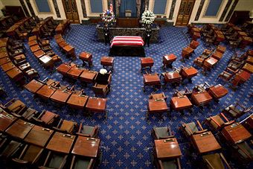
Key Numbers
  30 years old
  9 year citizen
  live in the state they represent
  100 total
  2/state (the Constitution says so)
  6 year terms

Slide 20
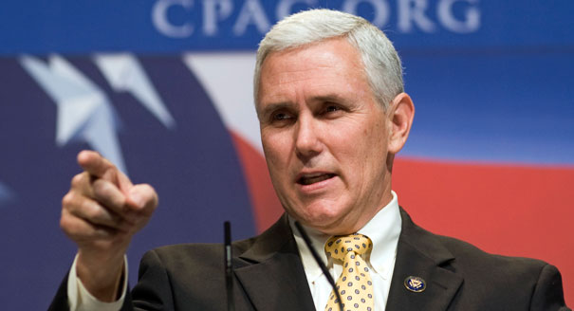
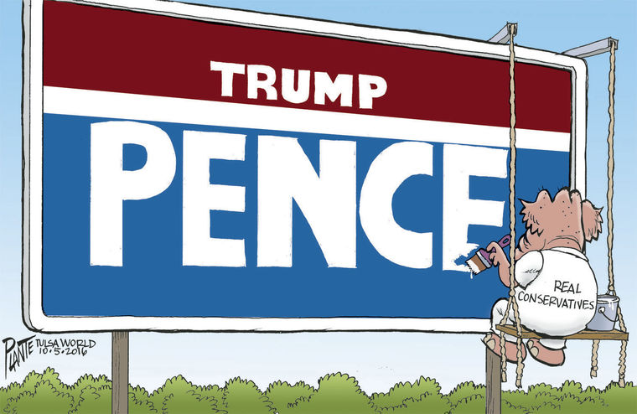

President of the Senate
Vice President – Mike Pence

Slide 21
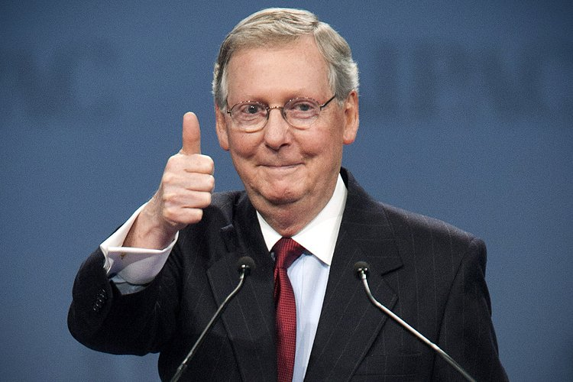
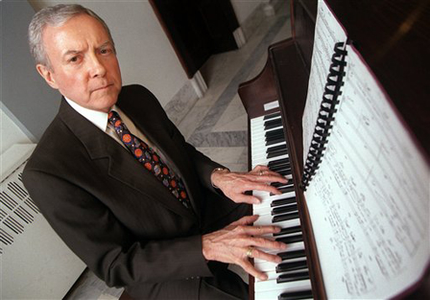
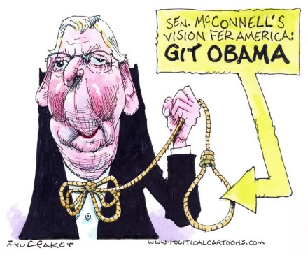
Other Leaders
Senate Majority Leader
Mitch McConnell – R-KY
President Pro Tempore
Orrin Hatch – R-UT

Slide 22
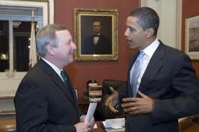
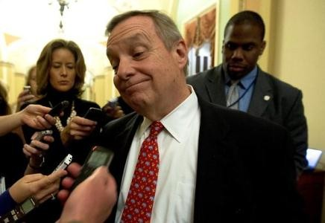
Illinois (Senior) Senator
Richard Durbin - D

Slide 23
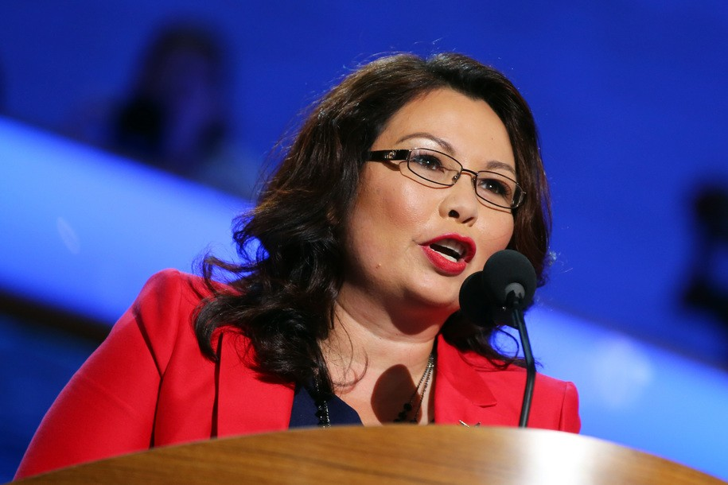
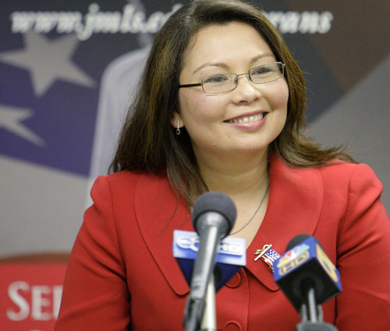

Illinois’ (Junior) Senator
Tammy Duckworth- D

Slide 24
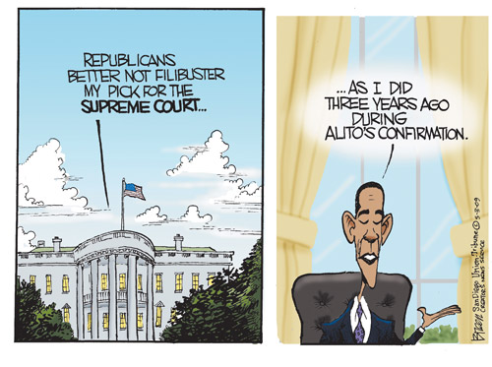
Special Characteristics of the Senate
  Open Debate
    Filibuster (40 votes)
    Holding up a bill’s passage by threatening to speak and holding the floor (formality now)
  Majority has less power than House
  Special Powers:
    ratify treaties
    approve appointments
    try the President (impeachment)

Slide 25

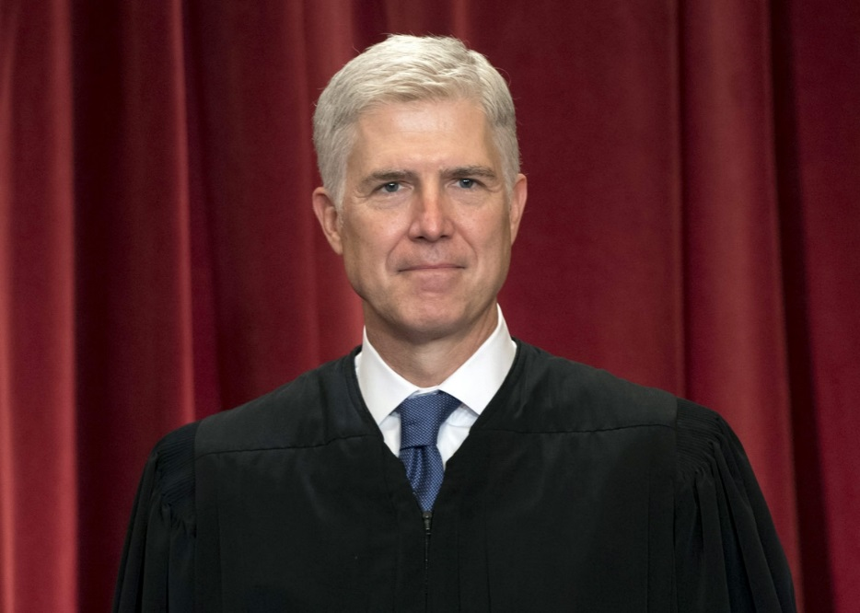
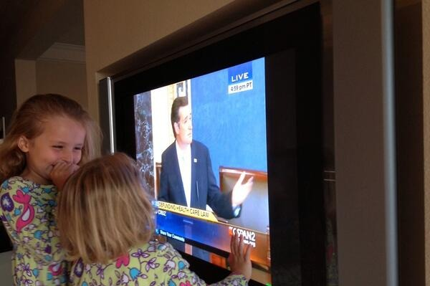
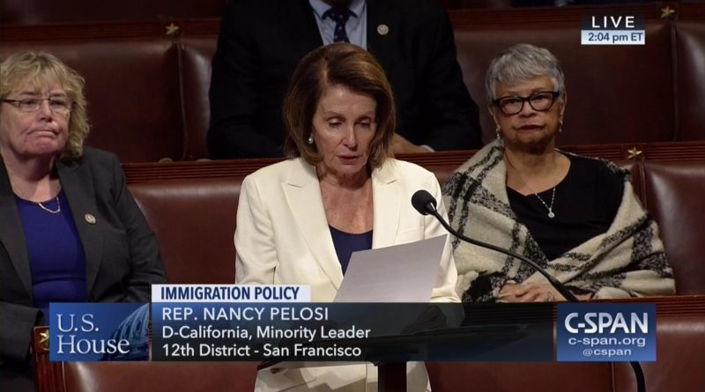
The Filibuster…why?

Slide 26
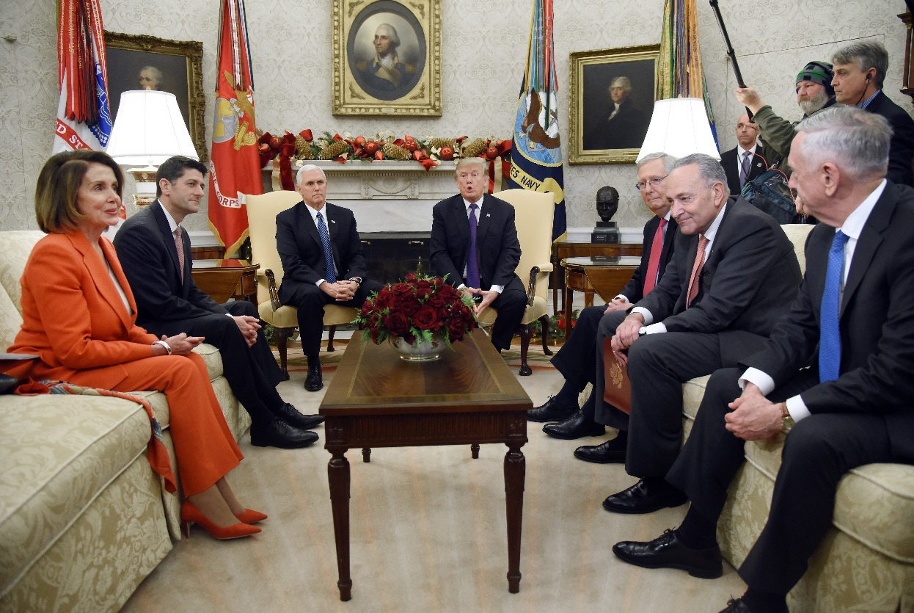
Congressional Leadership
Majority & Minority Leaders
Whips
Committee Chairmen

Slide 27
House & Senate
Compare & Contrast
Use your textbook (5.1) & notes to compare and contrast the House (5.2) & Senate (5.3) in the following categories:
  Qualifications
  # Members
  Terms
  Leaders
  Rules
  Special Powers

Slide 28
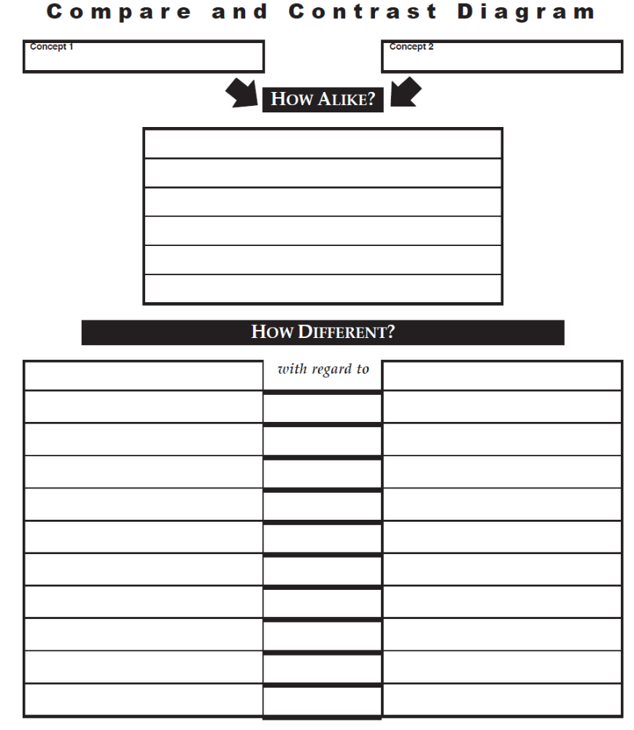
House of Reps
Senate
Qualifications
# Members
Terms
Leaders
Rules
Special Powers

Slide 29
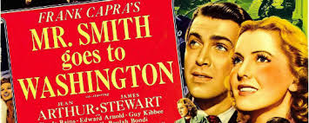
How the Senate Works…
Mr. Smith Goes to Washington

Slide 30
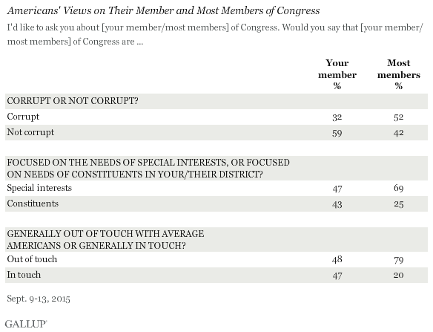
Have things changed?

Slide 31

Discuss…Differences?

Slide 32
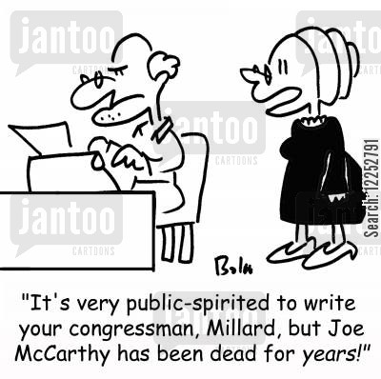

Slide 33
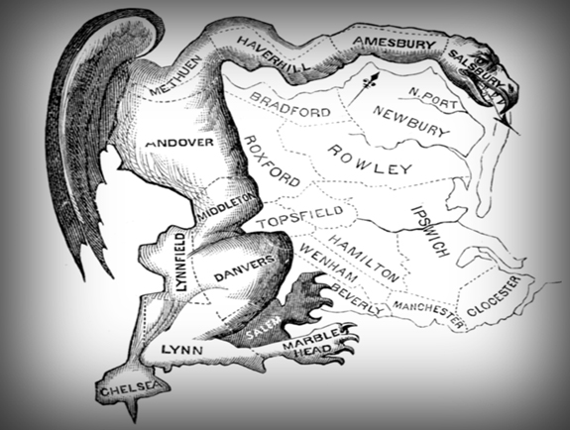
Gerrymandering
drawing district lines to the benefit or detriment of a particular group
  Wesberry v. Sanders
Illegal IF it violates “one person, one vote”
  “Packing & Cracking”

Slide 34
The Rules
Districts must be:
  Compact
  Contiguous
  Not drawn to limit or take away the voting power of citizens

Slide 35


Slide 36
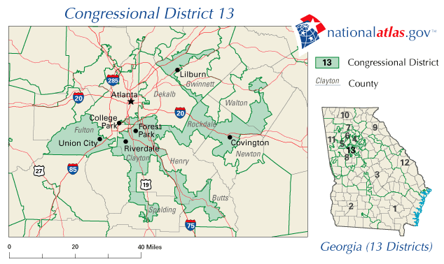
The 13th Congressional District (Amoeba) of Georgia

Slide 37
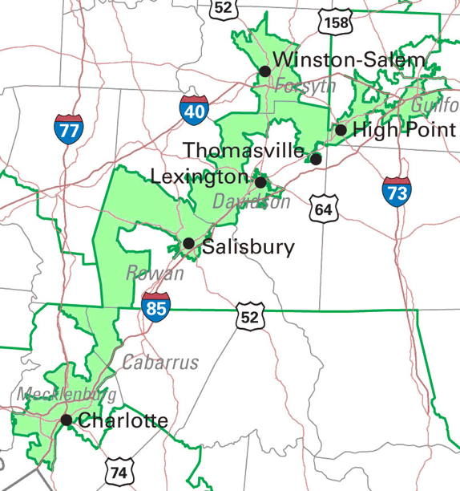
12th Congressional (I-85) District – North Carolina
Notes:
The 12th Congressional District in North Carolina, as put in place for the 1992 election, is perhaps America's best known congressional district. (The original Massachusetts "gerrymander" in 1812 may be more famous, but it was a legislative district.) North Carolina's 12th was a kind of in vitro offspring of an unromantic union: Father was the 1980s/1990s judicial and administrative decisions under the Voting Rights Act, and Mother was the partisan and personal politics that have traditionally been at redistricting's core. The laboratory that made this birth possible was the computer technology that became available for the 1990s redistricting cycle. The progeny won no Beautiful Baby contests. A Wall Street Journal editorial described the 12th as "political pornography." Known as the "I-85 district," the12th stretched 160 miles across the central Piedmont region of the State, for part of its length no wider than the freeway right-of-way.
The 12th Congressional District triggered redistricting law's major innovation of the 1990s, the "Shaw Doctrine."
Shaw Doctrine
On the basis of these opinions, the currently applicable standards appear to be:
It is permissible to be aware of race in the districting process and to consider issues of race.
Race, however, may not be the predominant factor in the redistricting process to the subordination of traditional districting principles.
Districts are not necessarily unconstitutional because they have odd shapes; however, a bizarre shape may be evidence that strongly suggests that race was the predominant factor driving the districting decision.
If race was the predominant consideration in the districting decision, the districts are subject to strict scrutiny analysis and the governmental body must demonstrate that they are a narrowly tailored means of addressing a compelling governmental interest.
Compliance with Section 2 of the Voting Rights Act is a compelling governmental interest.
The Court has been willing to assume that compliance with Section 5 of the Voting Rights Act is a compelling governmental interest, but it has never been required to decide the issue.
Districts drawn to comply with Sections 2 or 5 must be narrowly tailored. That means, among other things, that they use race no more than is necessary.
Compliance with Section 5 does not mean doing whatever the Department of Justice requires in order for it to preclear a districting plan. Essentially, the Supreme Court found that DOJ had required jurisdictions to do more than the law permitted. In those instances, a governmental body could not rely on the necessity of complying with DOJ's Section 5 preclearance requirements as a justification for a race-based decision.

Slide 38
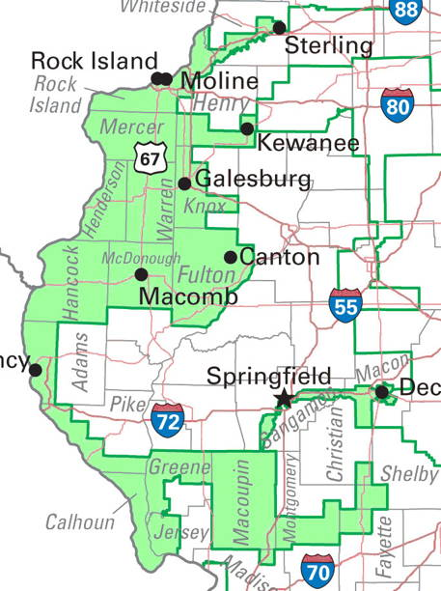
Illinois’ (old) 17th District
(rabbit riding a bicycle)

Slide 39
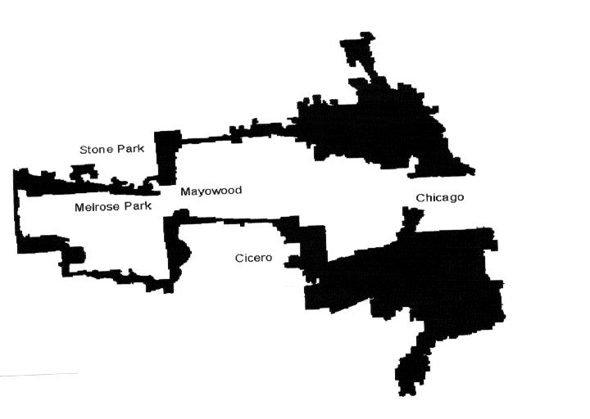
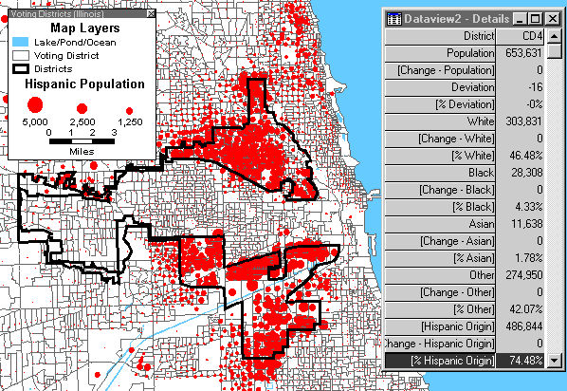
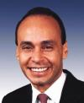
4th Congressional (Earmuff) District - Illinois
Rep. Luis Guitierrez
Notes:
District Demographics
· 49% white; 6% black; 3% Asian; 64% Hispanic
· Hispanic district, surrounding a black district (the 7th)
After Shaw was decided in 1995, the federal district court approved plan fell under scrutiny again. Specifically, the 4th congressional district, a majority Hispanic district, was challenged as an unconstitutional racial gerrymander. The court decided that although the district was indeed a racial gerrymander, it served the compelling interest of the state of Illinois in redressing past vote dilution of Hispanic voters.

Slide 40
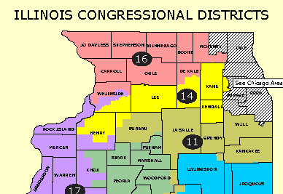
2002-2012

Slide 41
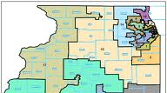
2012-2022

Slide 42

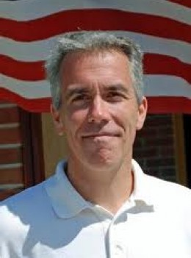
Which meant…..
vs
Randy Hultgren (R)
14th Congressional District
Joe Walsh (R)
8th Congressional District

Slide 43
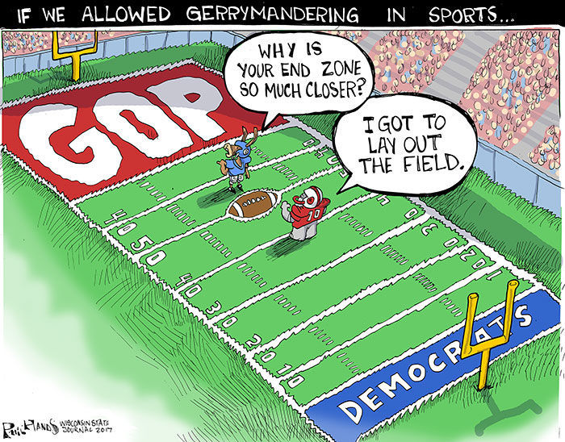

How to End Gerrymandering in Illinois
What are the negative effects of gerrymandering in Illinois?
What constitutional principles are present in this situation? Name at least one.
Partisan – prejudiced in favor of a particular case

Slide 44


