Slide 1
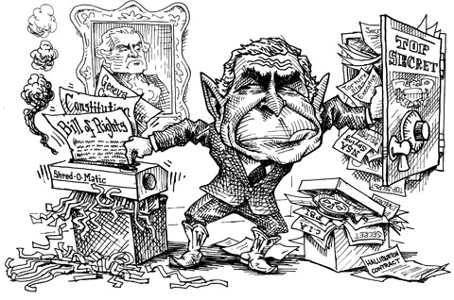
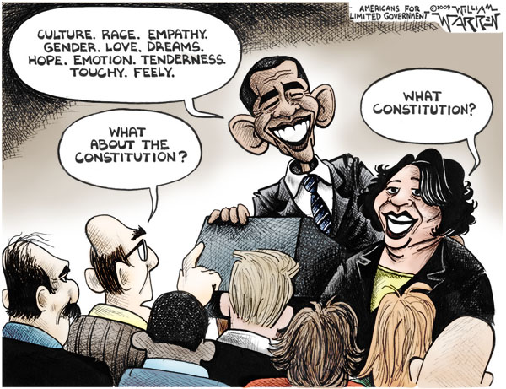

Slide 2
Structure of the Constitution
Preamble (goals)
Article I – Legislative Branch
Article II – Executive Branch
Article III – Judicial Branch
Article IV – Relations Among States
Article V – Amendment Process
Article VI – National Supremacy
Article VII – Ratification
Amendments
L.E.G.

Slide 3
“Subsections”
Article
Article I Legislative Branch
Section
Section 8
Powers of Congress
Clause
Clause 18
Elastic Clause (Necessary & Proper)
p.62

Slide 4
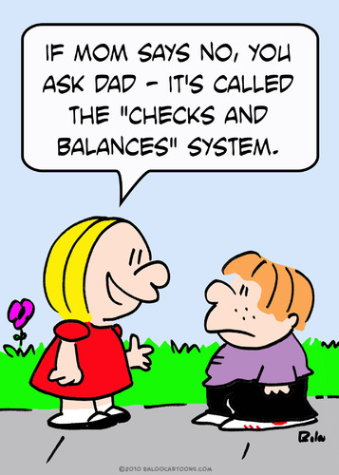
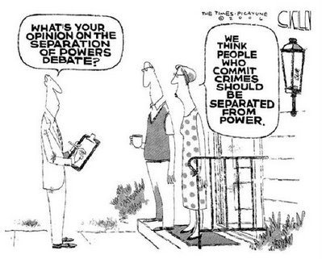
Principles of the Constitution?

Slide 5
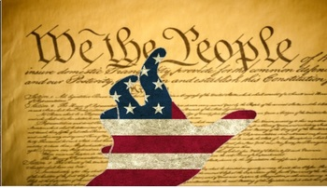
Power Grab GAME

Slide 6
Round 1
President - A serious economic crisis takes place in the U.S. President Obama decides to run for a third term. (Amendment)
Amend 22
Congress - Congress passes a law taking 10% on lumber being exported. (Article I)
Article I, Section 9, Clause 5
Courts - The Court rules that the government may not issue patents because of the need for technological advance. (Article I)
Courts- Article I, Section 8, Clause 8
Notes:
Pres. Amend 22
Congress Article I, Section 9, paragraph 5
Courts- Article I, Section 8, paragraph 8

Slide 7
Round 2
President – President Trump declares war on North Korea. (Article I)
Congress - Congress passes a law that people from Idaho may not drive cars in Oregon because of pollution. (Article IV)
Courts - Since Washington D.C. is not in any state, residents there may not vote in national elections. (Amendment)
Notes:
Pres. – Art. I, Sec. 8, Par. 11
Congress- Art. IV, Sec. 2, par. 1
Courts- Amend. 23

Slide 8
Round 3
President – President Bush appoints LeBron James to Senator McConnell’s seat when he resigns due to a personal scandal. (Article I)
Congress - Congress impeaches President Obama because he pardons Lindsay Lohan. The Republican Congress uses their anger to impeach him. (Article II)
Courts - The Court rules that because of our large national debt, the U.S. can no longer borrow money. (Article I)
Notes:
Pres. – Art. 1, Sec. 3, par. 2
Congress – Art. II, Sec. 4
Courts- Art. I, Sec. 8, par. 2

Slide 9
Round 4
President - To fight terrorism, the Attorney General decrees anyone found guilty of hijacking will be punished by having their fingernails ripped off. (Amendment)
Congress - Congress decides that beards are illegal; anyone who wore one in the last year must pay a $100 fine. (Article I)
Courts - The Court decides that religion and politics don't mix, therefore no government official is required to take an oath of office. (Article II or Article VI)
Notes:
Pres.- Amend. 8
Congress- Art. I, Sec. 9, par 3
Courts – Art. II, Sec. 1, par. 8 or Art. VI, Sec. 3

Slide 10
Round 5
President - The President decides that Congress will meet in regular session on December 15 of each year. (Amendment)
Congress - Congress decides to impeach President Trump with the President Pro-Tempore of the Senate presiding. (Article I)
Courts - The U.S. ambassador to Spain is brought home and tried in a New York court for crimes. (Article III)
Notes:
Pres. – Amend. 20, Sec. 2
Congress- Art. 1, Sec. 3, par. 6
Courts- Art. III, Sec. 2, par. 1

Slide 11
Round 6
President - The President orders that a mass murderer be sent back to Illinois from Indiana. (Article IV)
Congress - A House member dies, the House takes four days off to mourn but the Senate says they can only have two days off. (Article I)
Courts - The Court rules that the heads of departments may no longer make appointments of inferior officers, but only the President of the U.S. may. (Article II)
Notes:
Pres. – Art. IV, Sec. 2. par. 2
Congress – Art. I, Sec. 5, par. 4
Courts- Art. II, Sec. 2, par. 2

Slide 12
Round 7
President –Kim Kardashian comes to Chicago and cuts off the heads of all parking meters. President Obama pardons her. (Article II)
Congress - Congress passes a law naming 15 university students guilty of crimes against the government - orders them to be imprisoned. (Article I)
Courts - A male teacher sues over sexual discrimination by taking the case directly to the Supreme Court. (Article III)
Notes:
Pres. Art. II, Sec 2, par. 1
Congress- Art. I, Sec. 9, par. 3
Courts- Art. III, Sec. 2, par. 2

Slide 13
Round 8
President - Your land is in the way of a federal highway, so the President takes your land without compensation. (Amendment)
Congress - Congress passes a law that says you can sue your state in federal court. (Amendment)
Courts - The Court rules that income tax is illegal and you don't have to pay. (Amendment)
Notes:
Pres. Amend 5
Congress- Amend 11
Courts – Amend 16

Slide 14
Round 9
President - The President orders that since all citizens over 18 want to vote for the President, they may do so by popular vote. (Amendment)
Congress - Congress decides because of the contributions of Jim Thome in baseball & charity, they will honor him with the title, "Sir James". (Article I)
Courts - The Court rules that because of the difficulty of finding honest, law abiding citizens, they will allow Senator Tammy Duckworth to be Secretary of Interior as well as Senator from Illinois. (Article I)
Notes:
Pres. – Amend 26
Congress- Art. I, Sec. 10, par. 1
Courts- Art. I, Sec. 6, par. 2

Slide 15
Round 10
President - The President, concerned about gun violence in the state of Illinois, allows the Governor and Attorney General to suspend democracy for a period of one month. (Article IV)
Congress - Congress decides to change the Constitution to allow the President to be elected to one term of six years. (Article or Amendment)
Courts - The Courts find Benedict Arnold guilty of treason on the basis of testimony of George Washington alone. (Article III)
Notes:
Pres.- Art. IV, Sec. 4
Congress- Art. IV or Amend. 22
Courts- Art. III, Sec. 3, par. 1

Slide 16
