Slide 1
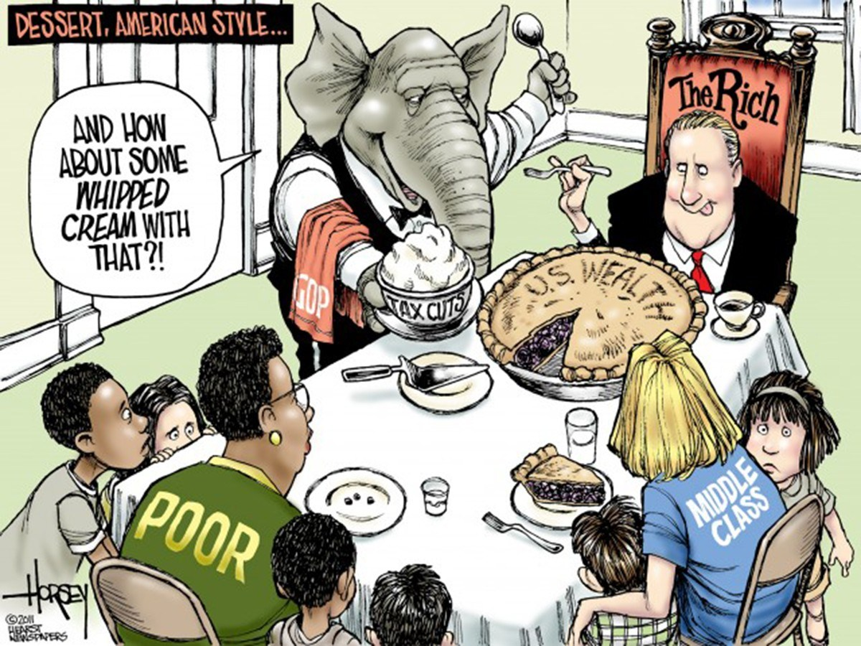
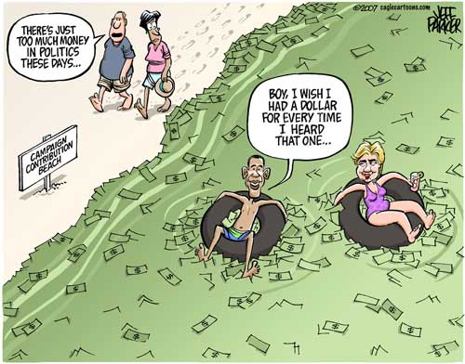
CAMPAIGN FINANCE:
What are the rules, regulations, and policies regarding money in politics?

Slide 2
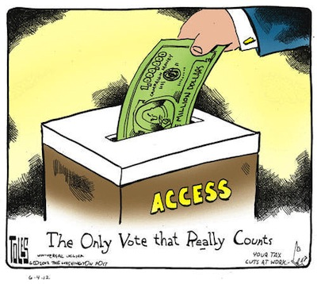
Bellwork 11/28
Interpreting political cArtoons p. 525

Slide 3
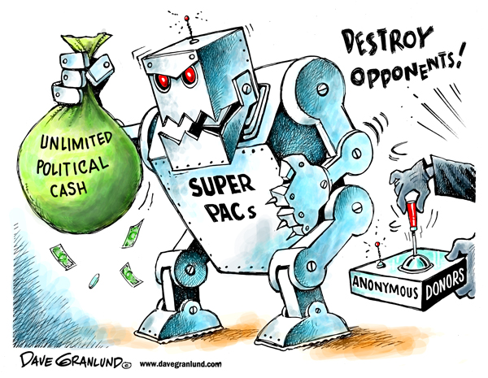
The Rise of super pacs… (Reading)
Notes:
Today we are going to continue to look at how money influences politics….begin by reading, highlighting/annotating and answering questions individually….
* Review answers with students…

Slide 4
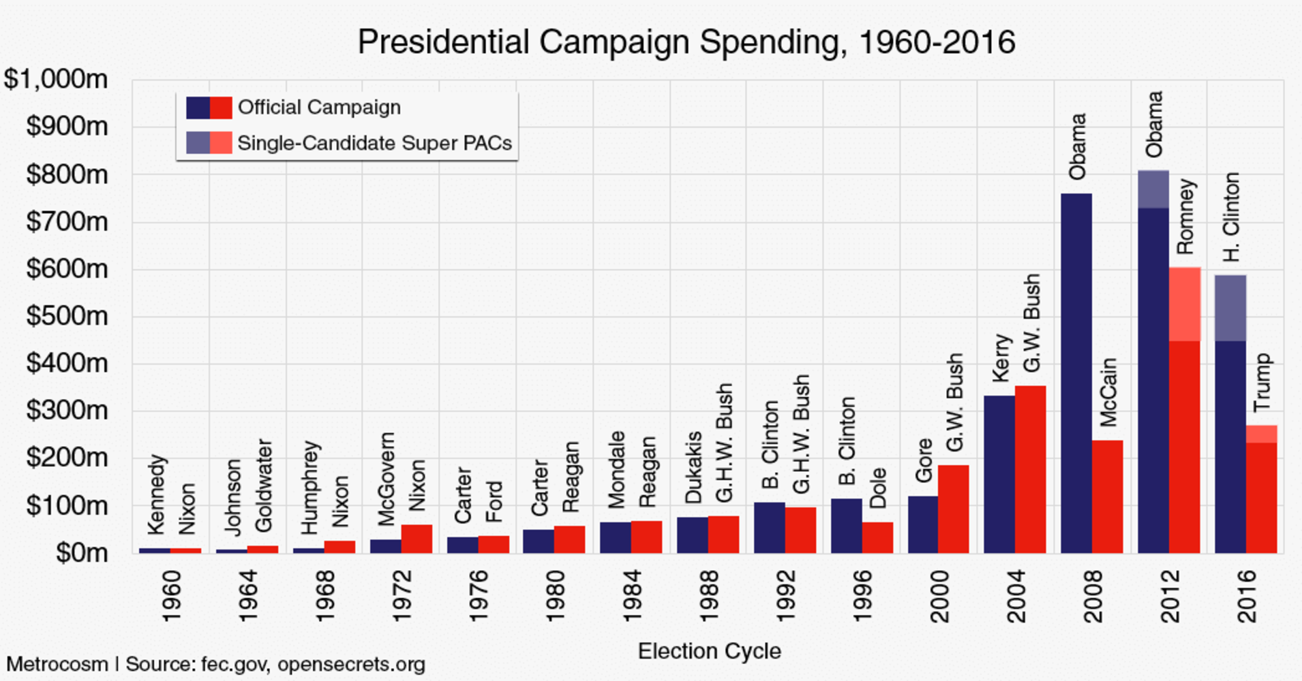
Campaign Finance
Notes:
Elections are becoming more and more expensive….

Slide 5
Campaign Finance
Essentials to understand:
  What is the FEC and what does it do?
  What are PACs?
  Why is Citizens United vs. FEC important?
  What are Super PACs?
Notes:
It is impossible to understand everything about campaign finance but…if you understand these four things you can be an effective citizen…

Slide 6

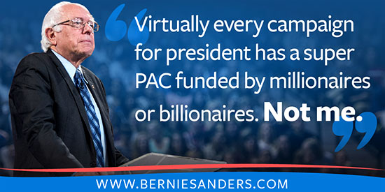
Campaign finance…
It’s so ridiculous it’s funny
It’s a huge problem
Notes:
Videos are hyperlinked, if not, saved to: staff shared – social studies – government

Slide 7

FEC
Federal Election Commission
Keeps elections “fair”
monitors money flow in (campaign donations) and out (spending)
  Disclosure
Contribution limits
Notes:
* Disclosure means that campaigns have to say where there money came from and is going to…they monitor regulated money

Slide 8
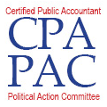



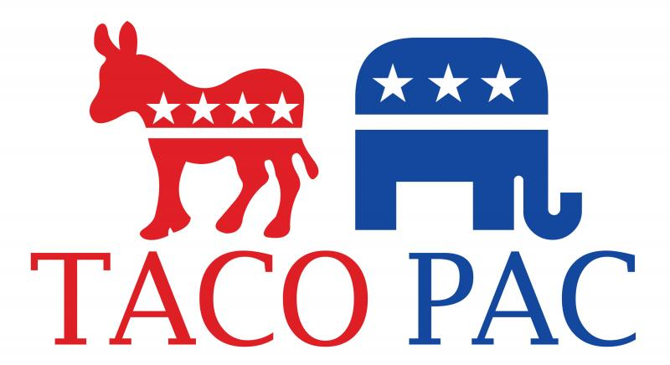

Political Action Committee (PAC):
  Officially registered fund-raising organization that
  Limited (direct) spending
  Represent & affiliated with candidates, interest groups & parties
Notes:
PACS are regulated by the FEC, they deal with money but that money is regulated and we know where it’s from and going to

Slide 9
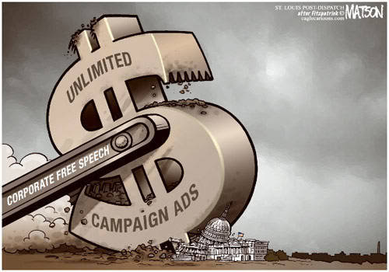
Citizens United v. FEC (2010)
SCOTUS DECISION:
Political = free speech
Corporations & unions can spend money to support or denounce candidates
No limit on uncoordinated spending
Upheld bans on direct contributions to candidates
Notes:
Citizens United changes everthing…PACs and the FEC still exist but uncoordinated spending leads to the rise of….Super PACs

Slide 10
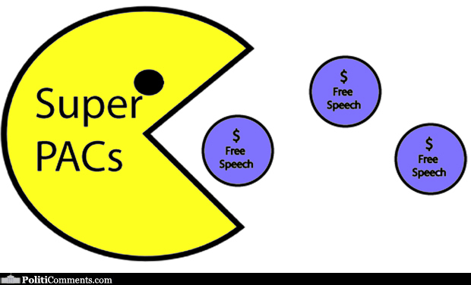
Super PACs
raise and spend unlimited $ for or against candidates
prohibited from donating $ or coordinating directly with campaigns
Less transparency
Notes:
Now much more money being spent and we know less of where it is coming from or where it is going…

Slide 11
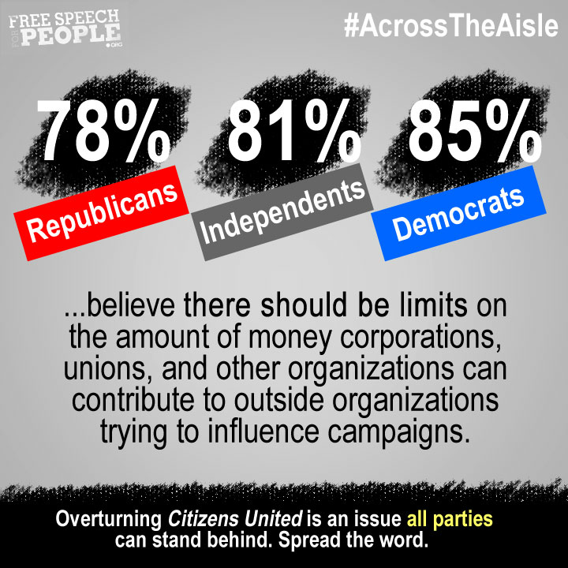
Notes:
Most people are against citizens United…and want limits on spending….

Slide 12

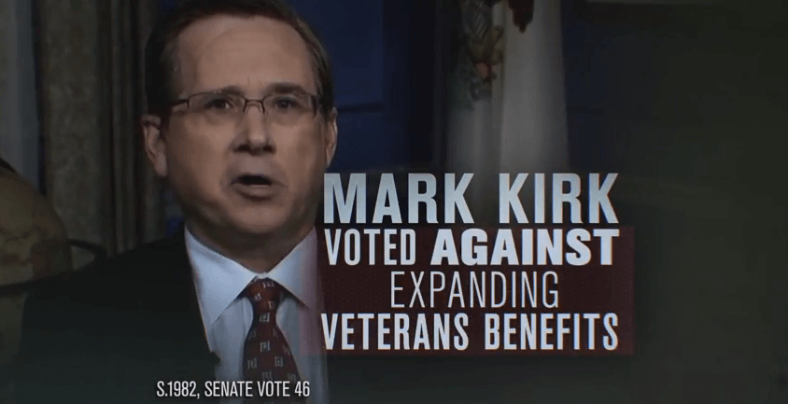
How do I know?!!
Notes:
You can tell who paid for an add by paying attention to commercials or researching but of course most people don’t….

Slide 13
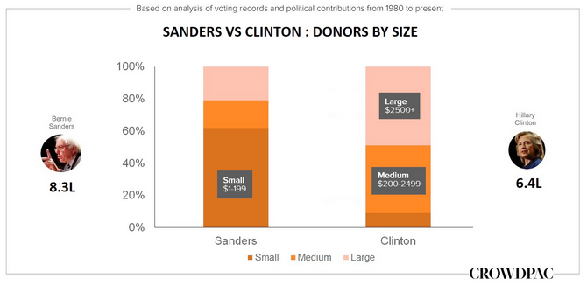
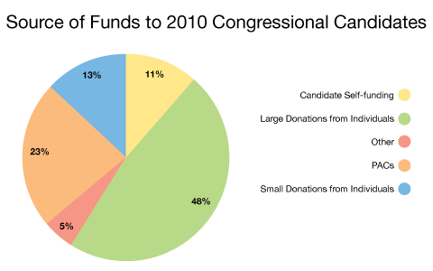
“Small donors make good press, big donors get you elected.”

Slide 14
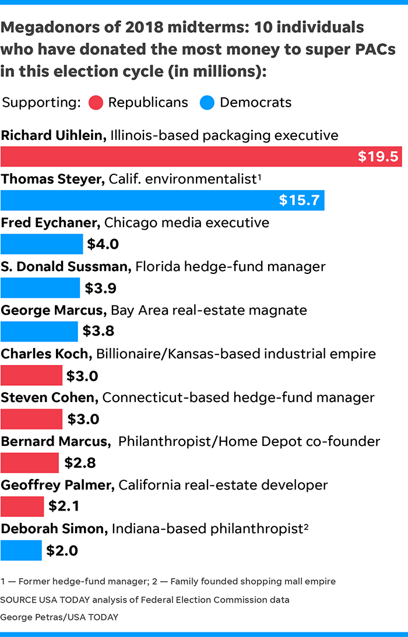
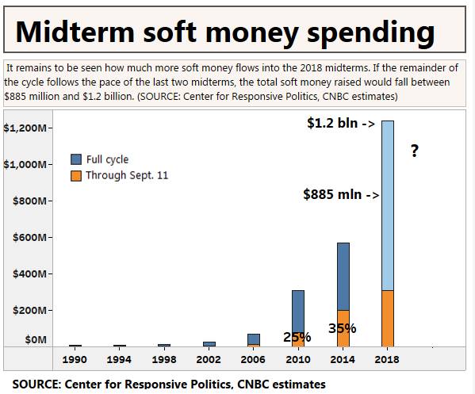

Slide 15
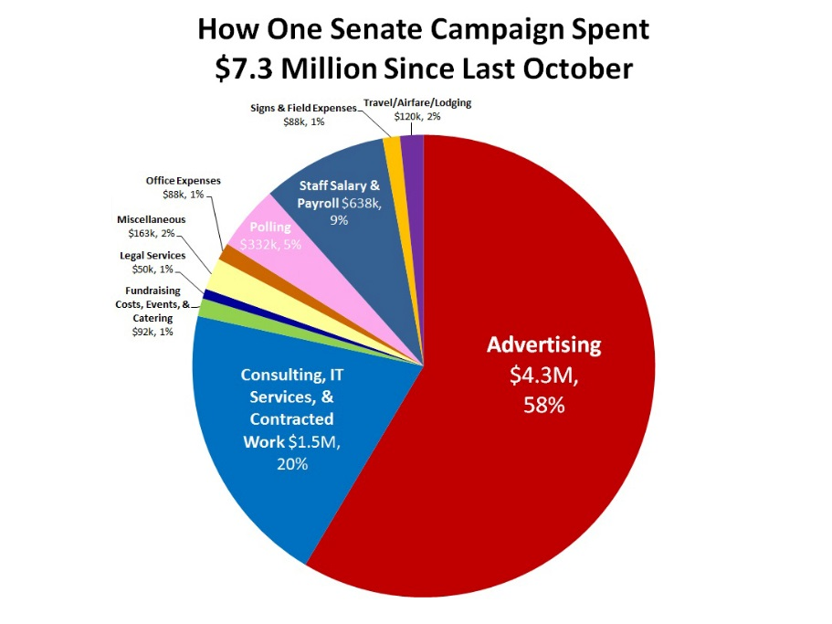
Breakdown of campaign spending

Slide 16
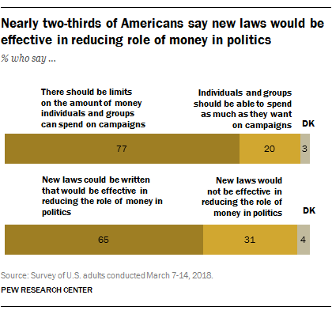
PEW ReSEARCH CENTER POLL…
Notes:
Next four slides just wrap up with the tendencies and/or identifying the main point of the graphics….just how much money is now involved in politics…..and it diminishes American’s trust in government…

