Slide 1
Bellwork 10/7:
List three qualities/attributes which you believe a President should possess and explain why.
Notes:
Discuss these when they are done, the point is to see that there are a lot of things that we look for in a President.

Slide 2
SET CARD # | A | B | C | D
1
2
3
4
What characteristics mattered the most to you? Why?
Which card was the MOST qualified? Why?
Notes:
Make this chart in their notebook. They will use card sets (in the second cabinet next to the desk) to rank each set 1 thru 4 as to who would be the best qualified to be president and who would be the least…then they take the best from each set to determine their overall number 1.
For instance I think A1 is the best in that set, B3 the best in that, C4 and D1; then I take those four and determine which one of those is best…then answer questions.
Students should form groups of four to share card sets.
Discuss who they though was best and why.
Groups are together JUST TO SHARE card sets not to make decisions together, this is individual decision, group sharing of resources.

Slide 3
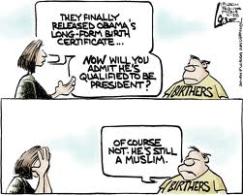

Slide 4
Informal Qualifications:
Age?
Married?
Good Looks?
Education?
Experience?
Public Speaking?
Military Experience?
Government Experience?
Notes:
When finished, discuss whether these qualifications were or would be important to them and why? Would they be important to those that vote?

Slide 5
SET CARD # | A | B | C | D
1 | TRUMP | H.W. BUSH | ADAMS | REAGAN
2 | SANDERS | WASHINGTON | KENNEDY | JEFFERSON
3 | H. CLINTON | LINCOLN | NIXON | J. JACKSON
4 | CRUZ | M.L. KING | W. CLINTON | O’ CONNOR
Notes:
Just show them who they chose, they usually love this, maybe show of hands as to who was the most popular.

Slide 6
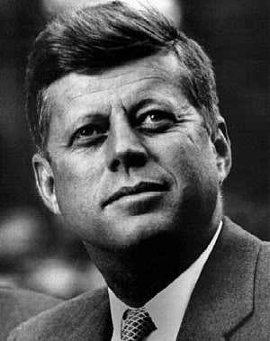
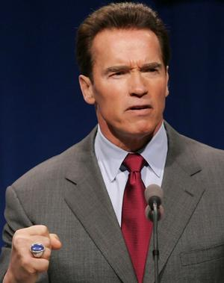
Formal Qualifications:
35 Years Old
Resident of the United States for 14 years
Natural Born Citizen
(the Vice President must meet the same qualifications)
Notes:
There are so many informal qualifications because there are only three formal qualifications for the Presidency because he is expected to fulfill many roles….

Slide 7
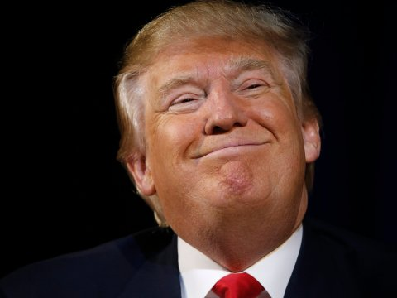
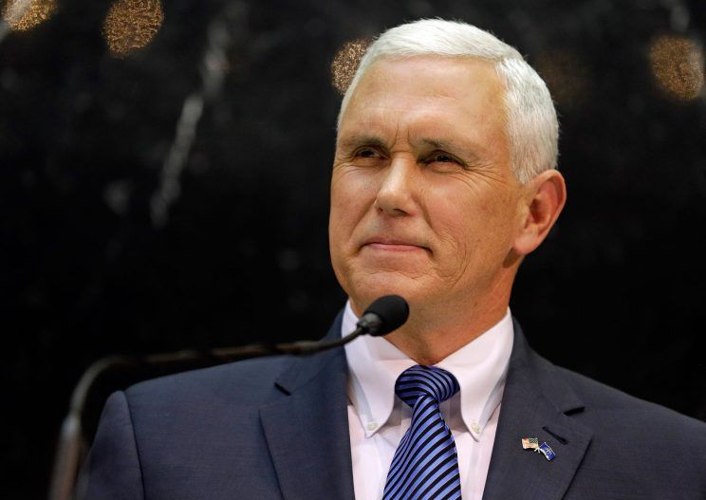
Names to Know
Donald John Trump
Michael Richard Pence

Slide 8

Roles of the president

Slide 9
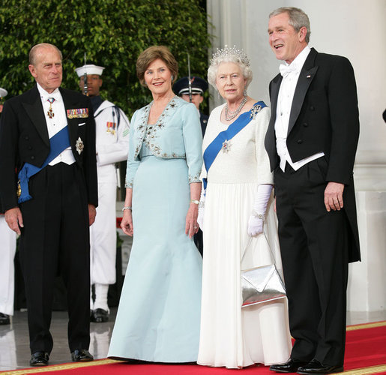
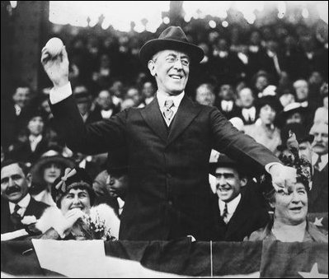
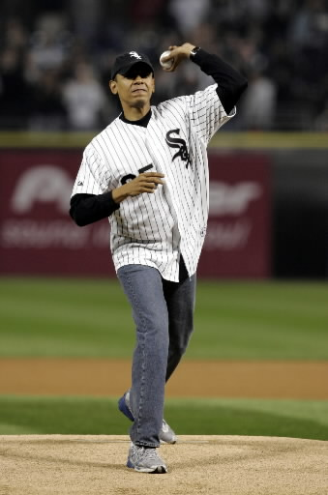
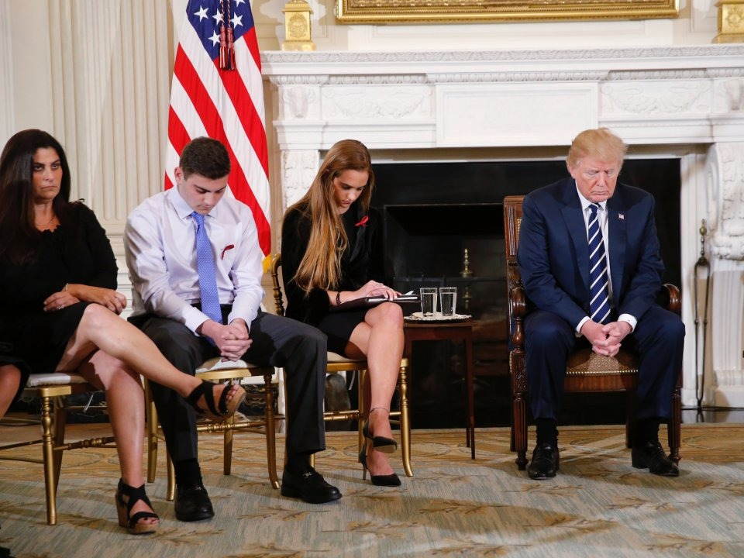
Head of State
Notes:
President is the ceremonial leader of the U.S.
Ex: meeting with foreign leaders, throwing out first pitch, meeting with students from Marjory-Stoneman

Slide 10

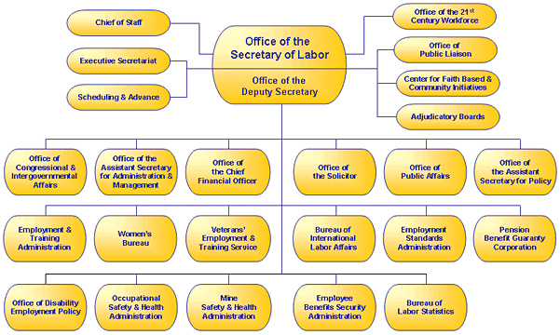
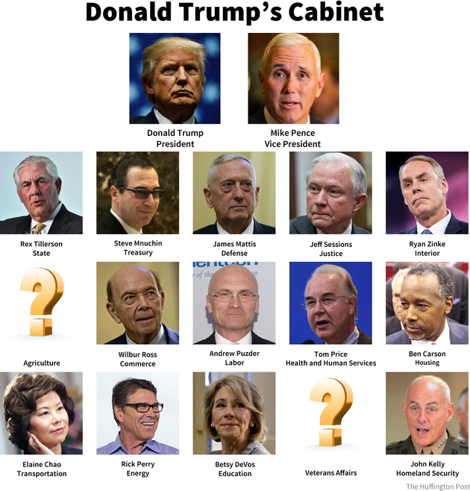
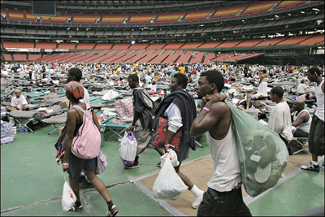
Chief Executive
Notes:
President is the CEO of the U.S. running the federal bureaucracy (government)
Ex: cabinet is like the board of a corporation

Slide 11
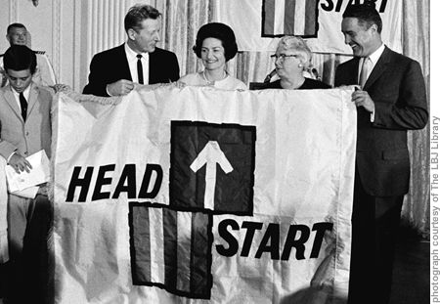

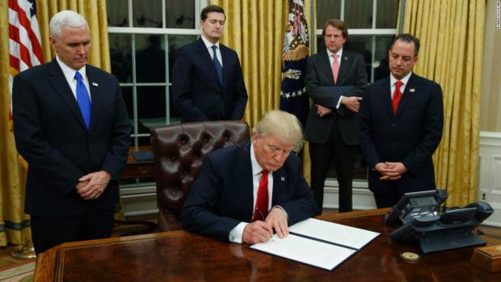
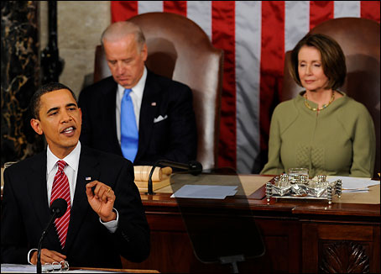
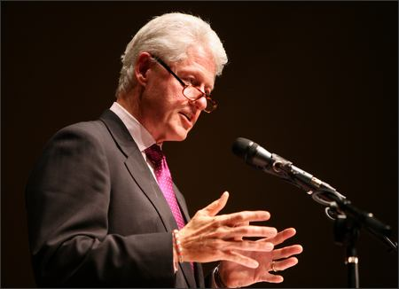
Chief Legislator
Notes:
Although he can’t make laws, he can affect what laws get passed, like Obama & Obamacare, LBJ and early childhood education, Trump & tax cuts

Slide 12
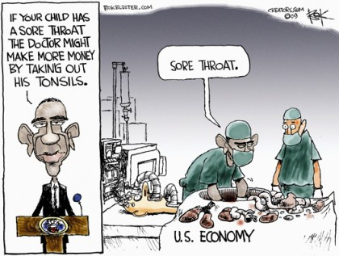
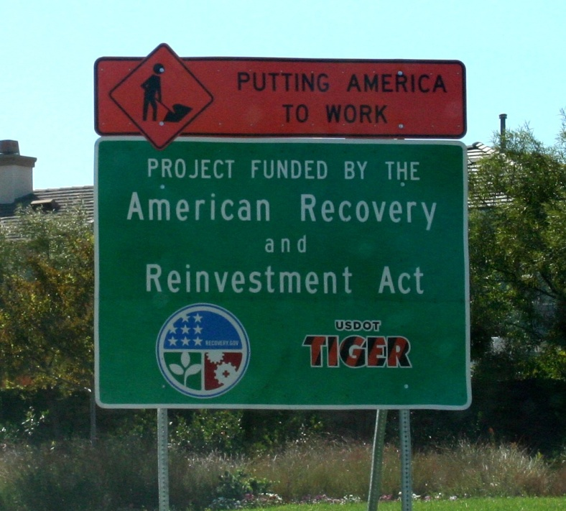
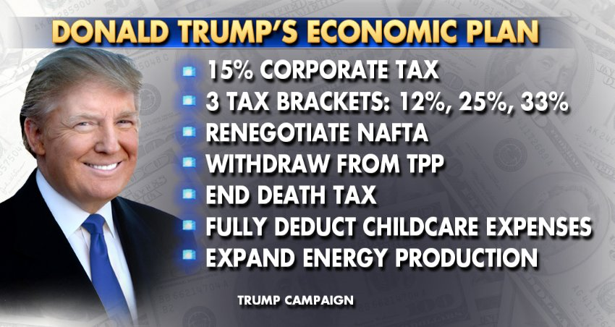
Economic Planner
Notes:
President is expected to assist with the economy….

Slide 13
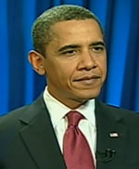
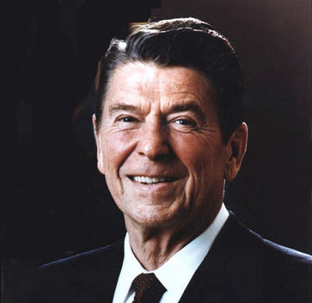

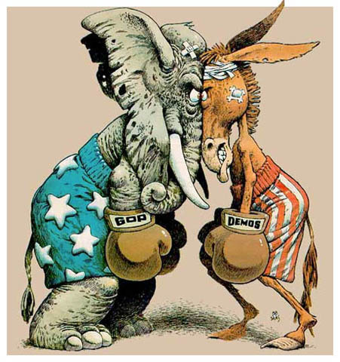
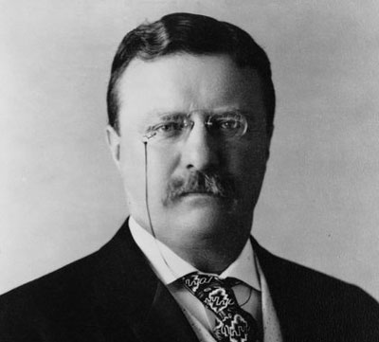
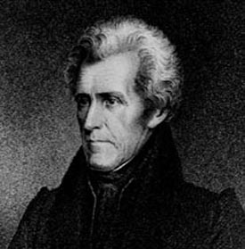
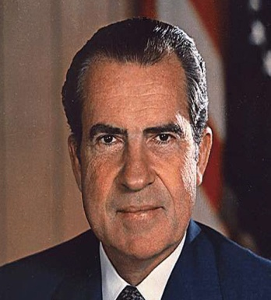
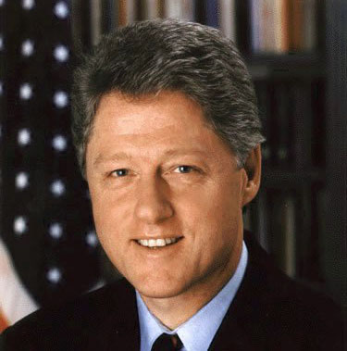
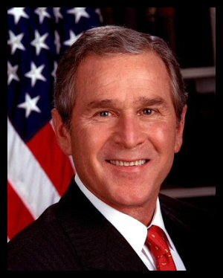
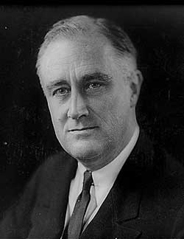
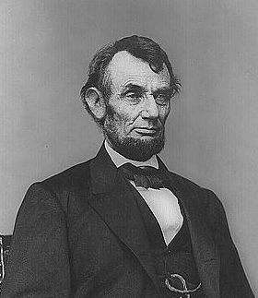
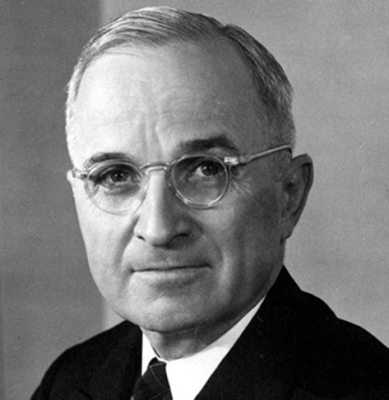
Party Leader
Notes:
Presidents are the defacto leader of their political party…even if the party isn’t happy about it ☺

Slide 14
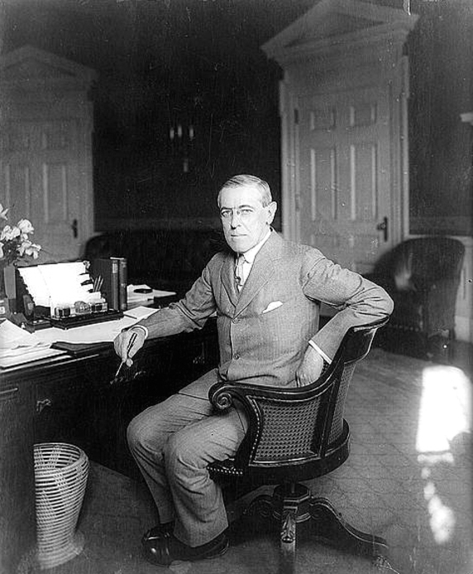
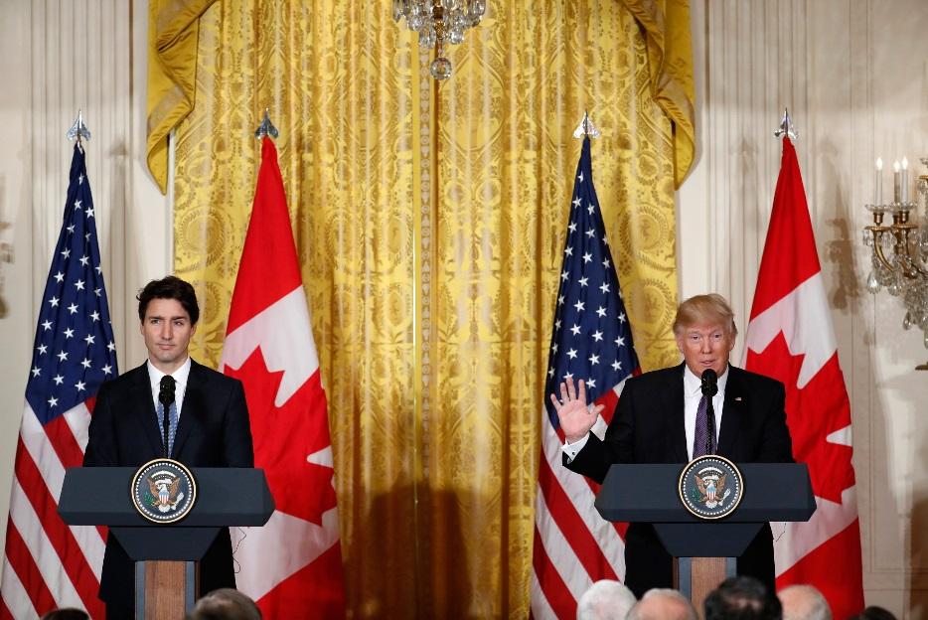
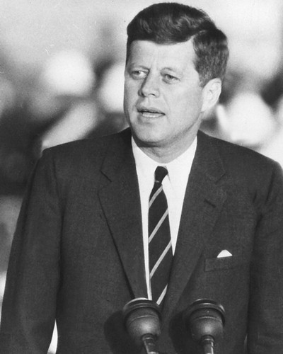

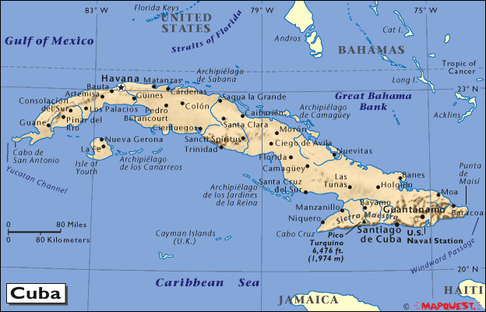
Chief Diplomat
Notes:
Presidents meet with and make agreements with foreign nations.
Ex: Wilson – Treaty of Versailles, Trump & Kim Jung Un, JFK & Cuban Missle Crisis

Slide 15
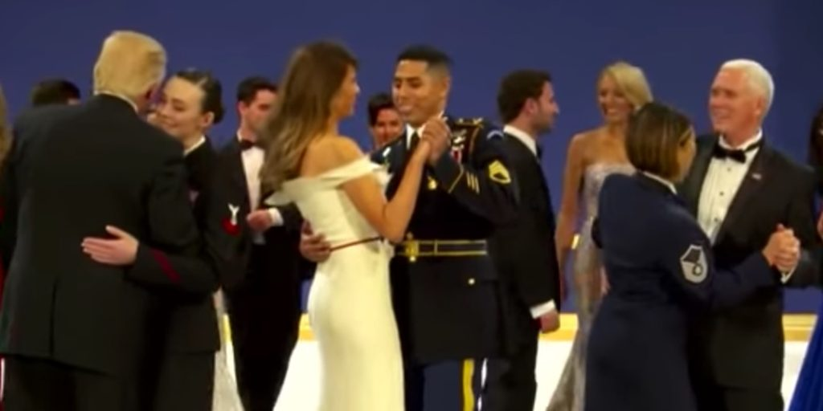
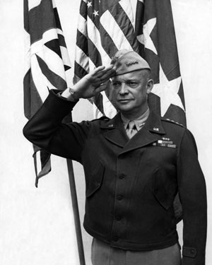
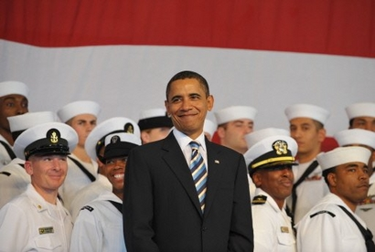
Commander in Chief
Notes:
Presidents are the Commander in Chief, the head of the armed forces.

Slide 16

“ The Vice Presidency isn’t worth a warm bucket of ****.”
- Vice President John Nance Garner
Notes:
But the Vice President we pay no attention to.....
* You may need to work these last slides in another class period depending on how long they discussed and worked on other stuff……

Slide 17
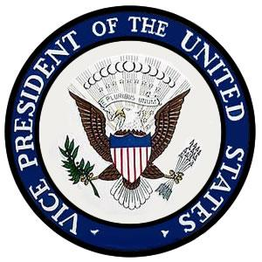
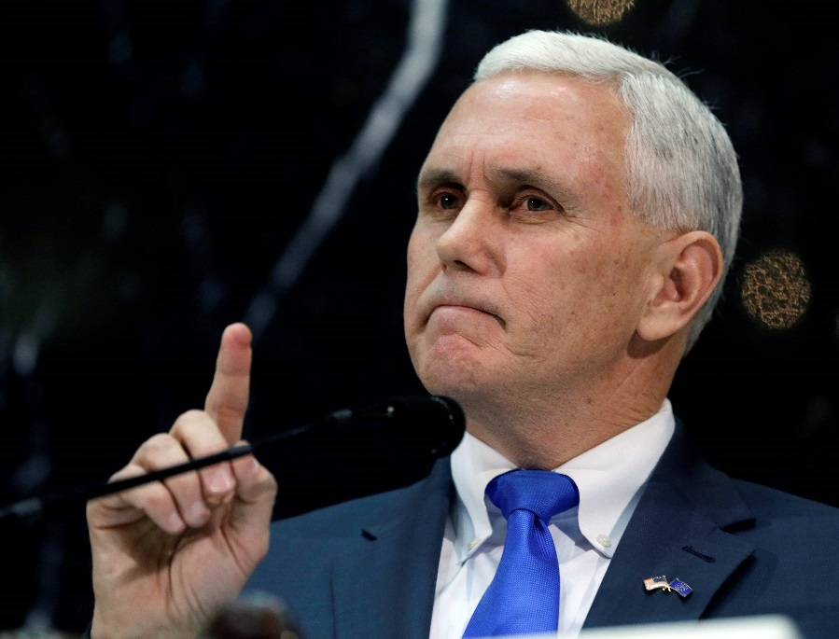
The Vice President
Official Duties
  Presidential disability
  President of Senate
    Breaks ties
  Take Over
  (delegated
  tasks)
  (balance the
  ticket)

Slide 18
Some “Presidential” Amendments…

Slide 19
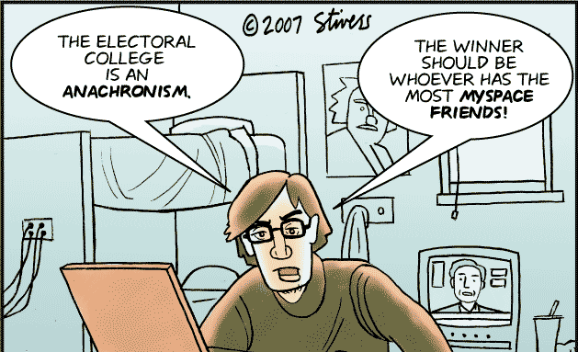
12th Amendment (1804)
Separated voting for the President & Vice President

Slide 20
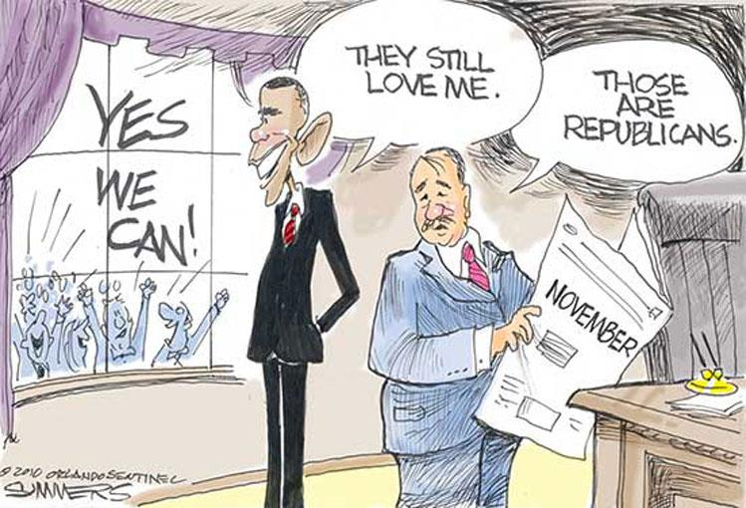
20th Amendment (1933)
Shortened the “lame duck period”
Changed the dates of taking office to:
  January 20 – President
  January 3 - Congress

Slide 21
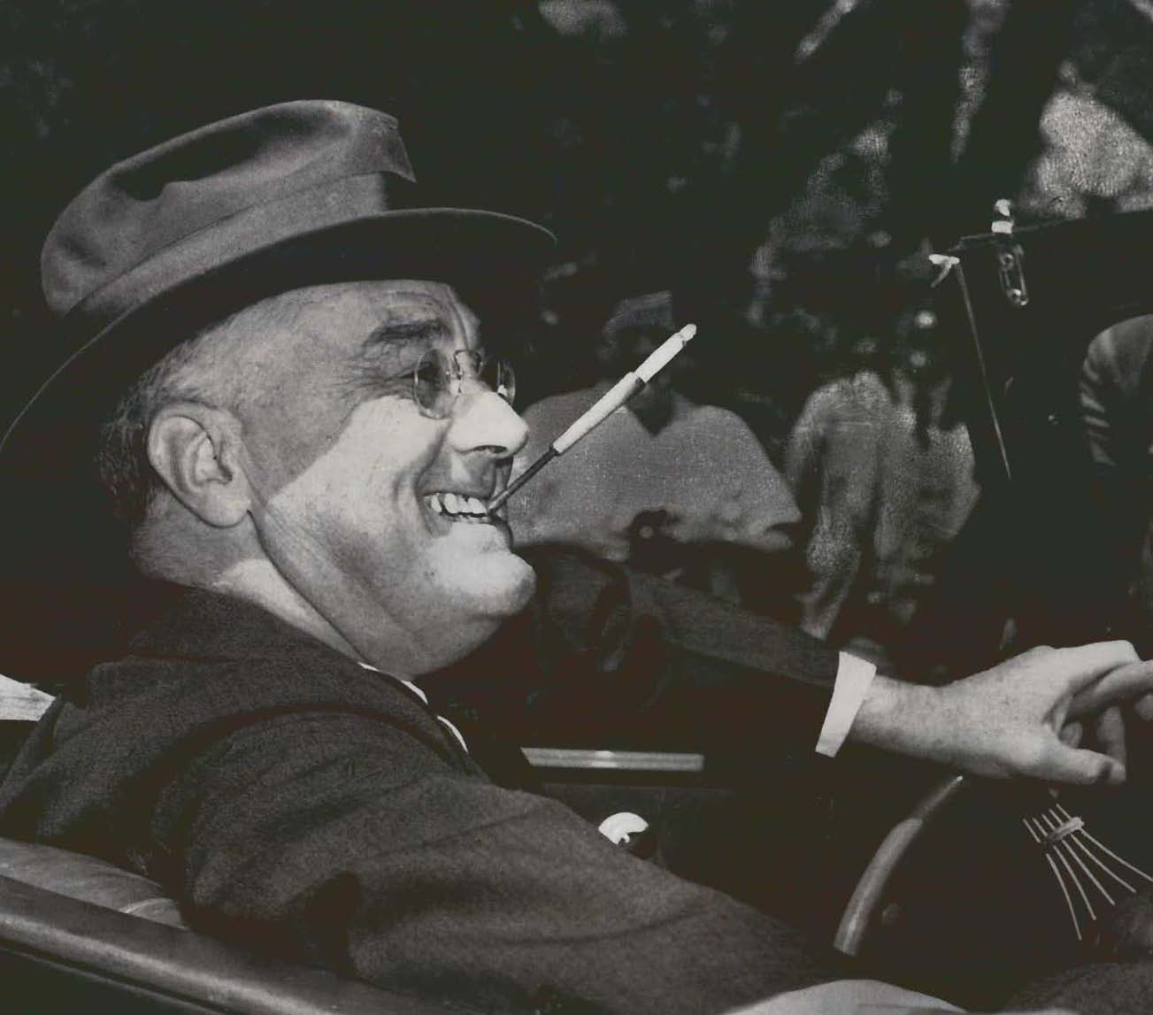
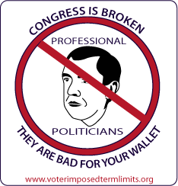
22nd Amendment (1951)
Limited to 10 years in office or two terms

Slide 22
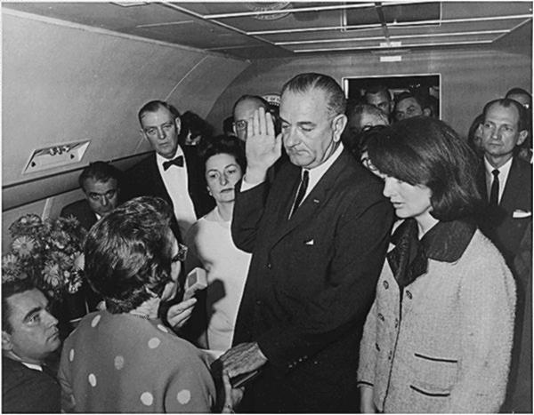
25th Amendment (1967)
Presidential Disability
Presidential Succession
  Vice President
  Speaker
  President Pro Tempore
  Secretary of State
  SecTreas

