Slide 1
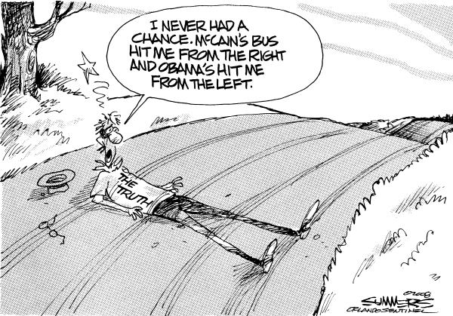
Notes:
First, have students read through the statements on the worksheet and simply circle agree or disagree.
Discuss cartoon – the truth lies somewhere in the middle…the liberal view and the conservative view destroy or run over the truth
* Cartoon is actually biased that the middle/moderate perspective is the truth

Slide 2
Ideology: a system of ideas and ideals, especially one that forms the basis of economic or political theory and policy
For Exam: a set of basic beliefs about life, culture, government and society
Notes:
Today, we are determining ideology and we need to be able to see these ideologies in statements, positions & policy

Slide 3
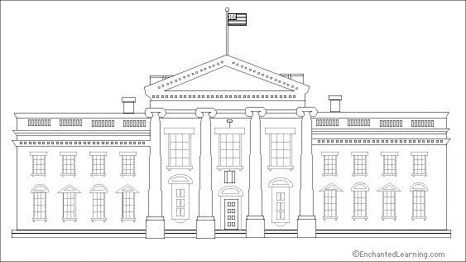
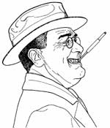
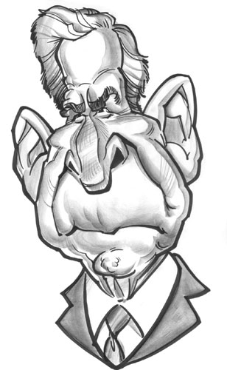
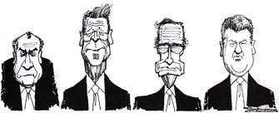
(Traditional) Political Spectrum
a system of classifying different political positions that symbolizes political ideology (beliefs)
LEFT CENTER RIGHT
Anarchist Radical Liberal Moderate Conservative Reactionary Anarchist
Notes:
The traditional political spectrum looks like so….

Slide 4
Loser Liberals & Crazy Conservatives
(& Moron Moderates)
Liberals (aka the Left)
Conservatives (aka the Right)
more regulation of economic (money) issues
less regulation of personal (individual freedom) issues
Democrats
  less military spending
  International foreign policy
  gun control*
  social programs to help
  active federal government
less regulation of economic (money) issues
more regulation of personal (individual freedom) issues
Republicans
  military spending
  unilateral(?) foreign policy
  right to bear arms*
  emphasize self reliance
  “less [federal] government”
Notes:
Liberals and Conservatives have some basic viewpoints (in the U.S., this doesn’t apply elsewhere)….if we can categorize those viewpoints…we can determine whether the viewpoint and/or the person is more or less liberal or conservative…
Do a few examples with the students going through statements and circling, economic or personal and then more or less regulation…and then applying the rules on the slide to classify them as liberal or conservative statements…have them pay attention to key words, i.e. increased = more
Give them the points to add or put in the blank box on the right…(tell them NOT to work ahead on the plus and minuses)…
Have students work with a partner to finish up the rest (be careful for exceptions to the rules like gun control)
Review answers with students giving them the plus and minus to use…when they are done, they should add up their numbers to see if they are more conservative or liberal based on their agree or disagree. (the “answer key” with plus and minus should be in the big file cabinet in the third drawer down in a folder labeled “Voters, Parties & Elections”)

Slide 5
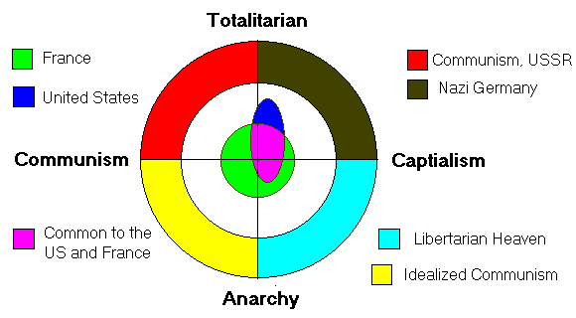
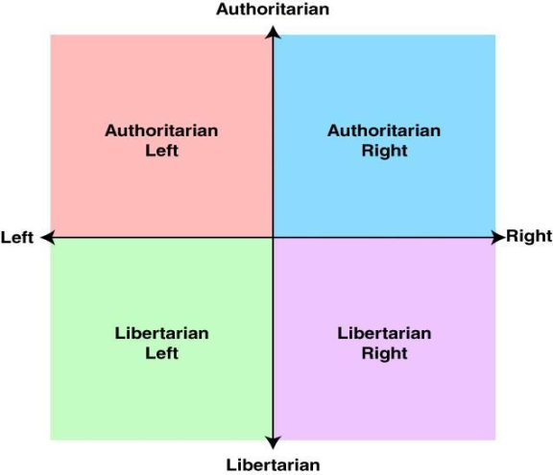
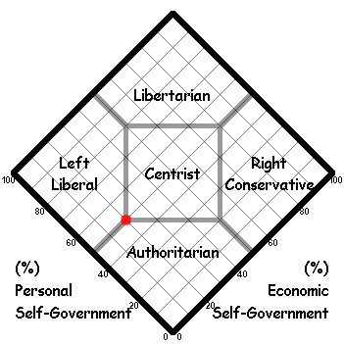
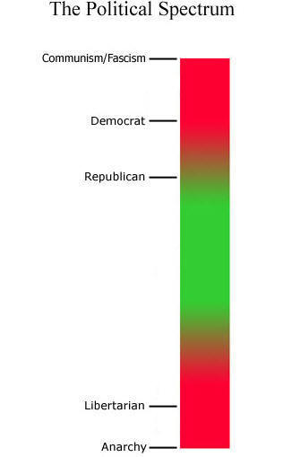
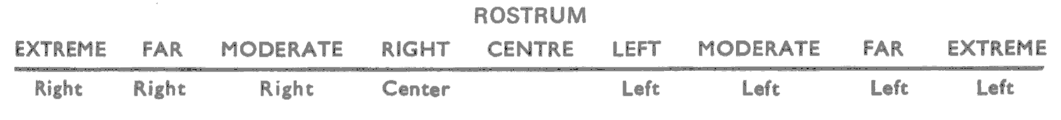
Visualizing the Political Spectrum
Notes:
Remember this is just one way of looking at the political spectrum and not always accurate….but it IS how Americans talk about and see ideology.

Slide 6
Voter A: “I worked my way up from poverty to become the successful business owner I am today. I get frustrated when I think that my tax money goes to support people who won’t help themselves. I think part of the blame belongs with the media – they promote all the wrong values.”

Slide 7
Voter B: “I really don’t care what other people do in their free time, as long as they don’t bother me. I sure don’t like it when the government tells me what to do with my money or in my own home – I’m certainly not going to turn around and do the same thing to my neighbors.”

Slide 8
Voter C: “I really worry about the state of the world today. It seems like more and more kids are growing up in poverty and there’s no one there to help them. I think we need to do more toward providing healthcare and education programs for our young people.”

Slide 9
Voter D: “These days, you can’t be too careful. I think we need to spend a lot more money on the national defense. I wish there was a police officer on every corner! The police could search my car all they want, since I don’t break the law. I also think the government should crack down on the media – their reporting gives our enemies an inside look at all our military preparations.”

