Slide 1
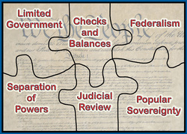

Slide 2
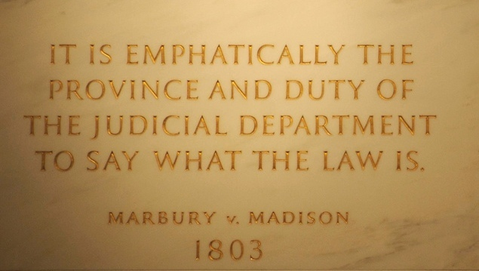
Marbury v. Madison
What was this case about? Explain/Summarize in ONLY 2 sentences max!
What was the importance of this case?

Slide 3
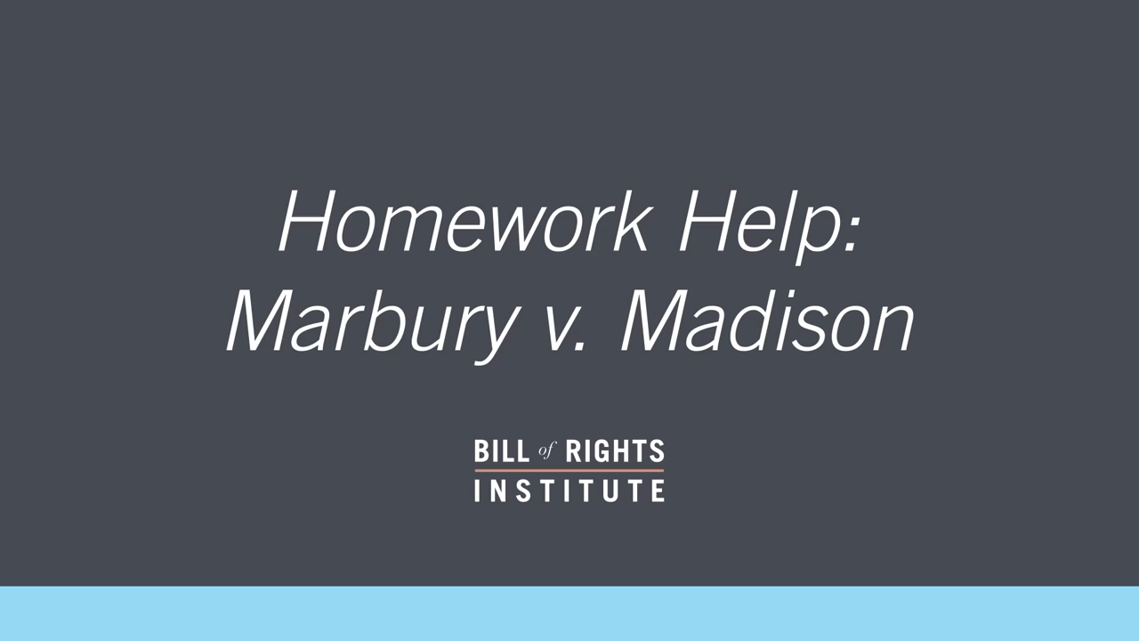

Slide 5
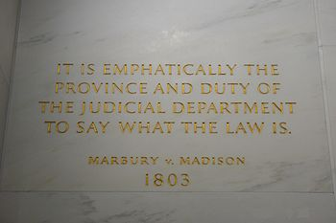
Marbury v. Madison
What is the importance of this case?

Slide 6
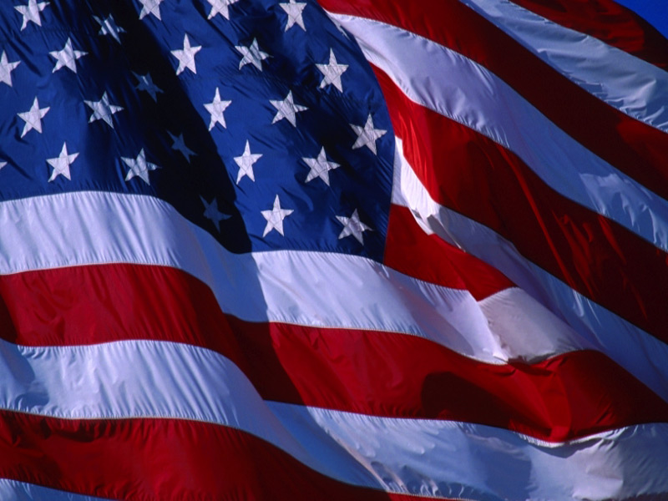
The United States Constitution

Slide 7
Bellwork: Caption ?’s p.65, 66, 67

Slide 8
Major Principles of the Constitution
Popular Sovereignty
Federalism
Separation of Powers
Checks and Balances
Judicial Review
Limited Government

Slide 9
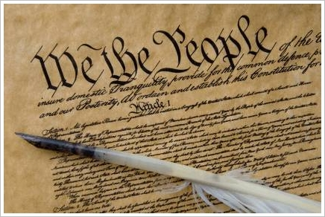
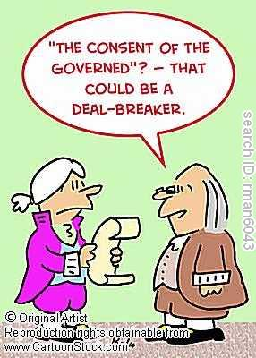

Major Principles of the Constitution
Popular Sovereignty

Slide 10
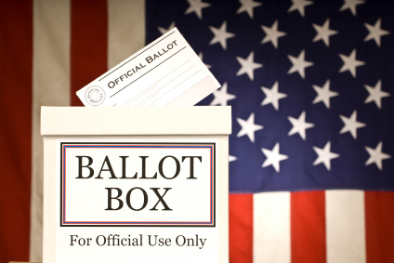
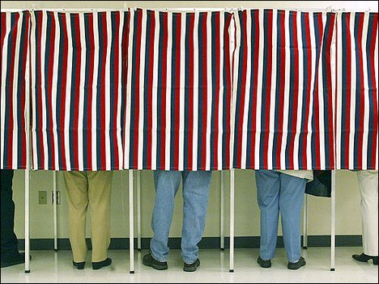
Popular Sovereignty: Voting

Slide 11
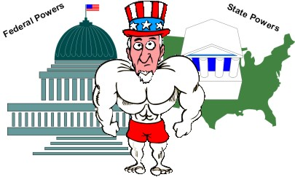
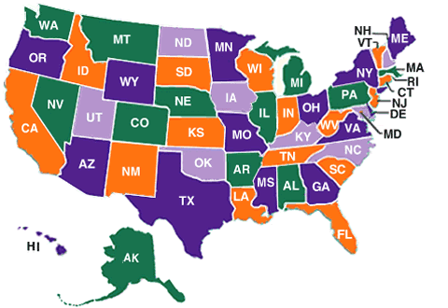
Major Principles of the Constitution
Federalism

Slide 12
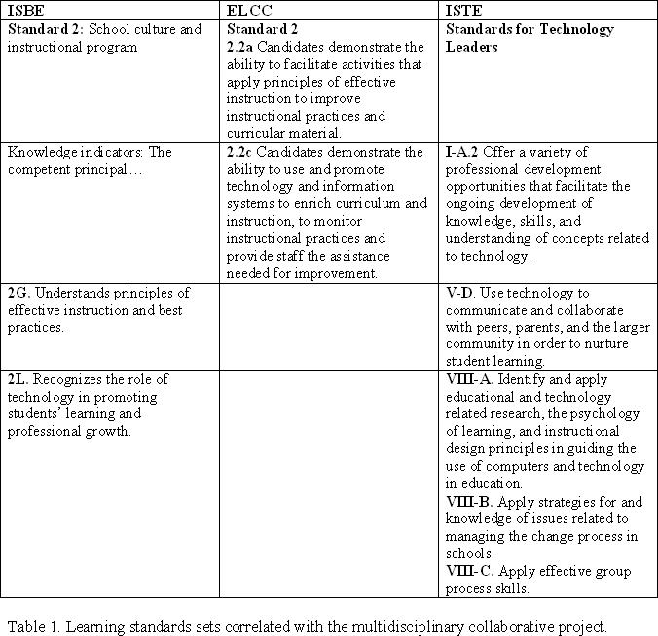
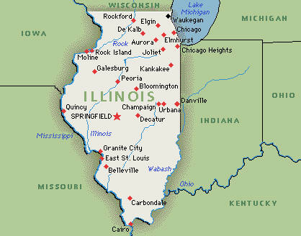
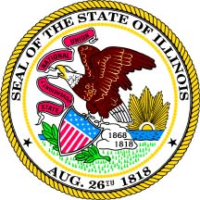
Federalism: Education

Slide 13
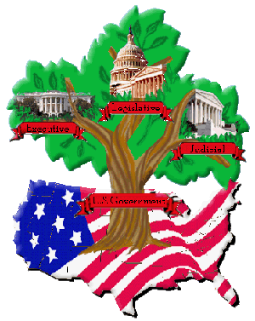
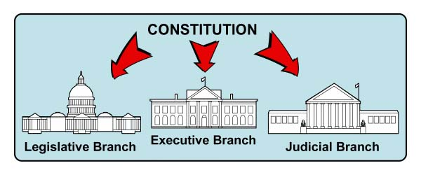
Major Principles of the Constitution
Separation of Powers

Slide 14
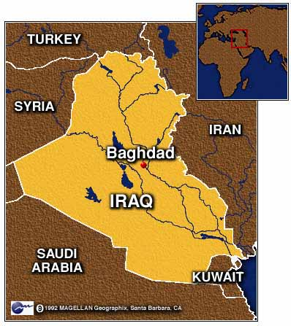
Separation of Powers: Iraq
                Declaration of War vs. Authorization of War

Slide 15
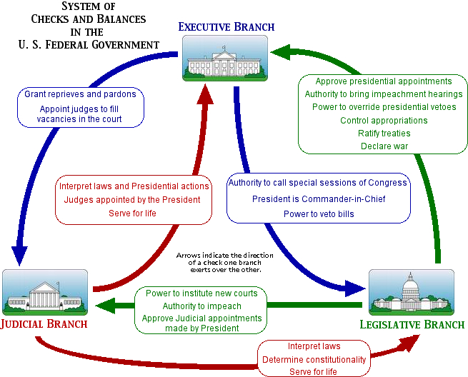
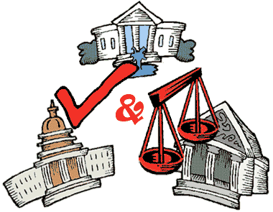
Major Principles of the Constitution
Checks and Balances

Slide 16
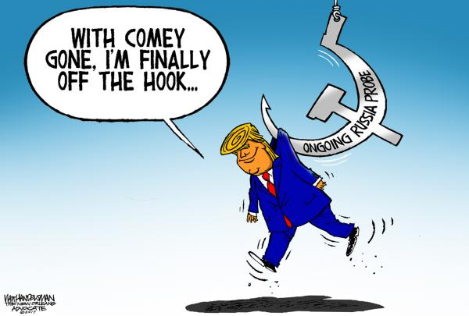
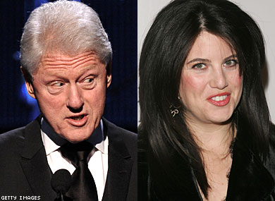
Checks & Balances: Clinton Impeachment

Slide 17
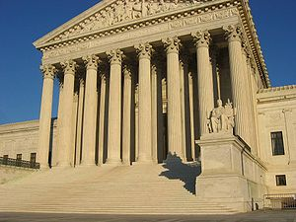
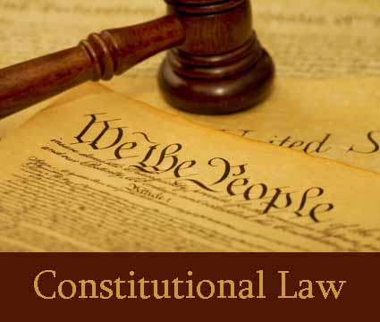
Major Principles of the Constitution
Judicial Review

Slide 18
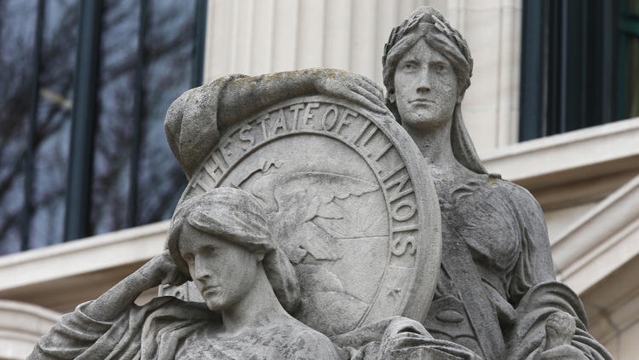
Judicial Review:
“Illinois Supreme Court finds state gun ban near parks unconstitutional”

Slide 19
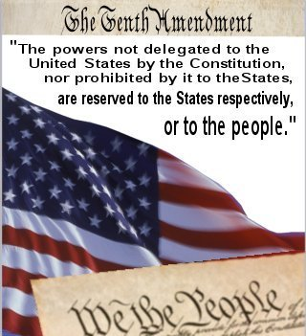
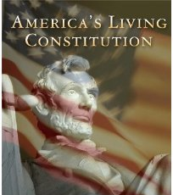
Major Principles of the Constitution
Limited Government

Slide 20
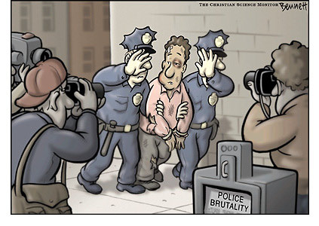
Limited Government

Slide 21
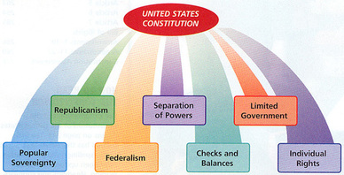

Slide 22
Stand and Declare…
Across the room, create a human spectrum (line) according to how you feel about each question.
  Talk to those around you to ensure you are in the right spot; feel free to move one way or the other if you don’t agree.
Where would you rather get a drink from Starbucks or Dunkin Donuts?
There should be restrictions on abortion.
The U.S. needs to increase border security.

