Slide 1
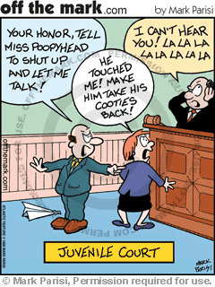
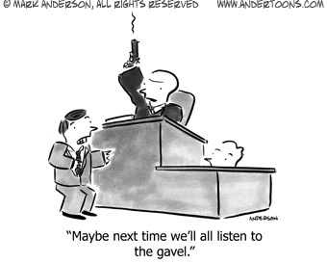
The Judicial Branch
Notes:
No bellwork, time might be tight. Today we will start looking at the judicial branch by walking through an actual Supreme Court case from start to finish. Their goal is to understand there are two court systems and that the three (basic) levels are district, appellate and supreme.

Slide 2
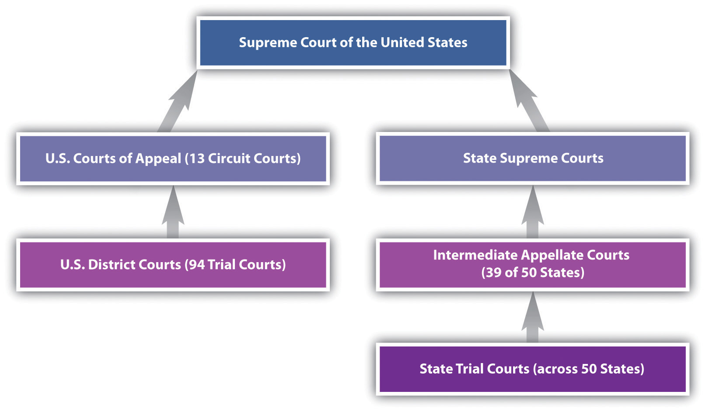
Court SystemS
Notes:
First thing to remember, there are two court systems, federal and state

Slide 3
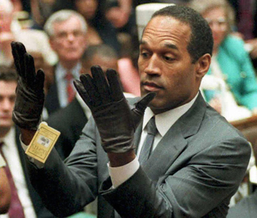
Criminal Law vs. Civil Law
Guilty vs. Not Guilty
Notes:
There are also two types of law
Criminal – you vs. the government; in this case, OJ was found not guilty (a trial)
Civil – you vs. another person; in this case, OJ was found liable so they took all his money (a lawsuit)

Slide 4
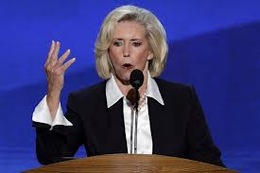

Ledbetter vs. Goodyear
Structure of the Federal Courts
Notes:
Use the video as a way to go through the courts….show the video & stop at each level as the case goes through and students add notes and answer/discuss questions.

Slide 5
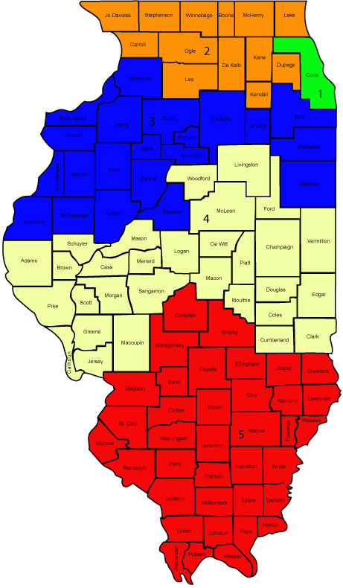
District (Trial) Courts
Original Jurisdiction
  hear case first
Trial conducted
  Judge, jury, witnesses
Determine guilty or not; liable or not
Notes:
First level is District Courts, as you watch pay attention for:
Why did Lilly’s case go to the Federal Courts? It’s a civil rights case involving federal law
Was Goodyear liable or not? Liable

Slide 6
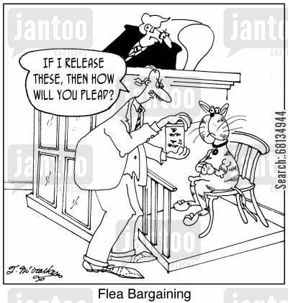

Slide 7
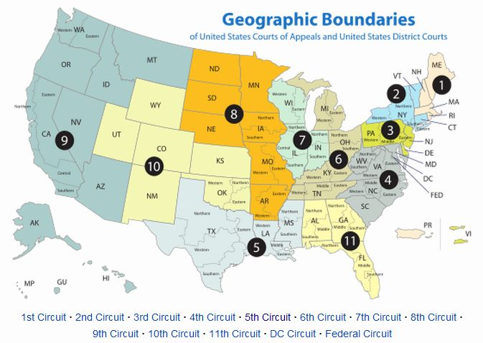
Appellate Courts
Cases heard 2nd (or 3rd) – appellate jurisdiction
  grounds
3 (or more) judges review the prior decision
affirm, remand or overturn decision of lower court
Notes:
Now Lilly’s case goes to the Apellate Courts….as you watch pay attention for:
What was Goodyear’s grounds (reason) for appeal? Filed the case too late, more than 180 days
Did they affirm (say decision was right), remand (send it back to be tried again) or overturn the District Court’s decision? overturned

Slide 8
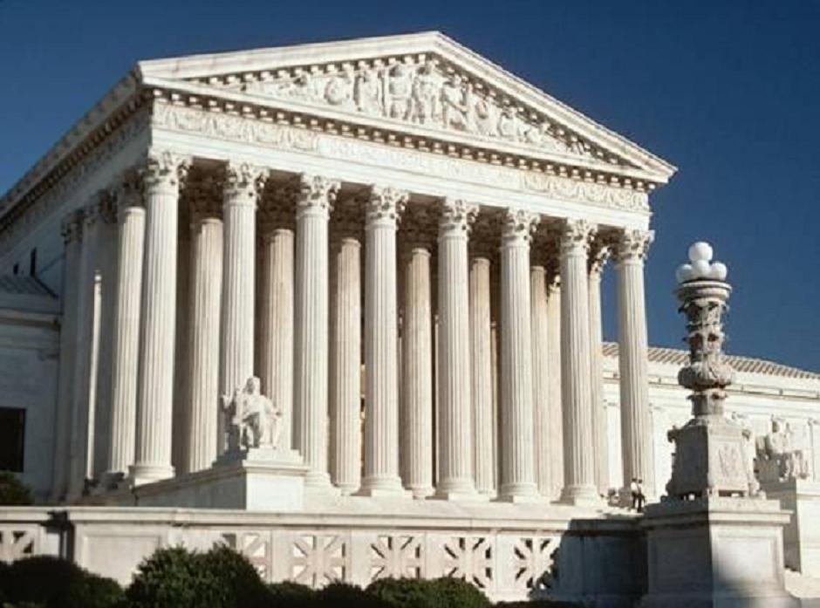
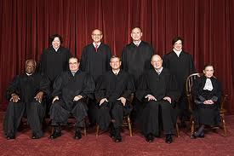
Supreme Court
Original & Appellate Jurisdiction
9 judges
Majority decision becomes the law
Dissenting opinion may matter later
  i.e. Plessy v. Ferguson
  Dissenting opinion used in Brown v. Board to end segregation
Notes:
Now Lilly’s case goes to the Supreme Court….it is the only court with both original and appellate jurisdiction (it can hear a case first or on appeal)
Why did the Supreme Court take the case? Because one appellate court said it was 180 days PERIOD (lilly’s court) and all the others said it was 180 days that resets

Slide 9
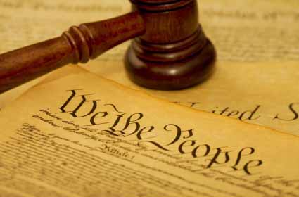
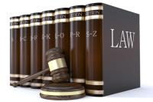
Constitutional Law
Vs.
Statutory Law
Notes:
Let it play through the rest, then….last two types of law
Constitutional – can only be changed by Amendment which is VERY hard
Statutory – made by Congress so can be changed by Congress

Slide 10
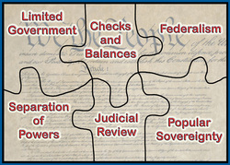
Notes:
Summary/End up with: don’t forget the principles of the Constitution work together…while the courts have Judicial Review, checks and balances can be used to change/limit those decisions.

