Slide 1
Outcome a Essential Question:
How should government define and distribute power, republicanism, freedom, democracy and citizenship?

Slide 2
WHAT does liberty look like?
On one side of your paper…draw a picture of what liberty looks like to you....be prepared to share/explain.

Slide 3
Group work:
With your group, analyze the three documents to determine who each author was speaking for and note evidence of liberty from the document.
When you have finished, complete the “assessment” on the back.

Slide 4
From: the Declaration of Independence
“We hold these truths to be self-evident, that all men are created equal, that they are endowed by their Creator with certain unalienable Rights, that among these are Life, Liberty and the pursuit of Happiness”

Slide 5
Different definitions of liberty
Negative Liberty (“Freedom from…”
Positive Liberty
(“Capacity to…”
Restraints on government action, the government has to leave me alone to do what I want to
Examples:
Actions by the government to give me freedom and/or opportunity, the government helps me do what I want to
Also… personal agency, the ability to do what you want to do.
Examples:

Slide 6
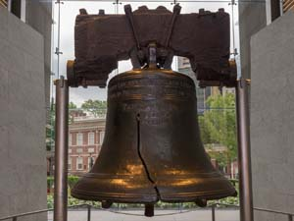
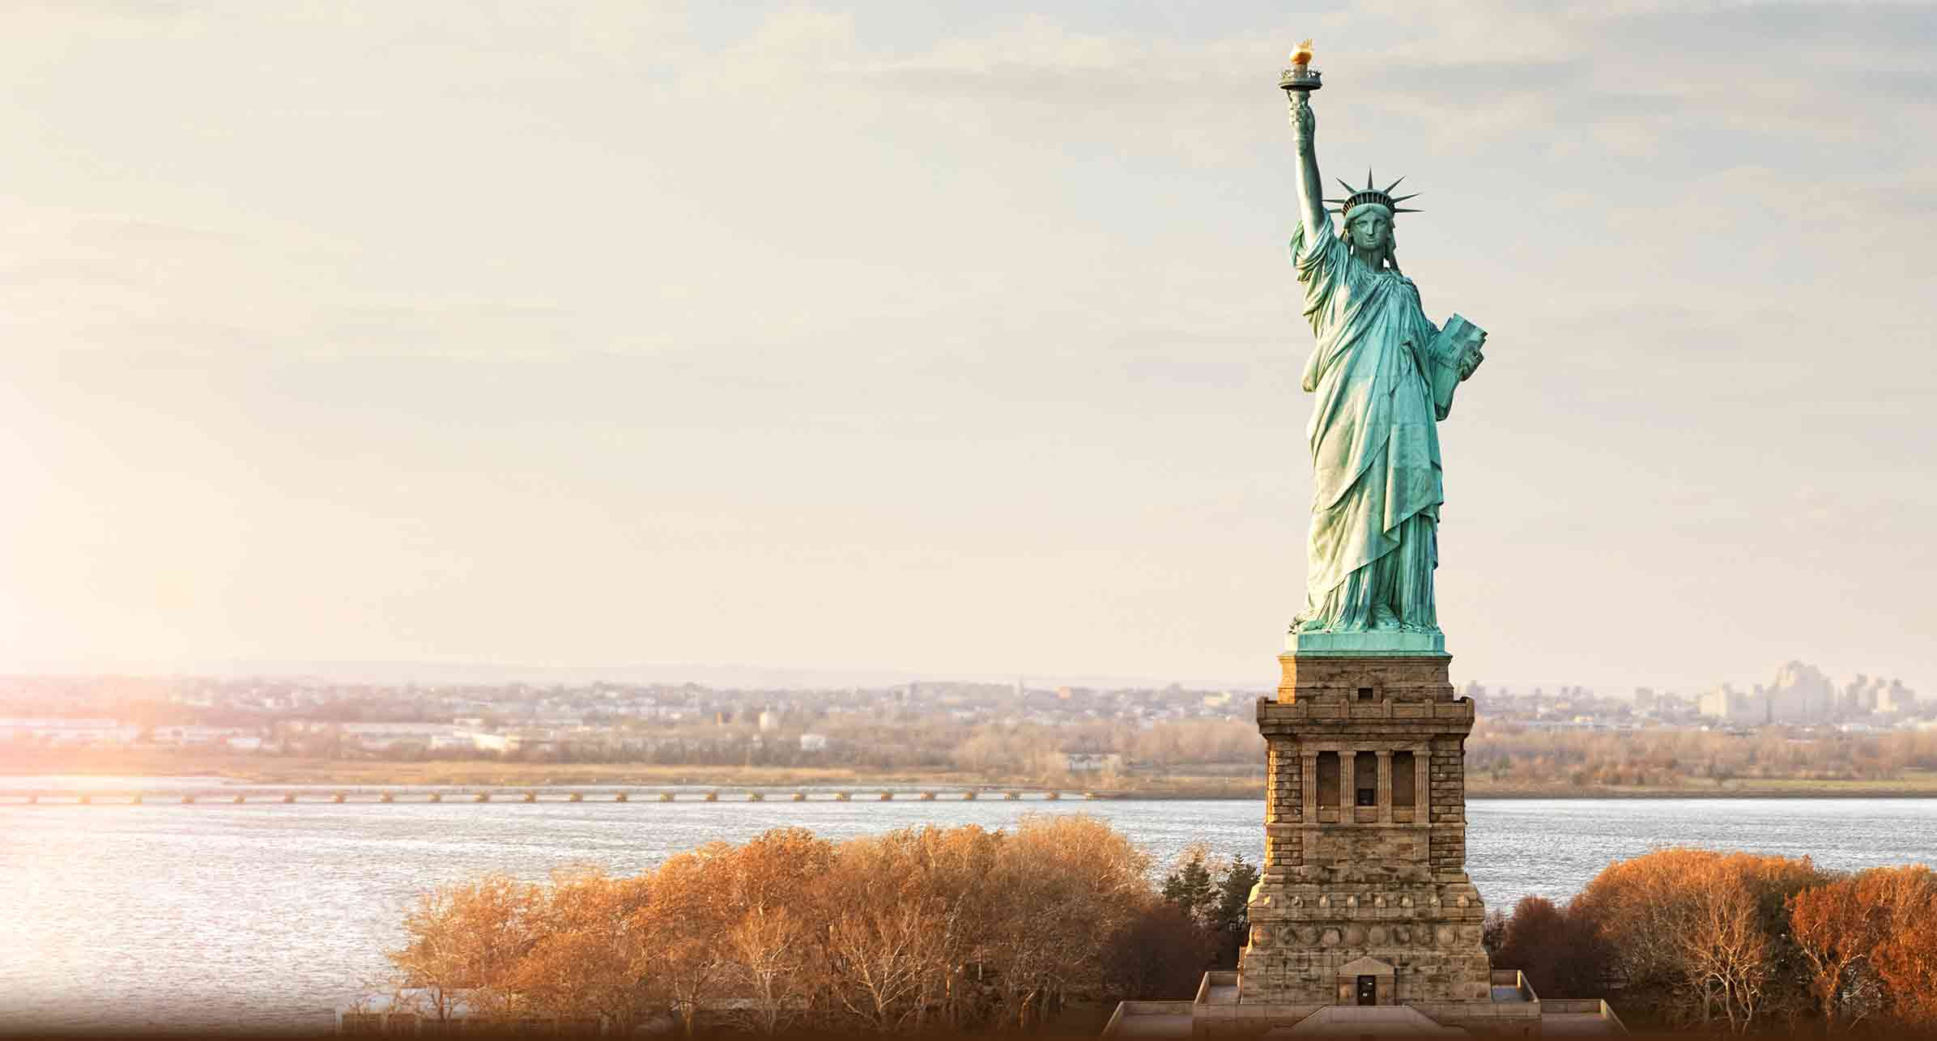
WHAT does liberty look like?
On the other side of your paper…draw a picture of what liberty looks like in the united states today….be prepared to share/explain.

Slide 7


Slide 8


Slide 9
http://www.gilderlehrman.org/history-by-era/road-revolution/resources/what-does-liberty-look

