Slide 1
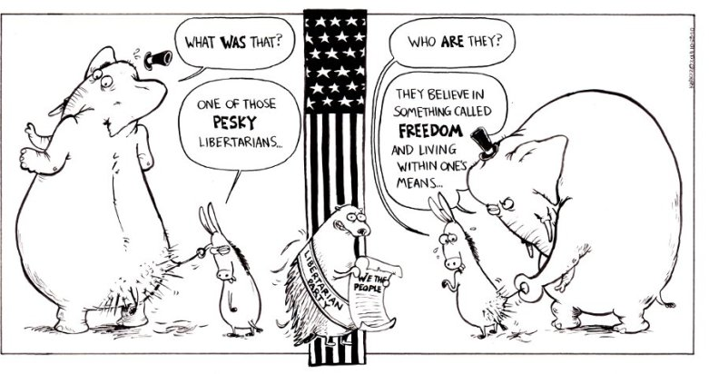
* Explain how structural barriers third party and independent candidate success
* Explain why political parties adapt and change

Slide 2
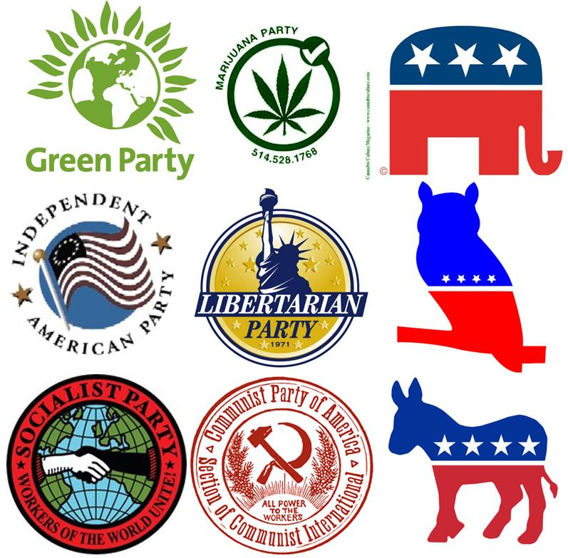

Slide 3
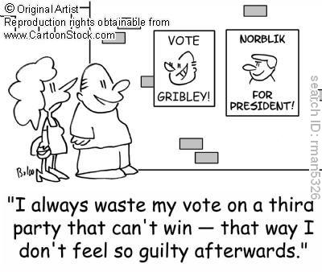
Third Parties

Slide 4
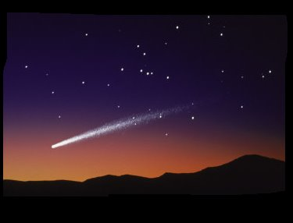
3rd Parties are like shooting stars…

Slide 5
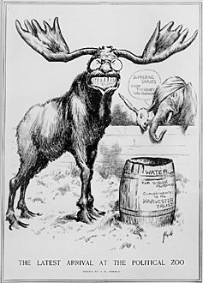
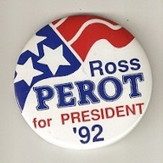
Too Much Credit…?
No minor third party has ever come close to winning the presidency:
Only 8 have won as much as a single electoral vote.
Only 5 third party candidates have won more than 10% of popular vote.
  including TR in 1912 and Ross Perot in 1992

Slide 6
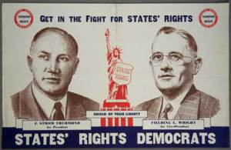
Roots of Third Parties
Sectionalism: 1948 – Dixiecrats
Economic protest: 1892 – Populist
Specific issues: Prohibition Party – Progressive Era
Ideology: Socialist, Communists, Libertarian
Charismatic personalities: 1912 – TR
Combination Parties: George Wallace in 1968 (dynamic leader w/ firm geographic base, South w/ emotional issue, civil rights; Ross Perot in 1992)

Slide 7
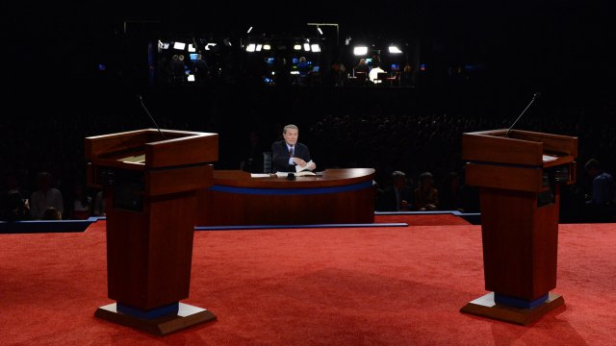
Barriers to Third Parties
With your group use the documents to answer questions 1 thru 3
  Document 1 – question 1
  Document 2 – question 2
  Documents 3 & 4 – question 3
You will need to use your brains & the other questions you answered for question 4

Slide 8
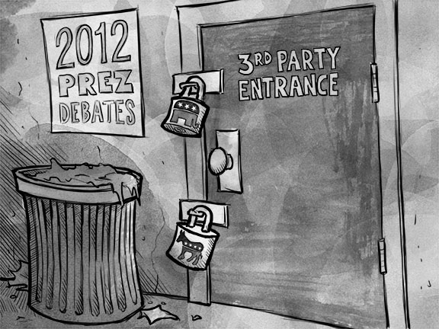
Barriers to Third Parties
Electoral College System
Public Financing of Presidential Campaigns
  (matching funds)
Ballot Access Laws
Debate participation
  (media coverage)
Fundraising
Support base
Would these be
different for
Congress?

Slide 9
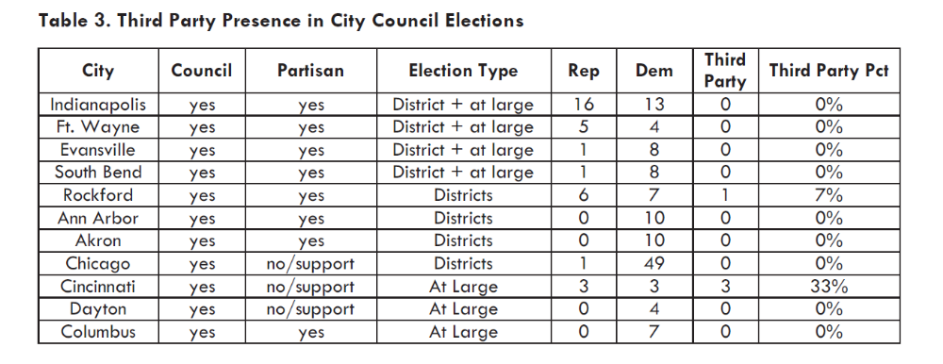
Is this different at the State/Local Level?

Slide 10
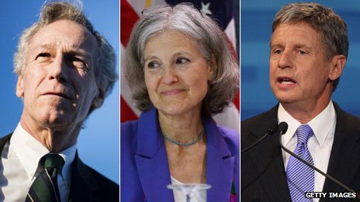
2016 - Third Party Presidential Candidates
Virgil Goode, Jill Stein and Gary Johnson

Slide 11
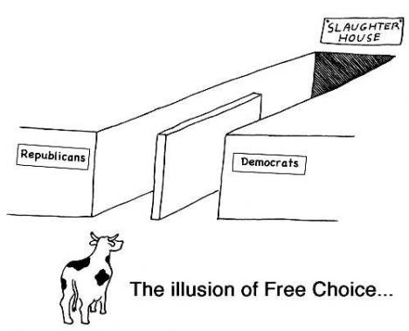
Effects of Third Parties
Ideas may be adopted by major parties
  1890’s populist ideas adopted by Democrats
  1992 Perot’s campaign reform ideas adopted
Spoiler Role
  1912 Bull Moose Party (T.R.)
  * Probably not their intent but…
Signal for a change
  Both the Republican and Democratic Parties in 1992 took on Perot’s reform government ideas, reduce the deficit

Slide 12
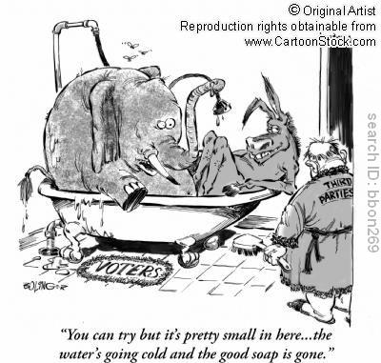

Slide 13
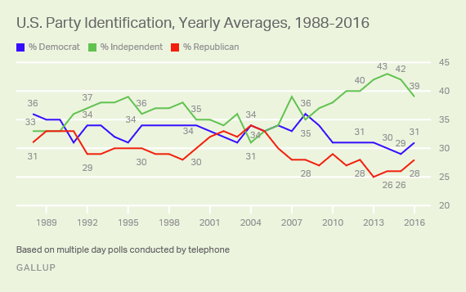
Indicators of Party identification
Realignment & Dealignment
Straight ticket voting
  Shows strong party membership
  support all candidates for one party
Ticket Splitting
  voting for candidates from multiple parties
  Weak party id; increase of independents

Slide 14
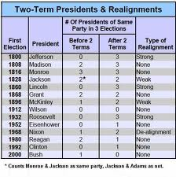
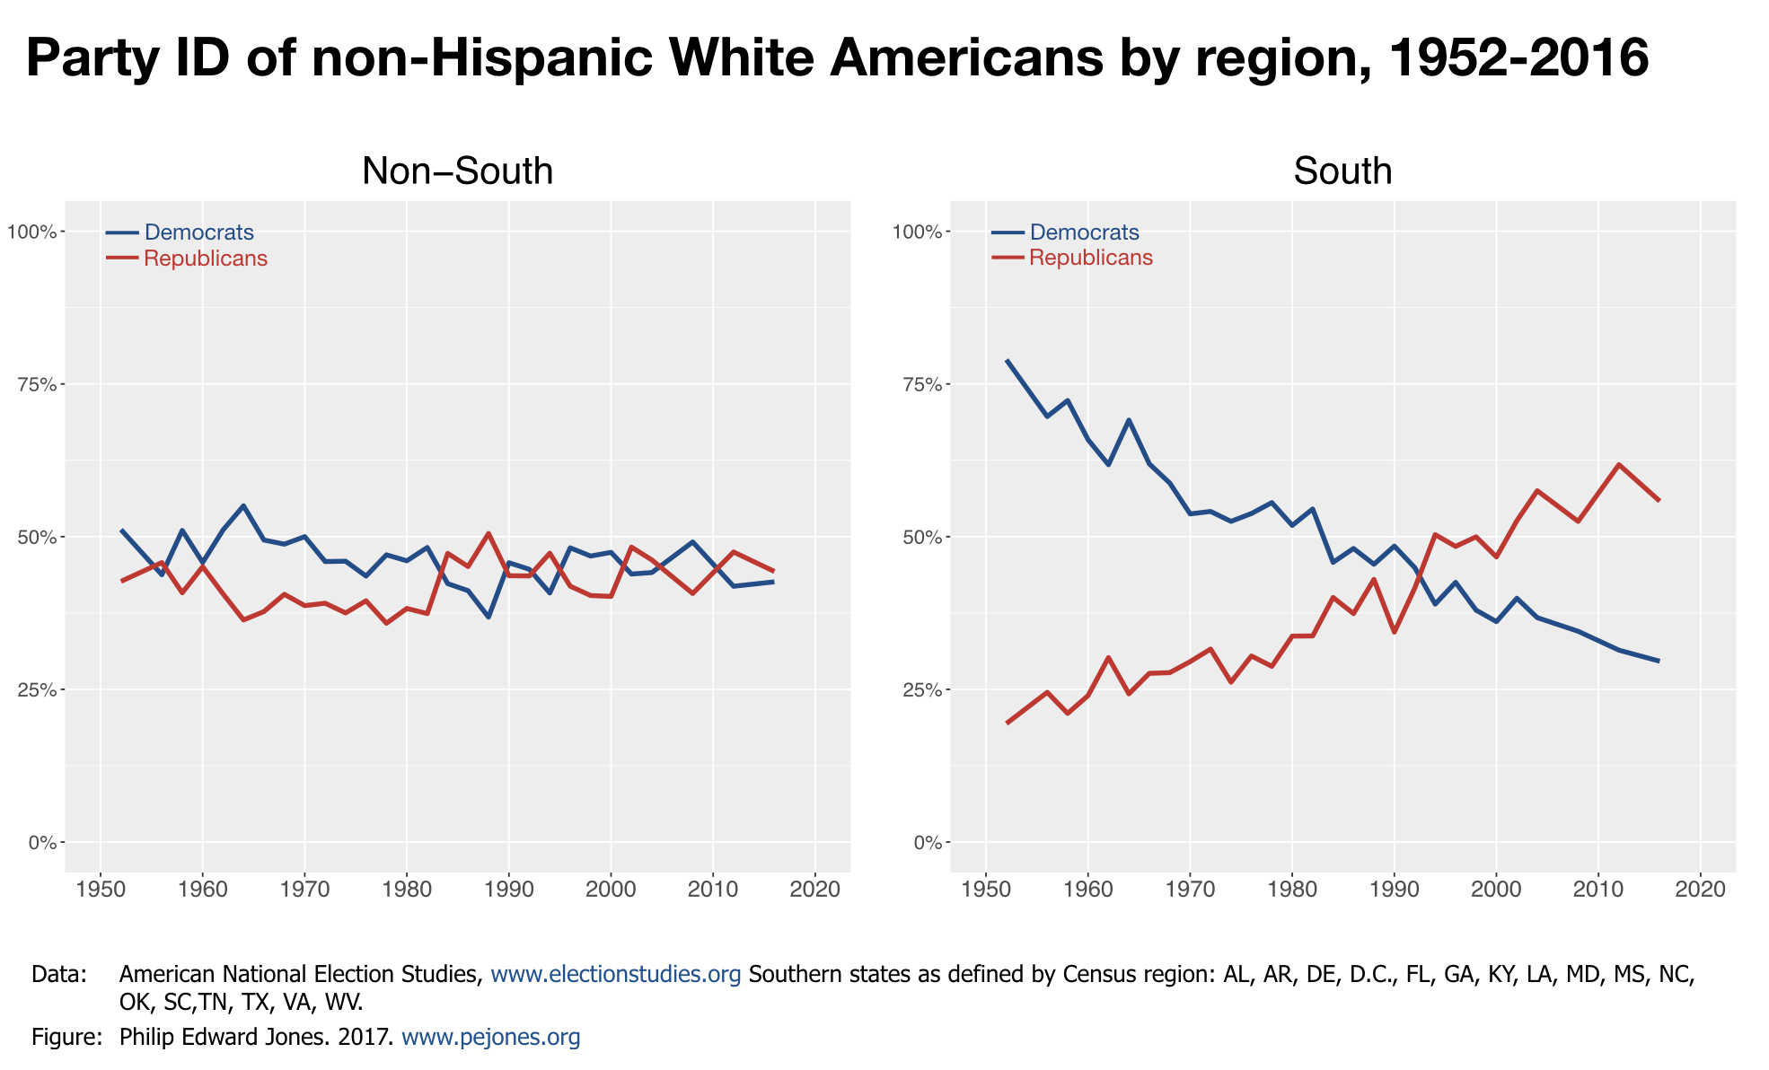

Slide 15
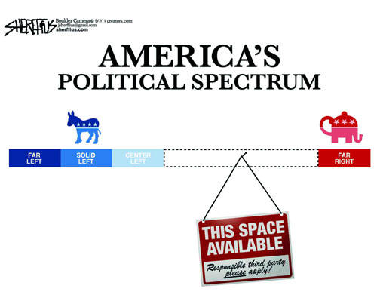

Slide 16
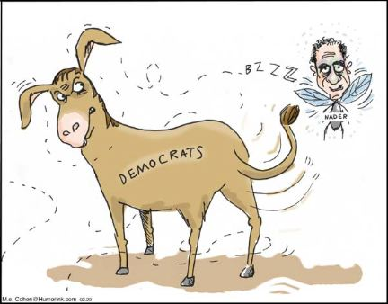

Slide 17
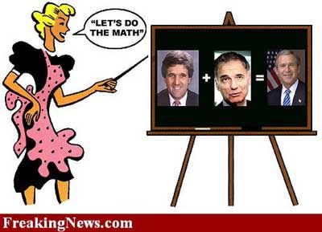

Slide 18
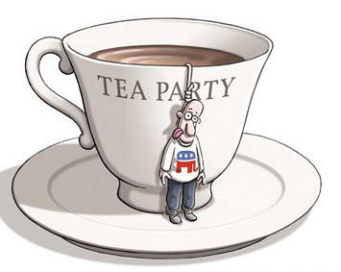
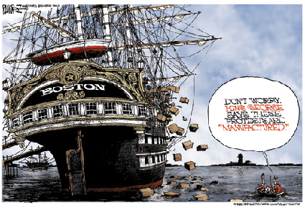
The Tea “Party?”

Slide 19
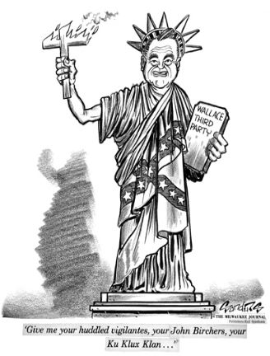

Slide 20
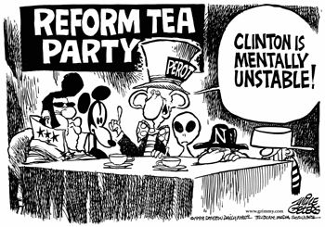

Slide 21
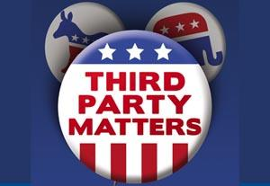
Third Parties 2016?

