Slide 1
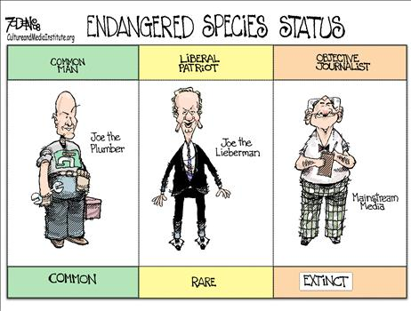
Explain the media’s role as a linkage institution.
Explain how increasingly diverse choices of media and communication outlets influence political institutions and behavior.

Slide 2
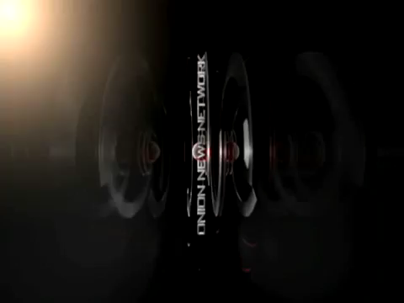
Of course the media is biased, different outlets count on different viewers…

Slide 3
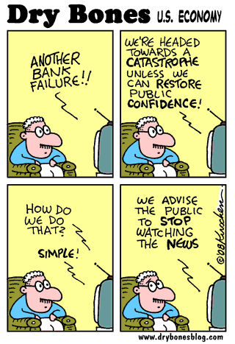
Roles of the Media
Gatekeeper
  for profit businesses
  sound bites
  bias
Agenda Setter
Watchdog
Entertainment

Slide 4
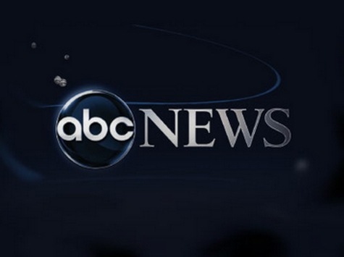



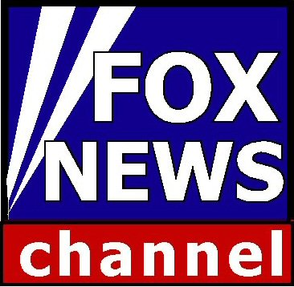
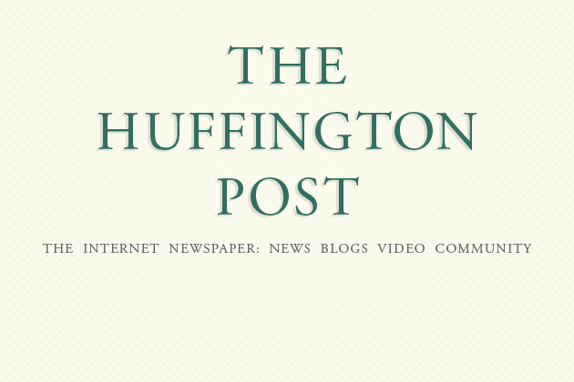
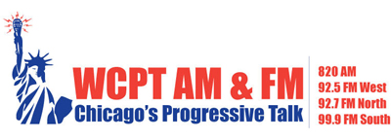
Are there different roles for different media?
Work with a partner to complete the webquest based on research by the PEW corporation.

Slide 5
To find hyperlinks…
Student Shared Drive
Social Studies
AP GOV
“Media Webquest”

Slide 6

Big ideas to remember…
The spread of different media influences how citizens acquire political information
Media polls and coverage of elections as “horse races” makes elections more about popularity than issues and qualifications **ON TEST
Debates about biased media, media ownership & partisan news sites
Democratic debate & political knowledge are impacted by:
  Increased media choice
  Ideologically oriented programming (incestuous amplification)
  Consumer driven media & reinforcement of beliefs
  Uncertainty over the credibility of news (fake news)

Slide 7
