Slide 1
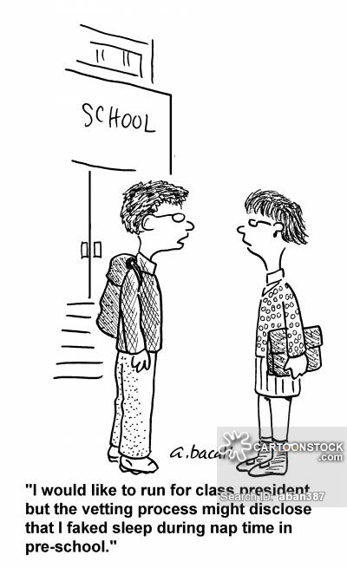
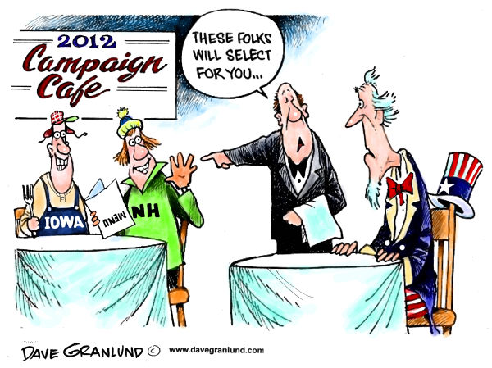
Campaigns & Elections
Explain how the different processes work in a U.S. presidential election
Explain how the different processes work in U.S. congressional election
Explain how campaign organizations & strategies effect the election process

Slide 2
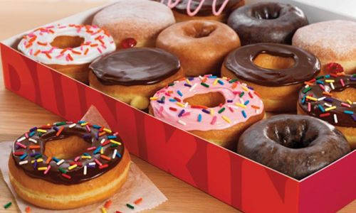
What’s on your doughnut?
What are the advantages of disadvantages of choosing doughnuts each way?

Slide 3
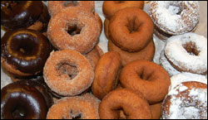
Nominees must have at least five backers:
Candidate/Doughnut 1:
Candidate/Doughnut 2:
Candidate/Doughnut 3:
Candidate/Doughnut 4:
Candidate/Doughnut 5:
Notes:
Process #1….once you have five nominations, then vote, one vote per student. Who wins?
Process #2….take the nominations and someone needs to speak for their favored donut and stand somewhere in the room….then supporters stand with them…cut a candidate/donut until one has a majority….groups still standing may “recruit” supporters of candidates that are cut
I usually tell them they WILL get the donuts they choose IF their class gets the highest score on the multiple choice portion of the next exam
Process #1 – is a plurality winner take all primary election which we will dicuss today
Process #2 – is the way a caucus works…both are ways to select candidates and they have plusses and minuses

Slide 4
Different Elections, Different Processes…
Incumbency Advantage Phenomenon
Open vs. Closed Primaries
Caucuses
Party Conventions
Congressional and State Elections
The Electoral College
General “Presidential” vs. General “Midterm” Elections
Notes:
All elections are not the same, these are the differences we will discuss today….

Slide 5
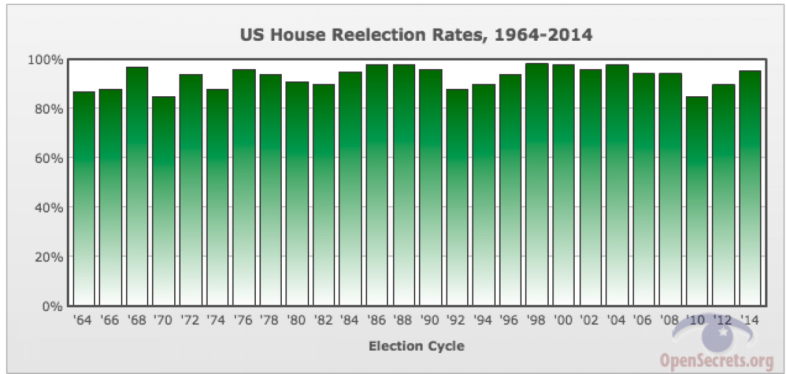
Incumbency Advantages
Unchallenged seats
Gerrymandering
Notoriety
Constituent Service
Media coverage
“bully pulpit”
Voter Preference(?)
Campaign funds
  Contacts
  Expectation of success
Notes:
The incumbent (person in office) has lots of advantages:
Unchallenged seats – often there is no challenger especially in a heavily GOP or DEM district
Gerrymandering – district lines are drawn to help them win
Nortoriety – they are more well known
Consituent Service – remember they “bring home the bacon”; do things for their voters
Media covers the incumbent more…especially the Prez
“bully pulpit” – the incumbent can use the power of his/her office (esp. Prez) to promote their policies
Voters may like the job the incumbent is doing…they have a record
Campaign funds….if incumbents usually win, and we know they do…they usually get more donations….

Slide 6
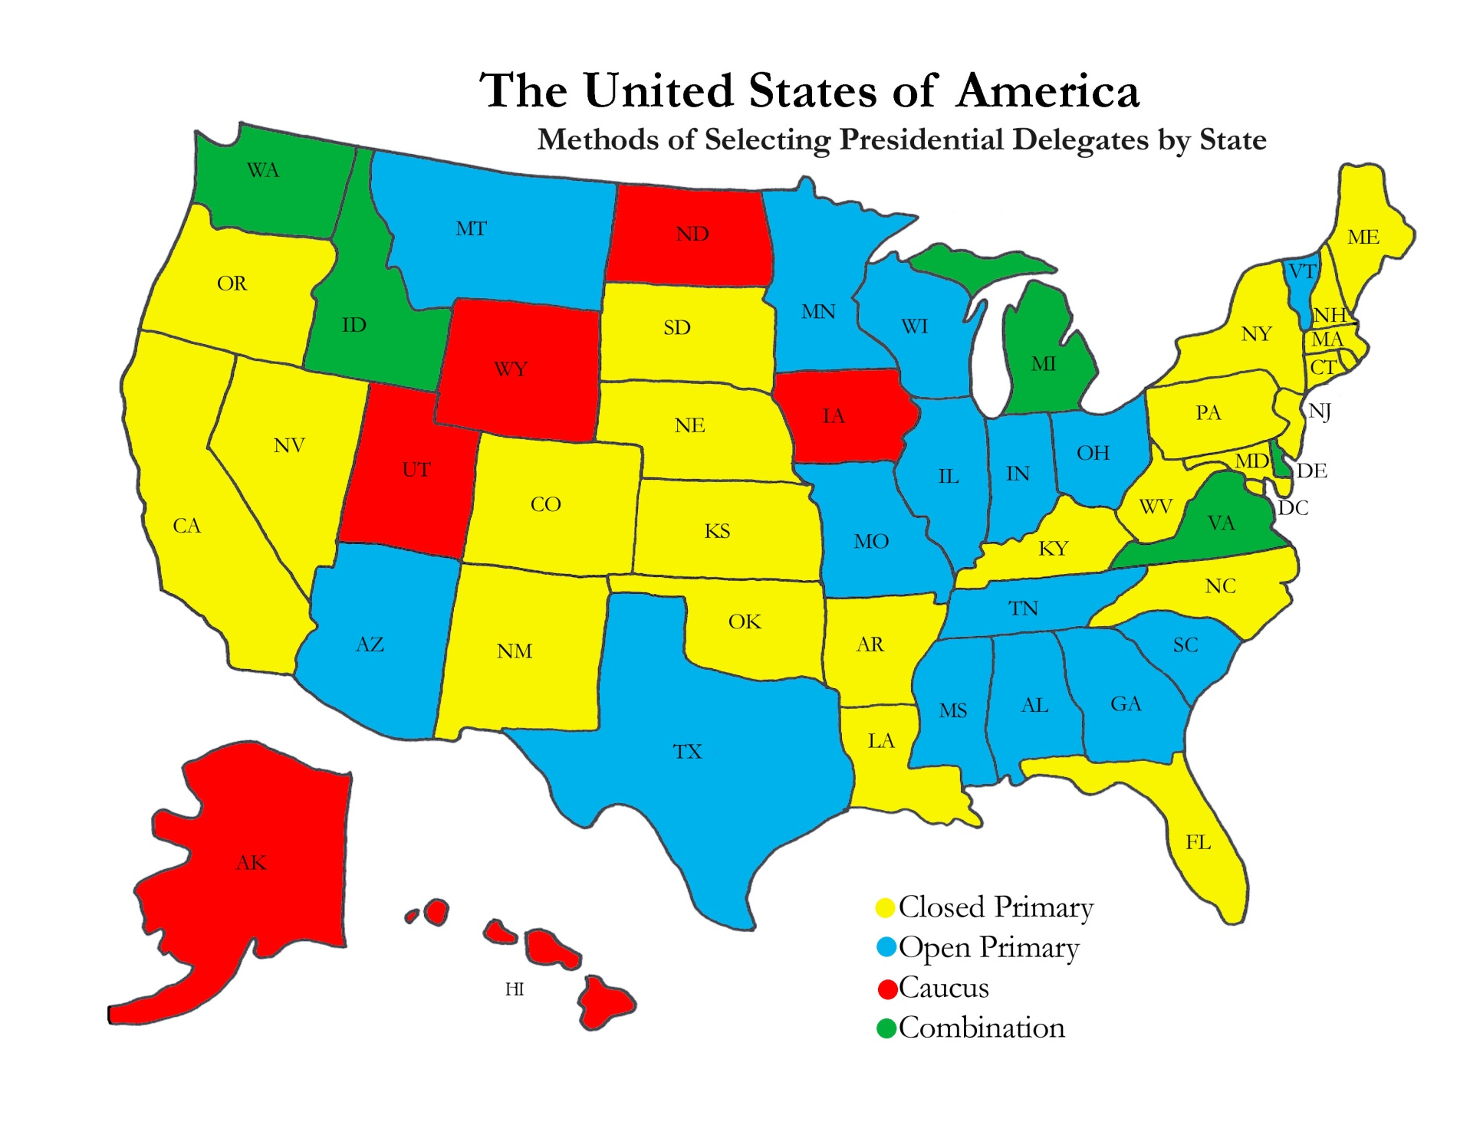
Caucuses & Primaries
Caucus
Primary
a closed meeting of party members in each state. Delegates to the meeting select the party’s choice for presidential candidate
Election in which voters decide which of the candidates within a party will represent the party in the general election
Notes:
Caucuses are Primaries are BOTH ways the parties choose candidates….refer back to donut selection….notice, most have primaries…they are “easier” but not necessarily better…

Slide 7
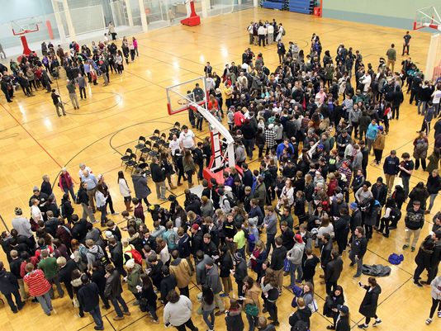
How a Caucus Works…
Notes:
*depending on time…caucusing is easy – 5 min
* Inside the 2008 iowa caucus – 10 min

Slide 8
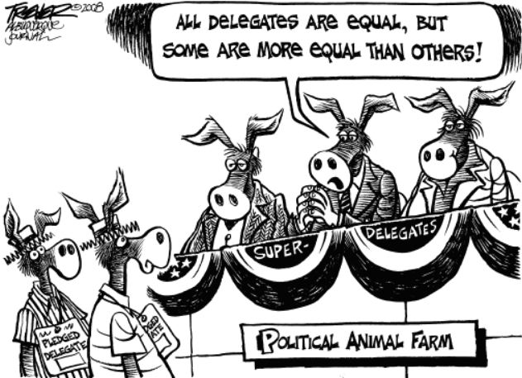
Types of Primaries
Open
Closed
Blanket
Winner Take All
Proportional
Notes:
Open – members of either party can vote in the primary
Closed – only members of the party can vote in the primary
Blanket – you can vote in both primaries at once (covers all)
Winner take all – you win the primary, you get all a states’ delegates in the presidential primary
Proportional – you get a percentage of delegates equal to the percentage of the vote you received in the presidential primary

Slide 9
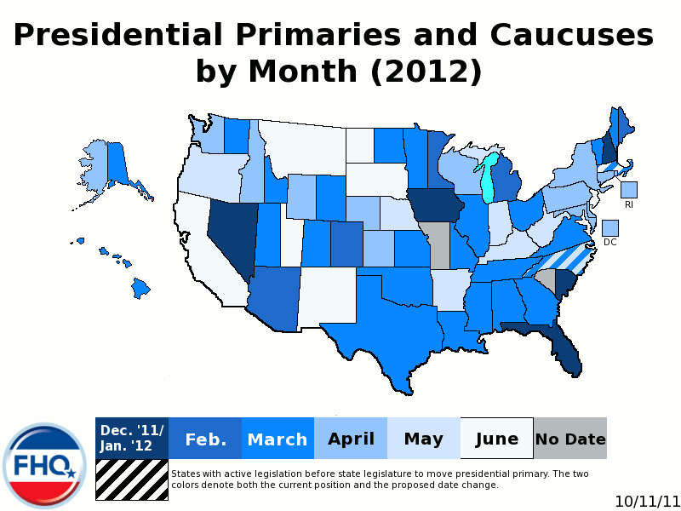
Presidential Primary
instead of choosing a candidate, voters actually choose “delegates” (party members) who will attend and vote at the national convention
FRONTLOADING – states move their primaries and caucuses to earlier dates to increase their importance
Notes:
*the presidential primary is unique….because it’s a LONG season
* Notice smaller states (esp. IOWA and NH) have theirs earlier because they don’t matter in the general election but they will and do in the primary

Slide 10
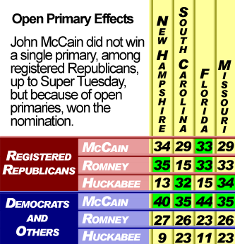
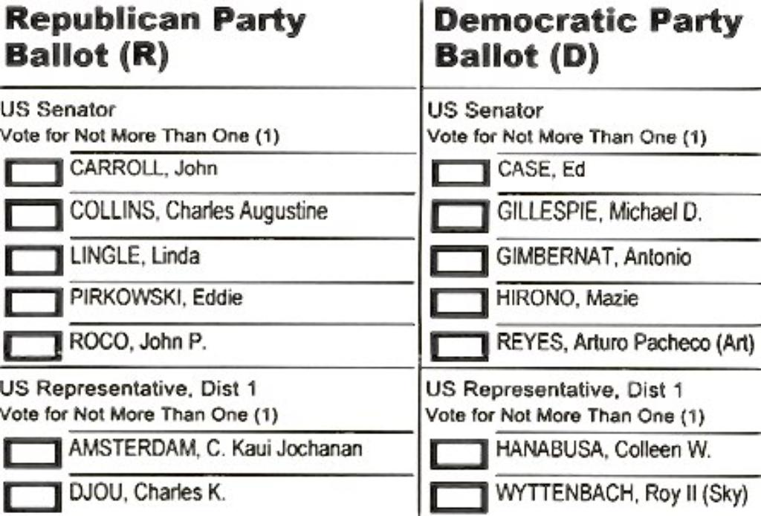
Blanket Primary
Notes:
Top right – McCain benefitted from Open primaries…because independents and democrats voted for him
Bottom Left – what a blanket primary would look like…we don’t have these in Illinois because the parties don’t want it to happen

Slide 11
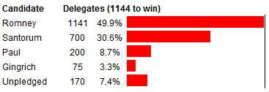
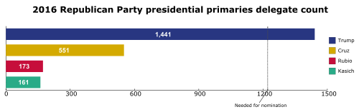
Notes:
Again, in the presidential primary you are collecting enough delegates in each states’ primary (which are different in every state) to win the nomination

Slide 12
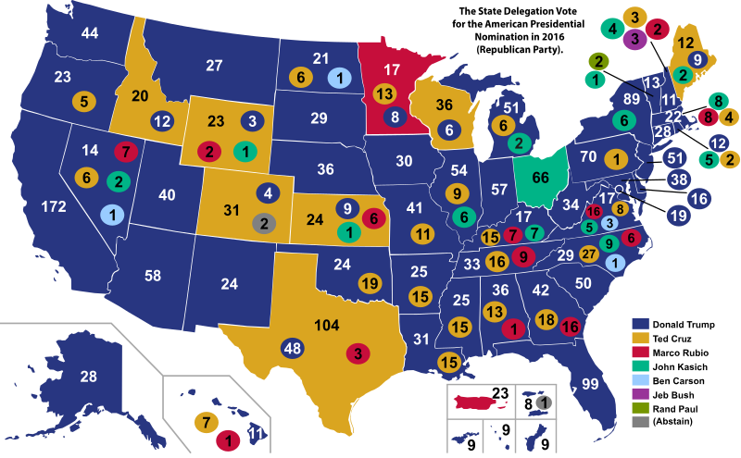
Notes:
Notice where President Trump did the best….WINNER TAKE ALL…he didn’t need a majority, just a plurality (more than anyone else)

Slide 13
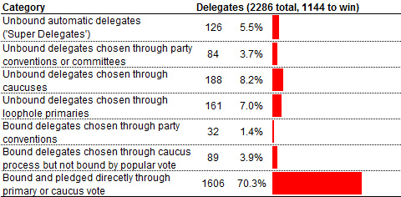
Superdelegates (DEM only)
Pledged vs. Unpledged Delegates
Notes:
Democratic Primaries are particulary interesting because….
Superdelegates (party leaders) can give their votes to whomever they want, even though they are not elected…i.e. Bill Clinton is a Superdelegate…many thought Hillary won the nomination from Bernie Sanders because of his influence on other Superdelegates
Pledged delegates – some delegates to the convention HAVE to vote for who they were elected to support
Unpledged delegates – some can change their vote from who they were supposed to vote for
20% of the delgates can vote for whomever they want

Slide 14
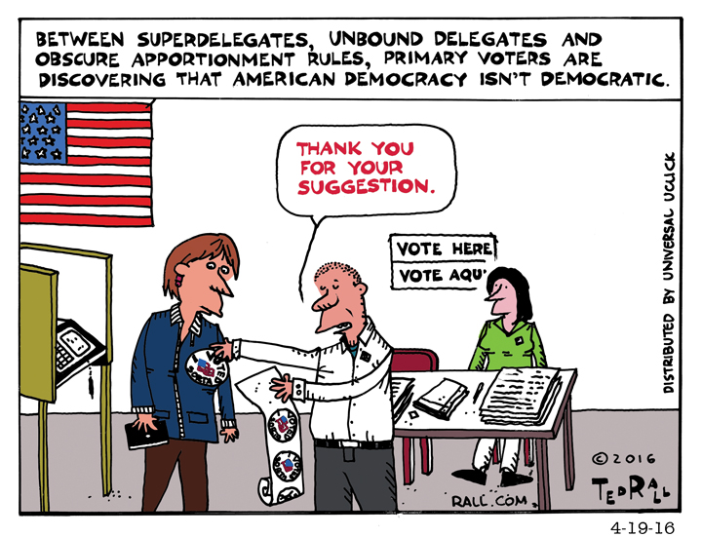
Notes:
Obviously, Primaries are difficult to understand because there are so many types and so many different rules…remember, political parties are like ladders, the national party can’t control everything so States set different laws and conduct elections differently

Slide 15
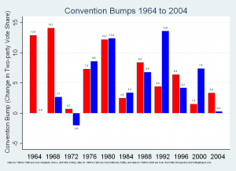
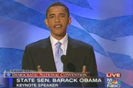
Conventions
held by parties every four years before presidential elections
Key Tasks/Events
Approve Platform
Nominate Candidate
Keynote Address
Acceptance Speech
Notes:
All Presidential Primaries end at the convention where they….
Usually the Candidate gets a “bump” in the polls immediately after a convention…it’s a media event…a party for the party

Slide 16
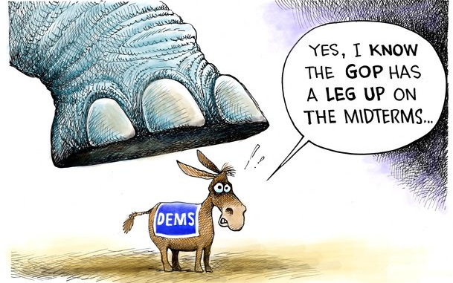
Midterm Election
General Elections that are during the middle of the President’s Term (ex. 2018)
The President’s party usually loses seats in Congress
Lower voter turnout (not 2018!)
Notes:
And there are other types of elections too…

Slide 17

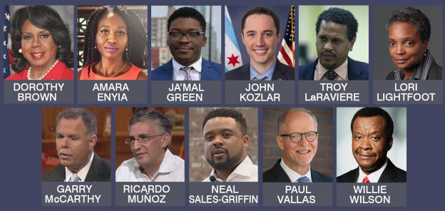
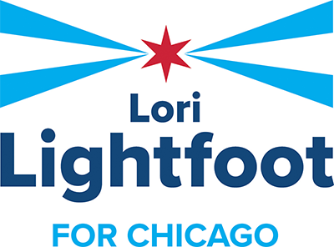
“Off Year” Election
City, State or Local Offices may be on the ballot
i.e. Mayor, School Board, Park District, Sherriff
Might even be at different time of year
Ex. 2019
Notes:
Even lower voter turnout….PSD 202 election in April 2019 approx. 16% voter turnout

Slide 18
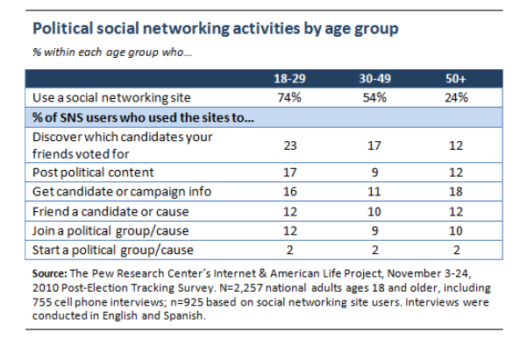
Campaign Organization & Strategy
Benefits and drawbacks:
  Dependence on professional consultants
  Rising campaign costs and intensive fundraising
  Duration of the election cycle increasing
  Impact of and reliance on social media for communication & fundraising
Notes:
Because campaigns are so complicated and so different, this has effects on campaign organization and strategy…

Slide 19
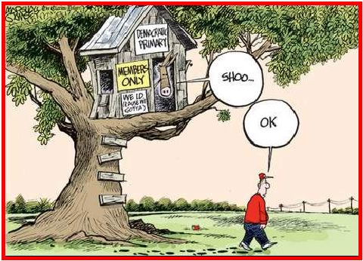
Notes:
A closed primary!

Slide 20
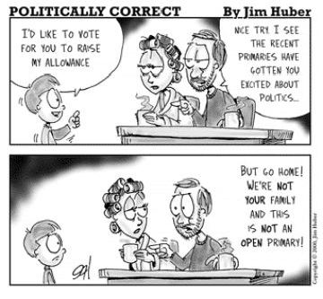
Notes:
He doesn’t get to vote because it’s a closed primary

Slide 21
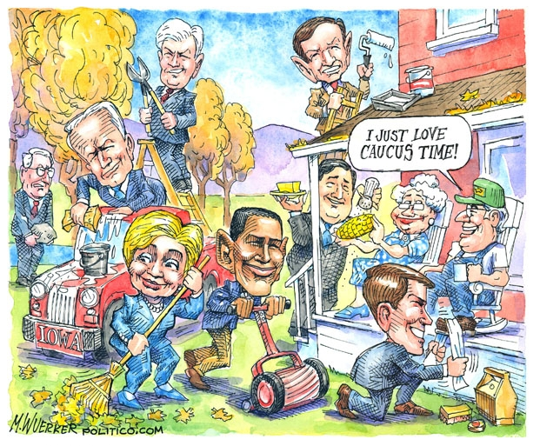
Notes:
IOWA caucus is the first in the presidential primary…it’s so important to gain momentum for a candidate that they will do anything to get support….this is from 2008 and shows Democratic Primary Candidates like Obama and Clinton

Slide 22
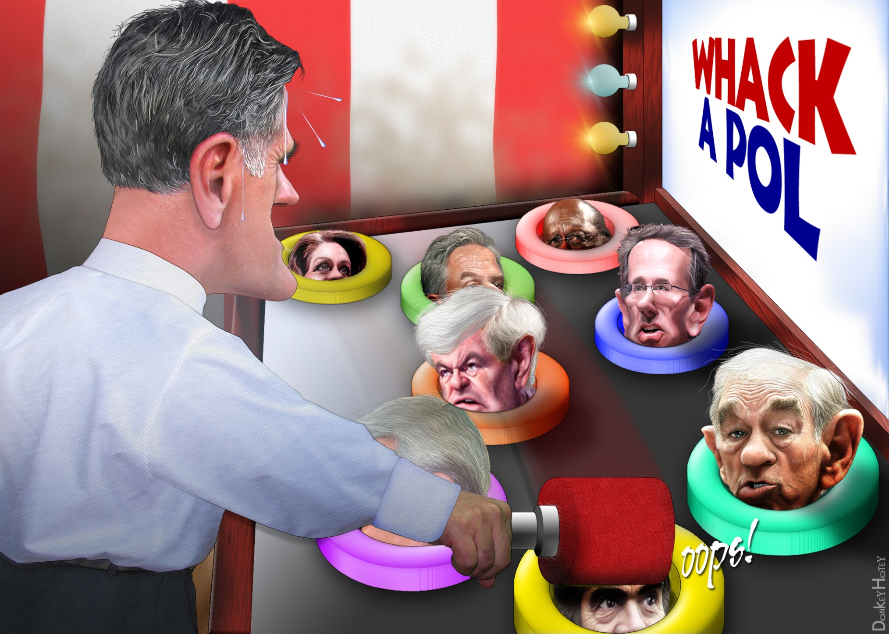
Notes:
Gotta survive during the presidential primary and knock down all the other candiates….

