Slide 1
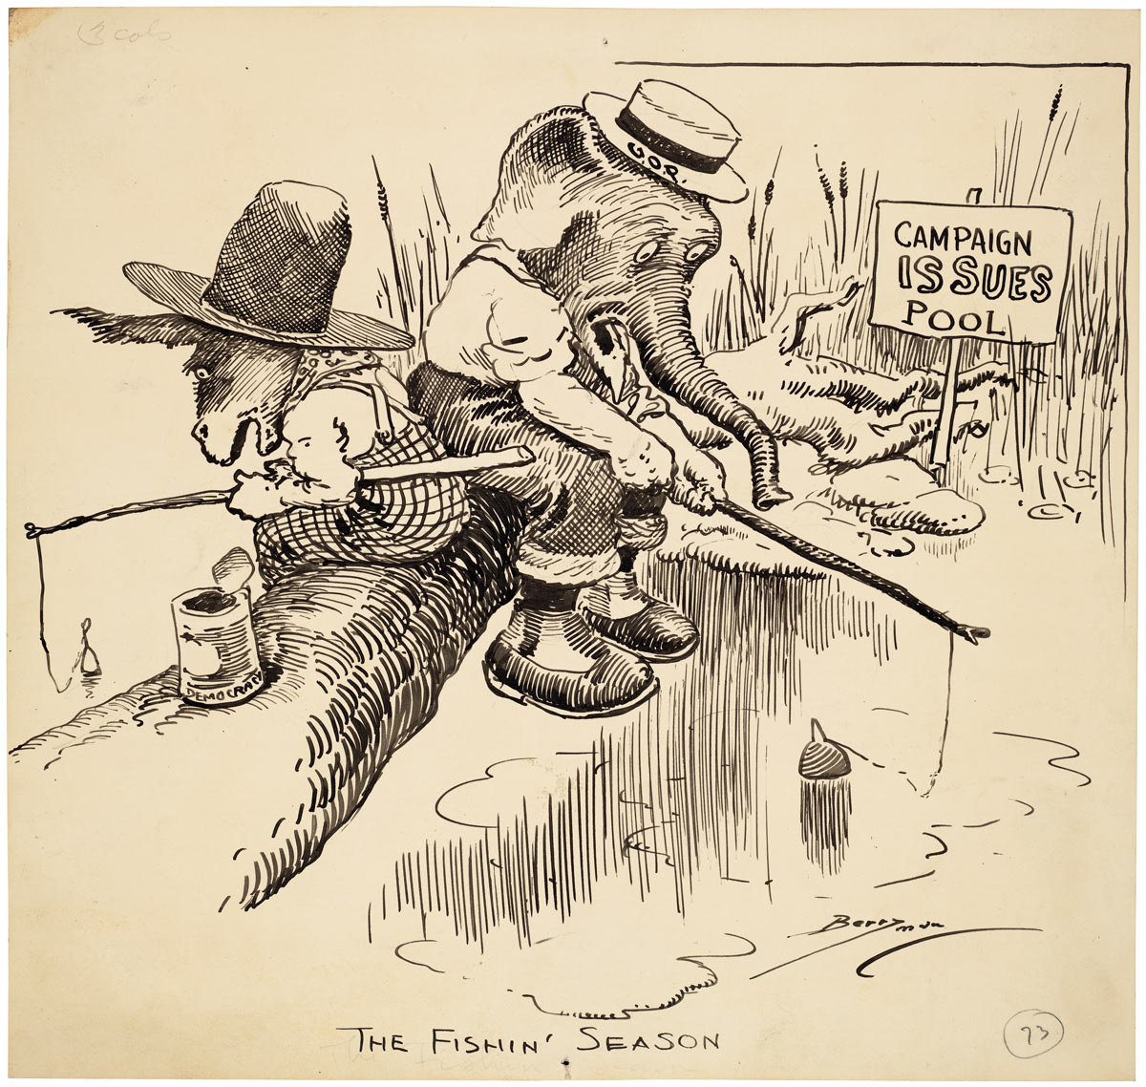
www.learnnc.org/lp/multimedia/9686 Clifford K.Berryman, 1919
National Archives and Records Administration
Notes:
Point?
* Both parties are fishing in the same pond to find issues that the public will “bite on”

Slide 2
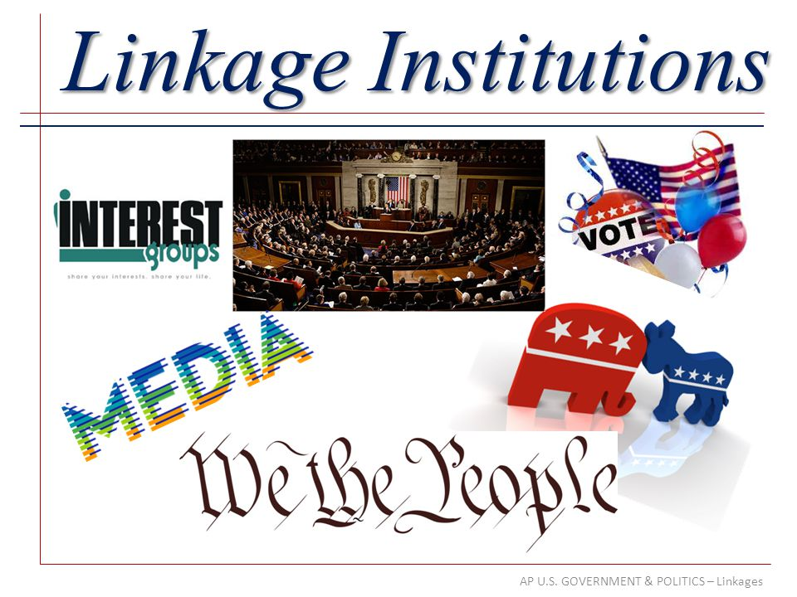
Describe linkage institutions
Explain the function and impact of political parties on the electorate and government
Notes:
Unit 5 is really about “linkage institutions”…things that connect the people to the government so they can participate….

Slide 3

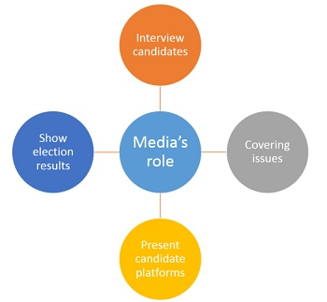
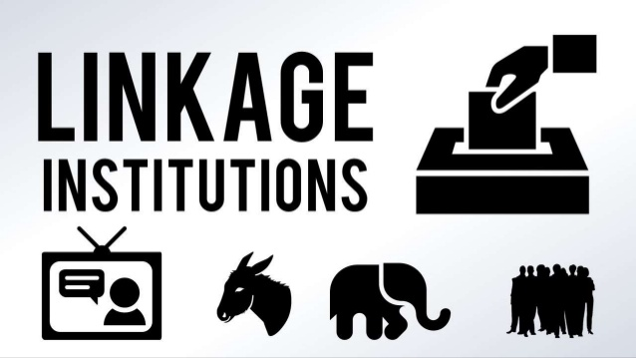
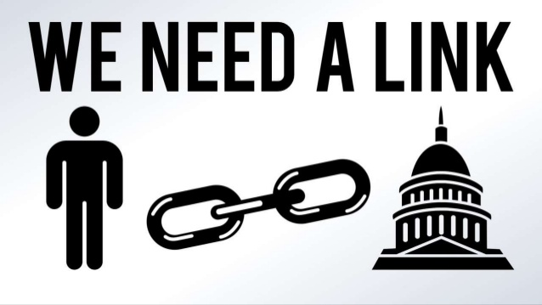
Linkage institutions
Channels that allow individuals to communicate their preferences to policy makers
  (a source of political efficacy)
  Interest Groups
  Elections
  Media
  Parties
Notes:
There are four types of linkage institutions and each of them play a slightly different role in connecting the people to the government….

Slide 4
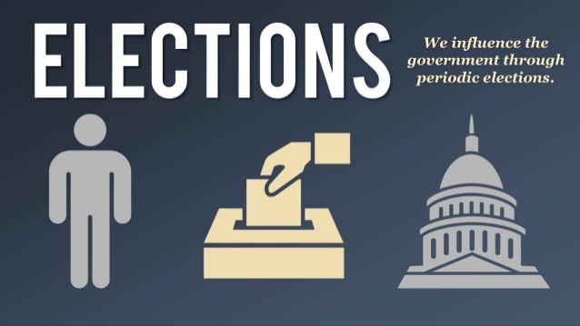
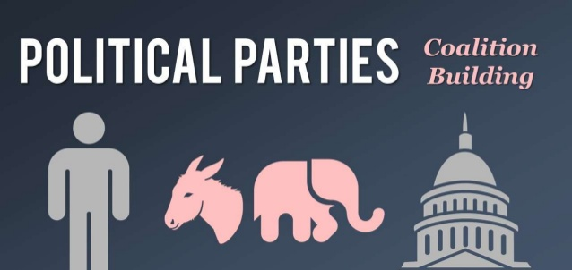
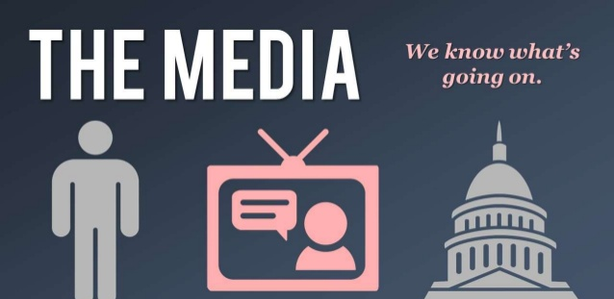
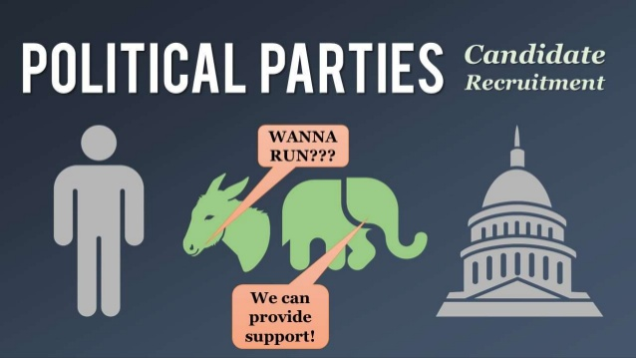
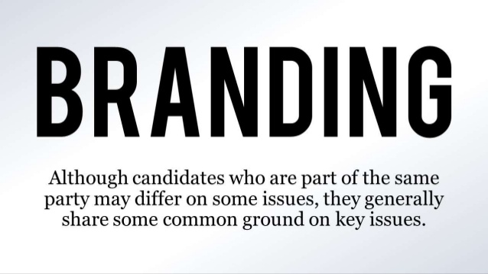
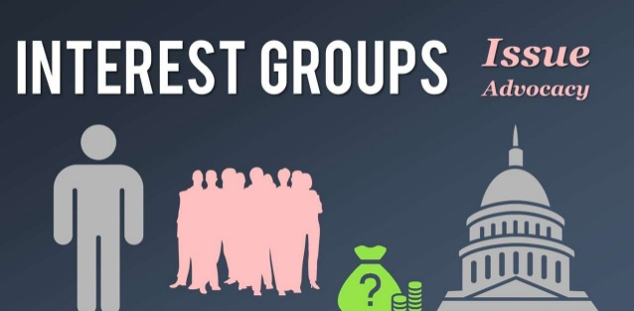
Notes:
Basically, these are the role each linkage institution plays….

Slide 5

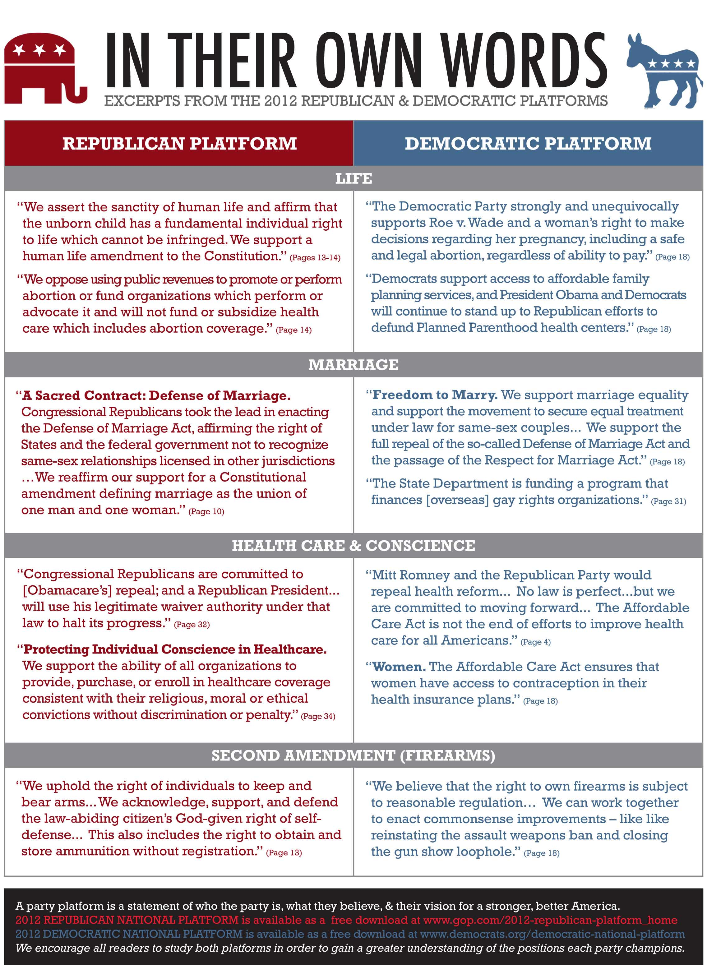
Function & Impact of political parties
Voter Mobilization & Education
Candidate Recruitment
Committee and Party leadership structure in legislatures (organize government)
Campaign Management
  Fundraising
  media strategy
Party Platforms
  Policy Formation and Promotion
  Inform the public
Notes:
Political Parties (whether major or minor) have similar functions….of course they do all of these according to their own ideology…

Slide 6
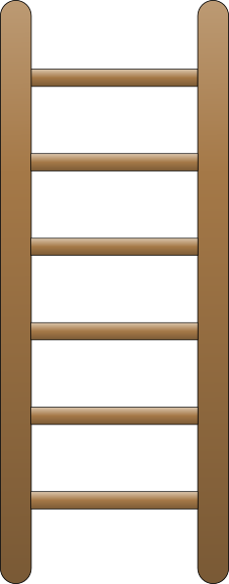
Political Parties are like ladders
National Committee/Party
State Committee/Party
County Committee/Party
Local Committee/Party
Precinct
Largely independent organizations at each level
united by common ideology & platform
Support each other in their efforts
NOT a hierarchy where the top tells the bottom what to do!
IDEOLOGY
PLATFORM
Notes:
But political parties are loose organizations otherwise you wouldn’t have a DJT that’s not a standard republican or an Alexandria Occasio Cortez or Bernie Sanders that have socialist views in the Democratic Party.

Slide 7
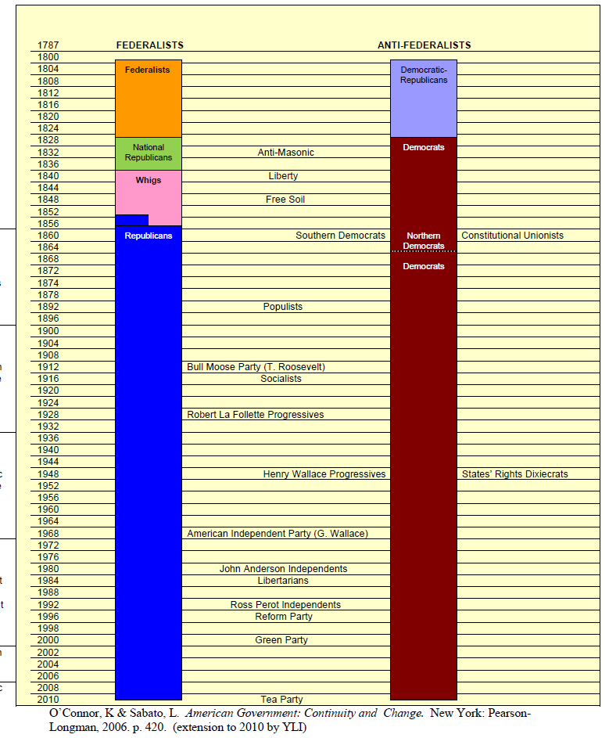
Why 2 parties?
Tradition
Single Member Districts
Winner-take-all system
  Winner receives a seat while loser
  receives no seats or power
So…what would be a 3rd party usually joins one of other parties
Opposite (other countries): Proportional Representation – % of votes is directly applied as the % of representatives
Notes:
The U.S. has always had two major parties because of:
Tradition – were used to it and politically socialized
Single member districts – there is one Representative or one Senator elected from each area…unlike multiple member district like a school district where you might elect two people from a list

Slide 8
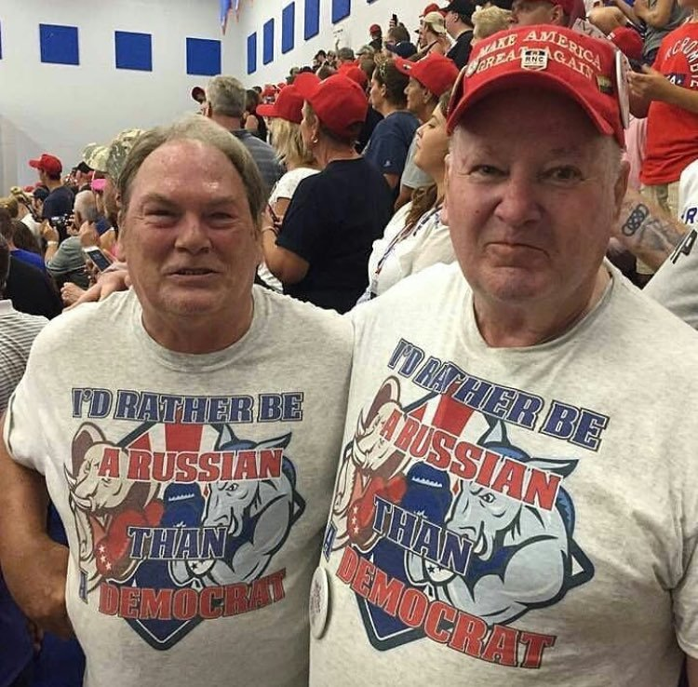
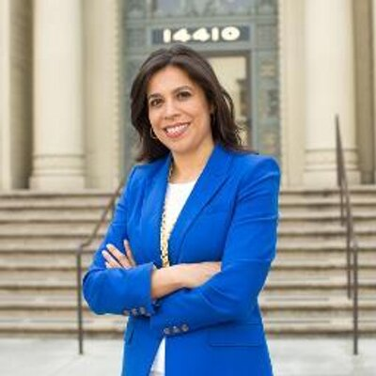
Candidate recruitment
“The making of a democrat”
Notes:
Use: the video series, Democracy in America (blue set on my desk in the office) the section on “Political Parties” and show “The Making of a Democrat” this is a great example of how political parties work and build their brand by recruiting the right candidates and promoting them….there is an external DVD drive under my desk.

Slide 9
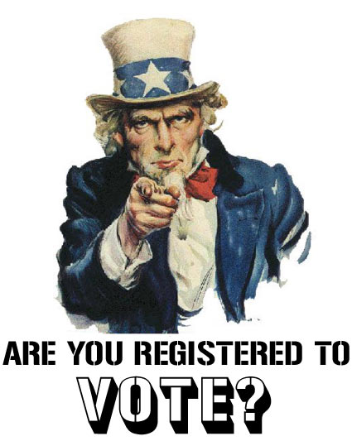
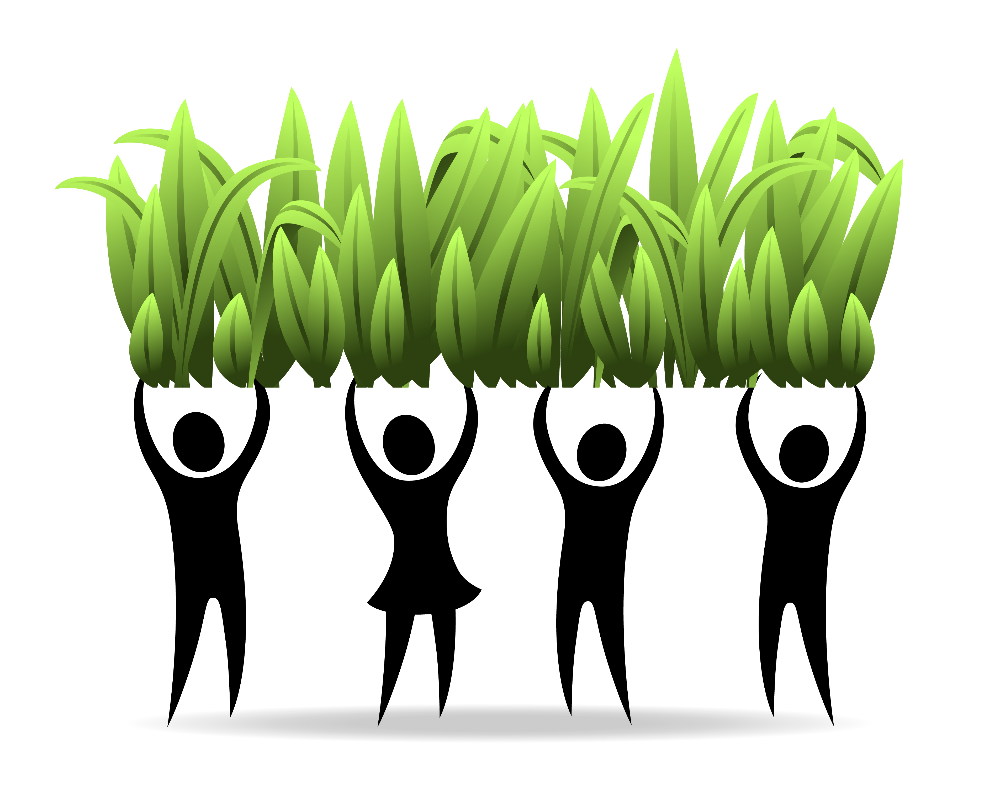
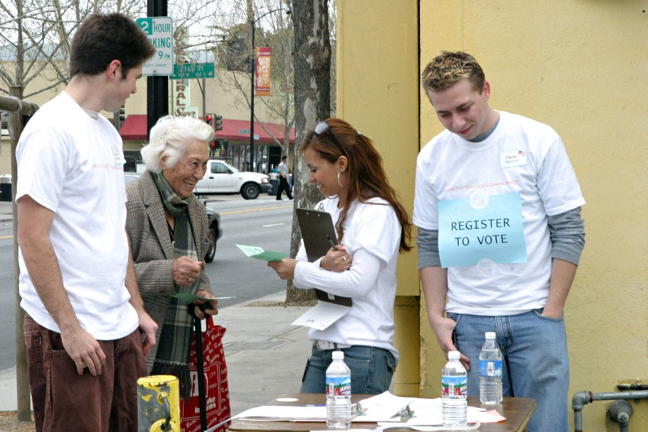
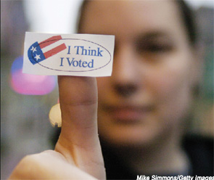
“Grass Roots”
                – parties can also reach the voters personally and “get-out-the-vote” on a local level
Notes:
So remember…parties are loosely organized from the bottom to the top…and people can connect to different levels of government indifferent ways and using different methods…

