Slide 1
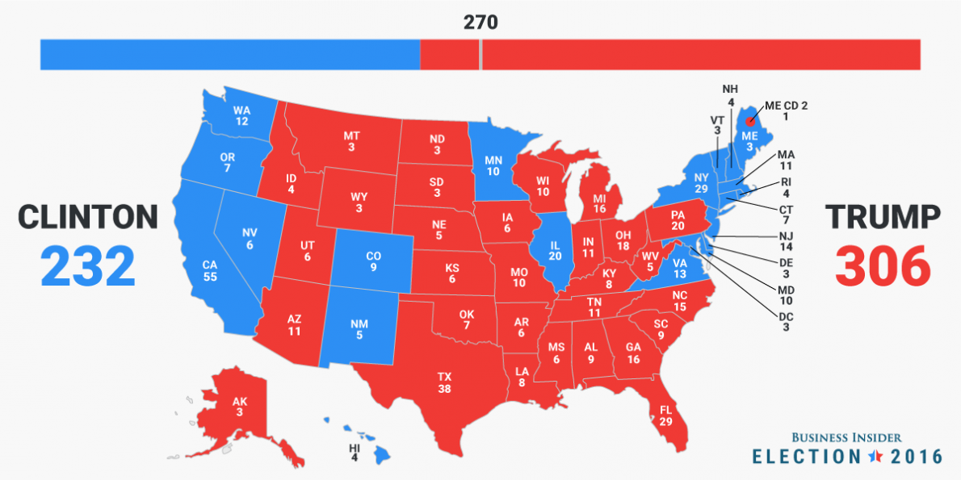
The Electoral College
* explain how the electoral college impacts democratic participation

Slide 2
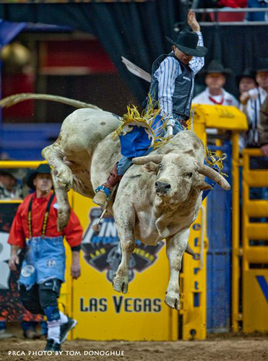


Slide 3
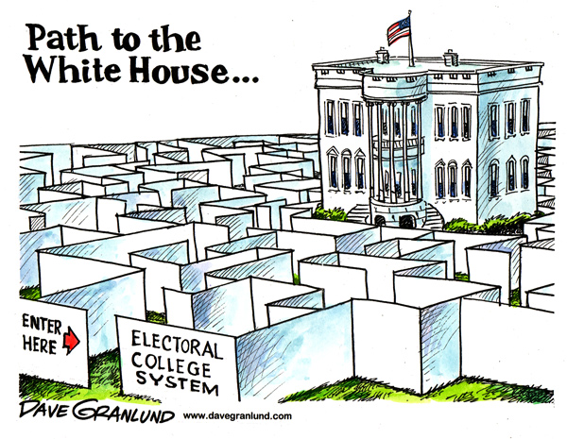

Slide 4
Do the voters matter?
Yes!
You are voting for ELECTORS State legislatures choose them.
* 51 small elections add up to one big one

Slide 5
Specifics
270 of 538 votes required to win
# Electors = # Senators + # Representatives
No winner- House of Reps. & Senate decide
Electors are selected by state legislatures
MOST states give votes on a winner take all basis

Slide 6
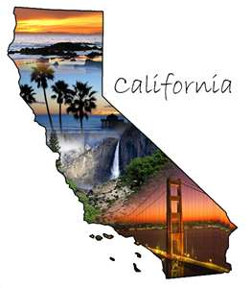
Large States are Extremely Powerful
Focus on smaller states in the primaries (earlier primary)
Focus on big states and swing states in the general election

Slide 7
Fictitious Election (partners)
With a partner or two, create a fictitious election map…you can switch off coloring in states or just color in sections…MAKE IT UP and see what happens
  Keep track of the number of electoral votes you have as you go so you don’t have to go back
Use the election you created to answer the questions on your worksheet
Use p.223-224 to help with #5 and #6
Notes:
Grab markers from the office so kids can color things in…a blank map should be in the file cabinet, folder is titled “Voters, Parties & Elections.”
Discuss their results, why no one wins in three party elections…which we never have…
Double side the map with the questions…

Slide 8
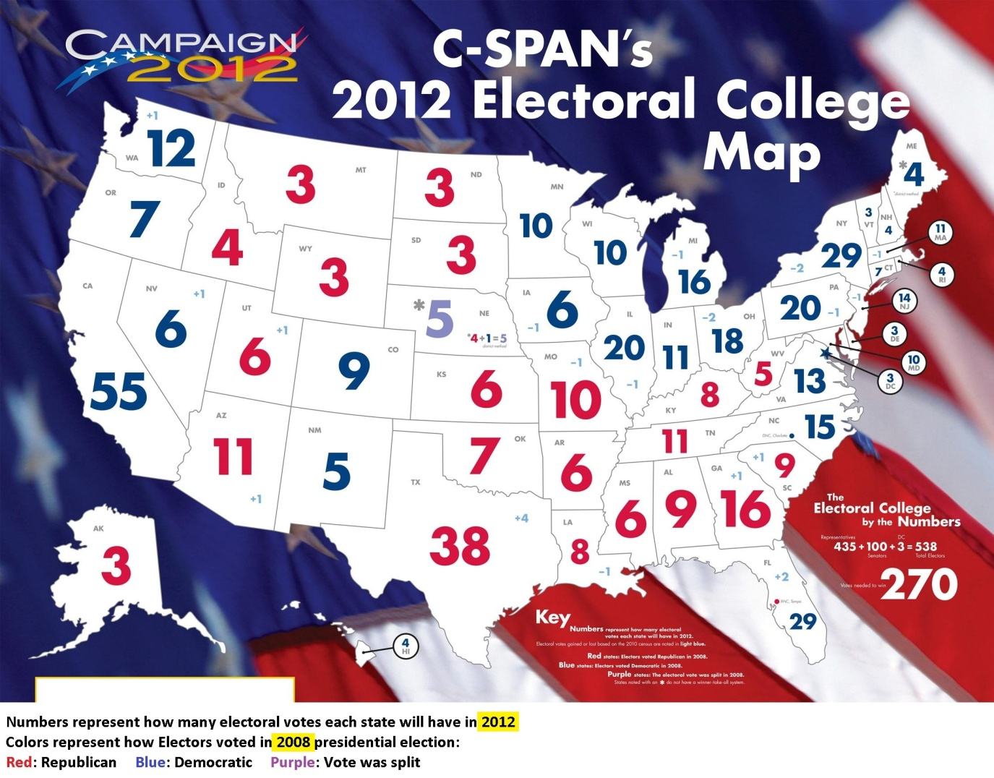
Use p.223-224 to help with #5 & 6

Slide 9
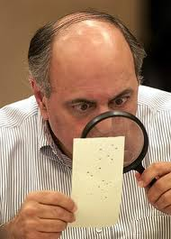
Problems
“Big 11”
Over-representation & under-representation
Non-Popular vote winner
“non-standard” votes

Slide 10
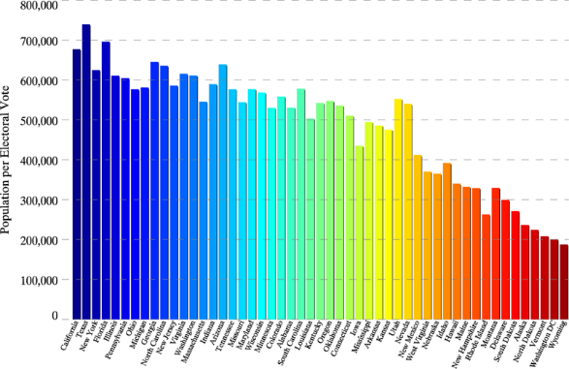
Over-representation & Under-representation

Slide 11
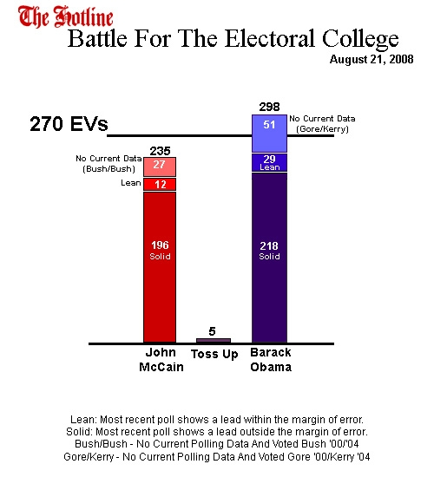
Solutions
Abolish
  Direct Popular Election
Divide electoral votes
  Proportionally?
  By district?
  (ME & NB)

Slide 12
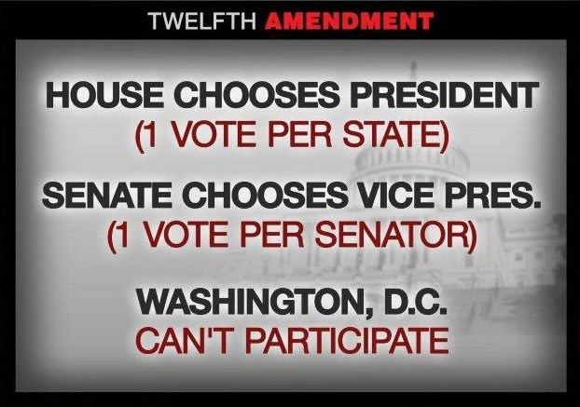
Why not get rid of it?
“safety valve”
  “Hamilton Electors”
Amendment Process

Slide 13

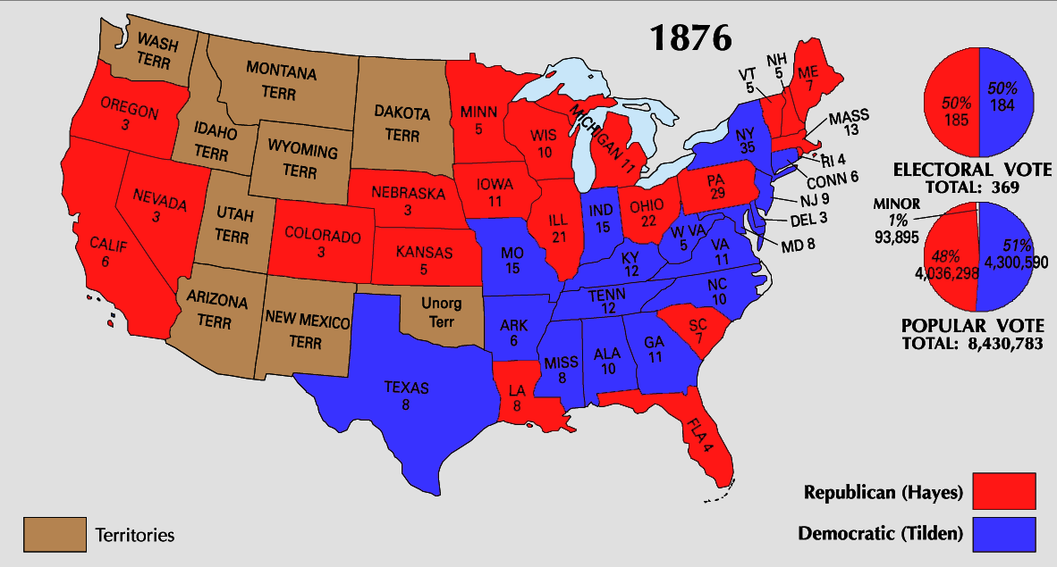
The Electoral College

