Slide 1

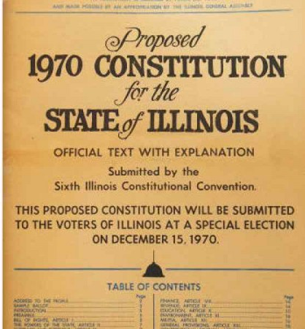

Slide 2
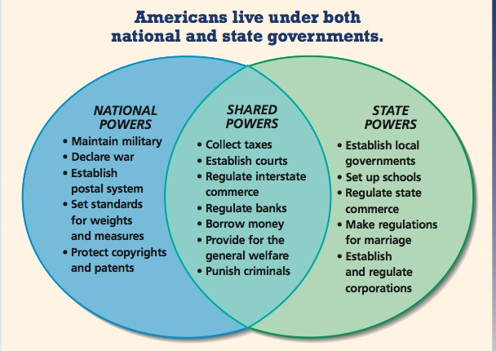

Slide 3
Comparative Constitutions
Constitution of the United States of America vs.
Constitution of the State of Illinois

Slide 4
Document Analysis
Use the “worksheet” to guide you through a comparison of the two documents.
I have added the articles, sections, and/or clauses of the Illinois Constitution which you will use (in some cases there is no specific place you need to look).
Join with a partner…complete the comparison of the Federal and State Constitutions.
  Do NOT “divide & conquer,” rather discuss & analyze ☺
  You may not need to look in the actual documents!

Slide 5

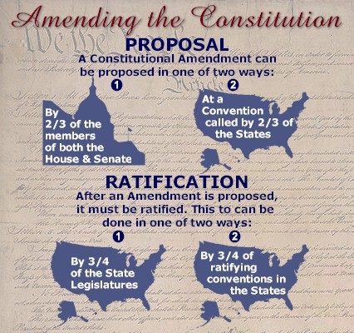
Federal Amendments:

Slide 6
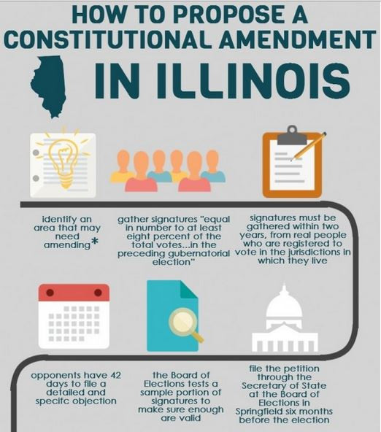
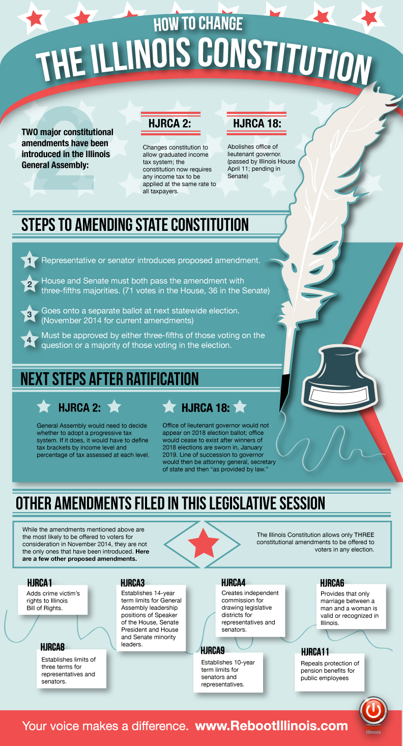


Slide 7
Illinois Constitution Amendment Processes
Option A
Proposed by a Constitutional Convention called for by 3/5 of General Assembly
Ratified by a majority of voters in the next general election
Option B
Proposed by a 3/5 vote of the General Assembly
Ratified by the voters:
* 3/5 of those voting on the question
or
* majority of those voting in the election
Option C
Proposed by a petition signed by = or > the number of voters in the last election
Ratified by the voters:
* 3/5 of those voting on the question
or
* majority of those voting in the election

Slide 8


Slide 9

Exit Slip…
Are the Illinois & US Constitution more different or more similar? Explain.
Please write on the back of the Compare/Contrast exercise.
5-7 sentences

Slide 10
Short Essay
Compare and Contrast the United States Constitution and the Illinois Constitution using at least three specific comparisons or areas of contrast and explain why you think this is so.
Prompt…The Illinois Constitution and the Federal Constitution are similar/different…
No more than 7-10 sentences, approximately ½ page if you type this.
Are the Illinois & US Constitution more different or more similar? Explain.

Slide 11


Study Guide Review

