Slide 1

Notes:
ILLINOIS BECAME A STATE DEC 3rd, 1818

Slide 2


Slide 3


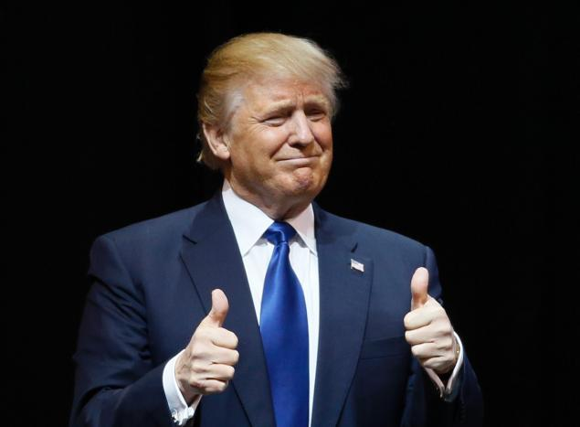
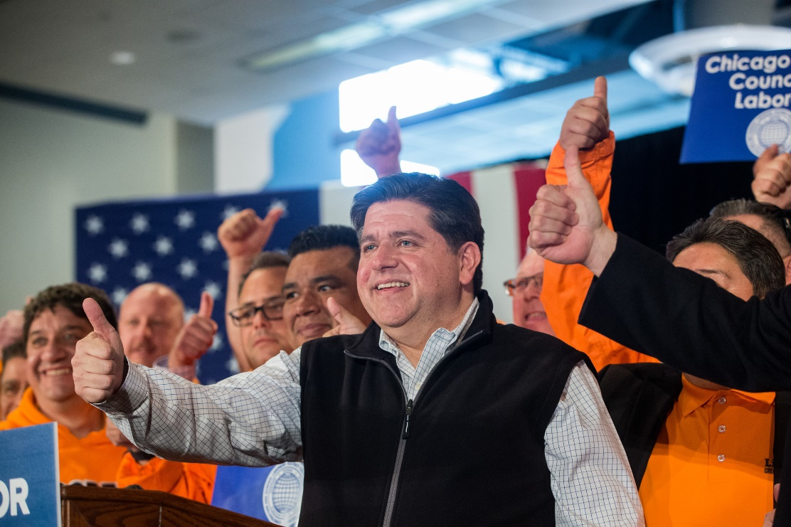
Which level of government is more important, the national (federal) government or the state (Illinois) government, why?

Slide 4
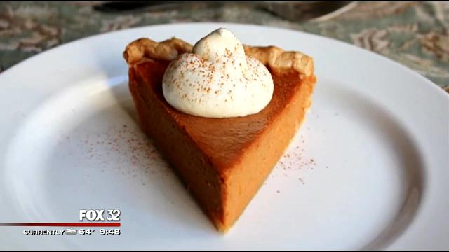
State Government at Work?
Your State Pie!
Notes:
Added recently by Gov Rauner

Slide 5
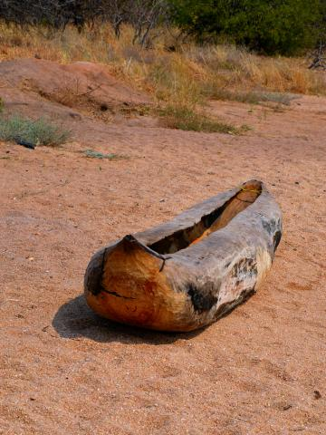
Or…the Pirogue
Your State Artifact!
Notes:
Added in 2006… this Canoe made from hollowed out tree bark was proposed by 8th grade students from St. Joseph Middle School in Wilmette to honor the Native American of Illinois

Slide 6
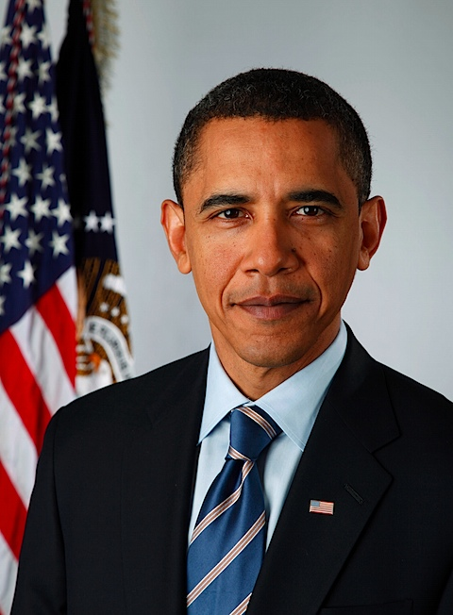
You know I’m from Illinois, but did you know…

Slide 7
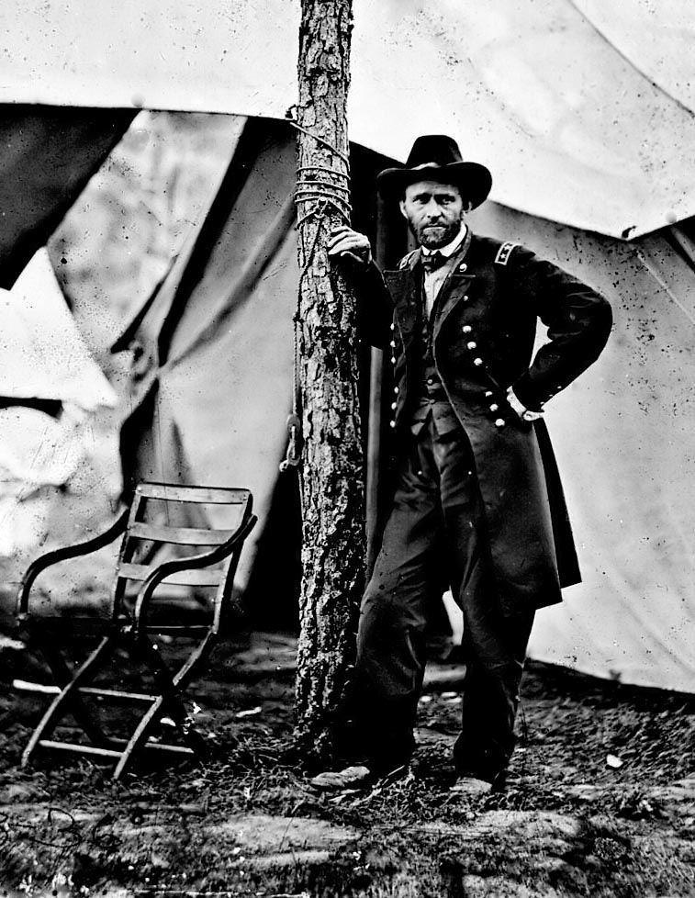
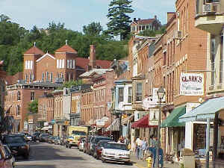
Galena
Illinois

Slide 8

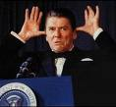
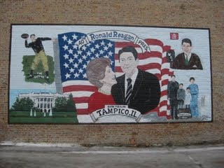
Notes:
Born in Tampico, IL and lived in Dixon, IL

Slide 9
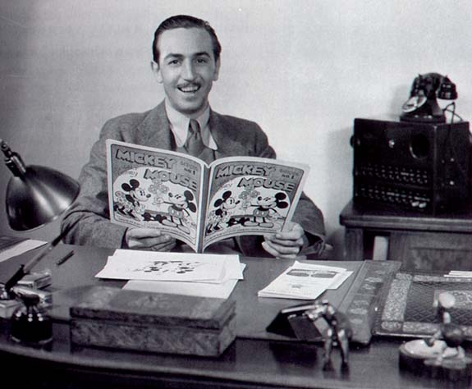
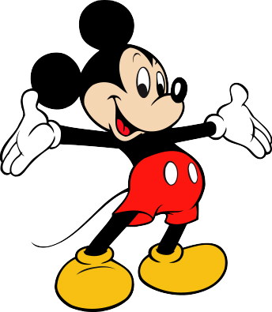
Notes:
Born in Chicago

Slide 10
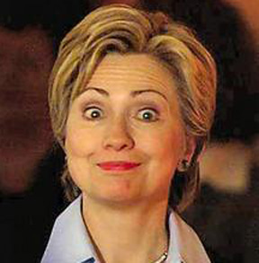

I’m from Illinois too!
Notes:
Born in Edgewater, IL

Slide 11
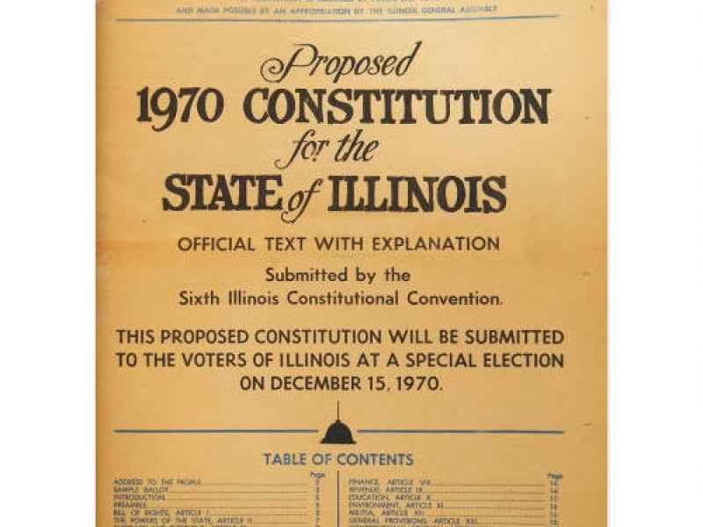
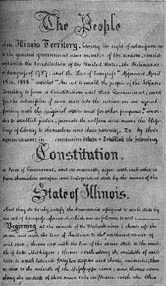
Illinois Constitution (1970)
Reserved & Concurrent Powers
  Remember Federalism?
State highways, local laws, intrastate commerce, traffic laws, education, marriage, divorce laws, hospitals, etc.
Biggest rule:
  If all else fails it’s like the federal government
Notes:
The 4th and current Illinois Constitution was adopted in 1970. It essentially contains 15 major sections called “Articles” broken down into subsections called “Sections.” It is very, very similar to the Federal constitution.

Slide 12
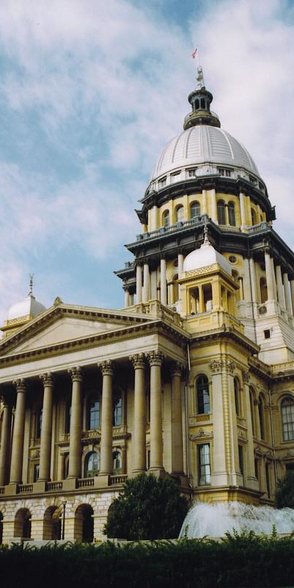
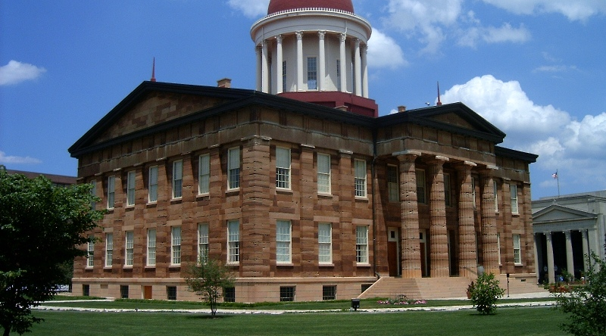
Illinois Capitol Building
Notes:
6th Statehouse / capitol building… admitted in started in 1868 and completed and admitted in 1888

Slide 13

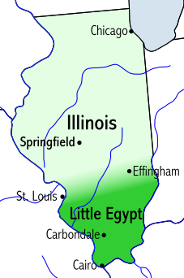
Capitals
Kaskaskia
Vandalia
Springfield

Slide 14
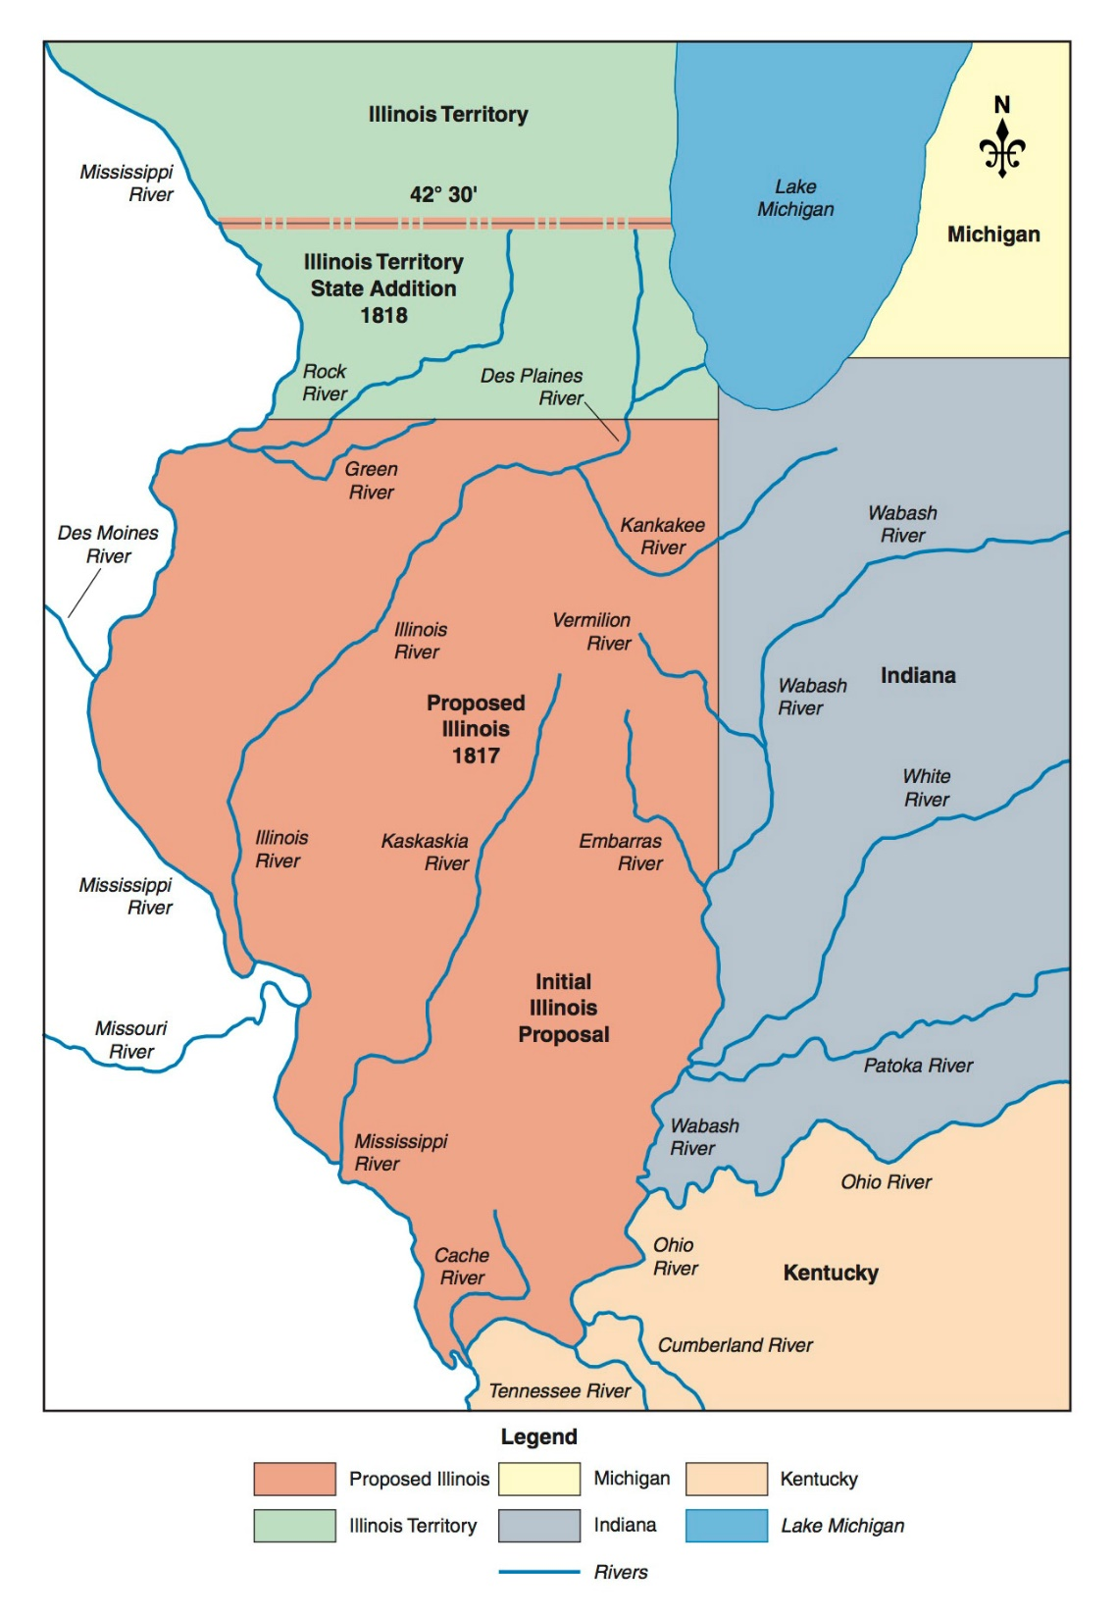
Why does Illinois Look this Way?
Notes:
Territory in 1808…. Statehood in 1818 (Dec 3)…

Slide 15
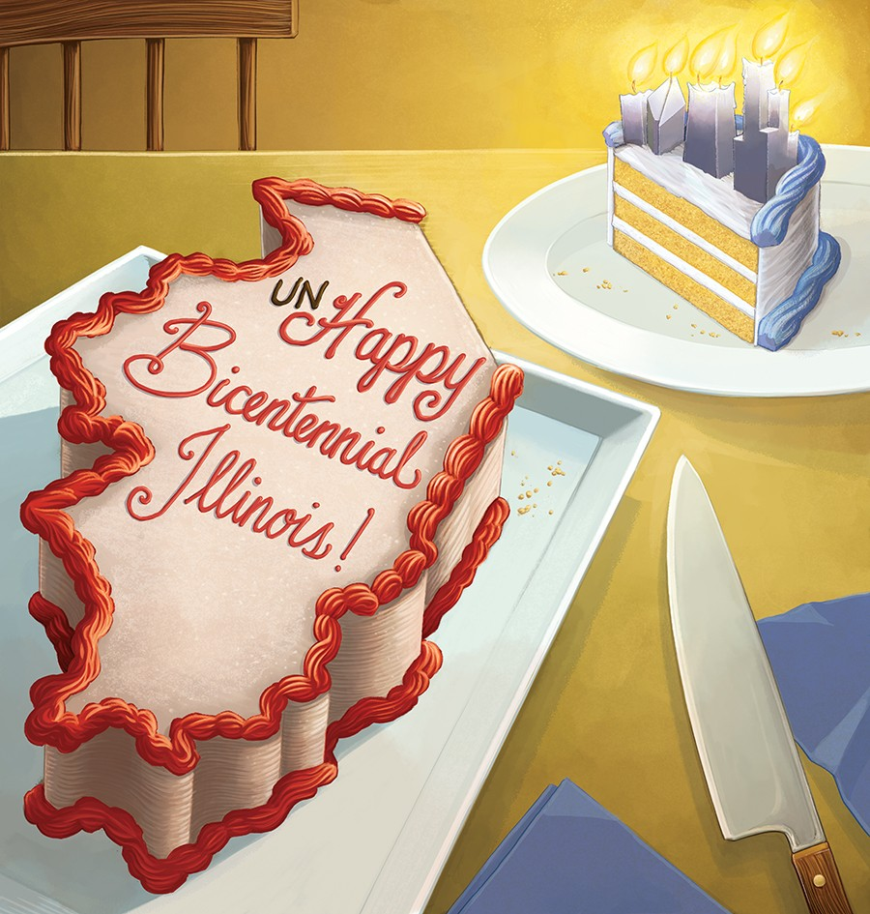

Happy Birthday Illinois!

Slide 16
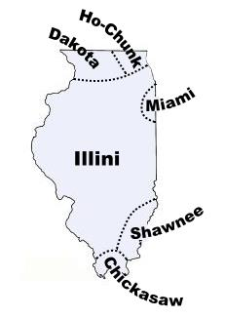
The History of Illinois
Illinois-21st state
1673 - French Explorers: Marquette & Joliet
1691 - First village, Pimitouri-later called Peoria
Indian tribes: Miami, Illiniwek (Illinois) and Potowatomee
1787 became part of the Northwest Territory
December 3, 1818 Illinois was admitted as the 21st state

Slide 17
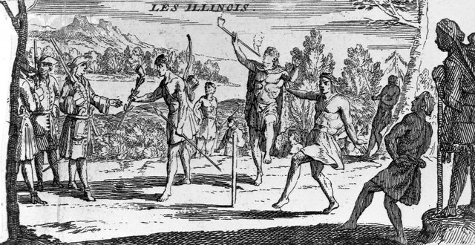
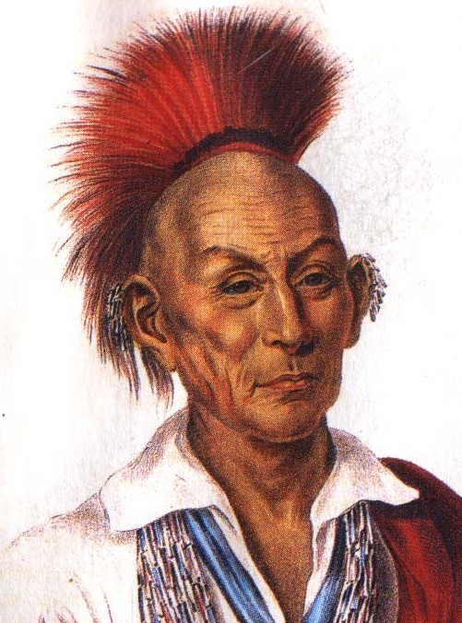
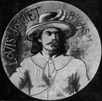
Chief
Black
Hawk
Louis Joliet

Slide 18
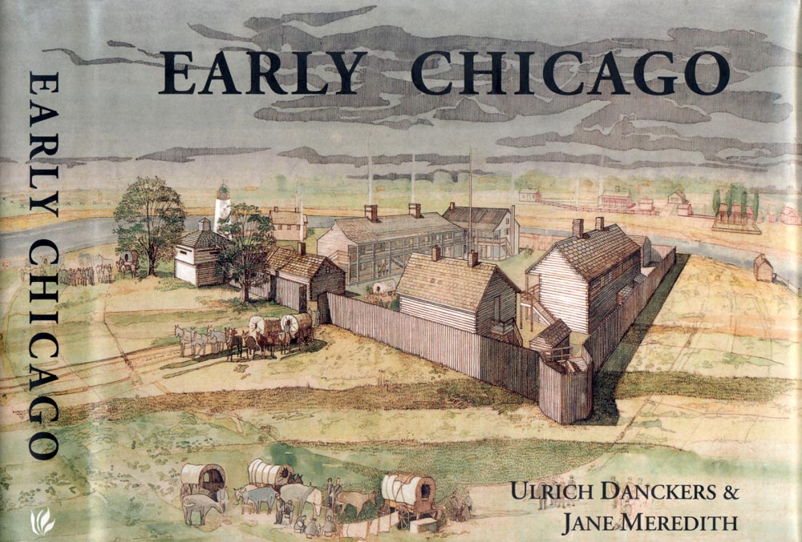


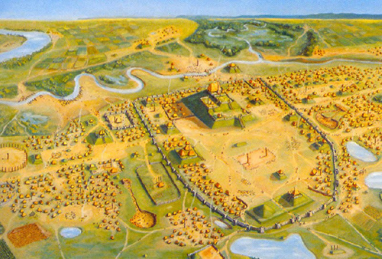

Slide 19
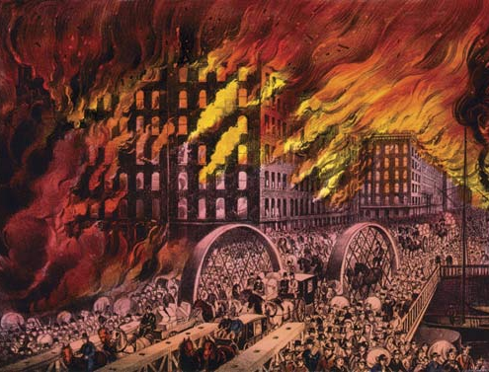
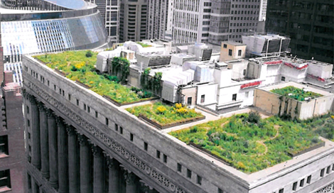

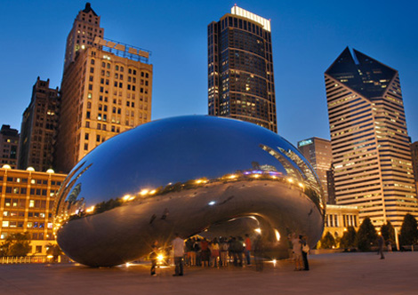

Slide 20
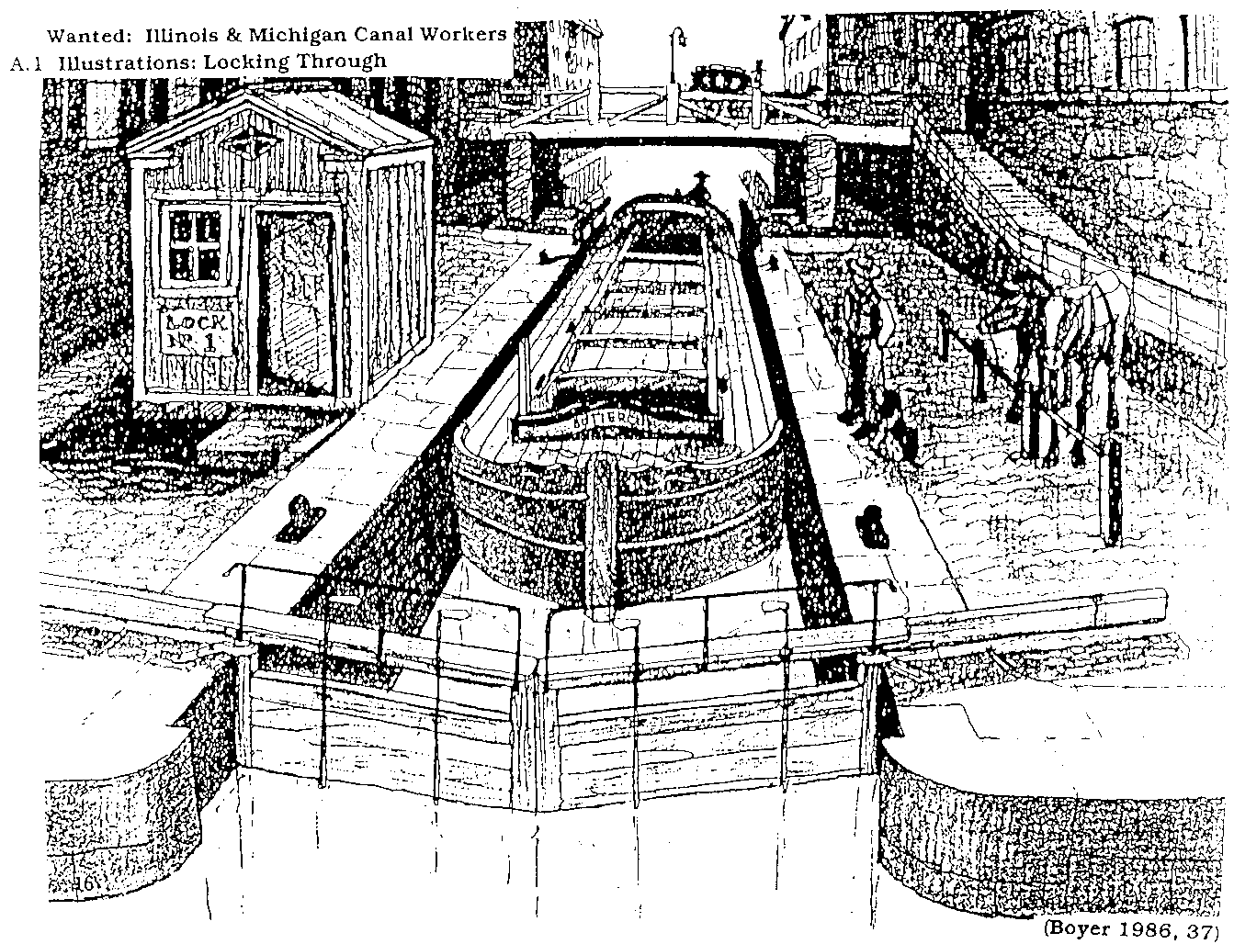
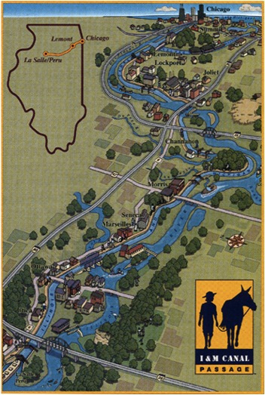
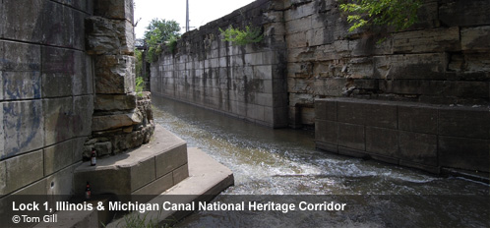
Illinois & Michigan Canal

Slide 21
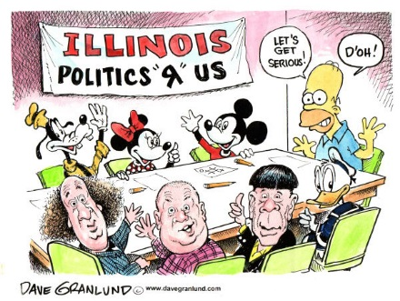

Slide 22
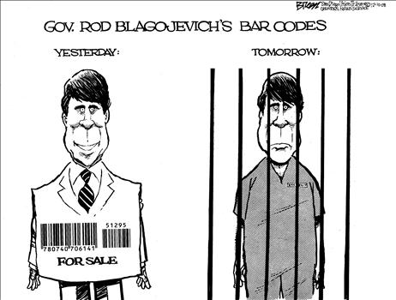
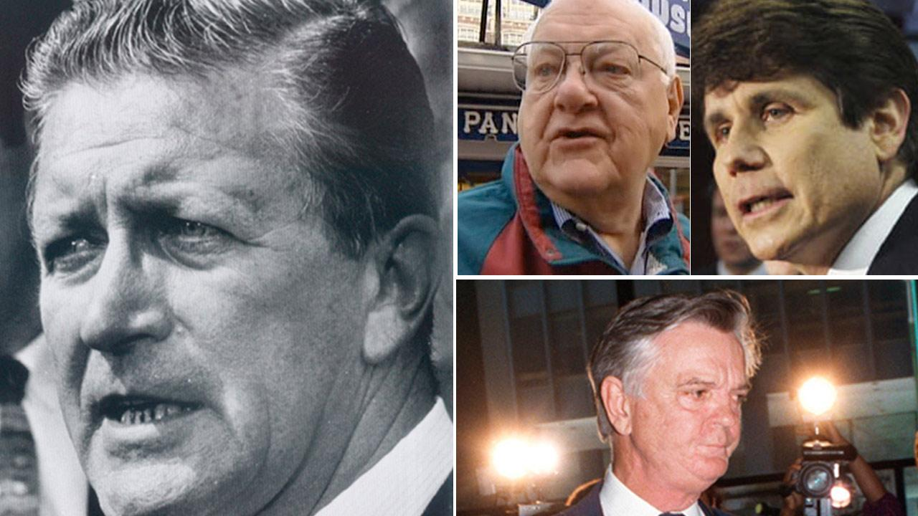
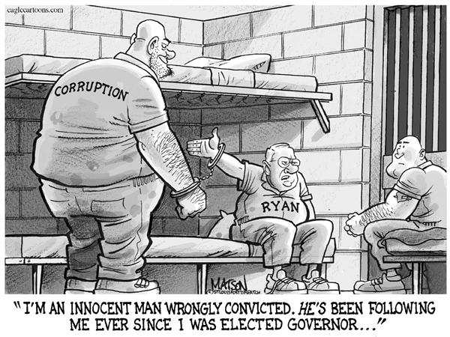

4 of last 9 in prison - $$

Slide 23
Governor
Chief Executive
Enforces laws
Vetoing/approves laws
Appoints many members of the state government
Grant pardons & reprieves
Delivers an address to the General Assembly
Commander-in-chief of the state militia
Requirements: 25 years old, resident for 3 years
Term: 4 years - unlimited terms

Slide 24
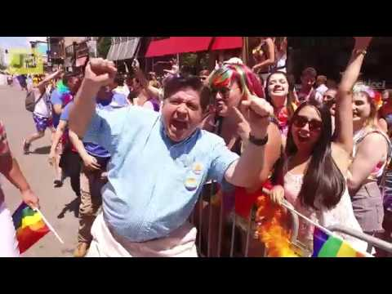
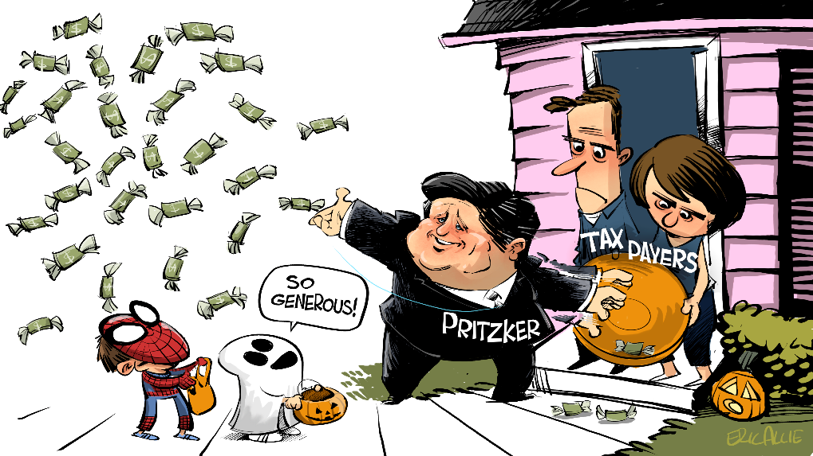
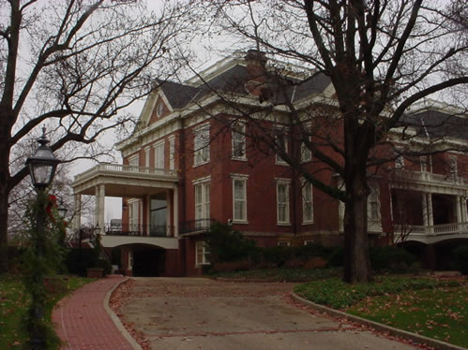
Governor
J.B. Pritzker (D)

Slide 25

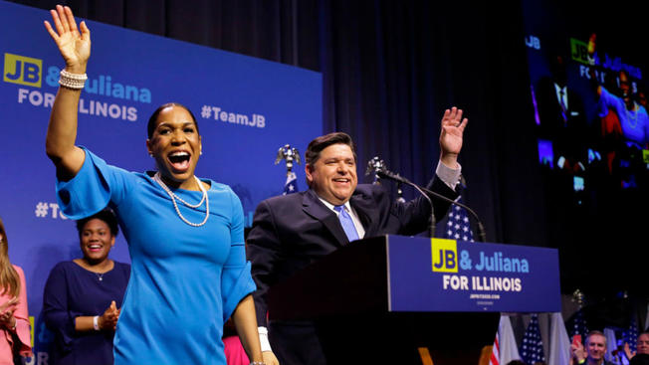
Lt. Governor
Juliana Stratton (D)
Takes over for the Governor
performs duties delegated by the Governor

Slide 26
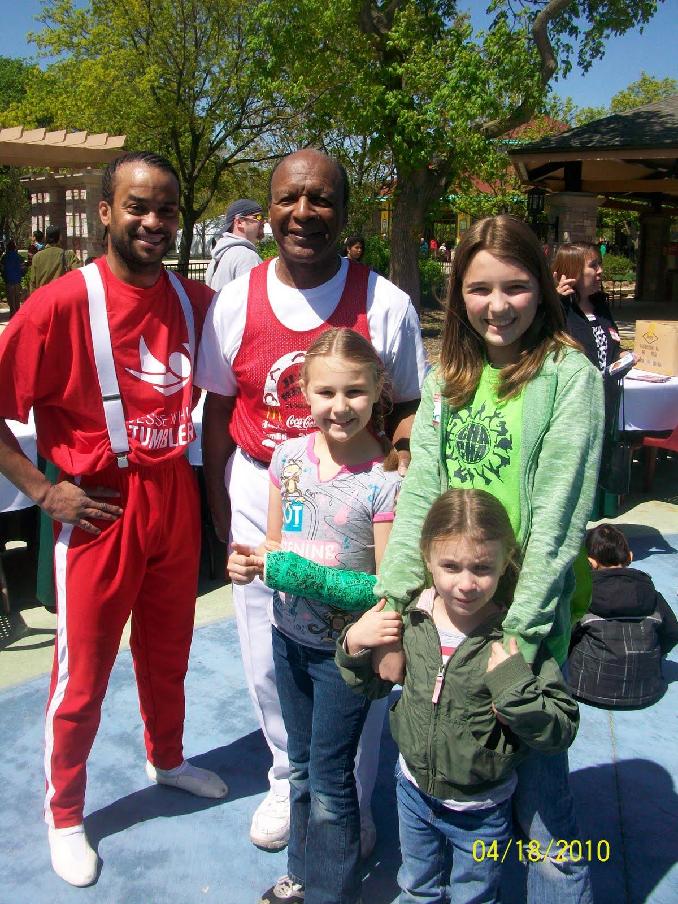
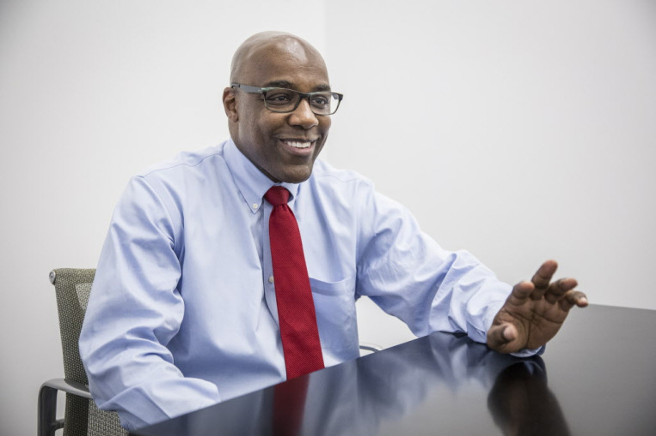
Other Executive Officers
Attorney General & Secretary of State
Kwame Raoul (D)
Jesse White (D)

Slide 27
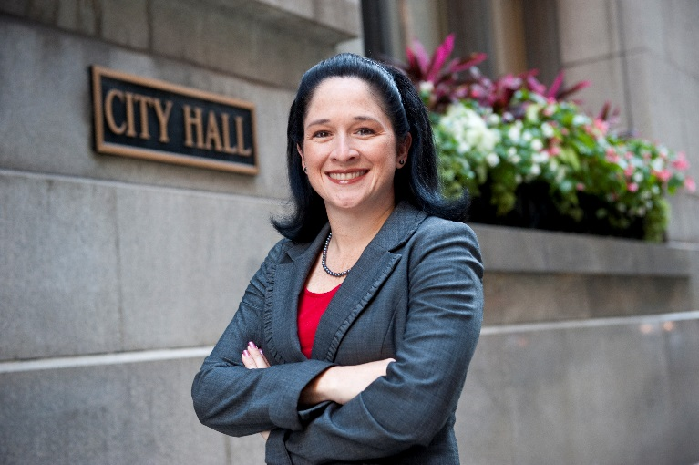
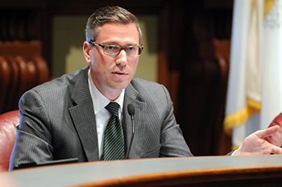
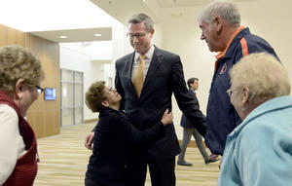
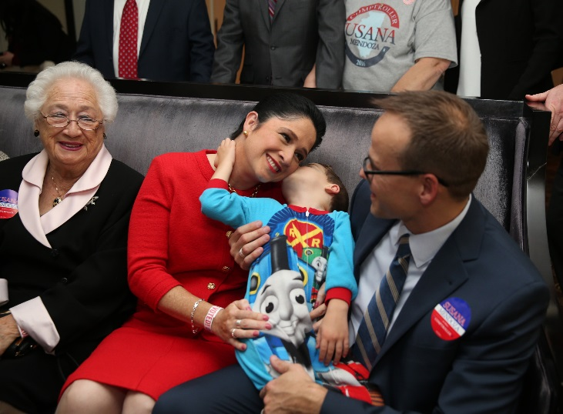
Comptroller & Treasurer
Susana Mendoza
(D)
Michael Frerichs (D)

Slide 28
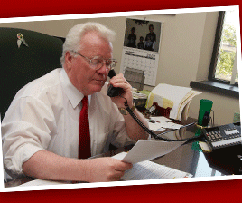


Lawrence Walsh County Executive
Illinois has 102 counties
Local: Municipalities(city, village, town)

Slide 29
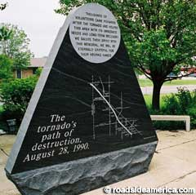

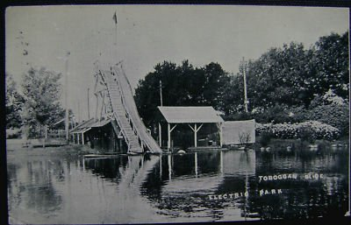

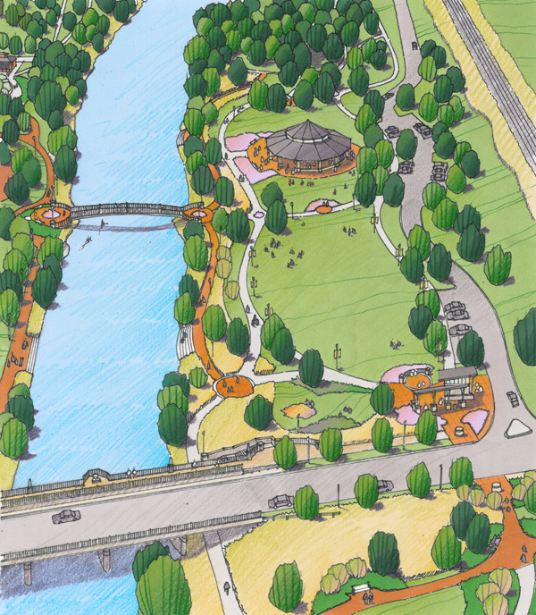

Village President
Michael P. Collins

Slide 30

Use the Illinois Handbook to describe the duties of each executive officer.
* Part III in your Study Guide

Slide 31
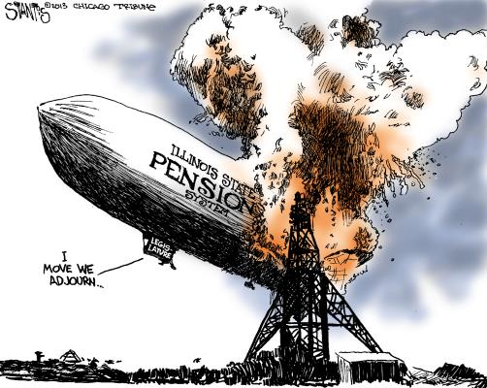

Slide 32

Meet
Squeezy!

Slide 33


Slide 34


Slide 35


Slide 36


Slide 37


Slide 38


Slide 39
The General Assembly
Legislative Branch
Law-making branch
Senate & House of Representatives
59 Legislative districts
Each district has one state senator and two representatives
21 years old, and resident of the district for 2 years

Slide 40


$68,000 / Year Compensation
* mileage
* additional duties
* expenses
* assistants

Slide 41


Slide 42

The State Senate
59 State Senators
2 or 4 year term/unlimited
Tries impeachment cases
approve appointments made by the Governor

Slide 43


former Will County Superintendent of Schools
voted for Gay Marriage
voted for pension reform
State Senator Jennifer Bertino-Tarrant

Slide 44

State House of Representatives
118 state representatives
2 from each district
2 year term/unlimited
Sole power of impeachment-(charge an official with wrongdoing)

Slide 45


Mark Batinick – 97th District Representative
Sponsored: same day voter registration bill, alternative fuels for government vehicles, higher education affordability task force

Slide 46


General Assembly Leadership
Speaker of the House
Michael Madigan - D
Senate President
John Cullerton - D

Slide 47



Slide 48

The Judicial Branch
Interprets the Meaning of the Law
Judges are elected!!
Three Levels:
  Illinois Supreme Court (10)
  Appellate Courts (10)
  Circuit Courts (6)
  (municipal courts)

Slide 49



Justice Anne Burke
Co-Founder of the Special Olympics
Former Bear
Chief Justice
Bob Thomas

Slide 50

Boards & Commissions = the State bureaucracy
Most state business is done through boards & commissions appointed by the Governor’s office…many but not all are approved by the General Assembly.
The Illinois State Board of Education will provide leadership, assistance, resources and advocacy so that every student is prepared to succeed in careers and postsecondary education, and share accountability for doing so with districts and schools.

Slide 51

Voting in Illinois
18 years old by election day
resident for 30 days
citizen
Different ways to register up to day of
Voting and elections are administered by LOCAL government

Slide 52

State Symbols
Motto: State Sovereignty, National Union
Nickname: Prairie State
Slogan: Land of Lincoln
Song: Illinois

Slide 53


Drummer (Silty Clay Loam)
State Soil

Slide 54



The Square Dance was designated the state dance in 1990.
Dance

Slide 55


Tree
1973, poll of school children changed the state tree from Native Oak to the White Oak

Slide 56


Bird
1928-Illinois School Children selected the cardinal as the State Bird of Illinois

Slide 57


Insect
1974-3rd grader from Decatur suggested that the monarch butterfly as the state insect

Slide 58


Fish
1986-School children selected the state fish as the Bluegill

Slide 59

Mineral
Fluorite as the state mineral in 1965
Illinois was the largest producer of Fluorite in the United States
Used in making steel, enamels, aluminum, glass, etc.

Slide 60


Animal
Illinois school children selected the White-Tailed Deer
1980

Slide 61


Snack Food
Popcorn was designated the official state snack food in 2003.

Slide 62


Lincoln’s Tomb

Slide 63



Slide 64


Slide 65



Divide Illinois into 3 or 4 states? Democrat running for governor says yes

Slide 66
Rauner, Madigan huddle…
State Budget
What Rauner Wants:
Rauner’s Criticisms of Madigan & Democrats:
What Madigan Wants:
Madigan’s Criticisms of Rauner & Republicans:
As you read, take some notes…
From what you have read, which side is more to blame for the budget impasse? Explain.
caucus – a group of legislators that meet to pursue common goals
approaching a year overdue…

Slide 67



Stateville

Slide 68



