Slide 1
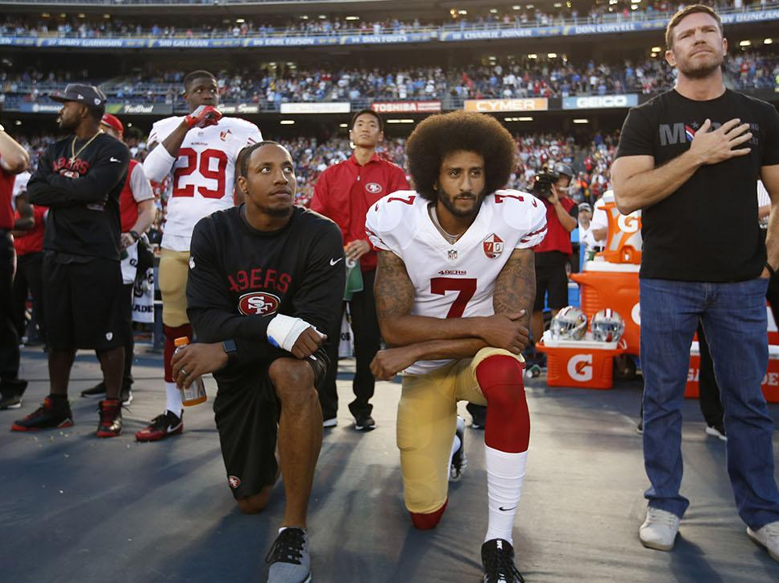
"Another source tells PFT that team president Bruce Allen previously has made clear within the organization his position that Kaepernick won't be signed by Washington, ever" in part because of Allen's political views and Kaepernick's history of protesting social injustice during the national anthem," Florio wrote at the time.

Slide 2
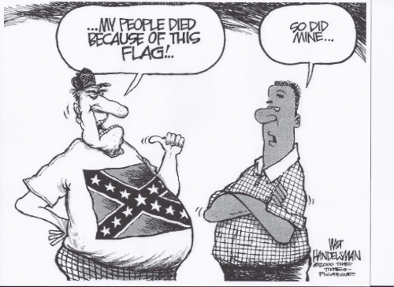

Slide 3
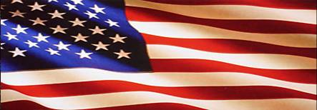
United States Flag Code

Slide 4
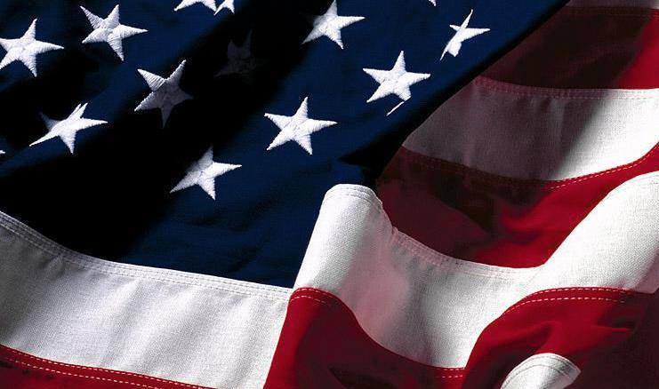
The United States flag code was passed by Congress in 1942 Breaking the flag code is breaking the law, however there are no provisions for enforcement.

Slide 5

Two Rules
Right is right
If it could be offensive, it’s probably against the flag code

Slide 6
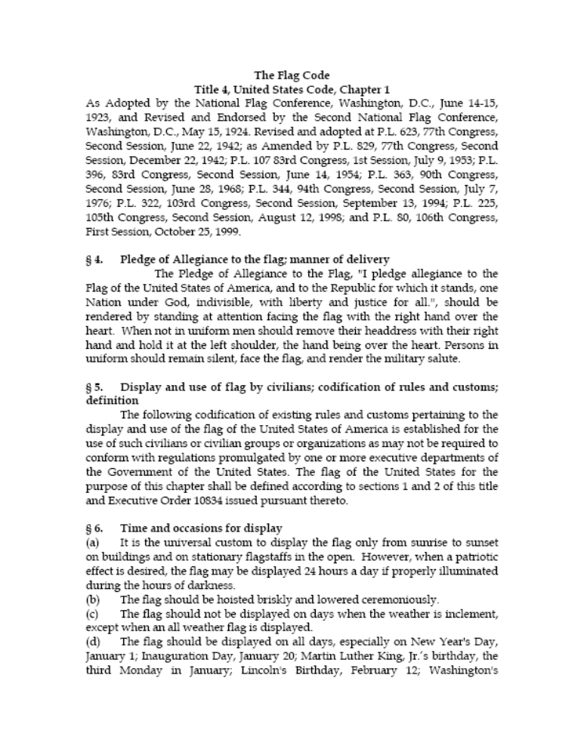

Slide 7
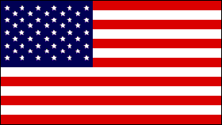
The flag has 13 stripes to represent the original colonies. For a brief time it had 15 stripes.
Union

Slide 8
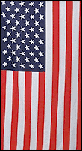
When displayed against the wall, the union should be on top and to your left.

Slide 9

When a flag is displayed on a staff near a speaker, it should be on the speaker’s right.

Slide 10
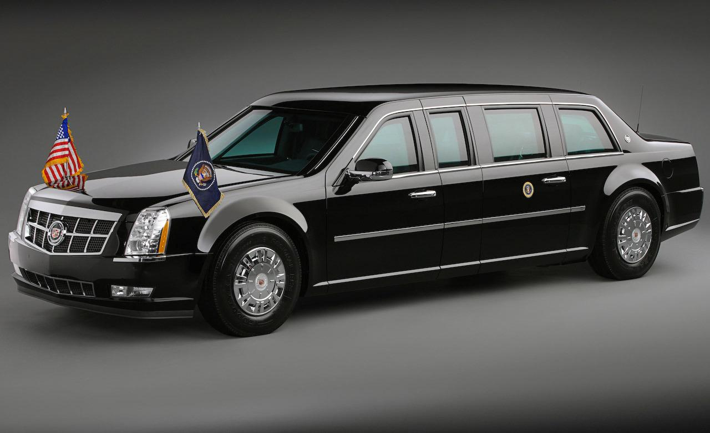
This baby gets 8 miles/gallon!
Look, it’s on the front RIGHT fender!

Slide 11

According to the Supreme Court, burning the flag is legal. It is protected by the First Amendment.
(Texas v. Johnson)

Slide 12
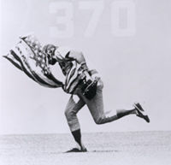
April 25, 1976: Cub outfielder Rick Monday rescues an American flag from two protesters attempting to burn the nation's symbol in centerfield at Dodger Stadium.

Slide 13


Slide 14

The United States flag should never be used for advertising purposes.

Slide 15

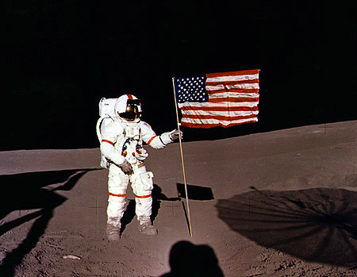
What is the proper way to display the flag on the moon?
Pssst…..
Hey you…..
Did you know that there is no wind on the moon?
So why is the flag waving in the breeze?

Slide 16
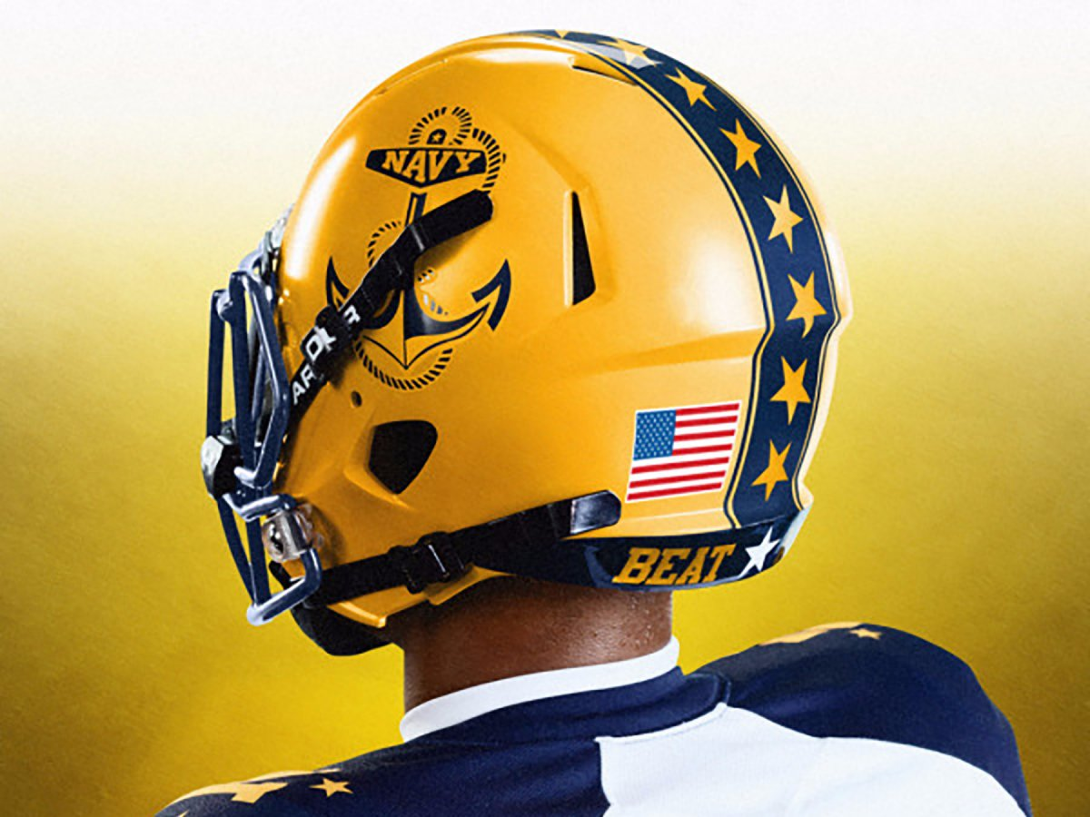
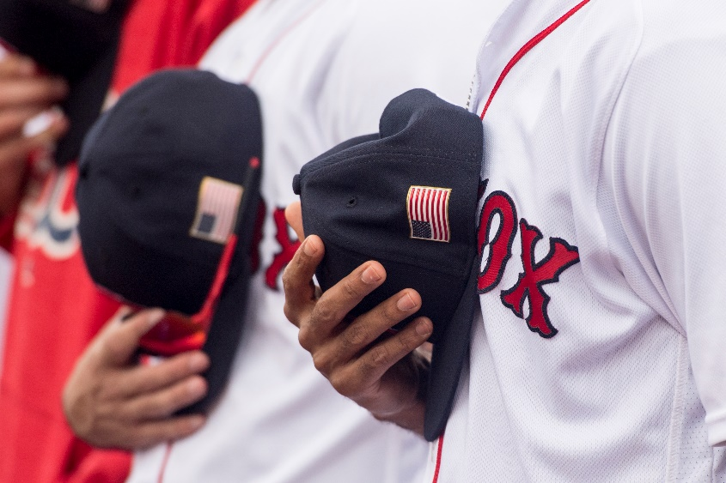
“The flag should not be used as part of a costume or athletic uniform, except that a flag patch may be used on the uniform of military personnel, fireman, policeman and members of patriotic organizations.”
So, yes. These are technically flag code violations…or are they?

Slide 17
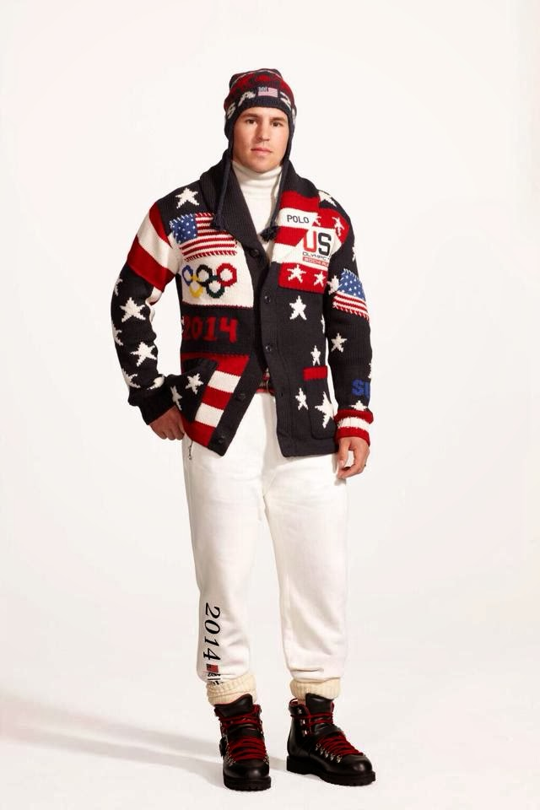
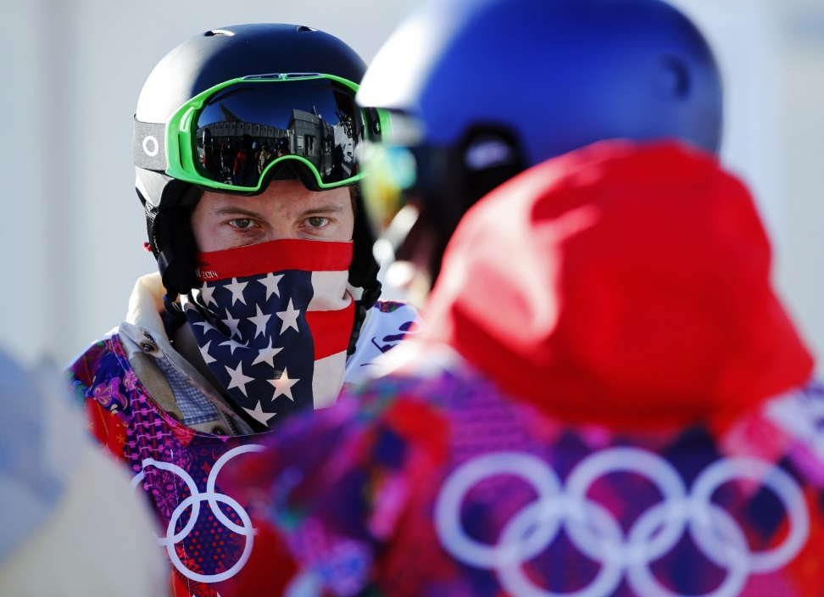
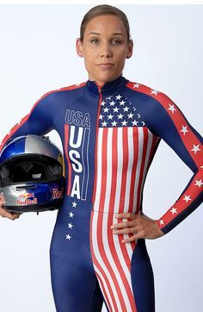
Are these Olympic athletes technically be violating the flag code?

Slide 18
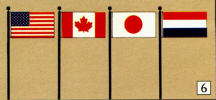
When flags of two or more nations are displayed, they are to be flown from separate staffs of the same height.
International usage forbids the display of the flag of one nation above that of another nation in time of peace.

Slide 19
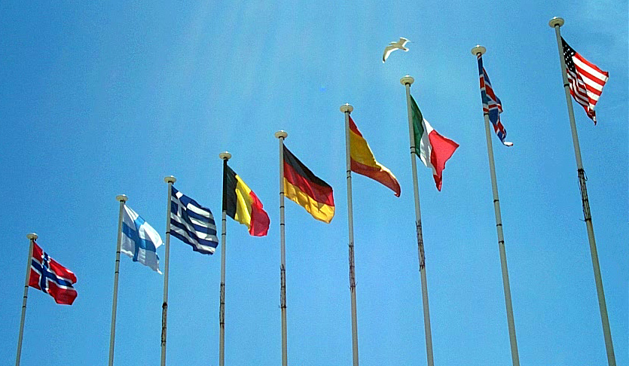
When flown in a line alongside flags of
other nations, the U.S. flag
should be flown first on the
flag’s right hand side.

Slide 20
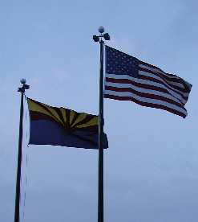
When flown with the flag of a state, the flag of the United States should always be higher.

Slide 21
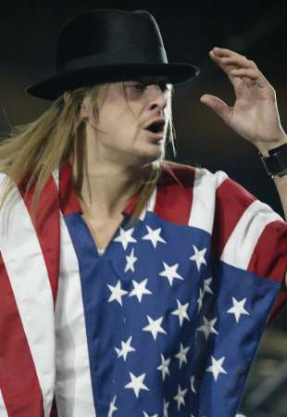
The flag should never be worn as an article of clothing.

Slide 22
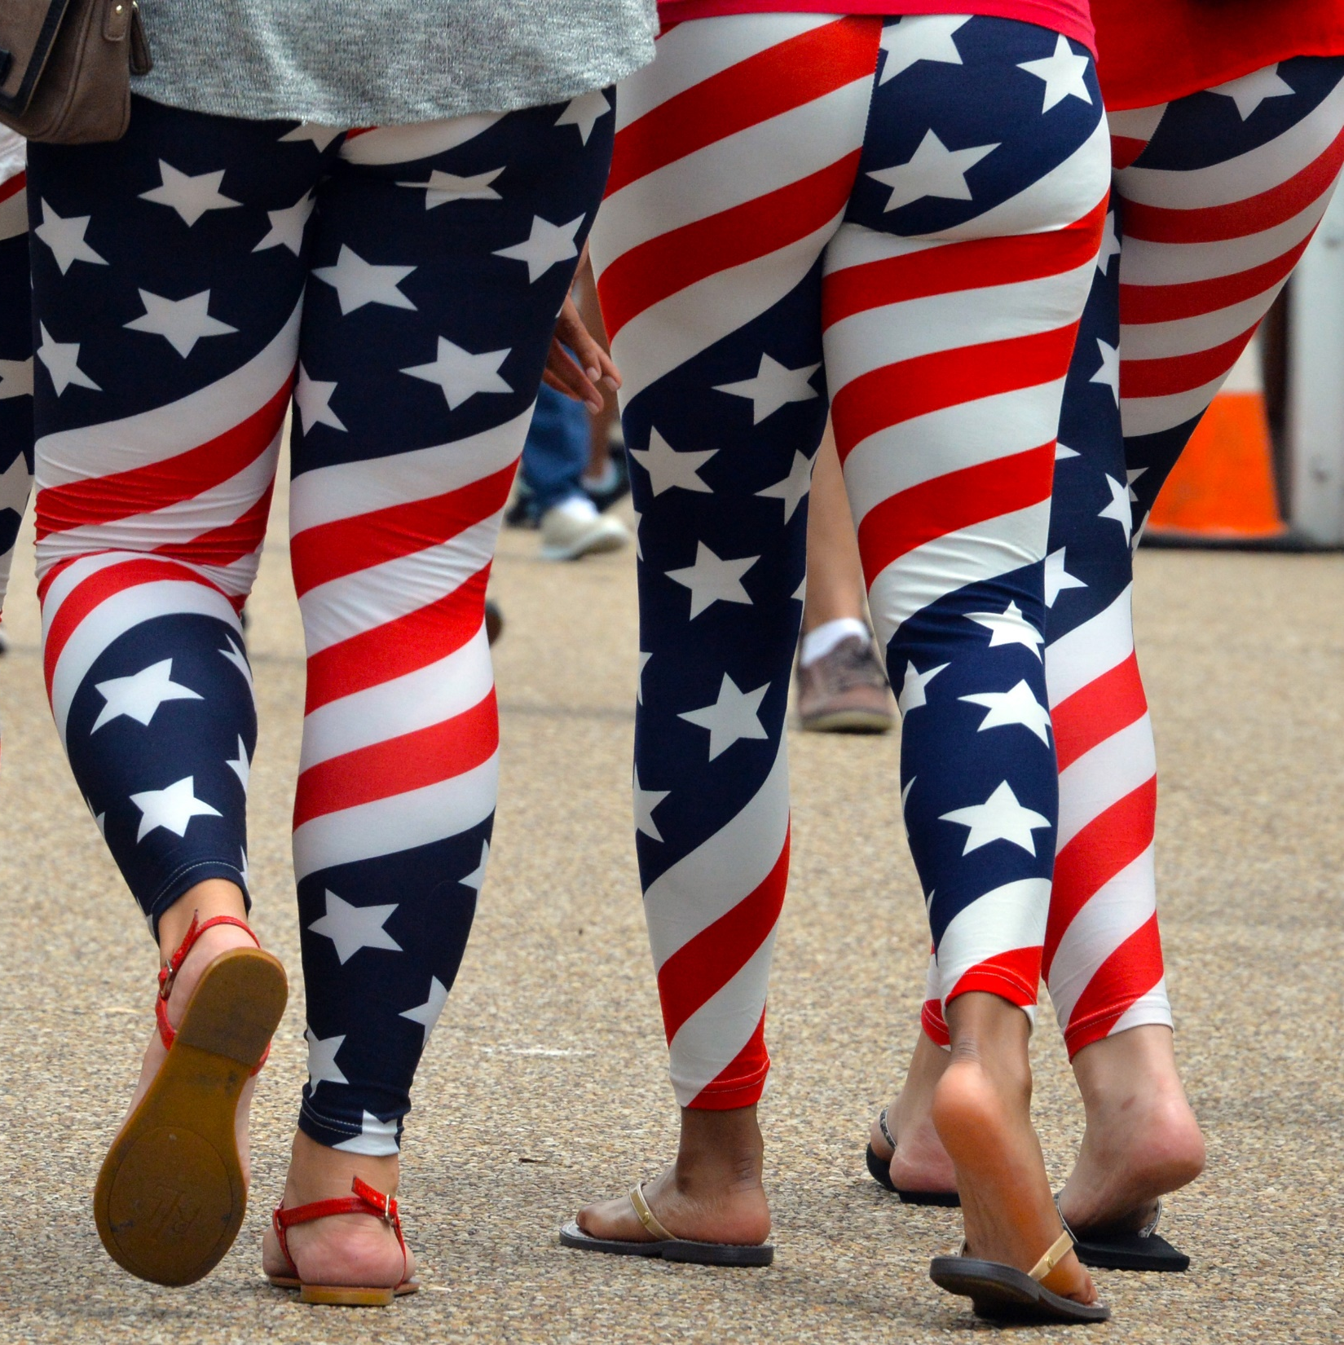
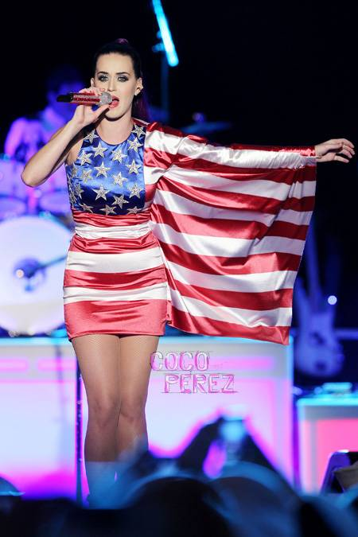

Slide 23
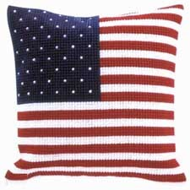
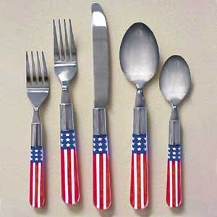
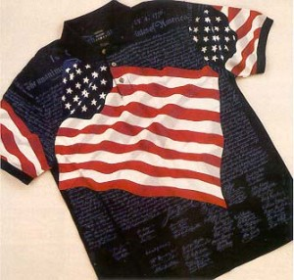
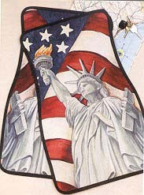
VIOLATIONS?

Slide 24

  The flag should not be used as a drapery, or for covering a speakers desk, draping a platform, or for any decoration in general. Bunting of blue, white and red stripes is available for these purposes.

Slide 25


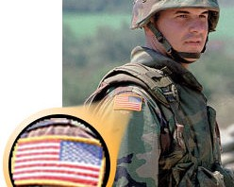
        To wear our country's flag properly, the field of stars should be worn closest to your heart. Thus, if your patch is to be worn on your LEFT sleeve, use a left flag. For patches worn on your RIGHT sleeve, use a "right" or "reversed field" flag. Some elect to use the "left" flag on both sleeves.

Slide 26
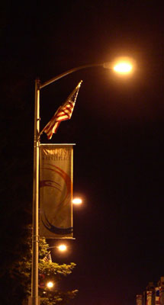
The flag must be illuminated if displayed at night.

Slide 27
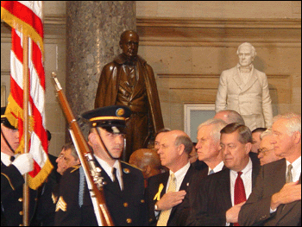
When the flag passes in a parade, a civilian should stand at attention with their right hand over their heart.

Slide 28
If the flag touches the ground, it should be picked up as quickly as possible…

Slide 29


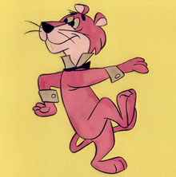

Slide 30
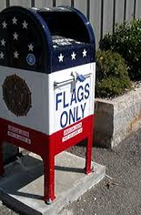
The flag should be burned as a means of disposal in a solemn ceremony.

Slide 31


