Slide 1
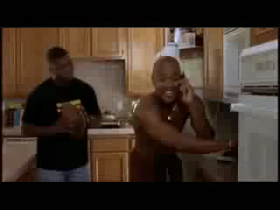

“Show Me the Money”
* Explain how the organization, finance and strategies of campaigns effect the election process
$$$$$ and the Political Process
Post-Citizens United

Slide 2

FEC
Federal Election Commission
Keeps elections “fair”
monitors money flow in (campaign donations) and out (spending)
  Disclosure
Contribution limits
Notes:
* Disclosure means that campaigns have to say where there money came from and is going to…they monitor regulated money

Slide 3
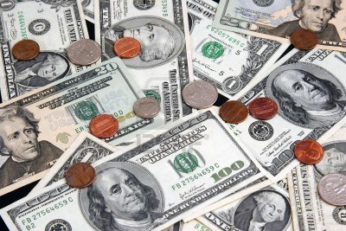
Hard Money:
    Campaign contributions regulated and limited by the federal government that are given directly to a candidate

Slide 4
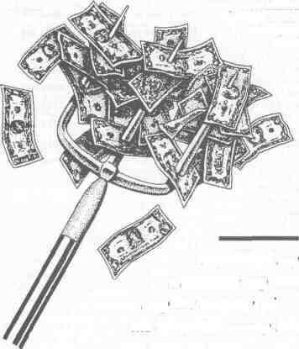
Soft Money*:
  Previously unlimited and unregulated campaign contributions
  Supposedly for generic “party building” activities
    (ex: get-out-the-vote drives, bumper stickers, yard signs, and “issue ads”)

Slide 5
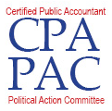



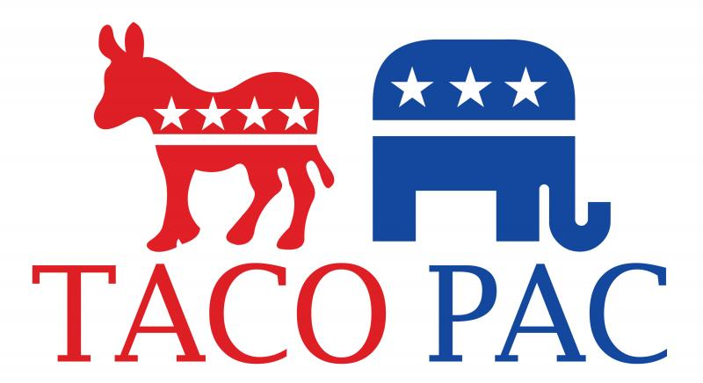

*Political Action Committee (PAC):
  Officially registered fund-raising organization that represents interest groups in the political process.

Slide 6
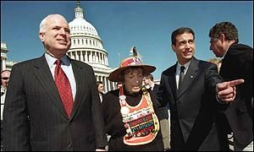
Bipartisan Campaign Reform Act of 2002 a.k.a. McCain-Feingold Bill
No "electioneering communications” 30 or 60 days before an election
  i.e. can’t broadcast ads mentioning a candidate

Slide 7
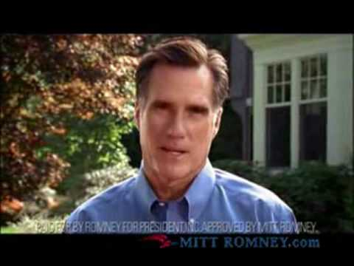
Bipartisan Campaign Reform Act of 2002 a.k.a. McCain-Feingold Bill
No“soft money”
“Stand by your ad” provision

Slide 8
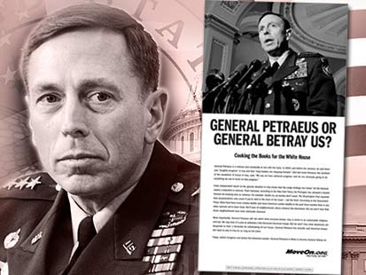
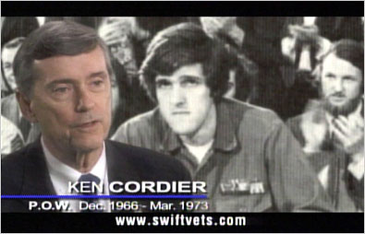

527 Groups
Tax-exempt organizations
raise money for political activities
Not subject to FEC disclosure rules.
try to influence federal elections through voter mobilization efforts and issue ads

Slide 9


Slide 10
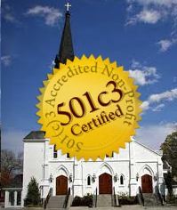
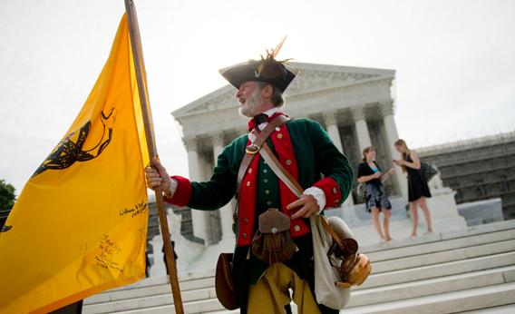

501(c) 3/4 Groups
Nonprofit, tax-exempt interest groups
engage in varying levels of political activity
Not subject to FEC disclosure rules.

Slide 11
Campaign Finance Reform
The Supreme Court Weighs In

Slide 12
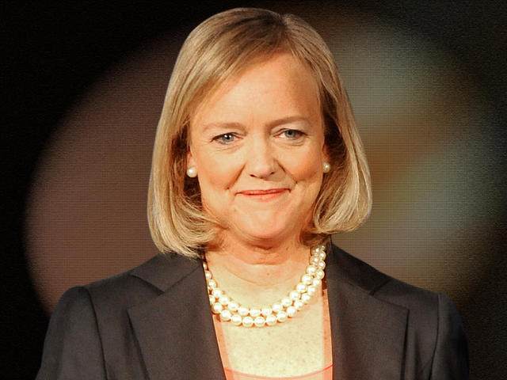
Buckley v. Valeo (1976)
money to finance campaigns is “free speech”
Candidates can spend an unlimited amount of their own $ to finance their own campaigns
Meg Whitman, former eBay CEO, spent $160 million of her own $ (about $50/vote) to finance unsuccessful campaign for Governor of CA in 2010
Donald Trump contributed
$66.1 Million to his campaign

Slide 13
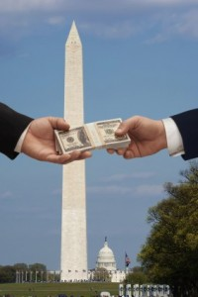
McConnell v. FEC (2003)
McCain-Feingold a.k.a. BCRA upheld
Restrictions on free speech justified by government’s interest to prevent corruption in campaigns

Slide 14
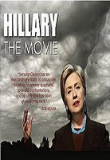
Citizens United v. FEC (2010)
BACKGROUND:
Conservative non-profit produced “Hilary: The Movie”
Purchase airtime on cable TV during 2008 election
FEC deemed movie “electioneering communication” in violation of BCRA

Slide 15
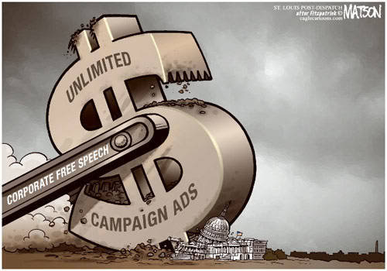
Citizens United v. FEC (2010)
SCOTUS DECISION:
Political = free speech
Corporations & unions can spend money to support or denounce candidates b/c they are “people”
No limit on uncoordinated spending
Upheld bans on direct contributions to candidates

Slide 16
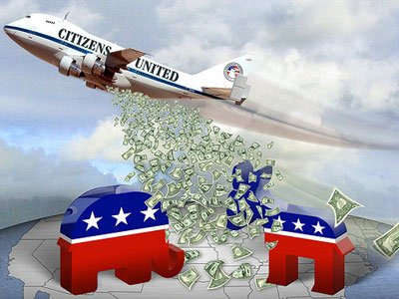
Consequences of Citizens United
Opens flood gates for advocacy spending in campaigns ($1.3 billion in 2012 election cycle)
Disclosure and transparency issues
Paves the way for Super PACs

Slide 17
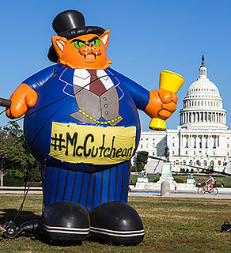
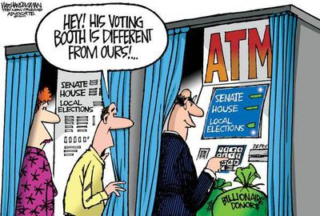
McCutcheon v. FEC (2013)
SCOTUS DECISION:
* Aggregate spending limits are a violation of free speech rights

Slide 18
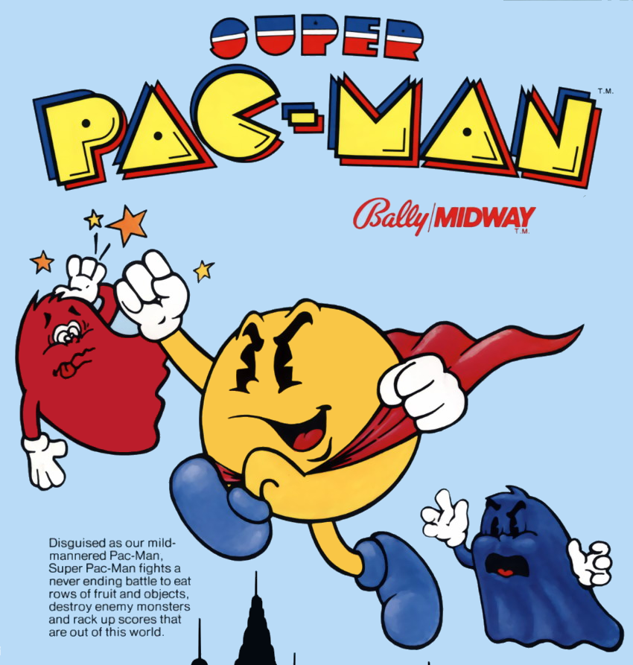
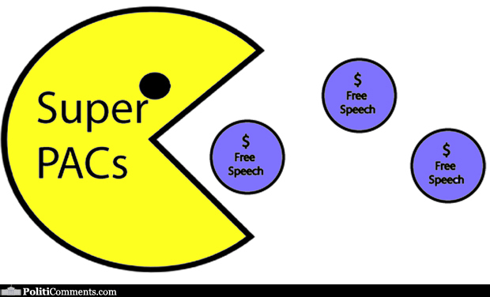
*Super PACs
Super PACs may raise and spend unlimited sums of money in order to advocate for or against political candidates.
Super PACs are prohibited from donating money directly to political candidates.

Slide 19
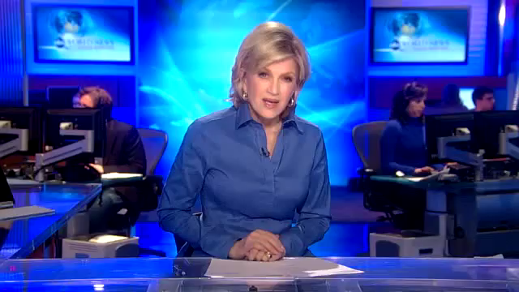
Stephen Colbert’s SuperPAC
Explained

Slide 20
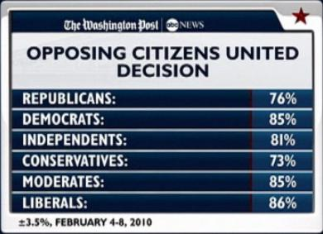
Citizens United Public Opinion Poll
Source: http://www.workingclassheroes.me/?p=1499

Slide 21
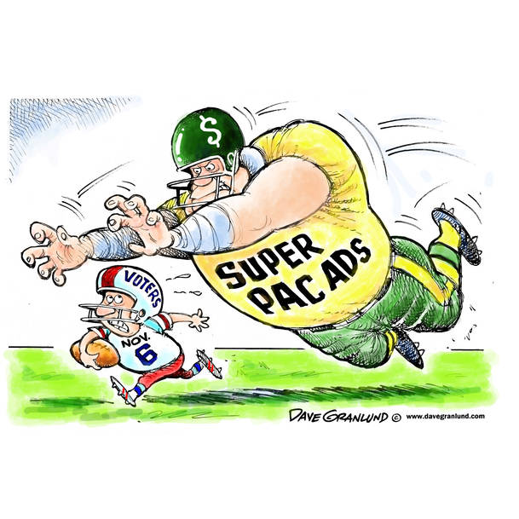
Impact of Super PACs on the 2012 Election
Over $1.3 billion spent by 629 outside groups
Only 32% of money spent yielded intended result
2,389 | number of super PACs
$1,790,907,772 | total raised by super PACs
$1,104,481,088 | total spent by super PACs
2016 Super PACs

Slide 22

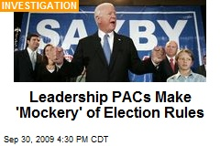
Skirting the Laws…

Slide 23
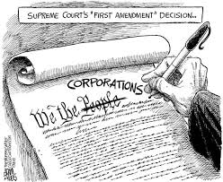
Political Cartoon #1
Source: http://theragblog.blogspot.com

Slide 24
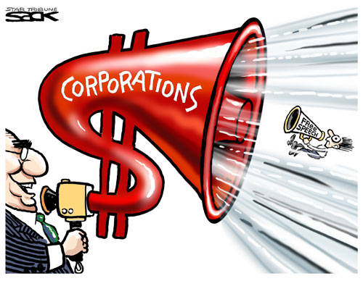
Political Cartoon #2
Source: jobsanger.blogspot.com

Slide 25
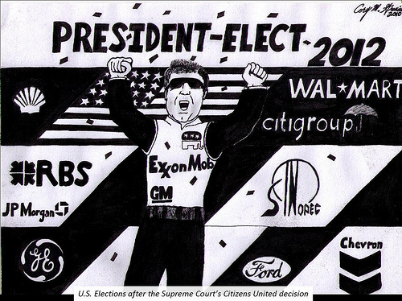
Political Cartoon #3
Source: www.citizenvox.org

Slide 26
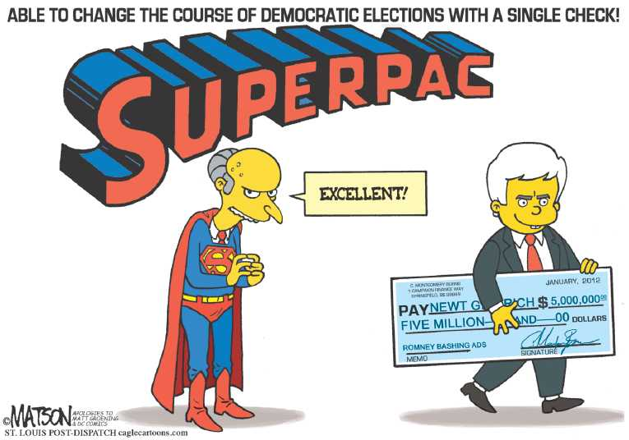
Political Cartoon #4
Source: thecomicnews.com

Slide 27
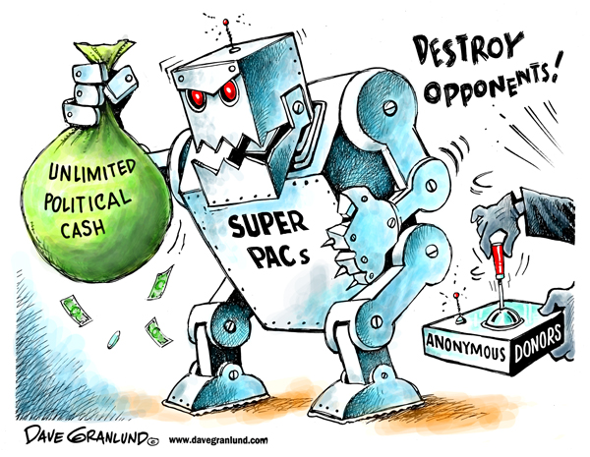
Political Cartoon #5
Source: unitedrepublic.org

Slide 28
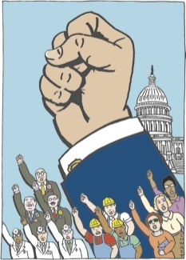
Interest Groups?
Organizations of people sharing a common interest or goal that seek to influence government policy and elections

Slide 29
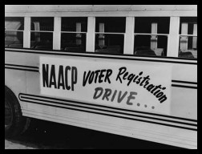
The Role of Interest Groups in the Political Process
Inform public about issues and candidates
Grassroots organizing
Recruit and endorse candidates
Form Political Action Committees (PACs)
Contribute money to campaigns
Sponsor “Issue Ads”

Slide 30
“Profitable Pacs”
List three surprising facts or examples about the use of campaign funds.
Explain the loophole of a “Leadership PAC.”
Explain the loophole of “personal loans to campaign funds.”
Explain the loophole of “hiring family members to work on campaigns.”

