Slide 1
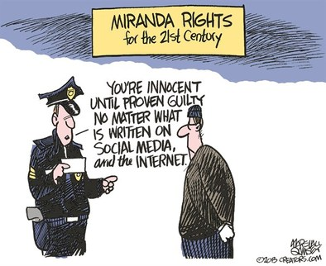
Pre-Trial Rights & Warrantless Searches
Explain the extent to which states are limited by the due process clause from infringing on individual rights

Slide 2
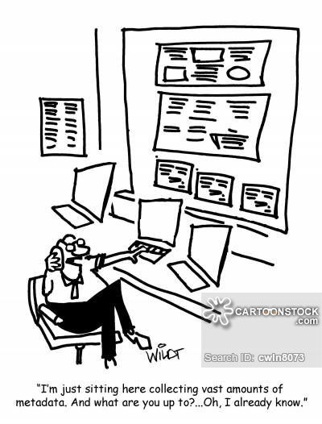
Metadata
PATRIOT Act
  law enforcement can search a home or business without the owner's consent or knowledge
  expanded use of National Security Letters
    allows FBI to search telephone, e-mail, and financial records without a court order
  Expanded gov. access to business, library and financial records
  some parts sunset (expired)
USA Freedom Act
  Restored, in modified form, several provisions of the Patriot Act
  Imposed new limits on metadata collection by NSA
Notes:
Review of main points of video from Friday; they watched “the United States of Secrets.” The Patriot Act was replaced by the USA Freedom Act
s

Slide 3
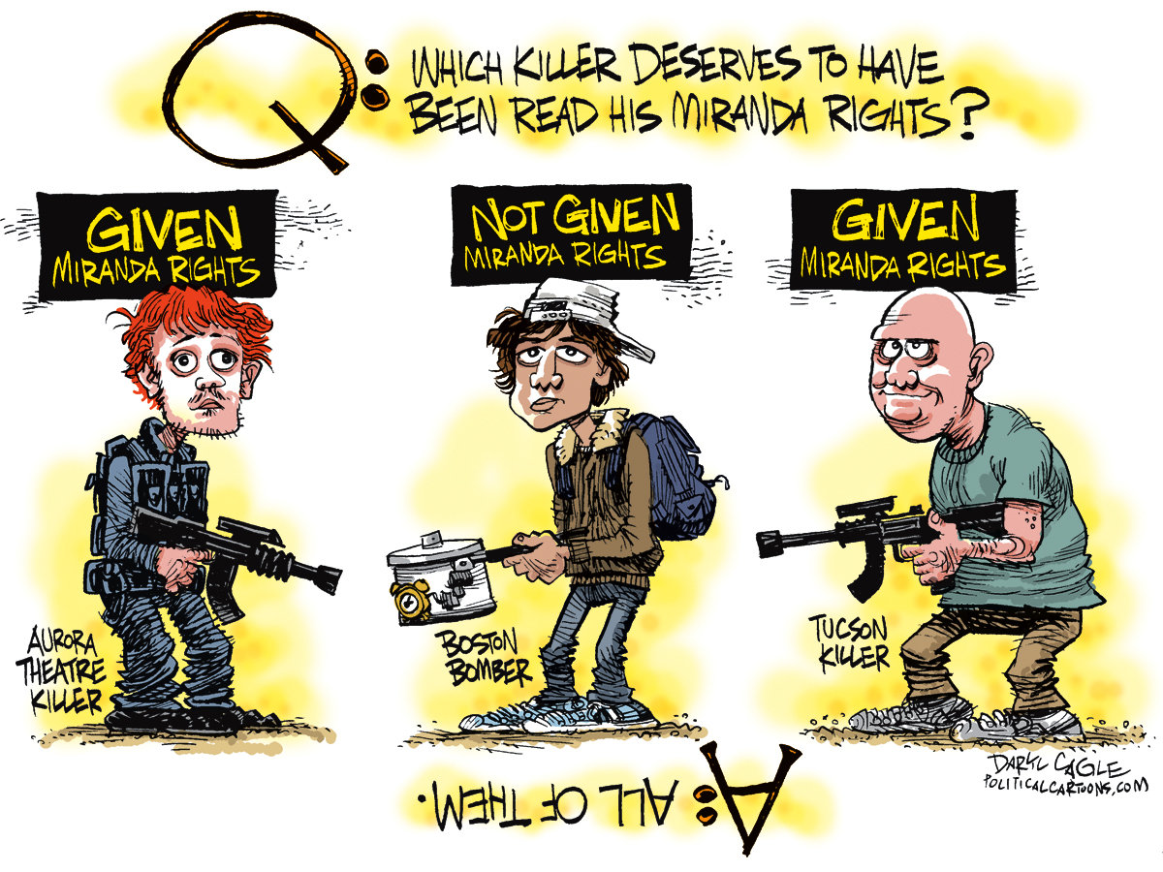
Boston marathon bomber
5th Amendment right against self incrimination
  Miranda v. Arizona
6th Amendment right to counsel
Public safety exception that allows unwarned interrogation to stand as direct evidence in court
Notes:
Review of main points of Wednesday

Slide 4
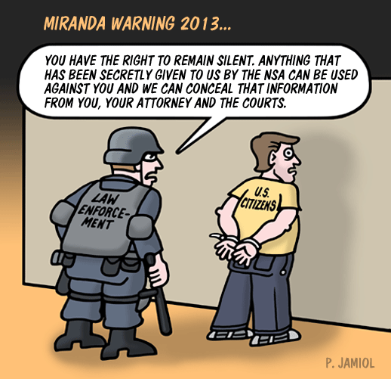
Pre-Trial rights
4th Amendment – no unreasonable search & seizure, warrant requirement
5th Amendment – grand jury, no forced self-incrimination
6th Amendment – right to legal counsel, speedy & public trial, impartial jury
Notes:
All of this concerns the rights of the accused BEFORE trial…such as those listed

Slide 5

Warrantless searches…
With a partner or two, read the case summaries and organize the precedents/rules they set as to when searches can be conducted without a warrant
What types of technology do you see in these cases?
Did any of these decisions surprise you?
Do you think that the decisions were appropriate? Why or why not?
Notes:
But, you don’t always need a warrant, so…place students in groups of three and have them answer the questions and analyze the cases (they can turn in on paper per group. Answer the three questions on the board on the back of last page.

Slide 6
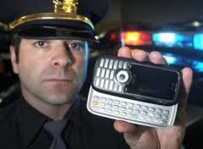
Riley v. California (2014)
… Cell phones differ in both a quantitative and a qualitative sense from other objects that might be kept ion an arrestee’s person. The term “cell phone” is itself misleading shorthand; many of these devices are in fact minicomputers that also happen to have the capacity to be used as a telephone. They could just as easily be called cameras, video players, rolodexes, calendars, tape recorders, libraries, diaries, albums, televisions, maps, or newspapers. …
Modern cell phones are not just another technological convenience. With all they contain and all they may reveal, they hold for many Americans “the privacies of life.” The fact that technology now allows an individual to carry such information in his hand does not make the information and less worthy of the protection for which the Founders fought. Our answer to the question of what police must do before searching a cell phone seized incident to an arrest is accordingly simple—get a warrant.
Notes:
Emerging cases…..

Slide 7
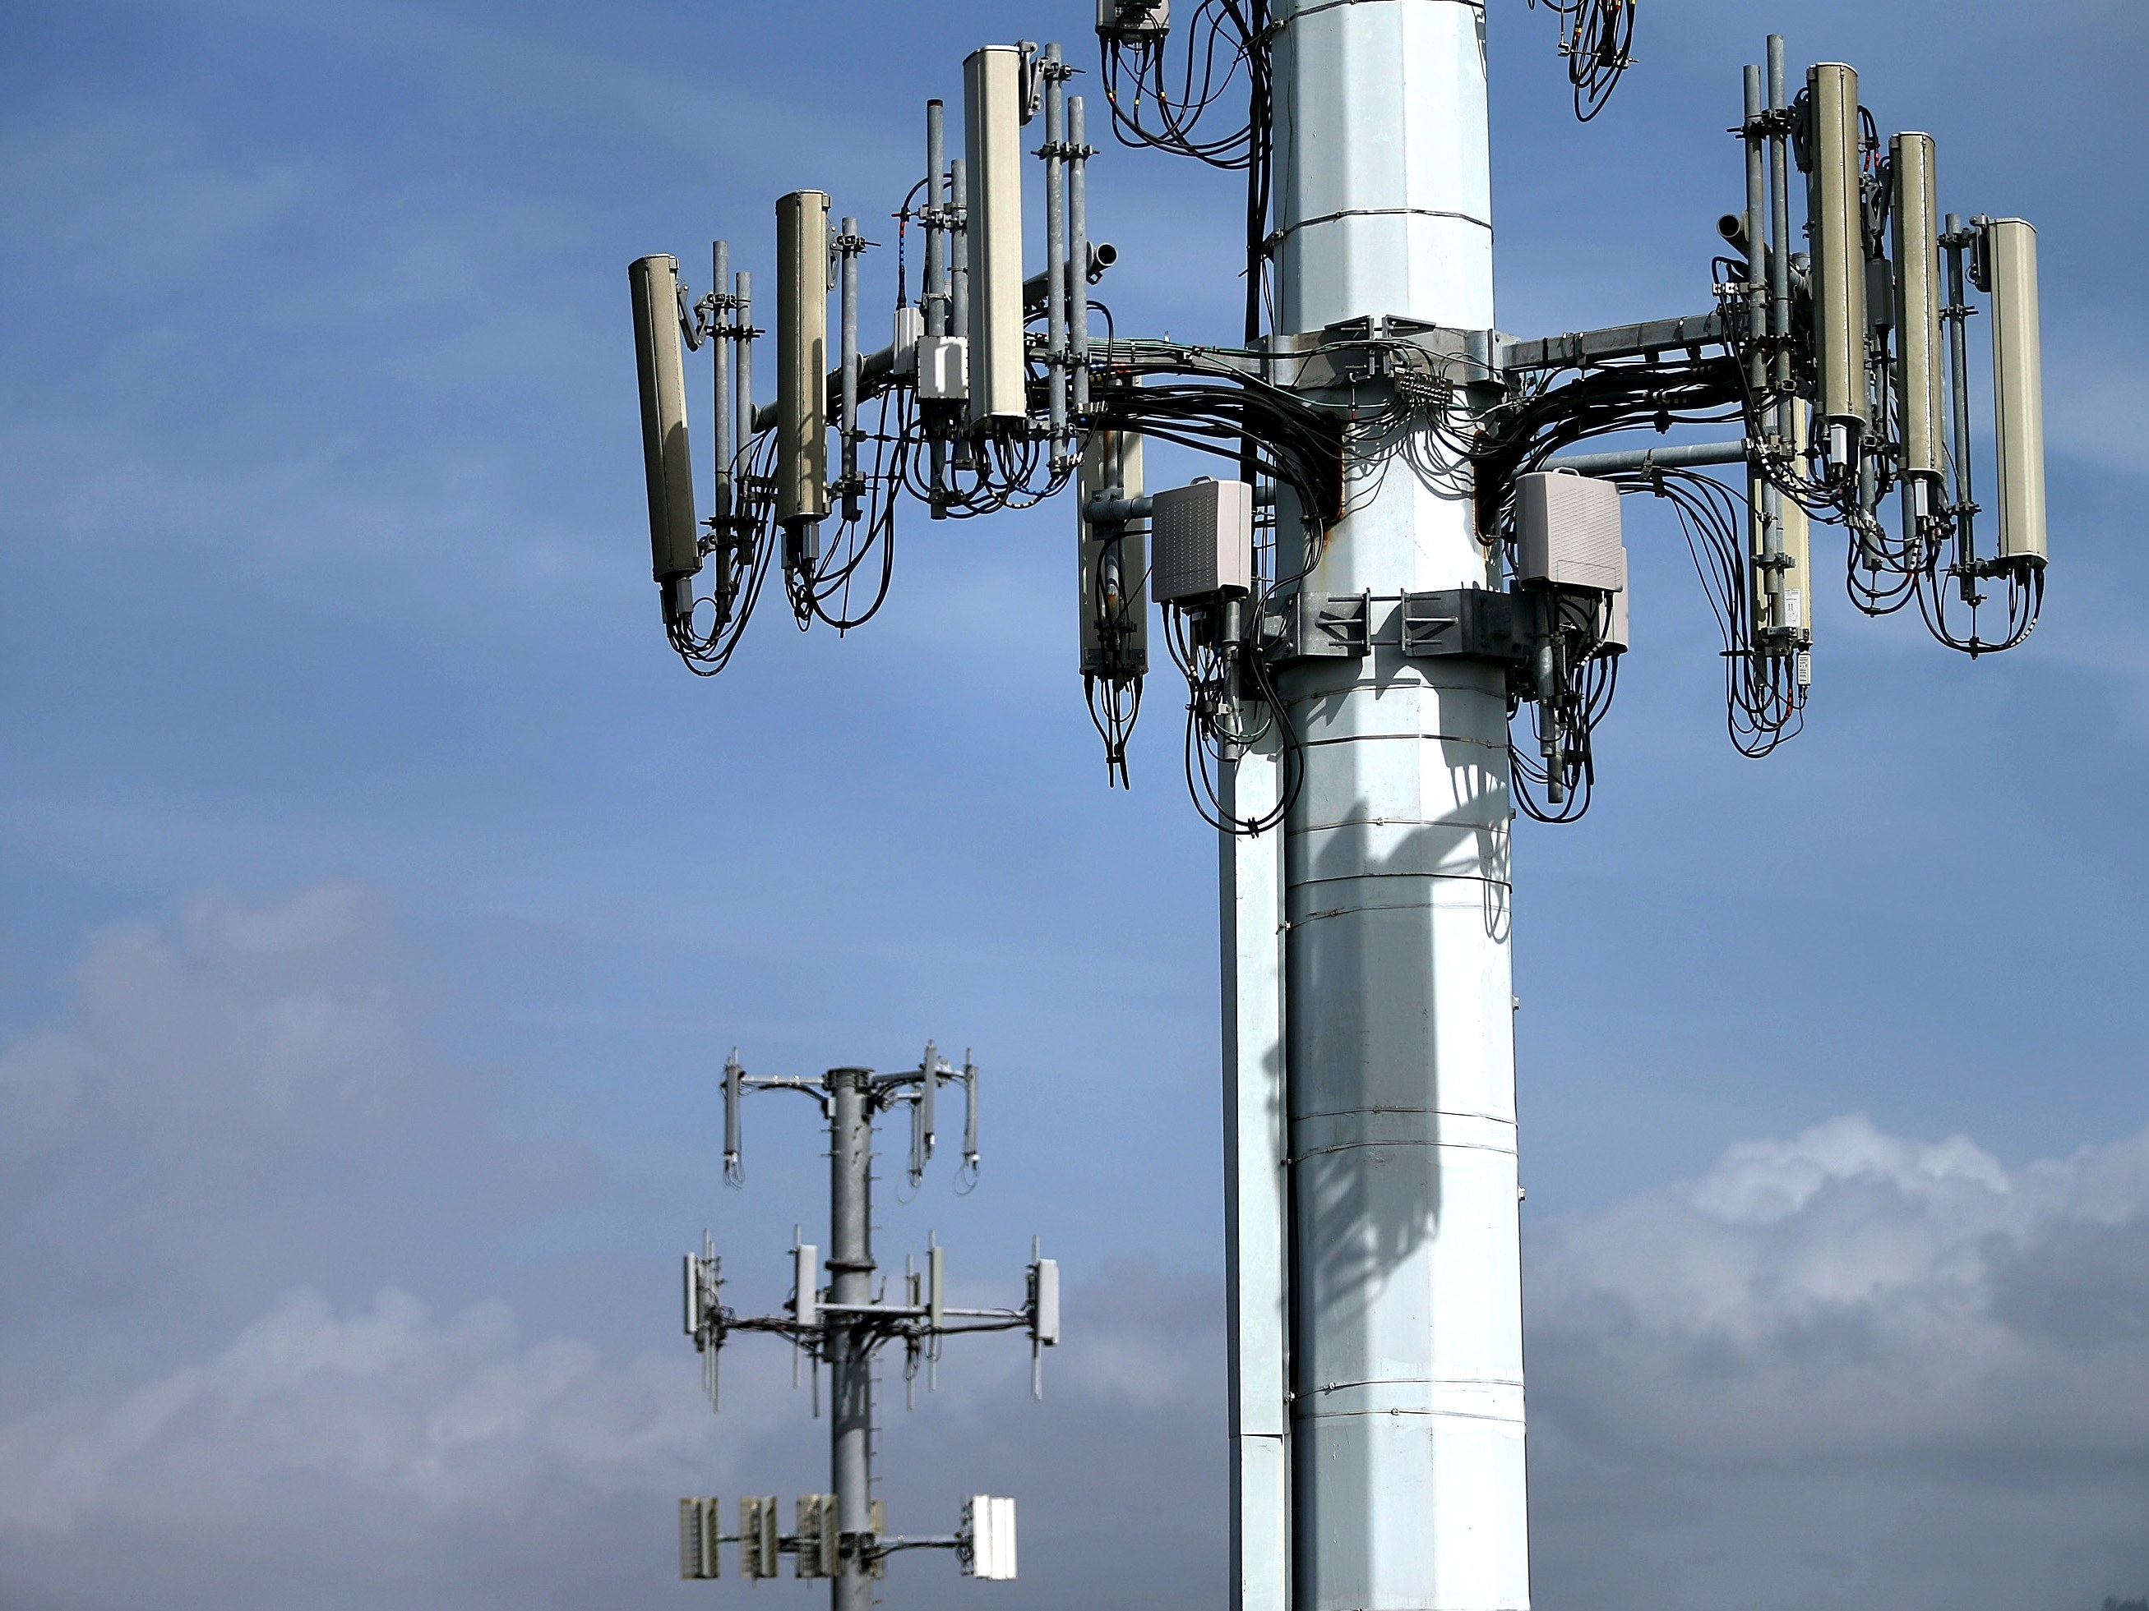
Carpenter v. united states (2018)
The government's warrantless acquisition of Carpenter's cell-site records violated his Fourth Amendment right against unreasonable searches and seizures. The majority first acknowledged that the Fourth Amendment protects not only property interests, but also reasonable expectations of privacy. Expectations of privacy in this age of digital data do not fit neatly into existing precedents, but tracking person's movements and location through extensive cell-site records is far more intrusive than the precedents might have anticipated. The Court declined to extend the "third-party doctrine"—a doctrine where information disclosed to a third party carries no reasonable expectation of privacy—to cell-site location information, which implicates even greater privacy concerns than GPS tracking does.

Slide 8

J.W. v. DeSoto County School District (2008)
“The court found that the search of the student’s cell phone was not unlawful because the student had brought it to school and used it against school rules. These acts diminished the student’s expectations of privacy. Here, the court said, the Mississippi school’s actions were “limited” to only looking at the student’s photos and was not “fishing” through the students personal life.”

Slide 9
