Slide 1
Political Socialization
The process of developing political opinions & experiences.

Slide 2
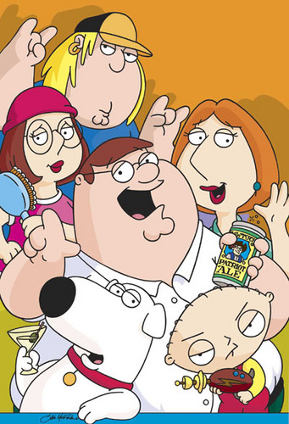
Family & Home Experiences
Opinion & Party Loyalty
Comes from Parents

Slide 3
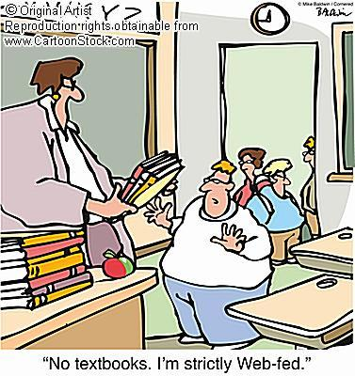
Schools
Political System
History
Democratic Values
Comes from Teachers
&
School Policies

Slide 4
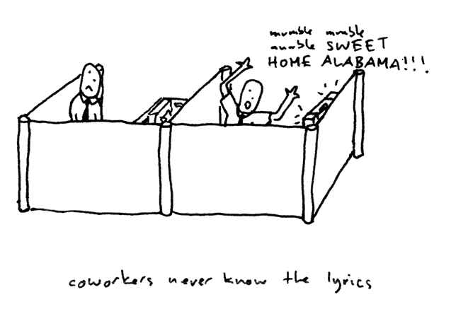
Peer Groups
Sharing of Opinions
Friends & Coworkers

Slide 5
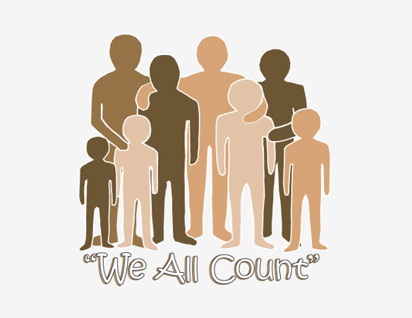
Social Characterisitcs
Demographics
Race
Gender
Age
Socioeconomic Status

Slide 6
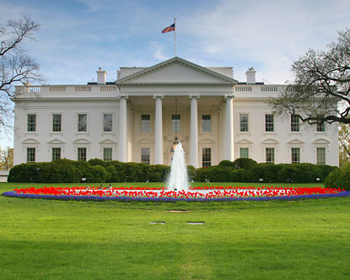
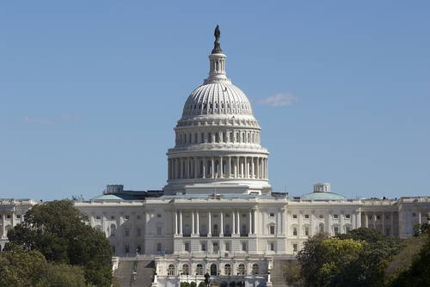


Government Influences
President
Congressmen
Interest Groups

Slide 7
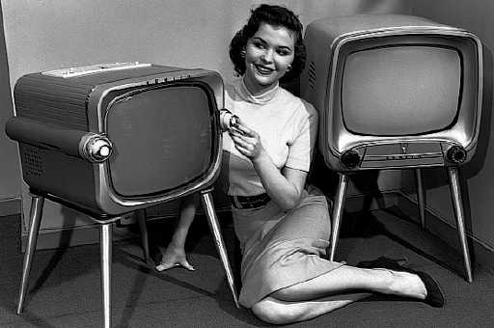
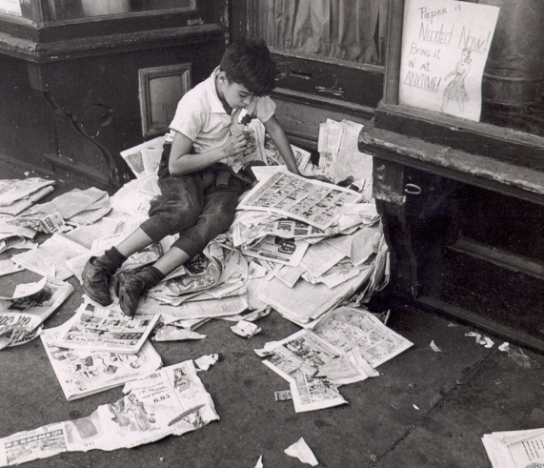
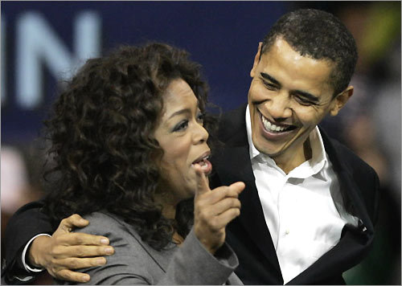
Media
T.V & News Coverage
Movies
Print News
Internet
Novels
Celebrity Endorsements

Slide 8
Family
School
Social Characteristics
Media
Peer Groups
Government Influences

Slide 9
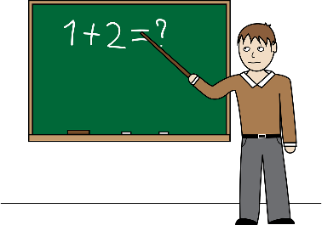
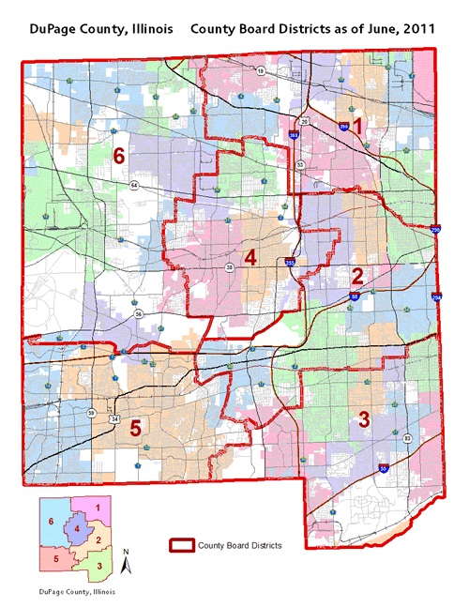
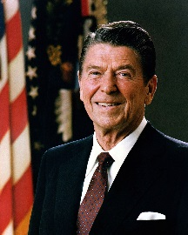
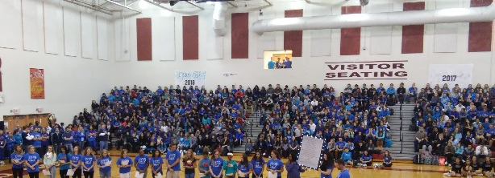




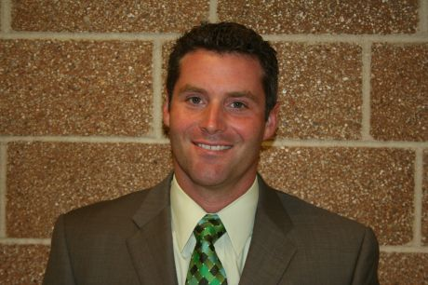
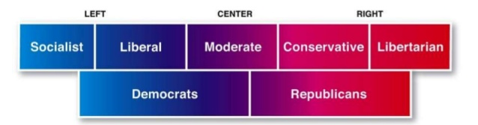
Liberal
Socialization
Factors
Conservative
Mixed influences
My top issues:
experience/
qualifications
taxes
education policy
This is how different groups have influenced my belief system….. blah, blah, blah, blah, blah,
blah, blah, blah, blah, blah,
Steve Krause
These are the basic beliefs of my ideology….. blah, blah, blah, blah, blah,
blah, blah, blah, blah, blah, blah, blah, blah, blah, blah, blah, blah
This is how personal identity (demographics) has influence my ideology…blah, blah, blah, blah, blah, blah, blah, blah, blah, blah,

Slide 10

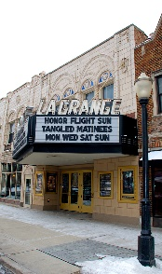
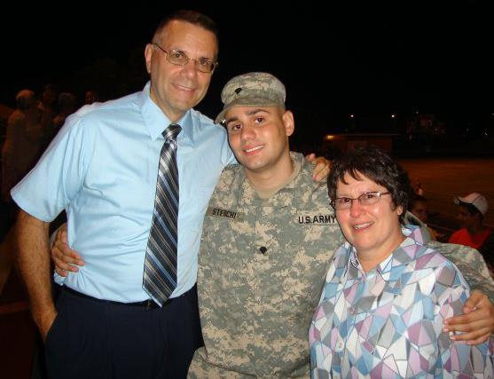


Liberal
Socialization
Factors
Conservative
Mixed influences
My top issues:
Use of military
Healthcare
Education
Maximum Freedom
This is how different groups have influenced my belief system…..
Aaron Sterchi
This is how personal identity (demographics) has influence my ideology…
These are the basic beliefs of my ideology…..

