Slide 1
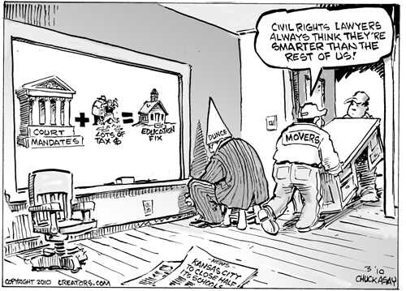
Notes:
Point of the cartoon: civil rights decisions are meant to help people but sometimes they have unintended consequences such as this one cost a lot of money so it didn’t fix education, it caused schools to close.

Slide 2
Is discrimination legal?
Notes:
Discuss if discrimination is legal or not….of course it is….as long as you have a good reason, i.e. under 18 can’t vote, under 16 can’t drive; we discriminate all the time, only sometimes it’s illegal

Slide 3
14th Amendment (1868)
Equal Protection Clause
Forbids any state to “deny to any person within its jurisdiction the equal protection of the laws.”
Sex, race, ethnicity, age, disability, sexual preference/identity?
Notes:
Discrimination is illegal because of the 14th Amendment….so if a law protects discrimination based on race such as the Civil Rights Act of 1965 then STATES cannot discriminate
* Sexual identity is a question because there is not federal law protecting against discrimination based on sexual preference but many states such as Illinois have their own laws

Slide 4
 | Rational Basis Review | Intermediate Scrutiny | Strict Scrutiny
Question to be asked: | Is the law reasonably related to a "legitimate" government interest? | Is the law substantially related to an "important" government interest? | Is the law narrowly tailored to be the least restrictive means of accomplishing a "compelling" government interest?
When it is used: | Used in cases involving any classifications that do not warrant strict or intermediate scrutiny. | Used in cases involving gender discrimination. | Used in cases involving racial minorities or "fundamental interests" that are spelled out in the Constitution.
Notes:
The supreme Court applies three standards to determine if discrimination is legal in particular cases…apply these standards using the scenarios…

Slide 5
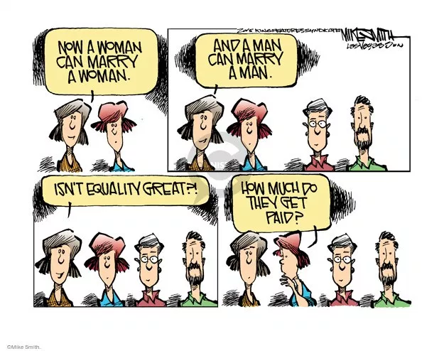
Scenario Time….
With a partner or two…
  decide under what standard each situation would be decided and why.
  Do you believe this would be legal or not, why?
Notes:
This often works best in groups that are NOT of their own choosing so there are different opinions.

Slide 6
