Slide 1

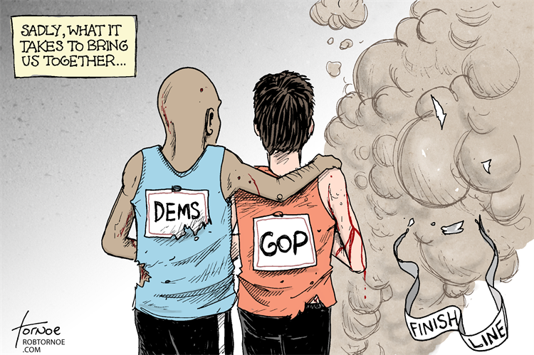
The Boston marathon bomber…a case study
Explain how the Supreme Court has attempted to balance claims of individual freedom with laws and enforcement procedures that promote public order and safety.
Explain the extent to which states are limited by the due process clause from infringing on individual rights.

Slide 2
The Boston marathon bomber…a case study in pretrial rights…
First read Miranda v. Arizona and answer the questions at the end on a separate piece of paper.
Next, watch the video which details the investigation and finally read the articles provided.
Using what you have learned….Answer the following in approximately 7-9 sentences on the back of the same paper you used above:
  Were the rights of Dzhokar Tsarnaev violated in the investigation of the boston marathon bombing? Explain using evidence gained from the above and at least one foundational document.

Slide 3

In case you are interested in the movie version…

