Slide 1
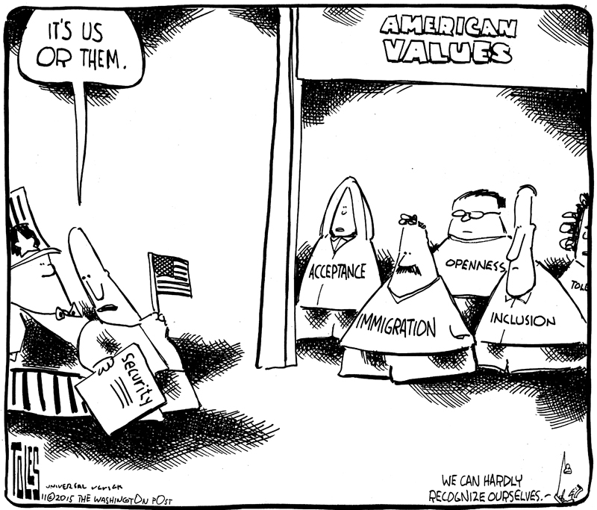
American Core Values
Explain the relationship between core beliefs of U.S. citizens and attitudes about the role of government

Slide 2
American Core Values…Equality
1) Should everyone be treated equally? Why or why not?
2) Should a person in a wheelchair be provided with a wheelchair accessible bathroom?
3) Should there be extra help in school for a dyslexic student?
Equal v. Fair
Notes:
Discuss answers to questions……ultimately, the question comes down to if we want equality or fairness (generally we want fairness)

Slide 3
In what ways are Americans …
Equal/same
UnEqual/different
* Are inequalities due to chance or choice?
Notes:
Students will probably say we are equal in that we are human, have right, etc……
Different in terms of race, abilities, etc.

Slide 4
1)When should the government be involved in making accommodations for those who are unequal in society?
  If the inequality is due to chance or to choice?
2) Do you think it is ever appropriate for the government to make accommodations for those who are unequal due to choice?
  When?
3) HOW involved do you think the government should be in making accommodations for those who are unequal due to chance?
  Should the goal be equal outcome for all citizens?
  Or equal opportunity?
Notes:
Ultimately, we usually agree to help those that are unequal due to chance…but sometimes choice…but this can be controversial…discuss questions….
* We generally want to give people equal opportunity, not equal outcomes

Slide 5
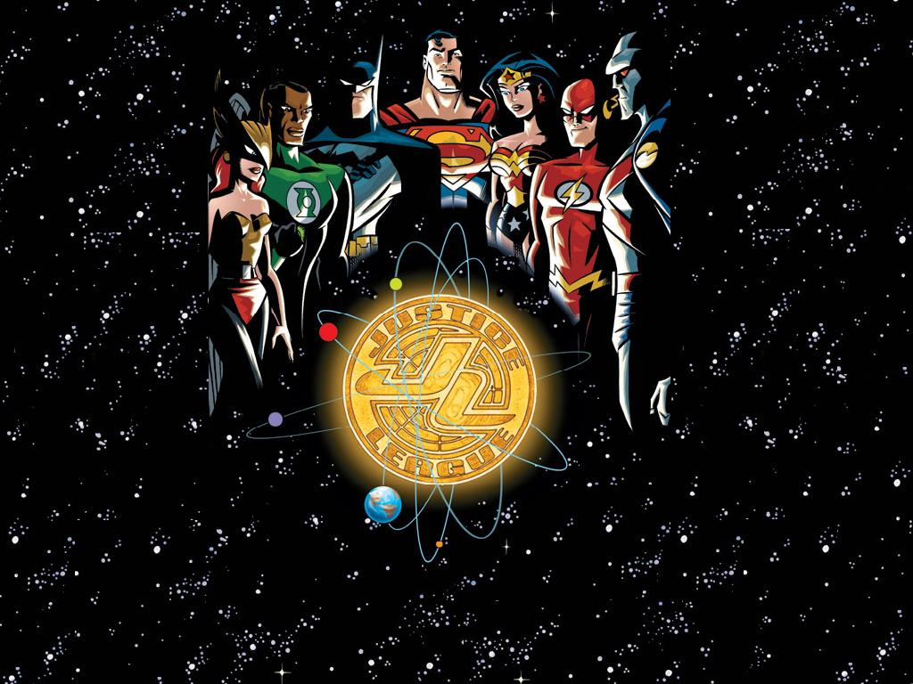
American Core Values…Justice
Notes:
So, while we all agree on certain American core values, we disagree on what they mean….have students work with a group (best if a group of three of your choice to create discussion) to complete the worksheet….discuss those that they found particularly difficult.

Slide 6
Justice is…
1. Justice means treating equals equally and unequals unequally, and the unequal treatment is in proportion to the inequality
2. Something that is properly due or merited (You get what you deserve based on what you have done, punishment is appropriate )
3. Conformity to truth, fact, or sound reason (American truth= the Constitution)
4. Justice is responding to cases of distress and meeting citizens' needs
5. Moral Rightness (A solution closest to satisfying moral opinions based on a specific moral code, e.g. the Bible)
6. Pleasing the majority
7. Utilitarianism: The greatest good for the greatest number of people
8. Eliminating the root of a problem to fix what is broken
9. When the victim is awarded some compensation, and the perpetrator is punished
10. When all aspects of a situation are looked at, and the best possible solution is decided upon.
Notes:
If they have extra time…have them choose one….again, we differ in our interpretation of values yet, they are all standard American Values…

Slide 7
American Core Values

Slide 8
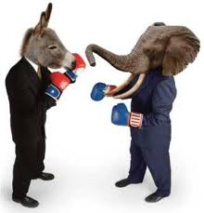
Political Culture
A distinctive and patterned way of thinking about how political and economic life ought to be
Notes:
Even though we fight, both GOP and Dem, conservative and liberal have a way at looking at political and economic life that is common to the vast majority of Americans, this is our political culture (not ideology)

Slide 9
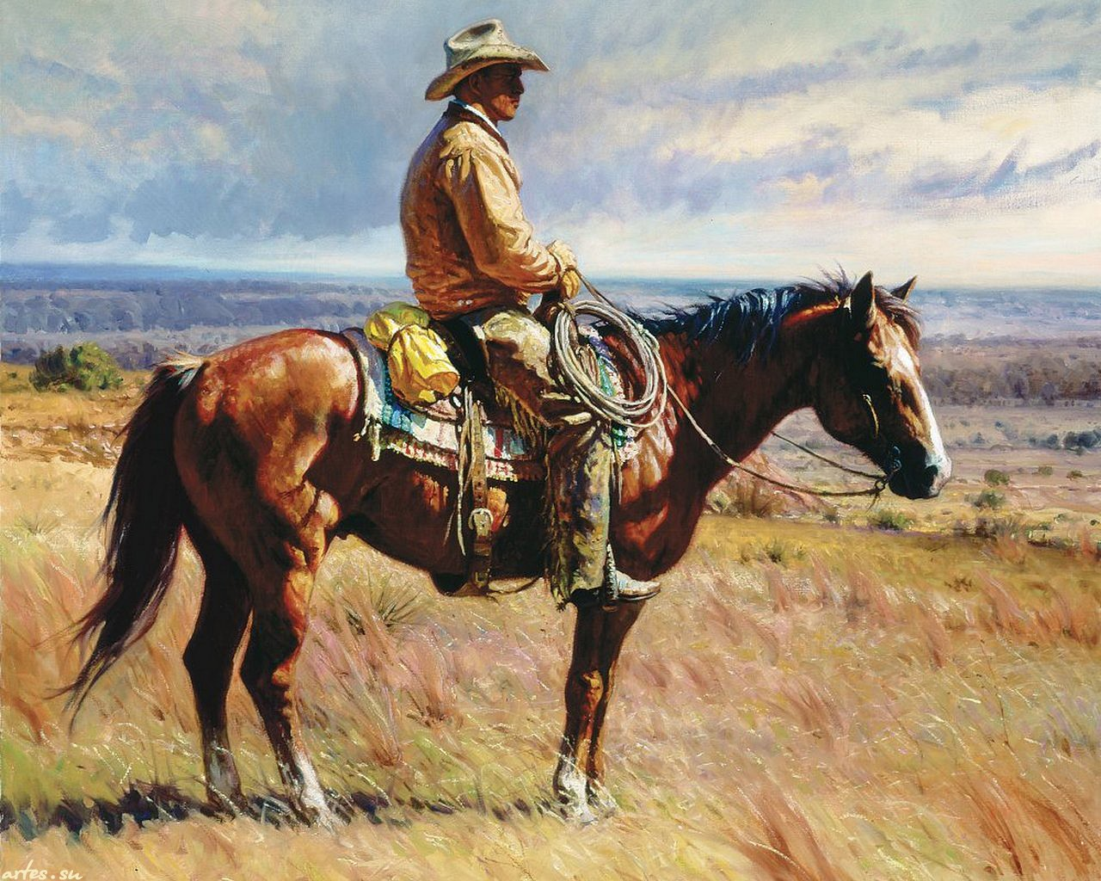
Individualism
valuing individual rights over those of the government
  emphasis on individual freedom, initiative and responsibility
  Self reliance and economic self sufficiency

Slide 10
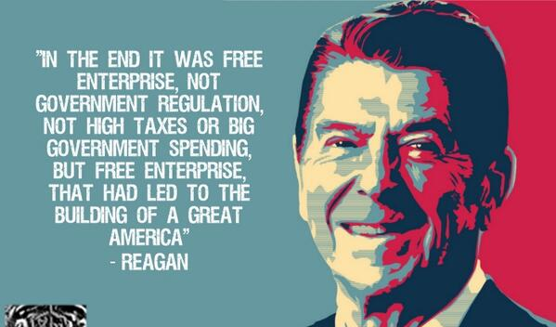
Free Enterprise
the right to compete freely in a market governed by supply and demand
  limited government involvement

Slide 11
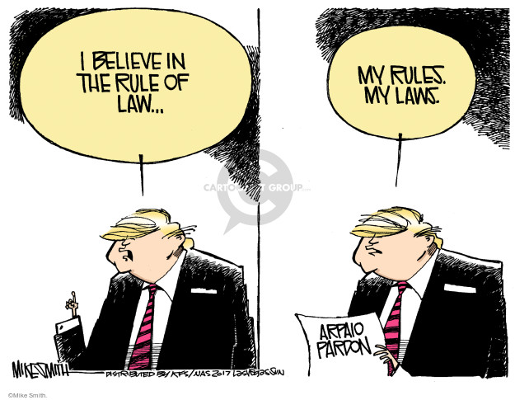
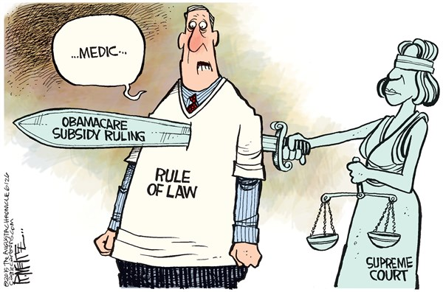
Rule of Law
law is applied equally and fairly to every citizen, not on the whims of those in charge
  no one is above the law, including the government.

Slide 12
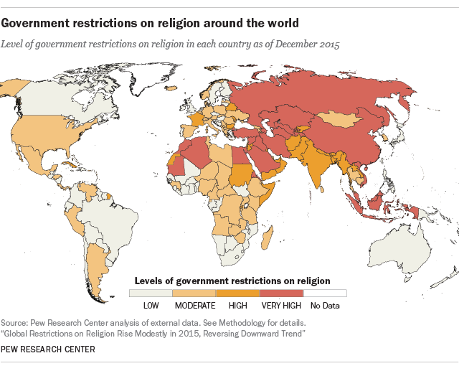
Limited Government
restrictions placed on government to protect individual rights and liberties

Slide 13
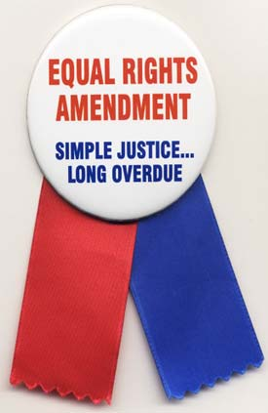
Equality of Opportunity
Everyone should have an equal vote and an equal chance to succeed
all people (at least all American people) are of equal value, and no one is born superior to anyone else.

Slide 14
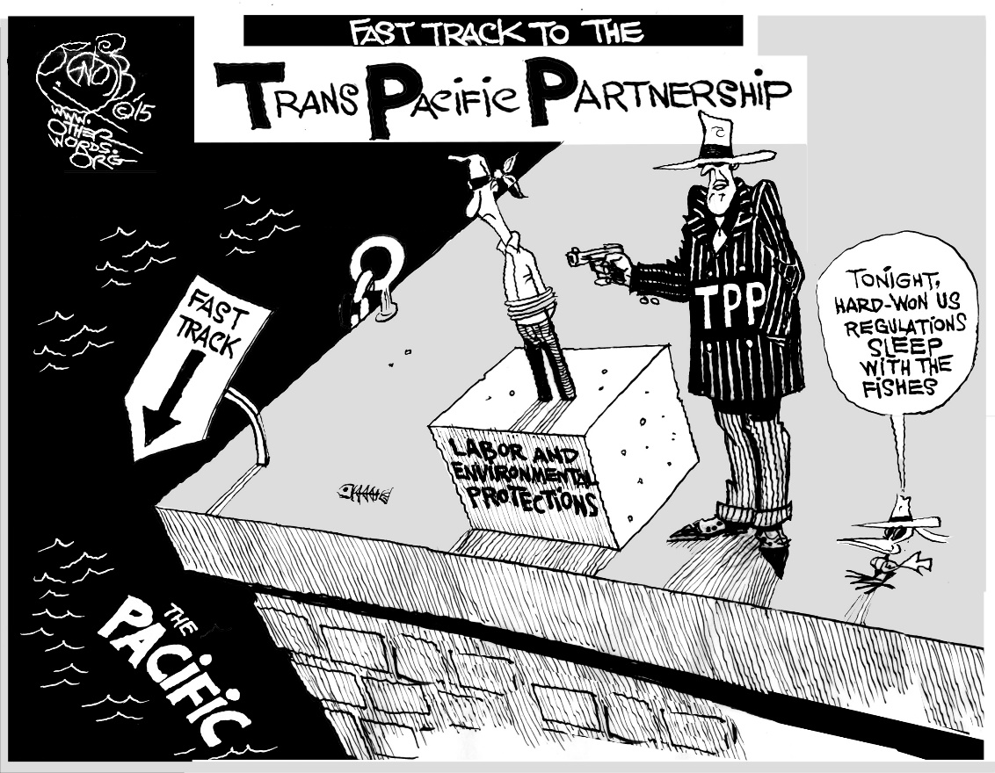
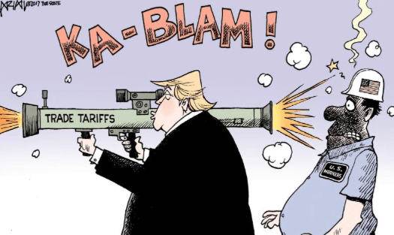
Conflicting Values & Interpretations
A bill proposing that large corporations can purchase carbon offsets in order to exceed EPA limits on pollution
Notes:
Sometimes our values conflict...which ones?
All of these, free enterprise v. limited government

Slide 15
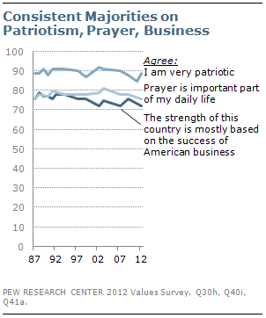
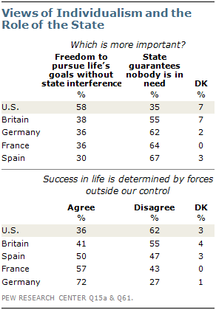
Conflict & Agreement…
* Different interpretations of values affect the relationship of citizens to the government & to each other

