Slide 1
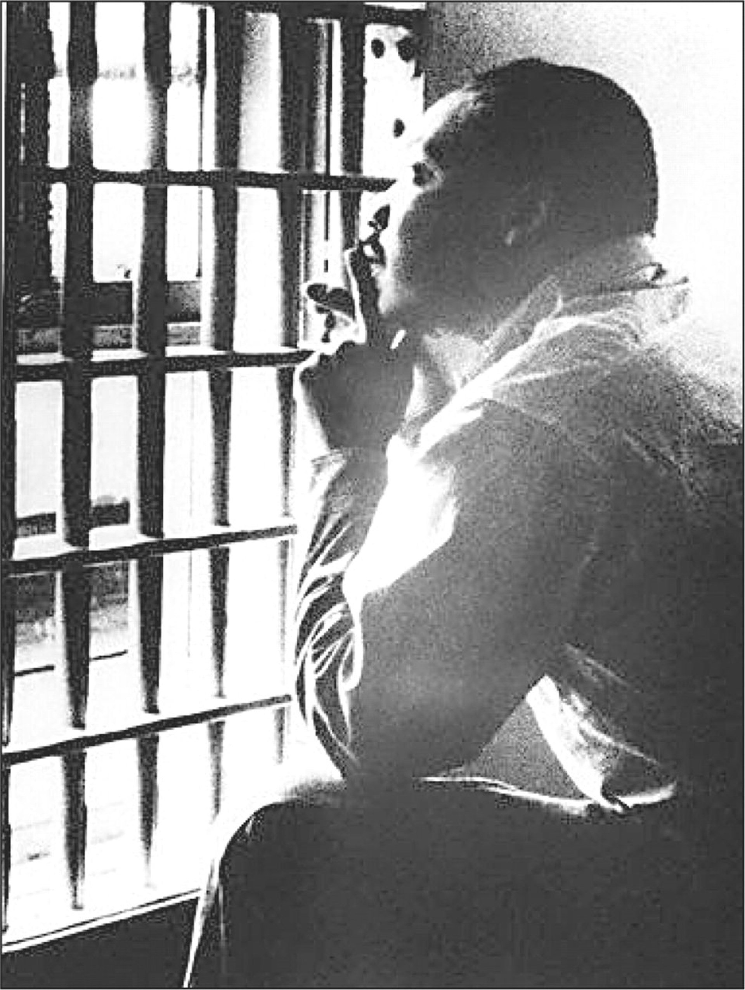
Letter From a Birmingham Jail
Notice….the only REQUIRED foundational document NOT from the founding time period…
Individually read and annotate the excerpt.
  “Brain” means think about it, it’s not directly in the text.
With a partner or two, compare your annotations, then answer the questions at the end. Be prepared to share with the class.
Notes:
Have students pick up a copy of “Letter” as they come in….they should first read & annotate individually (encourage them to read once without annotation, then read again and annotate); then work with a partner and review as a class answers.

Slide 2
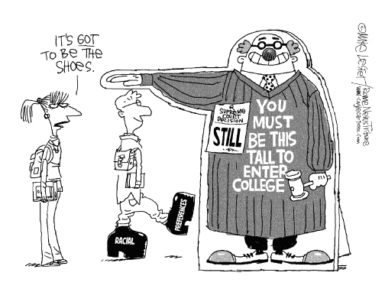
Affirmative Action
Equality of opportunity vs. equality of results – Do civil rights require the absence of discrimination OR require racial balance?
Notes:
Discuss......the courts would answer that we need the absence of discrimination (unless for a good reason, remember equal protection clause scenarios)
* so, this makes Affirmative Action controversial

Slide 3
Affirmative Action Cases
California v. Bakke (1978)
Grutter v. Bollinger (2003)
Upheld Affirmative Action… but ruled that “Strict quotas are UNCONSITUTIONAL.”
Race may be used as criteria for admission (and/or hiring)
Race may be used as one factor among many
Strict Quotas are still unconstitutional
Forecast the end of affirmative action
Notes:
Hyperlinks on the case names…..
* Remind students that the Bill of Rights Institute Homework Help Series is linked on my webpage and a good resource for required cases…even though these are not ☺

Slide 4
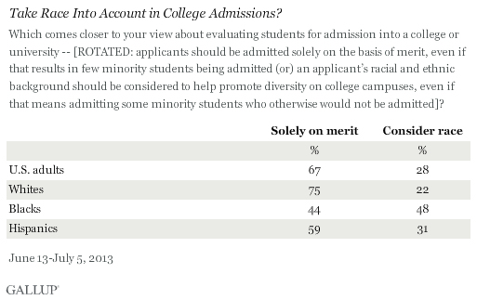
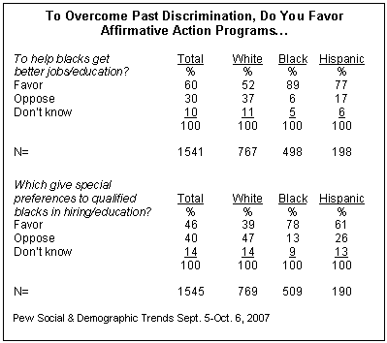
Education, No. Jobs, Yes?

Slide 5
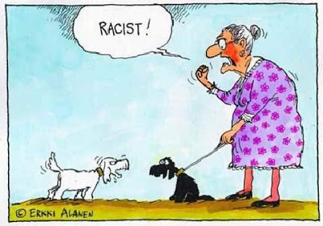
Notes:
It is sometimes a matter of perspective!

Slide 6
