Slide 1
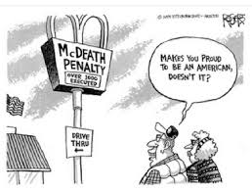
Amendment 8
Explain how the Supreme Court has attempted to balance claims of individual freedom with laws and enforcement procedures that promote public order and safety.

Slide 2
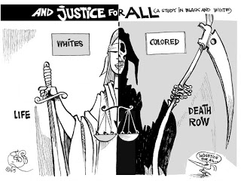
Death Penalty?
Furman v. Georgia (1972)
  focused on racial bias against black defendants
  States had to assure that the death penalty would not be administered in a capricious or discriminatory manner
Gregg v. Georgia (1976)
  a punishment of death did not violate the Eighth and Fourteenth Amendments under all circumstances
  the careful and judicious use of the death penalty may be appropriate if carefully employed
Some states have the death penalty, some don’t…the federal government does (but not usually used)
“No cruel and unusual punishment nor excessive bail or fines shall be imposed”
Notes:
Hyperlink to video on cartoon

Slide 3
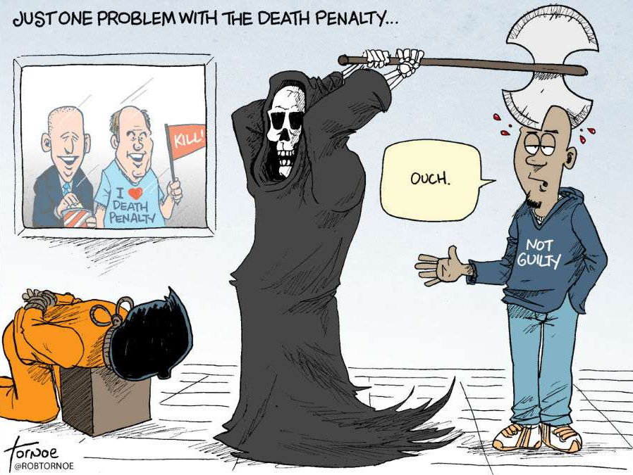
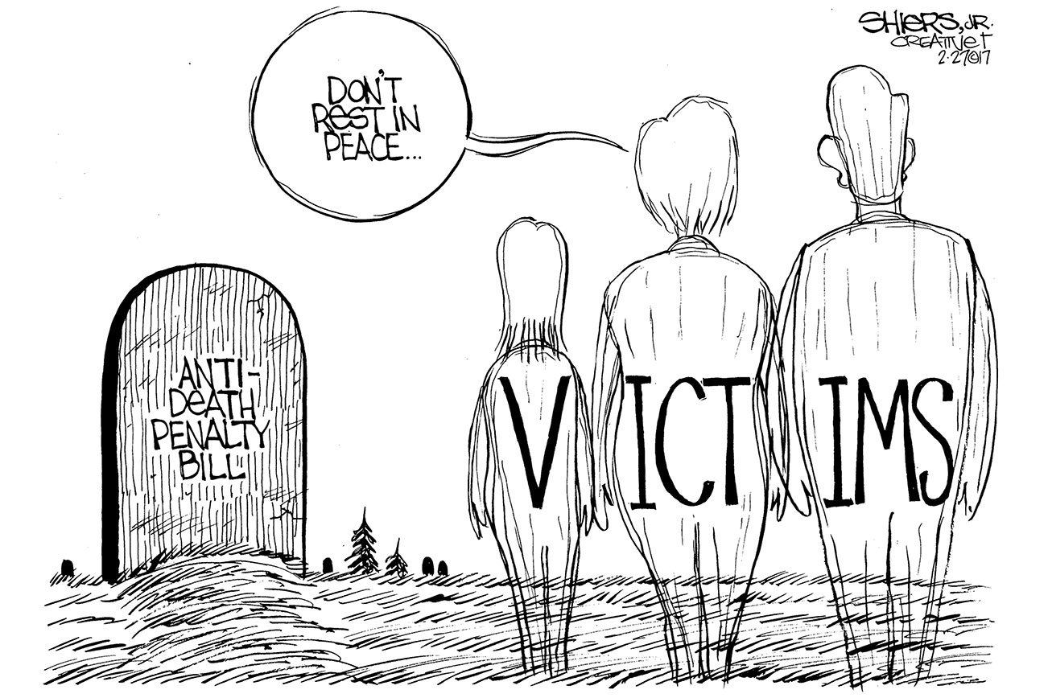
Philosophical chairs
Develop your arguments for and against the death penalty & be prepared to share & defend them
Take your sides chair when you are ready.
Briefly summarize the previous speaker’s argument before giving your own.
There must be three speakers between each of your comments.
Notes:
Give each student a copy of the philosophical chairs handout, then have students go to one side of the room if they are either for or against the death penalty; they then have 15 minutes to develop arguments (yes they may use their phone to find information); then put two chairs in the middle with students taking their “assigned” chair when they want to speak
Everyone must speak at least once or they do not get points for the class; I usually collect their sheet once they have spoken
If one side has many more students the other may need to speak (sit in the chair) more than once.
You may not speak at all unless you are I the chair!

Slide 4
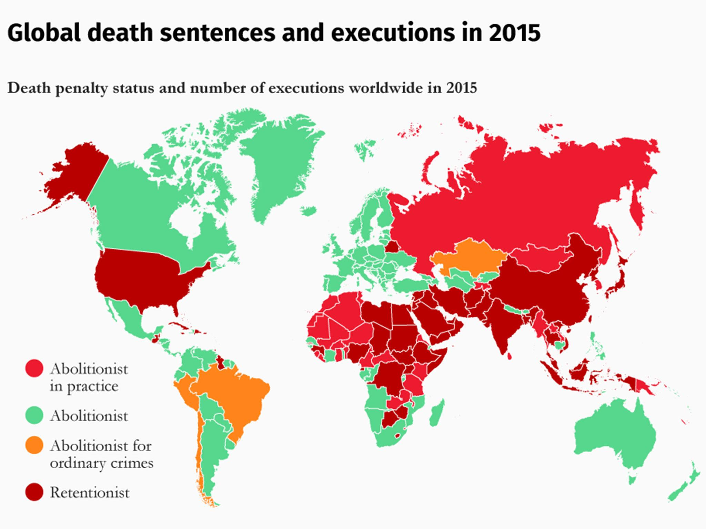
Notes:
Most of the world does have the death penalty

Slide 5
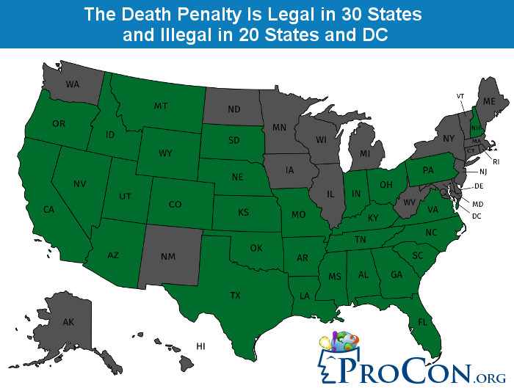
Notes:
So does most of the US, any trends, surprises?
More liberal states have abolished the death penalty (i.e. Illinois); just because you have the death penalty doesn’t mean you use it…harder to convict.
If there a bunch of time left over tell students to use their cell phones to work on their AP Central questions for unit 3 (practice).

