Slide 1
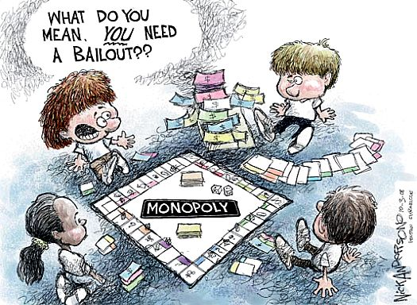
Economic Policy
* Explain how political ideologies vary on the government’s role in regulating the marketplace.

Slide 2
Read “C v. L: the Economic Debate” and complete:
Position/Issue | Conservative Beliefs | Liberal Beliefs
Sources of Economic Instability
Rules vs. Discretion in Economic Policy
Fiscal vs. Monetary Policy in Economic Stabilization
Causes of Inflation
Notes:
Students should read and complete the chart individually…..

Slide 3
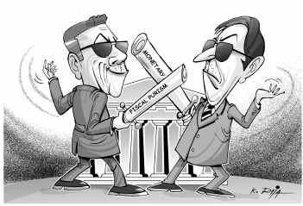
Notes:
Ideologies are similar even across the world….conservatives and liberals in India debate how to handle the economy in similar ways to how the GOP and DEMS do in the U.S.

Slide 4

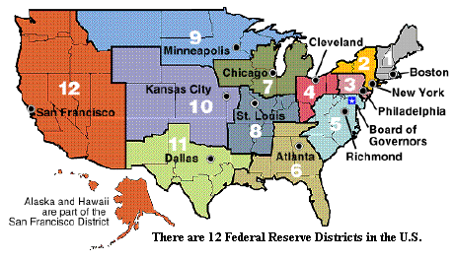
Monetary Policy ( more Conservative)
  Efforts to regulate the economy through manipulation of the supply of money and credit
    increase or decrease amount of money
    Increase or decrease the discount rate
      Interest rate which the FED (government banks) charge commercial banks
  Federal Reserve System
    Regulates member banks
    and uses monetary policy
    to fight inflation & deflation
Notes:
As the chart explained….conservatives are more likely to use monetary policy to control the economy…..

Slide 5
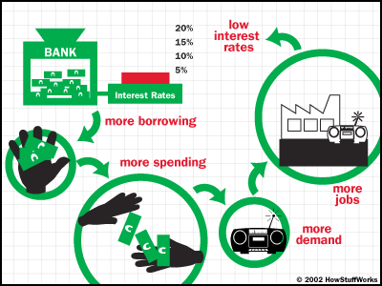
“FED starts here…”
* it might also do the opposite!
Notes:
This is supposedly how it works…..

Slide 6
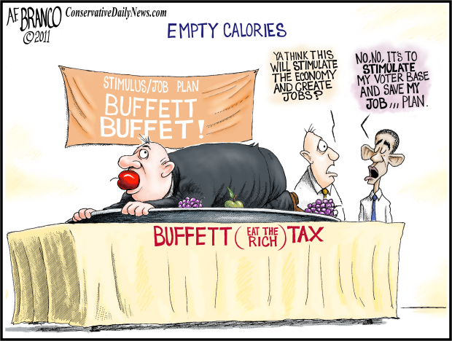
Fiscal Policy (more liberal)
  Using tax and spending powers to manipulate the economy
  Money comes from…
  Progressive Taxes
    Ex: income tax
    You make more,
    you pay more (%)
  Regressive Taxes
    Ex: sales tax
    You make less so
    it “hurts” more even
    If % doesn’t change

Slide 7
Fiscal Policy
Monetary Policy
Keynesian Economics
taxing and spending by Congress
Sometimes the government has to “help the economy”
fund spending by running a deficit
* replaces lost business spending
automatic stabilizers—graduated income tax and unemployment insurance
government borrows and spends using treasury bonds
*** We NEVER run the surplus Keynes recommended (or at least we don’t save it)
controlling the money supply
Federal Reserve Board
* holds reserves, “administrates” the banking system, controls the $ supply
Board of Governors is independent
loose monetary policy = decreased credit rate, more $, more spending
tight monetary policy = increased credit rate, less money supply, less spending
shorter lag than fiscal policy
tools of economic policy
address problems with the business “cycle”
affected by lag time
imperfect solutions
Notes:
These two policies are always working together….
* I would talk through this but tell them not to write it all down…..

Slide 8
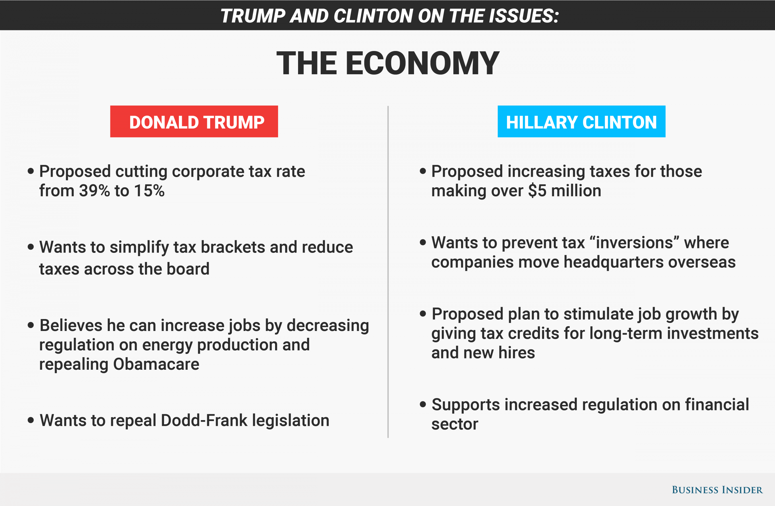
Tools of Economic Policy
Taxes
Eminent Domain
Grants
Subsidies
Contracting
Pork Barrel Legislation
Regulation
Deregulation
Interest Rates – money supply
Trade Policy (MFN Status, Tariffs, Quotas, NAFTA/USMCA)
Notes:
The government has lots of ways it can influence the economy through POLICIES
Eminent Domain – take land to build highways or schools, etc.
Grants – categorical or block…remember federalism
Subsidies – give money to encourage production of a product such as corn so the price drops
Contracting – buy lots of planes to shore up Boeing after the recent crashes….
Pork Barrel Legislation – local projects that bring money into a state or local district
Regulation – rules that businesses must follow
Deregulation – loosening the rules
Interest Rates – control the money supply
Trade Policy – think Trump and renegotiating deals or placing tariffs through executive order…

Slide 9

Review Ideology Predictions…..

