Slide 1
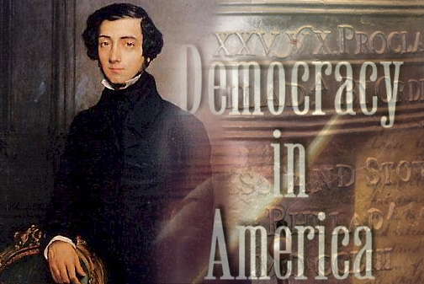
Democracy in America –
Alexis de Tocqueville
“The Americans combine the notions of religion and liberty so intimately in their minds, that it is impossible to make them conceive of one without the other.”
“The American Republic will endure until the day Congress discovers that it can bribe the public with the public's money.”
“Americans are so enamored of equality, they would rather be equal in slavery than unequal in freedom.”
“What is most important for democracy is not that great fortunes should not exist, but that great fortunes should not remain in the same hands. In that way there are rich men, but they do not form a class.”
Read & answer the questions in your notebook.

Slide 2
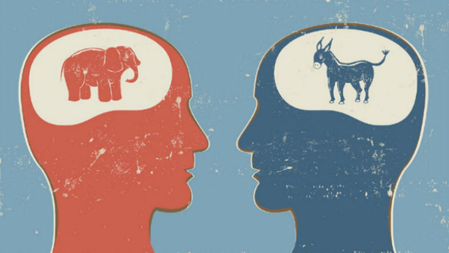
“Bipolar Disorder”
- Johnathan Rauch

Slide 3
Rauch – Bipolar Disorder
1. What are the characteristics of red & blue America?
2. What evidence have scholars used to prove that America is politically divided? (You should find at least five pieces throughout the article.)
3. What is wrong with this evidence according to Rauch? (You should find at least three pieces throughout the article.)
5. What does Rauch mean on p.3 when he states “the archetypes may be stereotypes?”
6. On p.3-4 why does Rauch say America appears divided? Who is actually divided?
7. Explain the analogy of American public opinion as a football.
8. On p.5, what are “landslide counties” and how do they make America appear more divided?
12. Do you agree with Rauch’s arguments? Has America become more or less culturally and politically divided since Rauch wrote this piece? (Write a short paragraph and use your own evidence/knowledge.)

Slide 4
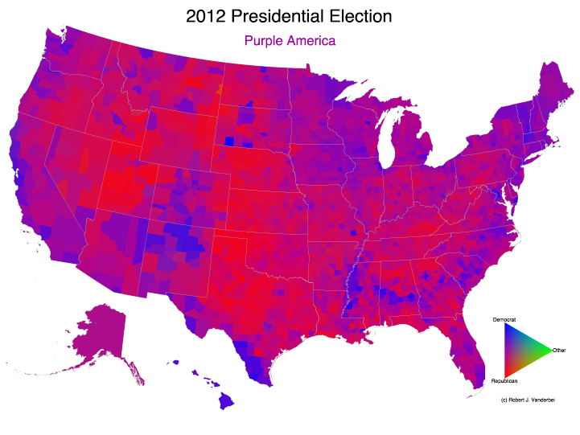

Slide 5
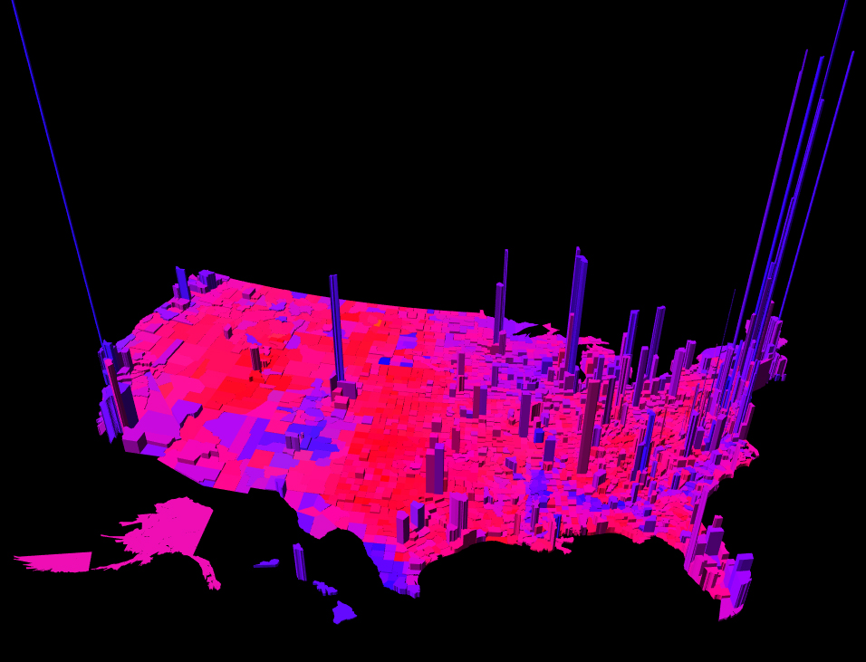

Slide 6
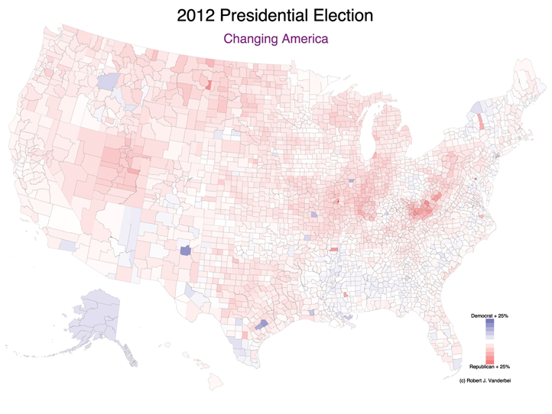

Slide 7
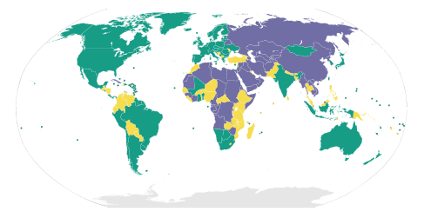
Liberal Democracy?

