Slide 1
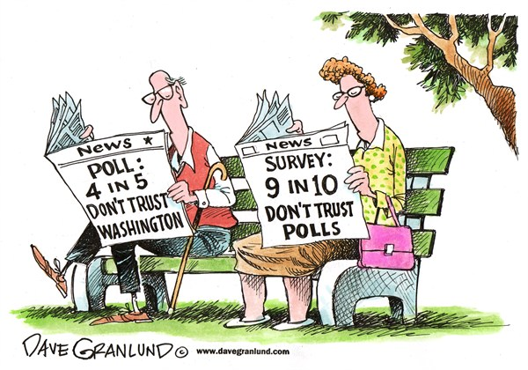
Describe the elements of a scientific poll.
Explain the quality and credibility of claims based on public opinion polling.

Slide 2
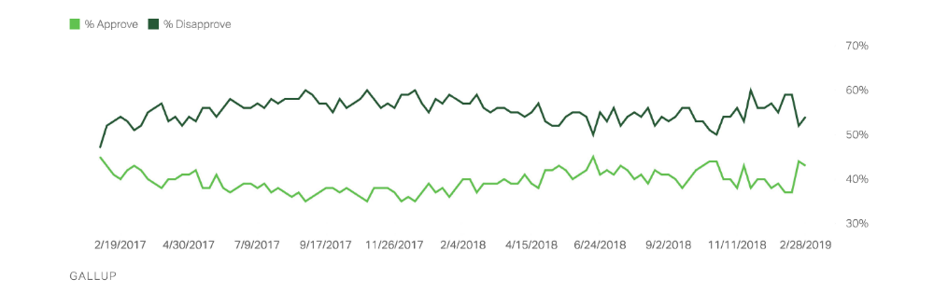
Polling & Public Opinion
President Trump – Job Approval Rating from Gallup.com
Notes:
Polls can be powerful instruments used to measure public opinion and to get policy approved/passed….or they can hinder these things…any trends or reasons behind the ups and downs you see?
* 2/28…meeting with Kim Jung Un

Slide 3
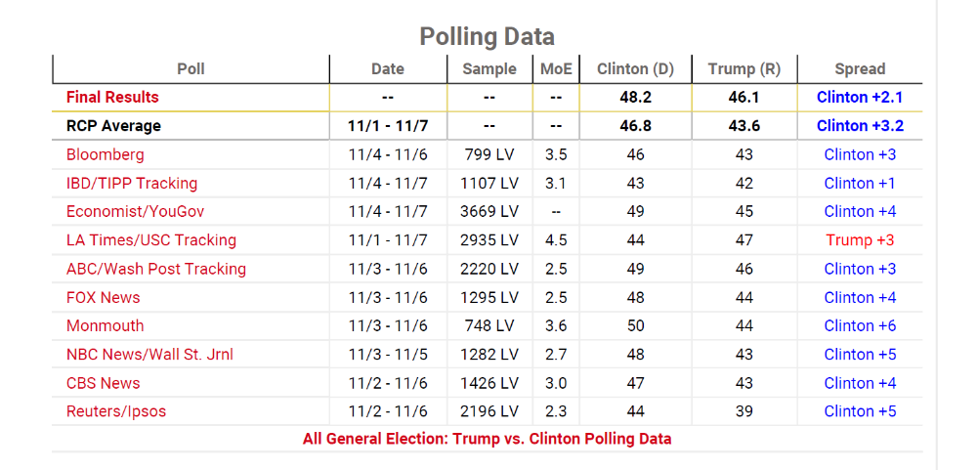
Can we still trust polls?
Notes:
Polls have come under more scrutiny since the 2016 election when the last polls showed Hillary Clinton solidly in the lead…
* Hyperlink on title to video…

Slide 4
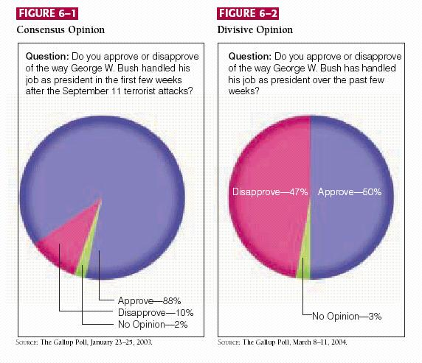
Public Opinion
the aggregate of individual attitudes or beliefs shared by some portion of adults.
  Consensus vs. Division
Notes:
The measuring of opinion most often occurs with polls but public opinion can be measured in a variety of ways including the results of an election, and participation in demonstrations
The transition from private to public opinion really occurs when an individual takes some action to publicly express their views on a public subject
This expression of one’s view can either be proactive – getting involved in a political issues OR reactive – responding to polling questions
Public opinion takes three different forms:
Consensus – general agreement on a public issue
Divisive opinion – the public is sharply divided on a public issue
Non-opinion – public opinion is generally uncertain about a particular issue i.e. close to a majority of the voters have no opinion
POLITICIANS and POLICY usually respond to consensus because there is a “clear direction” from the public

Slide 5
Polling Definitions
Poll - a sampling or collection of opinions on a subject, taken from either a selected or a random group of persons, as for the purpose of analysis.
Issue Poll vs. Favorability Poll
Margin of Error –an allowance for slight error or miscalculation; an allowance for changing circumstances (sampling error)
  Usually expressed as +/- ??%
Notes:
Issue poll – what people care about…so what the government might act upon
Favorability poll – how I feel about an issue
* All polls generally take these forms & all polls have a margin of error because I haven’t asked absolutely everyone or I may not have asked in the correct way…I can never be 100% certain of my results

Slide 6
What is wrong with each of these methods?
1. Calling survey participants on the phone only from Noon until 3PM.
2. Asking survey participants to call in their vote.
3. Polling only a retirement home to gauge the nation’s views on health care.
4. Asking bald men what kind of shampoo they prefer.
Notes:
Discuss why these polling methods might be bad and unscientific…

Slide 7
Polling Definitions
Representative Sampling – using a small group to represent the opinions of a larger group
  Most accurate if it is also random
Quota Sampling – ensuring you have enough of each sub-group to represent the whole
Push Polls – misleading polls that are meant to make a person respond a certain way or believe a certain outcome
Notes:
So….we want to ensure polls are accurate and measure the correct things…or do we?

Slide 8
What is wrong with each of these polling questions?
1. “Are you in favor of killing babies?” in an abortion survey.
2. “Would you say that Barack Obama clobbered John McCain in the last election?” in a post-election poll.
3. “Do you like the President?” in a presidential approval rating.
4. “For whom did you vote in the last election?” to assess partisan affiliation.
Notes:
Push polls, leading and improper questions for what I am trying to measure.

Slide 9
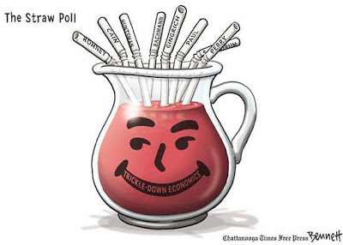
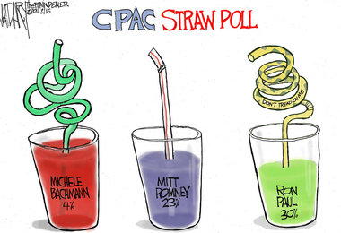
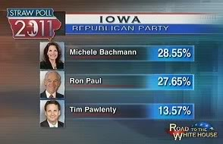
Straw Polls
Inaccurate & nonbinding
Have an effect on media and within the group they are taken from
Notes:
Again, some polls are purposely inaccurate but that doesn’t mean they don’t have an effect…

Slide 10
How can these results be skewed?
4 out of 5 doctors surveyed recommend Product X.
If the election were held tomorrow, 43% of all likely voters would vote for Roberta Jones.
85% of all Americans prefer Brand Q over Brand Y.
66% of all parents surveyed think their children watch too much television.
Notes:
Discuss the presentation of results and how these can be misleading…

Slide 11
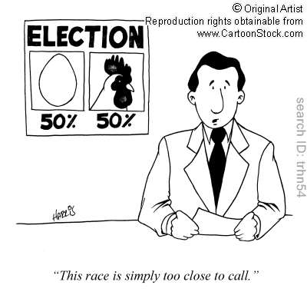

Slide 12
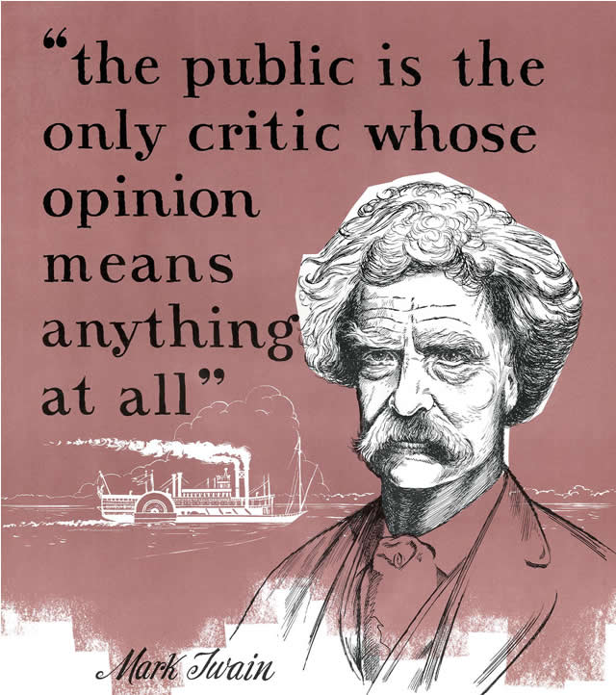
Political Input vs. Political Output
Notes:
Public Opinion & Polling are a key way we tell the government what to do…political input….and sometimes…that results in political output, but only sometimes…

Slide 13
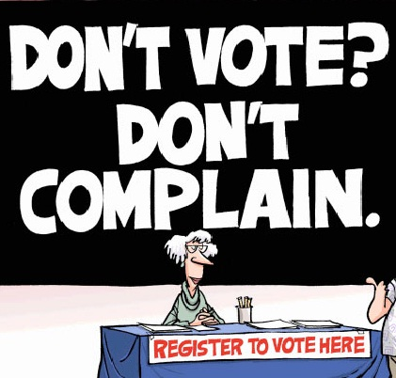

Political Inputs
Political inputs:
  demands
    for action, for concrete benefits or for other political outputs
  supports
    votes, ideological loyalty, party membership, donations, etc.
Notes:
Political inputs take numerous forms

Slide 14
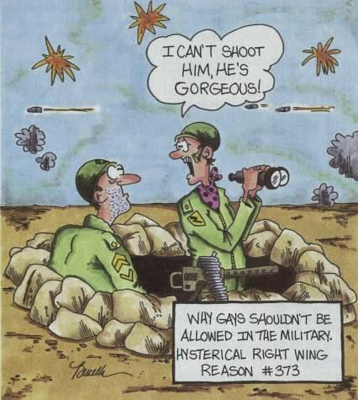
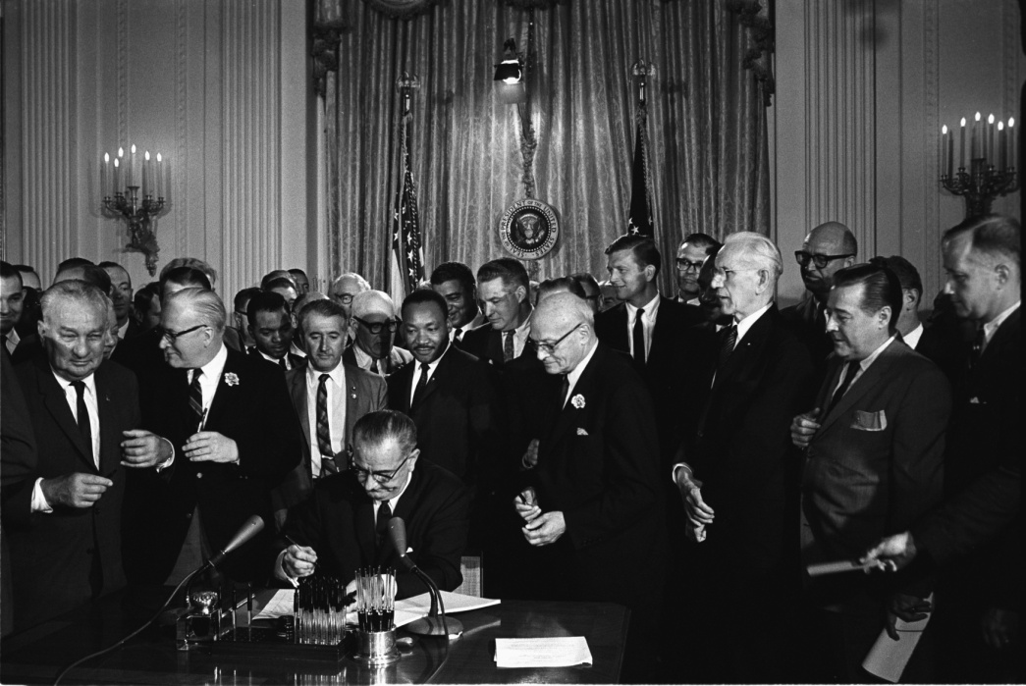
Political Outputs
Political outputs:
  decisions supporting values
  distributions of benefits, establishment of programs and services, new laws & regulations
Notes:
So do political outputs…

Slide 15
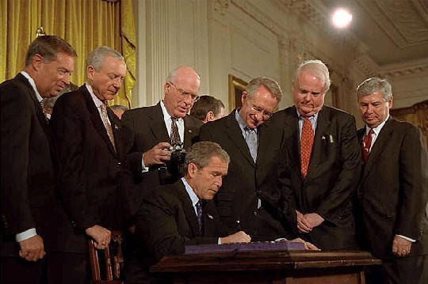
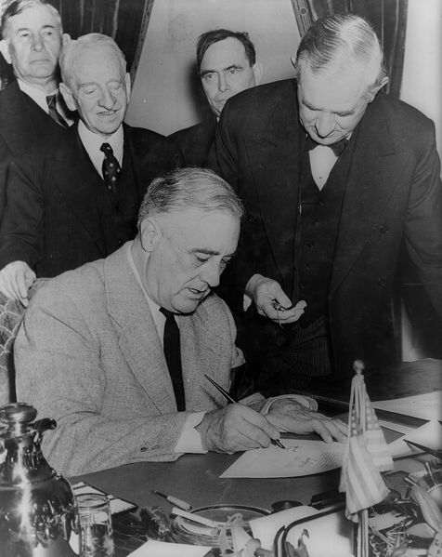
When does public opinion affect policy? – it depends…
degree of agreement within the public
intensity with which opinions are held
and the extent of organized support for and against the public position
clarity and simplicity of the issue

Slide 16
Public Opinion: Voice of the People
A Change of Heart about Federalizing Airport Security
  Why did the Republicans eventually give in on the airport security bill?
  How did political leaders know what the public wanted?
The Case of Vermont and Its Civil Unions Legislation
  How did Vermont’s citizens express their views on civil unions?
  Should polls be ignored in favor of participation in rallies or letter writing campaigns?
  Given public opinion, did Senator MacDonald do the right thing?
Notes:
Use “Democracy In America Video Series” the public opinion section….show both these clips and discuss if there is time…..

Slide 17
