Slide 1
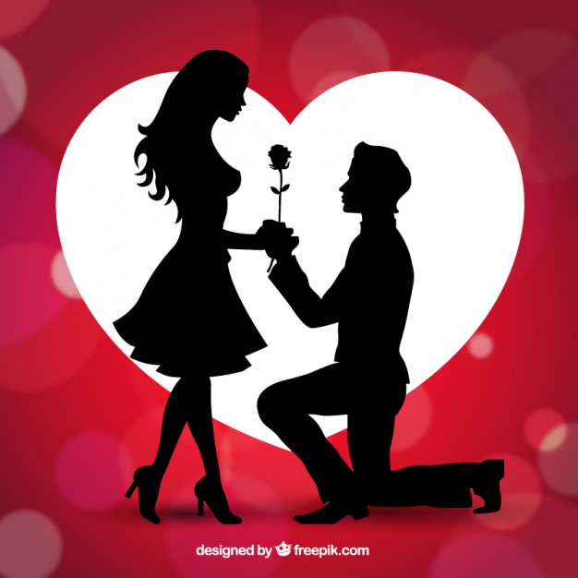

The Sociology of Love
Part I: History of Love
Part II: Modern Dating, Marriage, Divorce

Slide 2

Concepts of “Love”
The process of forming romantic partnerships has changed throughout history – as has the conception of “love.”
Forming romantic partnerships was not always about love – in fact, the process of courtship and marriage were almost entirely defunct of what we today would call “romantic love.”

Slide 3
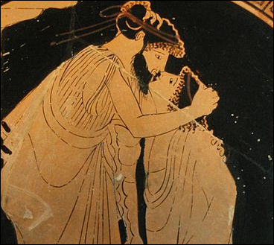
The History of Marriage
“Dating/Courtship” in early human societies were about consolidation of wealth and socio-political power.
Therefore, marriage was looked at as a necessary joint business venture between families for most of human history.
Male same-sex “bonding ceremonies” were common before the middle ages

Slide 4
Examples of Early Marriage
Mesopotamians, other tribal societies, and the early Hebrews, practiced polygamy and incestuous pairing commonly
In Ancient Greece, marriage (forming the Oikos) was a loosely regulated civil union and each city-state had their own customs. The patriarch was the legal representative of his wife and children. Monogamy becomes the norm in most Greek city-states.
In Ancient Rome, strict monogamy becomes enforced for the first time. It is also only when the Christian church becomes prevalent that the government takes a prominent rule in the regulation of marriage.

Slide 5
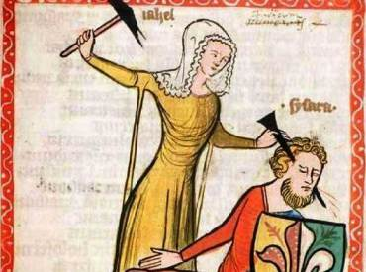
Examples of Middle-Period Marriage
With the spread of Christianity throughout Europe and the rise of the Catholic court-system, marriage becomes highly regulated.
However, it is still primarily an institution of consolidating power.
  Women had little to no choice in who they married. They were often promised within the first thirteen years of life to men at least twice their age.
  Men were encouraged to seek “romantic fulfillment” outside of marriage

Slide 6
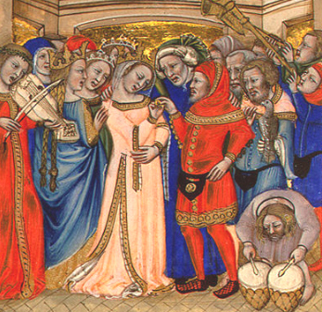
Examples of Middle-Period Marriage
  Women were encouraged to maintain their “wifely duties” and if they could not attain romantic love within their marriage – were socially constrained from pursuing it.
  Women were punished severely under “adultery laws.”
  Men could dissolve marriages if the woman was infertile. Women had very few options to exit unhappy or even abusive marriages.

Slide 7
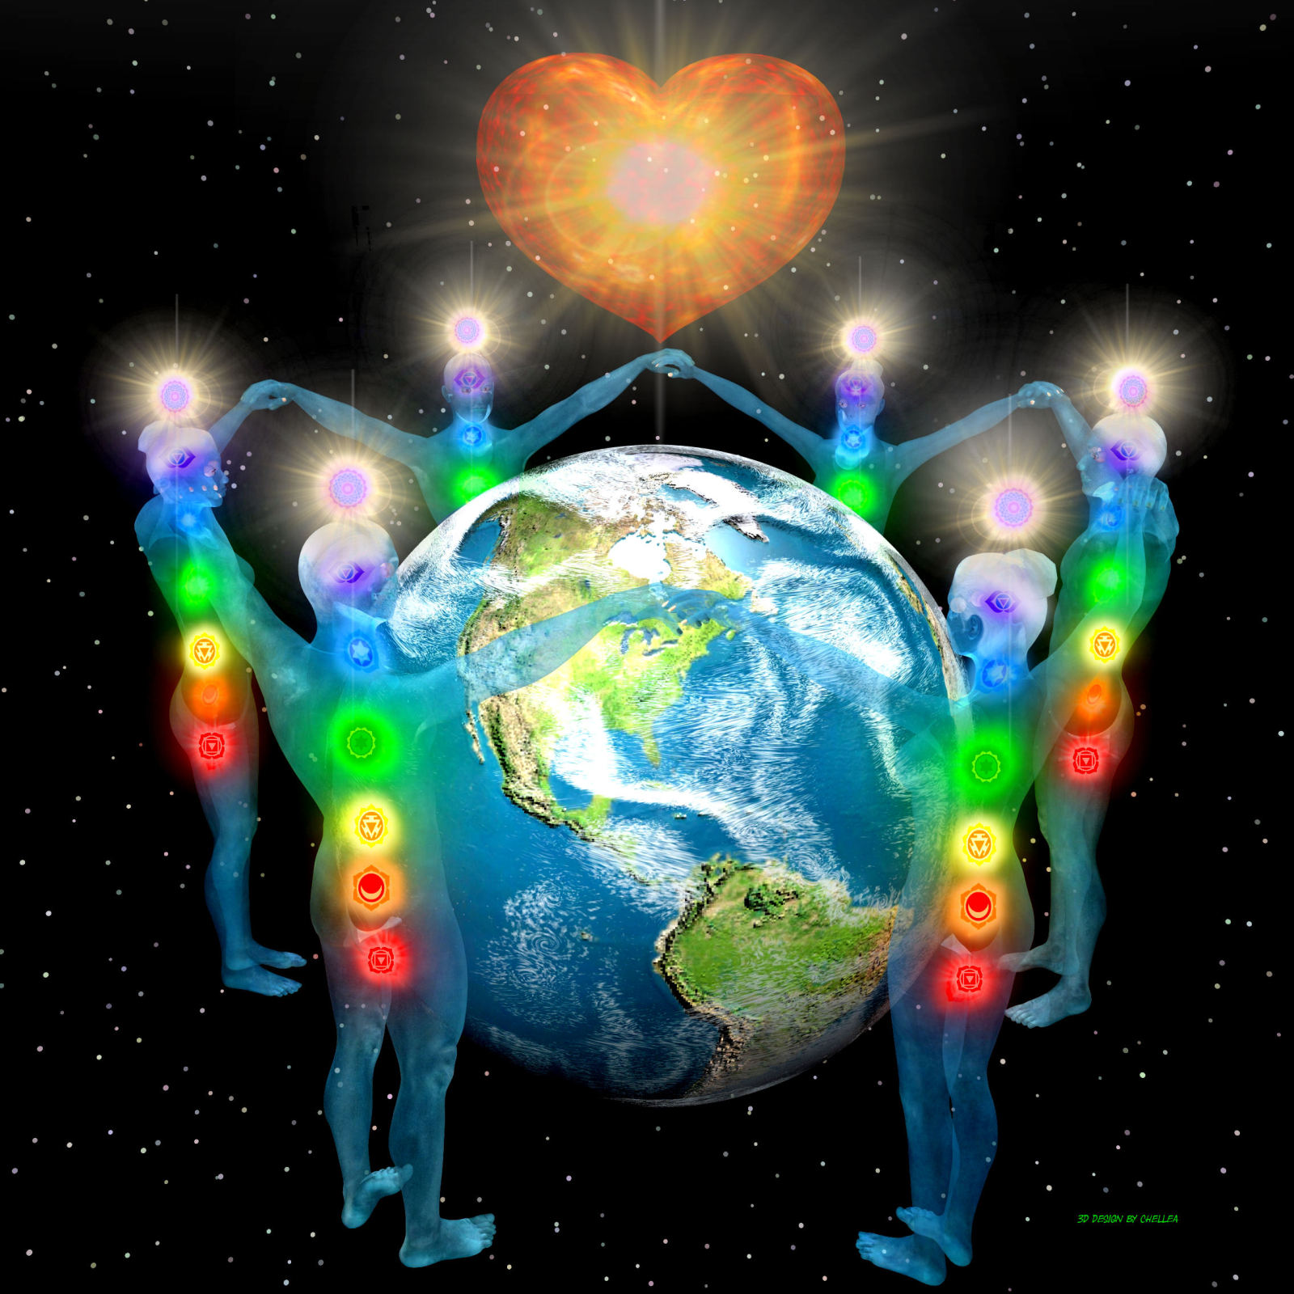
Love Conquers Marriage
It is only in the 17th/18th centuries when Enlightenment thinkers begin advocating for the “pursuit of happiness” -- that marriage for love becomes a prominent social idea.
Rigid system of courtship continues well into the 20th century – especially among the elite.
Marriage dramatically changes in the 1920s as feminist activists advocate for more political, social, and sexual freedom (Flappers).

Slide 8
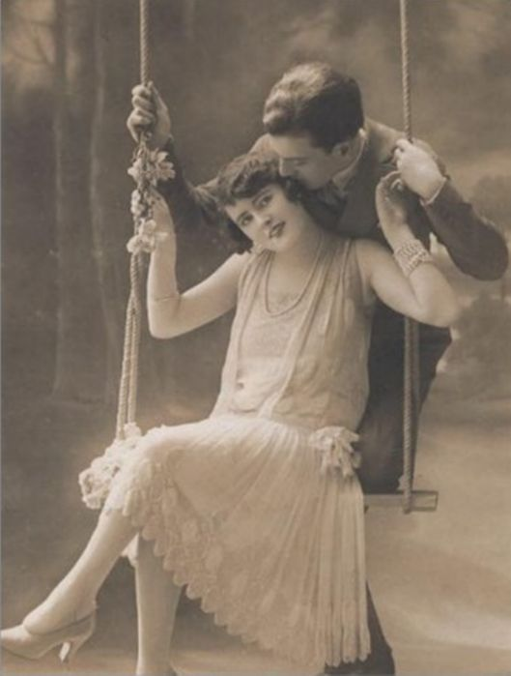
American Romance: 1920-1990
Proximity plays an enormous role: 1/3 of all marriages occurred between people who lived no more than five city-blocks from one another
People typically meet their spouses through school, mutual friends, or social organizations (churches, hobby groups, etc).

Slide 9
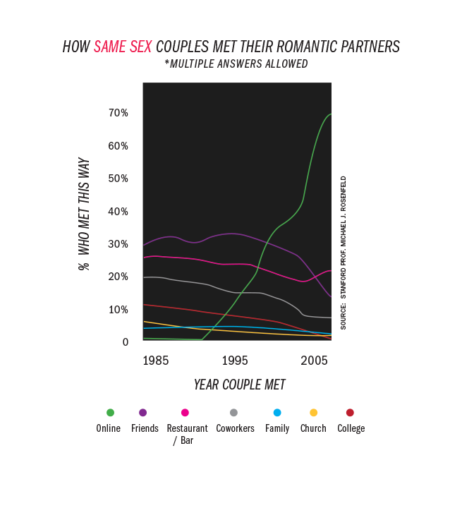

Slide 10
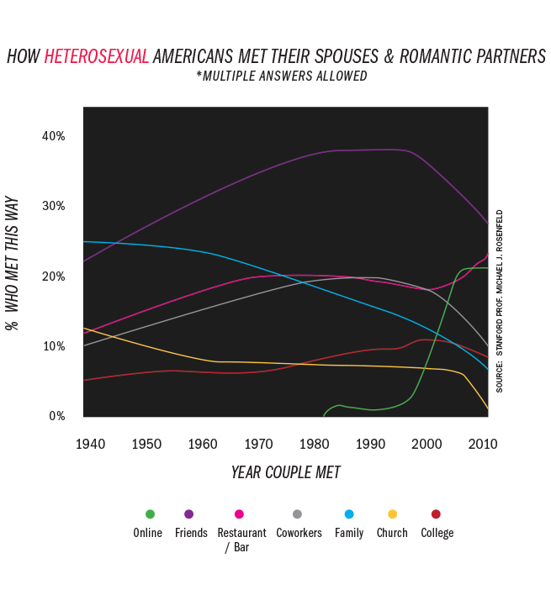

Slide 11
Staying Together
Among marriages formed from 1920-1990, 39% self-report that they stay with their spouse primarily out of social obligation (Svarer 2009:13:1).
Marriages formed from 1960-1990 [Baby Boomers] have significantly higher rates of divorce than any other cohort. They perpetuate the “half of all marriages end in divorce myth.”

Slide 12
Staying together:
What does that mean? It means our parents/grandparents conceptions of love and marriage may differ from our own.
What is a “good marriage” according to them?
  good marriage is defined as being happy at 75 percent of the time.
  About 17 percent of people believe a couple should happy 50% of the time.
  Just 1% think of marriage as successful if the couple is happy 25 percent of the time.
  75 percent said they are happy at least three-quarters of the time.
  About 15 percent said they are happy at least half the time.
  Just 5 percent said they are never happy in their marriages.

Slide 13
Generations:
Depression Cohort: Born 1901-1932
Baby Boomers: Born 1946-1964
Generation X : Born 1965-1980
Generation Y (Millennials): Born 1981-2000
Generation Z (Boomlets): Born after 2001

Slide 14
Cultural Attitudes (Univ of Ottawa Marriage Counseling Clinical Guide)
Depression Cohort: Viewed marriage as a stabilizing force. Express feelings of powerlessness and higher threshold for “living with dissatisfaction” in work and life and “staying together through difficulty.”
Baby Boomers: Higher degrees of education. Express a higher need for “optimization” in love and life. Higher focus on prestigious careers and a lower threshold for dissatisfaction. Highest historical divorce rate.

Slide 15
Cultural Attitudes cont’d
Gen X, Y (born 1965-1997): Higher education levels. Marry later in life and have far less children. Express a higher need for fun, challenging, and interesting careers and marriages.

Slide 16
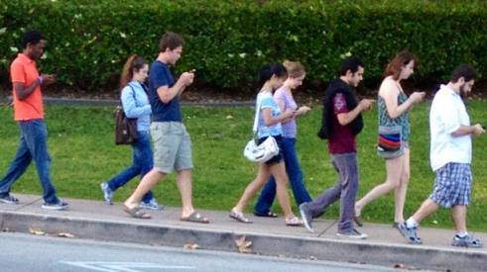
So what about YOUR generation?
How older generations perceive you:
    “Participation Trophy” Generation
    “Snowflake” Generation
    “Sexually Immoral”
    “Lazy”
    “Unable to be good workers”
    “Lack social skills necessary to function in the “real-world.” **Glued-to-Phone
    (Taken from various interviews conducted between 2015-2017).
    …Are these things true or false?

Slide 17
So what about YOUR generation?
Gender norms are negotiable: Who pays for the date?
Pre-Date information is at an all-time high (Facebook stalking, Googling).
People are waiting: For marriage (27), to have kids (26.3), For the first time ever people spend more time single than married (since 2007), Long-term cohabitation on the rise.
Having more sex?: Study after study shows… no! Your generation is having about as much sex as previous generations were as adolescents and young adults (Exception: Pre-Boomers)
STD Rate: Reported at an all-time high (2016) **Reported as key word

Slide 18
So what about YOUR generation?
More options than ever before (not necessarily a good thing): $2.4 Billion dating industry… Fastest growing trend (Men and women report VERY different experiences). **Disgusted & Hopeless
Social Skills are down: Seven recent studies suggest that Millennials lack social skills, social confidence.
    92% report “having difficulty finding a relationship.”
    82% report “high levels of anxiety when meeting face-to-face” without lengthy “phone only” encounters beforehand
    95% report “needing at least a little alcohol” to engage in face-to-face social encounters
    75% report they are currently involved in “casually hooking up” but also “wanting a committed relationship” *The “Try-to-not-show-you’re-catching-feelings Game” (Klineberg, 2016).

Slide 19

“It seems as though millennials are masking the desire for connection and relationships with quick fixes like drinking, social media interactions, and “no strings attached” relationships” (Klineberg, 2016).

Slide 20
What makes a “successful date”
Studies show that what makes a successful date is:
  The date is fun (this is the biggest factor)… duh?
  The date is unordinary/memorable

Slide 21
“Love is like a Drug”
Passionate Love (Stage 1): During this phase, your brain floods your neural synapses with dopamine, the same neurotransmitter that gets released when you do cocaine. **Wears off at 12-18 months
Companionate Love (Stage 2): Brain re-balances itself and is subject to long-term “peaks and valleys.” Healthy relationships maintain a cycle of balance”
“Patience in the valley is key” (Hardy, Social Psychologist @ NYU).

Slide 22
Unhealthy Relationships
Unhealthy relationships have much deeper valleys and higher peaks.
They often turn chaotic or toxic, but return to the original state of stage 1 when the “toxic issues” are ostensibly resolved.
Healthy relationships do not function this way.

