Slide 1
The Sociology of Flirting

Slide 2
What’s your best pick up line?
https://www.youtube.com/watch?v=uoOzbVxxYI8

Slide 3
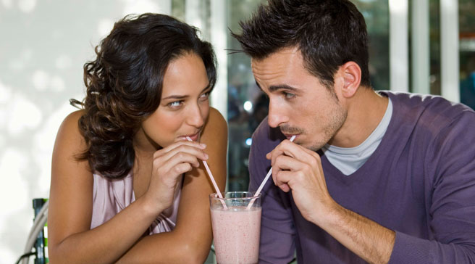
Opening questions:
In our society, who has the responsibility of “making the first move” when it comes to flirting?
Who has more “sexual capital”? Men or women?
Sexual capital = Sexual power/influence
**Catherine Hakim coined this term…building off the ideas of Pierre Bourdieu that we learned about when we discussed social class.

Slide 4
Actually, studies on heterosexual flirting show that women typically make the “first move” using body language to produce an environment of approachability.
It is then socially expected for the man to make an approach and strike up a conversation.
It doesn’t always work that way…and in fact many in society resist these dating norms – but they do exist!

Slide 5
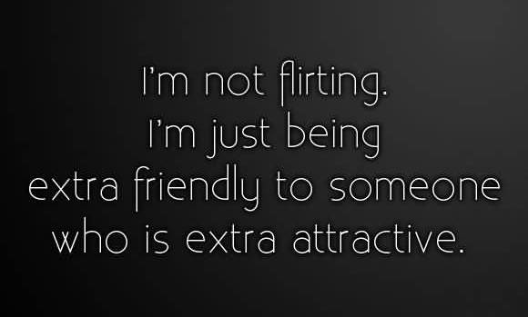
What is “Flirting”?
Flirting – a negotiation process that takes place to establish and expand on initial attraction
60-70% of flirting is done non-verbally
Source: Steven W. Gangestad, Evolutionary Psychologist

Slide 6
Video(S): What are the rules of attraction?
Pay attention to people’s behavior and the rules they follow:
Video 1: Indicators of Interest: Body Language as a Sign of Interest
Video 2: Secrets of the Sexes
Video 3: The Science of Flirting: “HOT APE”ing

Slide 7
What types of behavior constitute flirting:
Your eyes will dilate when they focus on someone you are attracted to
Sitting with your feet, legs, and shoulders pointed at the person
Teasing/Banter
Leaning toward the person
Brief touching to mitigate tension regarding personal space
Hair flipping
Eye contact
…And much more

Slide 8
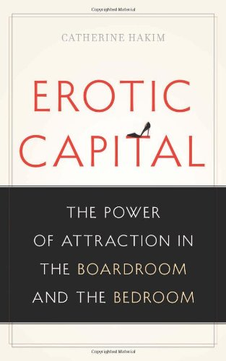


Slide 9
Catherine Hakim, British Sociologist
In Erotic Capital: The Power of Attraction in the Boardroom and the Bedroom (2013) and Honey Money(2011) argues that because women have more “erotic capital”, or in other words, sexual power, they should use it to get ahead in the world.
Do you agree or disagree?

