Slide 1
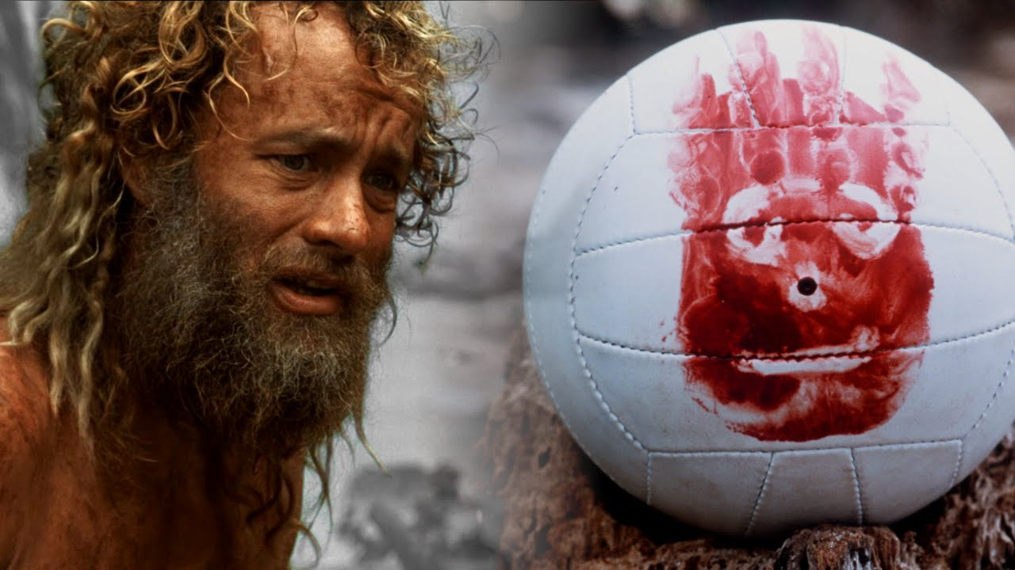
The Social Psychology of Cast Away

Slide 2
The Film:
Obsessively punctual FedEx executive Chuck Noland (Tom Hanks) is en route to an assignment in Malaysia when his plane crashes over the Pacific Ocean during a storm.
The sole survivor of the flight, Chuck, washes ashore on a deserted island. When his efforts to sail away and contact help fail, Chuck learns how to survive on the island, where he remains for years.

Slide 3
Coping Strategy:
Coping strategies refer to the specific efforts, both behavioral and psychological, that people employ to master, tolerate, reduce, or minimize stressful events.

Slide 4
Self-Concept:
Self-Concept refers to a one’s image of themselves as distinctly different from other people.
It is…
          One’s personal identity
          One’s beliefs about themselves
          One’s important values, beliefs, and character tics
          It is formed through long-term processes (Mead) and short-term processes (Cooley’s Looking-Glass Self).

Slide 5
Maslow’s Hierarchy of Needs
Abraham Maslow was a psychologist who developed the most widely-used theory on human motivation.
He described categories of “needs” that motivate human behavior. This is a theory that blends psychology and sociology.

Slide 6
